Slide 1
RWD Fundamentals
Flexbox
Grid system
Media queries
Responsive frameworks ‘bootstrap’

Slide 2
Flexbox

Slide 3
Flexbox
One dimensional layout model .
Flexible and efficient layouts
Distribute space among items
Control their alignment

Slide 4
Why Flexbox ?
A lot of flexibility
Arrange items
Spacing
Alignment
Order of items
Bootstrap is built on top of the flex layout

Slide 5
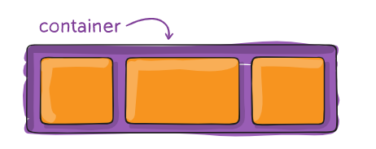
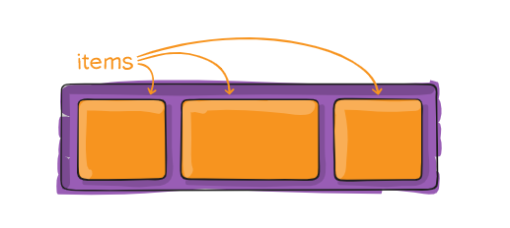
Terminology
Flex container
Flex items

Slide 6
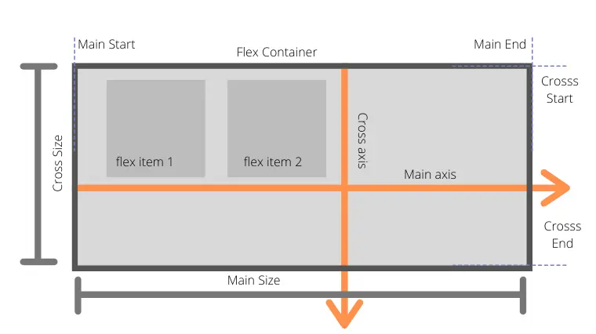
Flexbox Axes
Main axis
Cross axis

Slide 7
Flex Container Properties
Display
Flex-direction
Flex-wrap
Flex-flow
Justify-content
Align-items
Align-content
Gap

Slide 8
Display
Create either a block level or inline level flex container.
Flex
Inline-flex

Slide 9
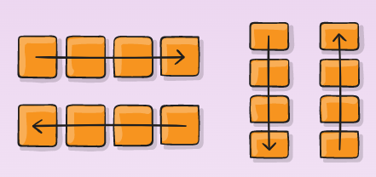
Flex-direction
Sets the direction of the main axis.
Row ➔ Default value
Row-reverse
Column
Column-reverse

Slide 10
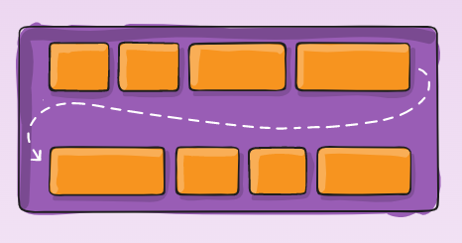
Flex-wrap
Control the wrapping of flex items within the container.
Nowrap ➔ Default value
Wrap
Wrap-reverse ➔ push the last item above instead of below

Slide 11
Flex-flow
Shorthand for flex-direction and flex-wrap.
Flex-flow : <flex-direction> <flex-wrap> ➔ the Default is row nowrap

Slide 12
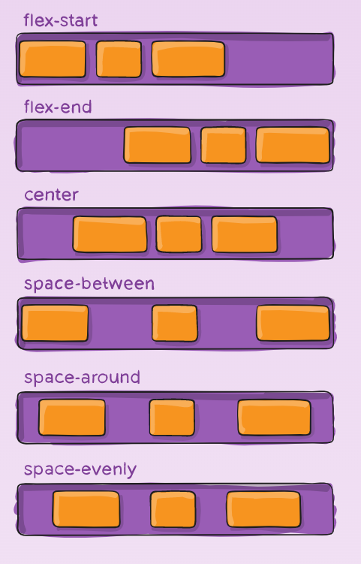
Justify-content
Align items and distribute any extra spacing in the parent container.
The alignment is always along the main axis.
Flex-start ➔ Default value
Flex-end
Center
Space-between
Space-around
Space-evenly

Slide 13
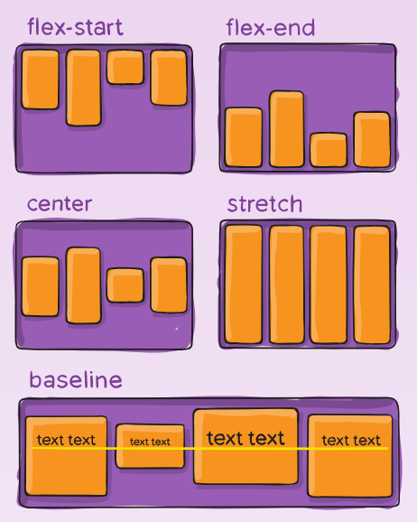
Align-Items
Align items along the cross axis.
Flex-start
Flex-end
Center
Baseline
Stretch ➔ Default value

Slide 14
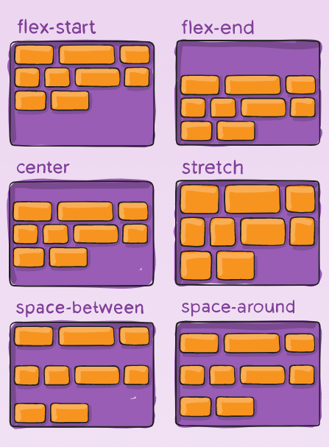
Align-Content
Aligns lines of content along the cross axis and distribute any extra spacing in the parent container .
Flex-start
Flex-end
Center
Space-between
Space-around
Stretch ➔ Default value

Slide 15
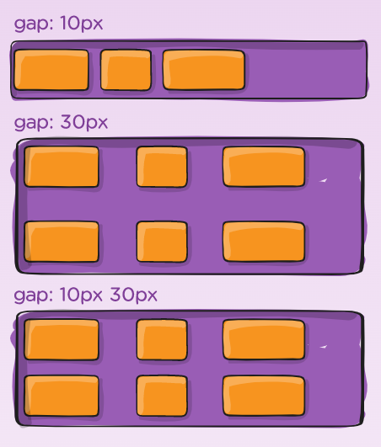
Gap
gap : row column

Slide 16
Flex Items Properties
Order
Flex-grow
Flex-shrink
Flex-basis
Flex
Align-self

Slide 17
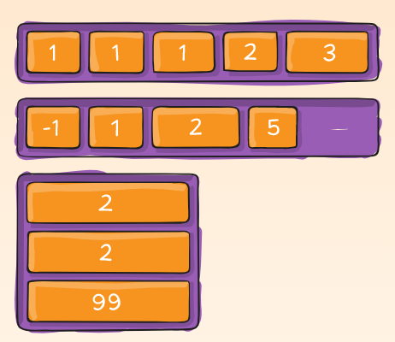
Order
Control the order of items in the flex container .
Zero is the default value .

Slide 18
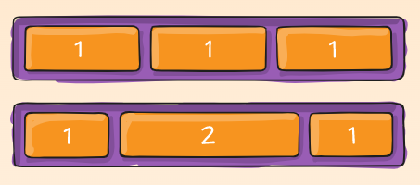
Flex-Grow
Dictates what amount of the available space inside the flex container the items should take up.
Relative to other items in the container.
Default value is zero .

Slide 19
Flex-Shrink
Dictates the shrink factor of the flex items when the default size of flex items is larger than the flex container .
Relative to other items in the container in case of increasing shrink .
Default value is 1 .

Slide 20
Flex-Basis
Set the initial size of flex items.
It accepts pixels , percentages or relative units .

Slide 21
Flex
Shorthand for flex-grow , flex-shrink and flex-basis .
Flex : <flex-grow> <flex-shrink> <flex-basis>

Slide 22
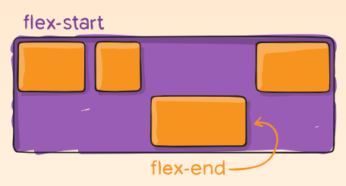
Align-Self
Align items individually .
Overrides the align-items value of the flex container
Auto
Flex-start
Flex-end
Center
Stretch

