Slide 1
An introduction to deep long-tailed learning
By Samer Baslan

Slide 2
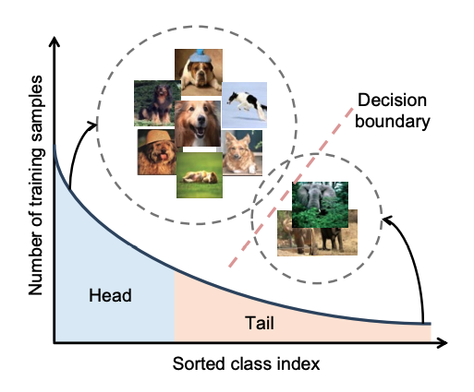
What’s the problem?
Deep learning has been extremely successful at various image recognition tasks.
Real world problems often include many edge-cases and can have samples of long-tailed class distributions.
Need to create methods to improve performance on long-tail classes.

Slide 3
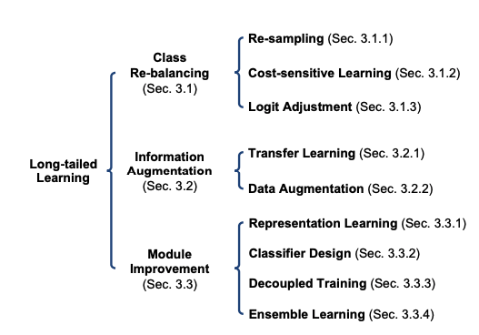
Taxonomy of long-tailed learning methods

Slide 4
Class re-balancing
Re-sampling:
Random over sampling (ROS)
Random under sampling (RUS)
Class-balanced resampling
Scheme-oriented sampling
Cost-sensitive Learning:
class-level re-weighting
class-level re-margining
Logit adjustment

Slide 5
Information augmentation
Transfer Learning:
Head-to-tail knowledge transfer
Model pre-training
Knowledge distillation
Self-training
Data Augmentation:
Transfer-based augmentation
Conventional (non-transfer) augmentation

Slide 6
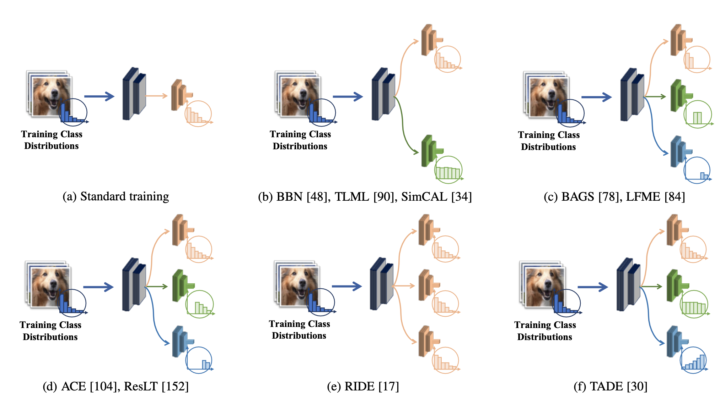
Module Improvement
Representation Learning
Metric learning
Sequential training
Prototype learning
Transfer learning
Classifier Design
RTC
Casual classifier
GIST classifier
Decoupled Training
Ensemble Learning

Slide 7
Relative Accuracy: A novel Metric
Need for a metric that alleviates or removes the influence of unnecessary factors in long-tailed learning

