Slide 1
Tuple
Combining multiple returned values using tuples

Slide 3
Without Naming Tuple
public (string, int) GetFruit()
{
return ("Apples", 5);
}
(string, int) fruit = bob.GetFruit();
WriteLine($"{fruit.Item1}, {fruit.Item2} there are.");

Slide 4
Named Tuple
public (string Name, int Number) GetNamedFruit()
{
return (Name: "Apples", Number: 5);
}
var fruitNamed = bob.GetNamedFruit();
WriteLine($"There are {fruitNamed.Number} {fruitNamed.Name}.");

Slide 5
Controlling how parameters are passed
By value
By reference
As an out parameter
public void PassingParameters(int x, ref int y, out int z)
{
// out parameters cannot have a default
// AND must be initialized inside the method
z = 99;
}
Var result = PassingParameters(a, ref b, out c);

Slide 6
Real-World out example
Int.tryparse()

Slide 7
Splitting classes using partial
public partial class Person

Slide 8
properties
//Old way
Public string name {
get{return _name;}
Set{_name=value;}
}
//New way to declare properties
Public string name {get;set;}

Slide 9
read-only properties
public string Greeting => $"{Name} says 'Hello!'";
public int Age => DateTime.Today.Year - DateOfBirth.Year;

Slide 10
Requiring properties
public required string? Isbn { get; set; }
Required properties should have value when you create new object.

Slide 11
Init-only properties
Init-only properties should assign value when create new instance and value can’t change later.
public string? FirstName { get; init; }

Slide 12
Defining indexers
Real-world example
string alphabet = "abcdefghijklmnopqrstuvwxyz";
char letterF = alphabet[5]; // 0 is a, 1 is b, and so on
public Person this[int index]
{
get
{
return Children[index]; // pass on to the List<T> indexer
}
set
{
Children[index] = value;
}
}

Slide 13
Working with records
public record ImmutableVehicle
{
public int Wheels { get; init; }
public string? Color { get; init; }
public string? Brand { get; init; }
}
ImmutableVehicle car = new()
{
Brand = "Mazda MX-5 RF",
Color = "Soul Red Crystal Metallic",
Wheels = 4
};

Slide 14
ImmutableVehicle repaintedCar = car
with { Color = "Polymetal Grey Metallic" };

Slide 15
New way to declare record
public record ImmutableAnimal(string Name, string Species);
ImmutableAnimal oscar = new("Oscar", "Labrador");

Slide 16
Delegate
Reference to method
delegate int DelegateWithMatchingSignature(string s);
DelegateWithMatchingSignature d = new(p1.MethodIWantToCall);
int answer2 = d("Frog");

Slide 17
Implementing interfaces
public interface IGamePlayer
{
void Lose();
}
public interface IKeyHolder
{
void Lose();
}
public class Person : IGamePlayer, IKeyHolder
{
public void Lose() // implicit implementation
{
// implement losing a key
}
void IGamePlayer.Lose() // explicit implementation
{
// implement losing a game
}
}

Slide 18
public interface IPlayable
{
void Play();
void Pause();
void Stop() // default interface implementation
{
WriteLine("Default implementation of Stop.");
}
}

Slide 19
Releasing unmanaged resources
public class ObjectWithUnmanagedResources
{
public ObjectWithUnmanagedResources() // constructor
{
// allocate any unmanaged resources
}
~ObjectWithUnmanagedResources() // Finalizer aka destructor
{
// deallocate any unmanaged resources
}
}

Slide 20
IDisposable
using (ObjectWithUnmanagedResources thing = new())
{
// code that uses thing
}

Slide 21
Making a value type nullable
int thisCannotBeNull = 4;
int? thisCouldBeNull = null;

Slide 22
Checking for null
if (thisCouldBeNull != null)
{
}
if (!(thisCouldBeNull is null))
{
}
if (thisCouldBeNull is not null)

Slide 23
? And ?? operator

Slide 24
Checking for null in method parameters
public void Hire(Person manager, Person employee)
{
ArgumentNullException.ThrowIfNull(manager);
ArgumentNullException.ThrowIfNull(employee);
...
}
Or
public void Hire(Person manager!!, Person employee!!)
{
...
}

Slide 25
Inheriting from classes
public class Employee : Person
{
}

Slide 26
Hiding members
public new void WriteToConsole()

Slide 27
Inheriting from abstract classes
When a class is marked as abstract, this means that it cannot be instantiated because you are indi-
cating that the class is not complete.

Slide 28
public abstract class PartiallyImplemented // C# 1.0 and later
{
public abstract void Gamma(); // must be implemented by derived type
public virtual void Delta() // can be overridden
{
// implementation
}
}

Slide 29
Preventing inheritance and overriding
public sealed class ScroogeMcDuck
{
}
// sealed prevents overriding the method in subclasses
public sealed override void Sing()
{
WriteLine("Singing with style...");
}

Slide 30
Extending types when you can’t inherit
public static class StringExtensions
{
public static bool IsValidEmail(this string input)
{}
}

Slide 31
Asp.Net Web Development

Slide 32
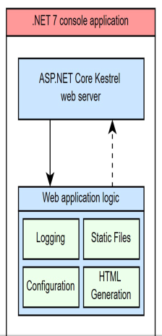

Slide 33
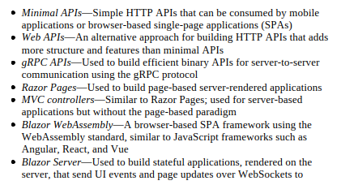

Slide 34
Your First ASP.NET Core Application
Explore Project Program.cs & Startup.cs
public class HomeController : Controller {
public IActionResult Index() {
return View();
}
}

Slide 35
What is middleware?
Middleware is a piece of code in an application pipeline used to handle requests and responses.

Slide 36
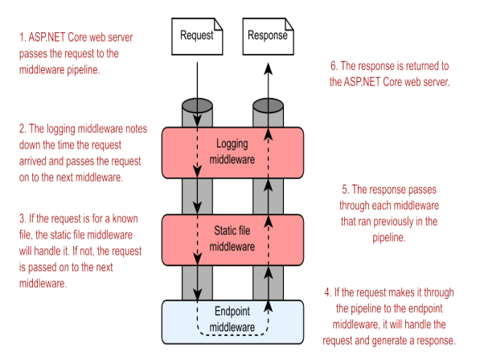
Middle Ware

Slide 37
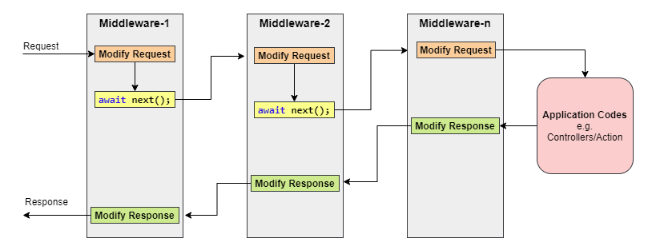

Slide 38
Using of middleware
Logging each request
Adding standard security headers to the response
Associating a request with the relevant user
Setting the language for the current request

Slide 39
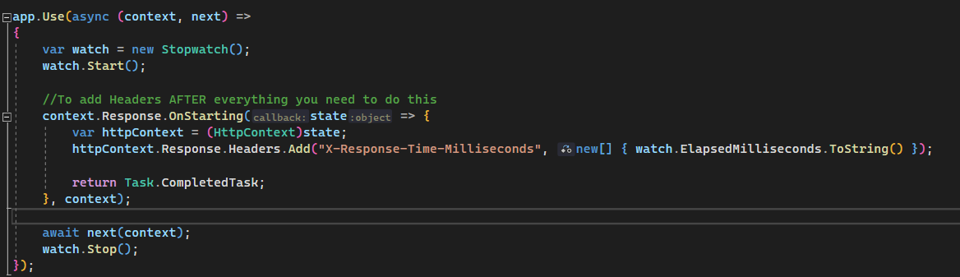
Example

Slide 40
Middleware methods
app.Run()
This middleware component may expose Run[Middleware] methods that are executed at the end of the pipeline. Generally, this acts as a terminal middleware and is added at the end of the request pipeline, as it cannot call the next middleware.
app.Use()
This is used to configure multiple middleware. Unlike app.Run(), We can include the next parameter into it, which calls the next request delegate in the pipeline. We can also short-circuit (terminate) the pipeline by not calling the next parameter.
app.Map()
These extensions are used as a convention for branching the pipeline. The map branches the request pipeline based on matches of the given request path. If the request path starts with the given path, the branch is executed.

Slide 41
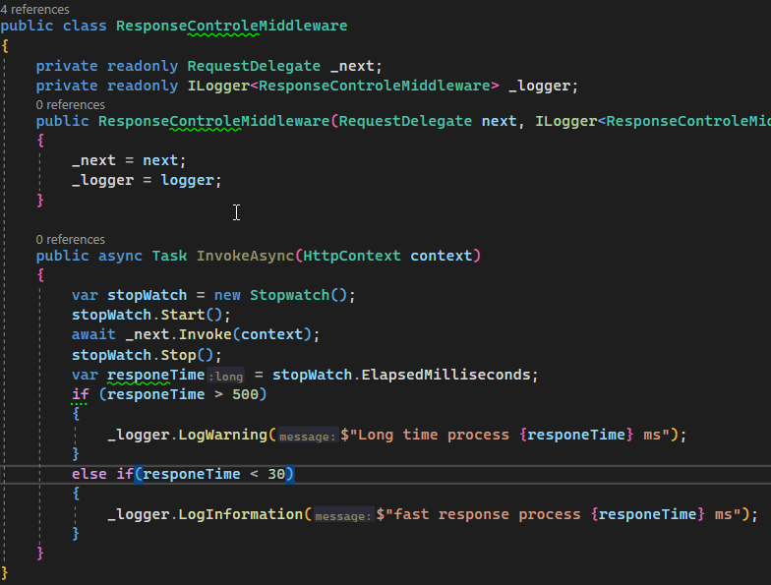
Example 2

Slide 42
H.W
Write a middleware to log request dtaetime + url

Slide 43
Razor Pages
Getting started with Razor Pages
Introducing Razor Pages and the Model-View-Controller (MVC) design pattern
Using Razor Pages in ASP.NET Core

Slide 44
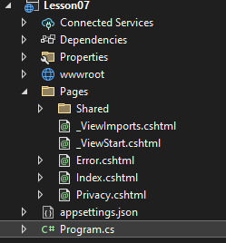
Your first Razor Pages application

Slide 45
Add C# code in razor pages
@{
ViewData["Title"] = "Privacy Policy";
}

Slide 46
Handling request logic with page models and handlers
As you’ve already seen, the @page directive in a .cshtml file marks the page
as a Razor Page, but most Razor Pages also have an associated page model.
By convention, this page model is placed in a file commonly known as a
code-behind file that has a .cs extension,

Slide 47
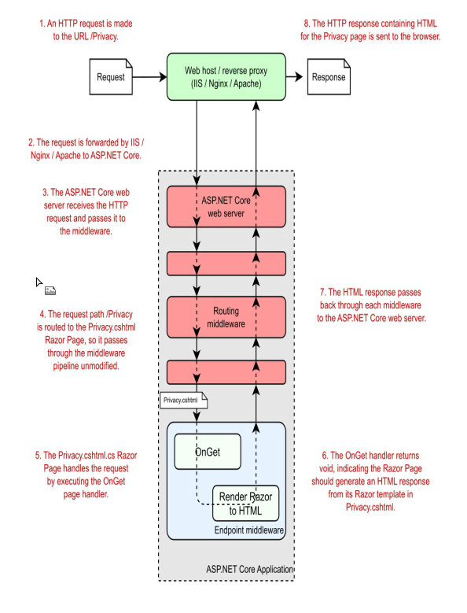

Slide 48
Example Login Page
H.W
Create a page that search in array of names (Static array).

Slide 49
Applying the MVC design pattern to Razor Pages
Razor Pages builds directly on top of the underlying ASP.NET Core MVC framework, using the MVC framework under the hood for their behavior.

Slide 50
Summary
Razor Pages are located in the Pages folder of a project and by default are named according to the URL path they handle.
Razor Pages must contain the @page directive as the first line of the .cshtml file.
Razor templates can contain standalone C#, standalone HTML, and
dynamic HTML generated from C# values. By combining all three, you can build highly dynamic applications.
Razor Pages should inherit from the PageModel base class and contain page handlers.
Page handlers generally should delegate to services to handle the
business logic required by a request instead of performing the changes themselves.

Slide 51
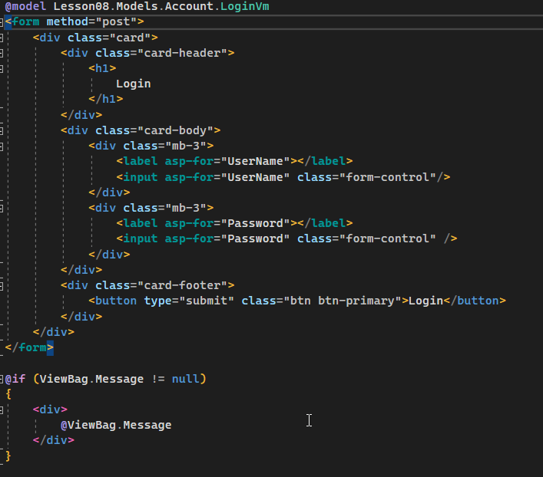
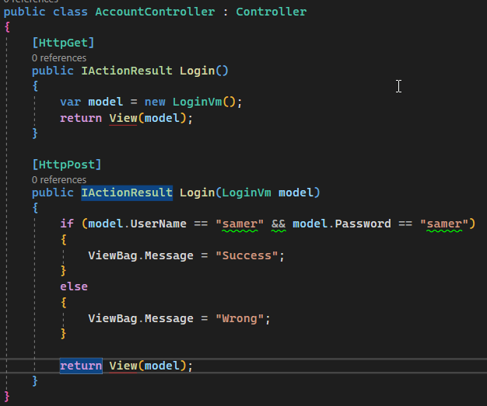
Login Form With MVC

Slide 52
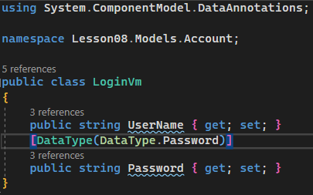
Login Form With MVC

Slide 53
ViewBag and ViewData in ASP.NET Core
The Views needs to get the data from the controller. One of the ways in which to pass the data to the view is using the ViewData or ViewBag object. In this tutorial, we look at how to use ViewBag and ViewData to pass the data to the View.

Slide 54
What is Viewdata
The ViewData is a property of the Controller Base class, which returns a ViewDataDictionary object.
The ViewDataDictionary as the name suggests is a dictionary object which allows us to store key-value pairs. The key must be a case-insensitive string. To pass data to the view, you can assign values to the dictionary using the Key. You can store any number of items as needed in the ViewData.
The ViewData is passed to the view from the Controller. When you invoke the View method in the Controller Action method, the ViewData is automatically passed to the View.
The data stored in the ViewData object exists only during the current request. As soon as the view is generated and sent to the client, the Viewdata object is cleared.

Slide 55
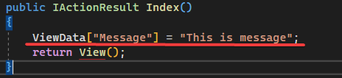
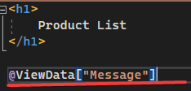
EX of viewdata

Slide 56
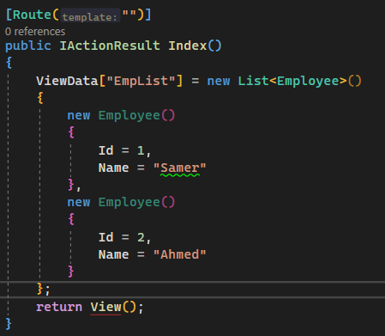
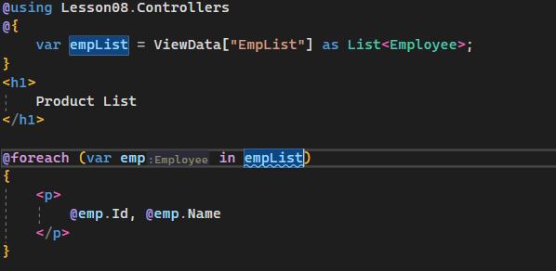
Passing the Object using View Data

Slide 57
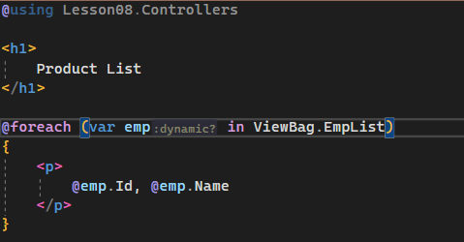
What is Viewbag
The ViewBag uses the dynamic feature that was added in C# 4.0. It is a wrapper around the ViewData and provides the dynamic properties for the underlying ViewData collection.
The ViewBag can be more convenient to work with since it doesn’t require casting.

Slide 58
ViewData Vs ViewBag
Both ViewBag and ViewData uses the same ViewDataDictionary underneath. Hence, you can use both ViewData and ViewBag and mix and match between them when reading from or write to them.

Slide 59
When to use ViewData or ViewBag
The ViewData and ViewBag are equally good options when you want to pass the small amount of data from the controller to the View. The choice usually depends on the personal preference
The Drawback of ViewData/ViewBag is that they are resolved dynamically at the runtime. They do not offer any compile-time type checking, Hence more error prone
The ViewData and ViewBag can pass data from the Controller to View. It cannot be used to pass data from One Controller to another controller.

Slide 60
routing
Routing requests to Action
Customizing MVC application route templates
Generating URLs for Actions

Slide 61
What is routing?
Routing is the process of mapping an incoming request to a method that will
handle it.

Slide 62
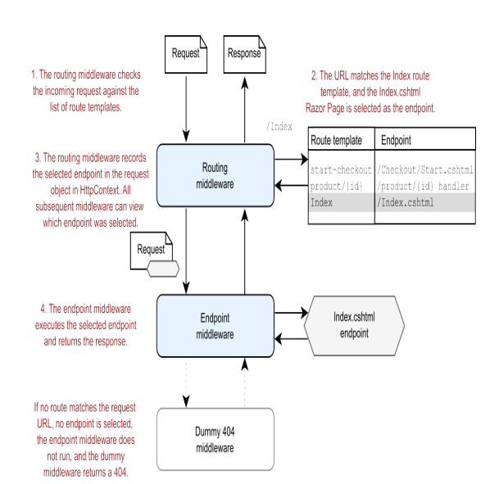

Slide 63
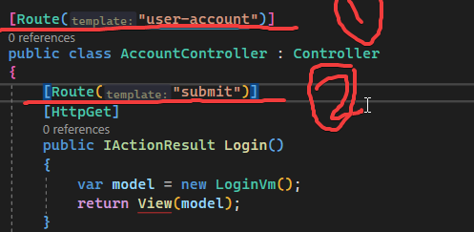
Replacing controller and action rout

Slide 64
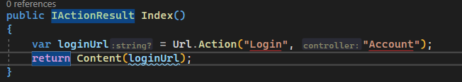
Generating URLs for MVC Action

Slide 65
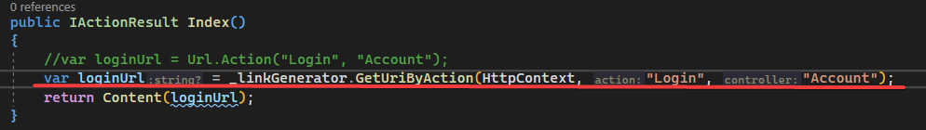
Generating URLs with LinkGenerator

Slide 66
Conditional Routing
Full Routing Example give.

Slide 67
Customizing conventions with Razor Pages
builder.Services.AddRazorPages();
builder.Services.Configure<RouteOptions>(o =>
{
o.LowercaseUrls = true;
o.LowercaseQueryStrings = true;
o.AppendTrailingSlash = true;
});

Slide 68
Summary
Routing is the process of mapping an incoming request URL to an endpoint that will execute to generate a response.
You can define the mapping between URLs and endpoint in your application using either convention-based routing or explicit routing.
By default, each Razor Page has a single route template that matches its path inside the Pages folder, so the Razor Page Pages/Products/View.cshtml has route template Products/View.
You can use IUrlHelper to generate URLs as a string based on an action name or Razor Page.

Slide 69
An introduction to dependency injection
ASP.NET Core supports the dependency injection (DI) software design pattern, which is a technique for achieving Inversion of Control (IoC) between classes and their dependencies.
ASP.NET Core is designed from scratch to support Dependency Injection. ASP.NET Core injects objects of dependency classes through constructor or method by using built-in IoC container.

Slide 70
IoC Container
IoC Container (a.k.a. DI Container) is a framework for implementing automatic dependency injection. It manages object creation and it's life-time, and also injects dependencies to the class.
The IoC container creates an object of the specified class and also injects all the dependency objects through a constructoror a method at run time and disposes it at the appropriate time. This is done so that we don't have to create and manage objects manually.
Register Resolve Dispose
Example of IOC Container:
Autofac
Unity
Asp.net Core Build-in

Slide 71
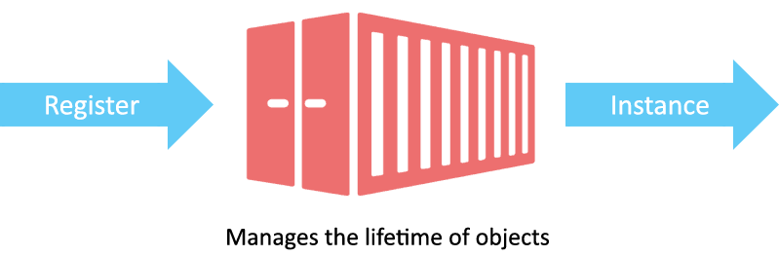

Slide 72
Built-in IoC Container
ASP.NET Core framework contains simple out-of-the-box IoC container
The built-in container is represented by IServiceProvider implementation that supports constructor injection by default. The types (classes) managed by built-in IoC container are called services.
There are basically two types of services in ASP.NET Core:
Framework Services: Services which are a part of ASP.NET Core framework
Application Services: The services (custom types or classes) which you as a programmer create for your application.
In order to let the IoC container automatically inject our application services, we first need to register them with IoC container.

Slide 73


Reasons to Use Dependency Injection
Maintainability
Testability
Reusable
More Readable Code
Reduced Dependencies

Slide 74
Registering Application Service
public interface ILog
{
void info(string str);
}
class MyConsoleLogger : ILog
{
public void info(string str)
{
Console.WriteLine(str);
}
}
services.Add(new ServiceDescriptor(typeof(ILog), new MyConsoleLogger()));

Slide 75
Understanding Service Lifetime
Singleton: IoC container will create and share a single instance of a service throughout the application's lifetime.
Transient: The IoC container will create a new instance of the specified service type every time you ask for it.
Scoped: IoC container will create an instance of the specified service type once per request and will be shared in a single request.
services.AddSingleton<ILog, MyConsoleLogger>();
services.AddSingleton(typeof(ILog), typeof(MyConsoleLogger));
services.AddTransient<ILog, MyConsoleLogger>();
services.AddTransient(typeof(ILog), typeof(MyConsoleLogger));
services.AddScoped<ILog, MyConsoleLogger>();
services.AddScoped(typeof(ILog), typeof(MyConsoleLogger));

Slide 76
Constructor Injection
ILog _log;
public HomeController(ILog log) { _log = log; }
public IActionResult Index() {
_log.info("Executing /home/index");
return View(); }

Slide 77
Action Method Injection
public IActionResult Index([FromServices] ILog log)
{ log.info("Index method executing");
return View(); }

Slide 78
Get Services Manually
var services = this.HttpContext.RequestServices;
var log = (ILog)services.GetService(typeof(ILog));

Slide 79
Registering a service in the container multiple times
builder.Services.AddScoped<IMessageSender, EmailSender>();
builder.Services.AddScoped<IMessageSender, SmsSender>();
builder.Services.AddScoped<IMessageSender, FacebookSender>();
string RegisterUser(
string username,
IEnumerable<IMessageSender> senders) #A
{
foreach(var sender in senders) #B
{ #B
Sender.SendMessage($”Hello {username}!”); #B
} #B
return $"Welcome message sent to {username}";
}

Slide 80
Configuring an ASP.NET Core application
ASP.NET Core ships with configuration providers for loading data from common locations:
JSON files
Extensible Markup Language (XML) files
Environment variables
Command-line arguments
Initialization (INI) files

Slide 81
Adding configuration values to an appsettings.json file
{
"Logging": {
"LogLevel": {
"Default": "Information",
"Microsoft": "Warning",
"Microsoft.Hosting.Lifetime": "Information"
}
},
"AllowedHosts": "*",
"MapSettings": { #A
"DefaultZoomLevel": 9, #B
"DefaultLocation": { #C
"latitude": 50.500, #C
"longitude": -4.000 #C
}
}
}

Slide 82
Read Data From Configration Using IConfigration
public IActionResult Index([FromServices] IConfiguration configuration)
{
return Json(new {password = configuration["EmailSetting:Password"] });
}

Slide 83
Customize configuration providers
JSON file provider
User Secrets
Environment variables
Command-line arguments

Slide 84
WebApplicationBuilder builder = WebApplication.CreateBuilder(args);
builder.Configuration.Sources.Clear(); #A
builder.Configuration.AddJsonFile("appsettings.json", optional: t

Slide 85
Read All Configration values
public IActionResult Config([FromServices]IConfiguration configuration)
{
return Ok(configuration.AsEnumerable());
}

Slide 86
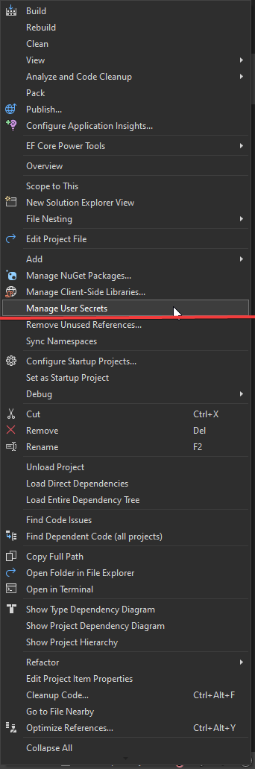
Storing secrets with the User Secrets Manager

Slide 87
Connect To Database using Entity Farmwork
Steps to flow to Connect to Database:
Install below nuget packages using nuget package manger:
Microsoft.EntityFrameworkCore
Microsoft.EntityFrameworkCore.Design
Microsoft.EntityFrameworkCore.SqlServer
Microsoft.EntityFrameworkCore.Tools
Create a DbContext:
public class YourDbContext : DbContext { public YourDbContext(DbContextOptions<YourDbContext> options) : base(options) { } // Define your DbSet properties for each entity (database table). public DbSet<YourEntity> YourEntities { get; set; } }
Use the DbContext:
To Retrieve data from database.

Slide 88
Configure the Database Connection:
{ "ConnectionStrings": { "DefaultConnection": "Server=YourServer;Database=YourDatabase;User=YourUser;Password=YourPassword;" } }
In Program.cs Add Below Code to register DB Context to DI
services.AddDbContext<YourDbContext>(options => options.UseSqlServer(Configuration.GetConnectionString("DefaultConnection")));
Add your entity to db context:
EX: Product
public DbSet<Employee> Employees { get; set; }
Apply Migrations:
Open Package manager Console
Write below migration code
Add-Migration InitMigration
Update-Database

Slide 89
Read Data Using DbContext
public IActionResult Index([FromServices] AppDbContext context)
{
return View(context.Cities.ToList());
}

Slide 90
Search Data using DbSet & Linq
public IActionResult Details([FromServices] AppDbContext context, [FromRoute] int id)
{
var city = context.Cities.FirstOrDefault(i => i.Id == id);
if (city == null)
{
return NotFound();
}
return View(city);
}

Slide 91
CRUD Operation using EF & MVC

Slide 92
Database-first using ef core power tool

Slide 93
MVC Pending Topics
Create Full Example with Scaffolding
EF With Stored Procedures & SQL Views
Partial page & view Component
Tag Helper
Layout page (apply new Design)
Master Detail Example.
Data Annotation for model
Upload file in asp.net core
Bind dropdown list
Filters
Authentication & Authorization

Slide 94
Map To SQL View
protected override void OnModelCreating(ModelBuilder modelBuilder)
{
modelBuilder.Entity<ProductsView>()
.ToView("ProductsView")
.HasKey(i=>i.Id);
}

Slide 95
PARTAIL VIEW
Create Partial View
Reference partial view
<partial name="_Header"/>
Controller return partial view
public IActionResult GetProductAjax(int id)
{
var prod = _appDbContext.Products.FirstOrDefault(i => i.Id == id);
if (prod == null)
{
return NotFound();
}
return PartialView(prod);
}

Slide 96
View Component
public class SocialLinksViewComponent : ViewComponent
{
List<SocialIcon> socialIcons = new List<SocialIcon>();
public SocialLinksViewComponent()
{
socialIcons = SocialIcon.AppSocialIcons();
}
public async Task<IViewComponentResult> InvokeAsync()
{
var model = socialIcons;
return await Task.FromResult((IViewComponentResult)View("SocialLinks", model));
}
}
@(await Component.InvokeAsync("SocialLinks", new { IconsToShow = 5 }))

Slide 97
Tag Helper
// HTML Helpers
@Html.ActionLink("Click", "Controller1", "CheckData", { @class="my-css-classname", data_my_attr="my-attribute"})
//Tag Helpers
<a asp-controller="Controller1" asp-action="CheckData" class="my-css-classname" my-attr="my-attribute">Click</a>
<cache enabled="true"> Last Cached Time: @DateTime.Now </cache>
[HtmlTargetElement("my-first-tag-helper")]
public class MyCustomTagHelper : TagHelper
{
public string Name { get; set; }
public override void Process(TagHelperContext context, TagHelperOutput output)
{
output.TagName = "CustumTagHelper";
output.TagMode = TagMode.StartTagAndEndTag;
var sb = new StringBuilder();
sb.AppendFormat("<span>Hi! {0}</span>", this.Name);
output.PreContent.SetHtmlContent(sb.ToString());
}
}

Slide 98
Creating an HTTP API using web API controllers
Create Api Project
Create New Api Controller
Why use [Api Controller] Attribute
Connect api to database
Create rest-full Api

