Slide 1

Week 13: Binary Search Tree
CS/COE 0445 - Data Structures
Sherif Khattab
http://www.cs.pitt.edu/~skhattab/cs0445
(Some slide contents are © 2016 Pearson Education, Ltd. All rights reserved.
Others are from Dr. Ramirez’s CS 445 course)

Slide 2
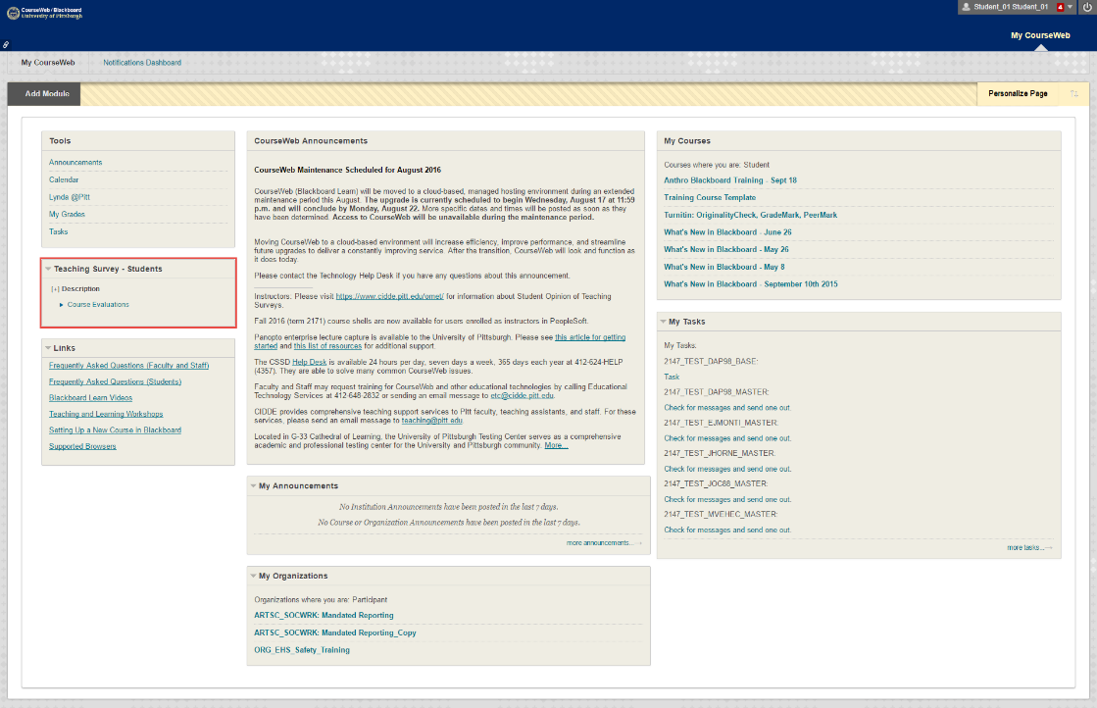
Administrivia
Assignment 4 due tomorrow @11:59pm
OMET Teaching Survey
Email with subject Teaching Survey
My Pitt
CourseWeb

Slide 3
Binary Search Trees
Binary Trees are nice, but how can we use them effectively as data structures?
One way is to organize the data in the tree in a special way, to create a binary search tree (BST)
A BST is a binary tree such that, for each node in the tree
All data in the left subtree of that node is less than the data in that node
All data in the right subtree of that node is greater than the data in that node
Note that this definition does not allow for duplicates. If we want to allow duplicates we should add "or equal to" to one of the above lines (but not both)

Slide 4
Binary Search Trees
Naturally, we can also define BSTs recursively:
A binary tree, T, is a BST if either
T is empty (base case) or
T is a node with the following structure
where all values in the tree rooted at left are less than data
where all values in the tree rooted at right are greater than data
where left and right are BSTs
left | data | right

Slide 5
Binary Search Trees
50
BST
30
80
10
40
90
5
20
45
85
95
50
NOT A BST
BST
30
50
10
30
80
5
10
40
20
90
Notes:
Note that the shape of the tree is unrelated to the BST property. BSTs can be full, linear or anywhere in between.

Slide 6
BST Interface
Let's back up a bit now
We haven't defined the BST ADT yet (i.e. the methods that make up a BST):
Actually, the text defines a more general SearchTreeInterface, which our BST will implement:
public boolean contains(T entry)
Is an entry in the tree or not?
public T getEntry(T entry)
Find and return and entry that "equals" the param entry
If the key matches return the object; otherwise return null

Slide 7
BST Interface
public T add(T newEntry)
Add a new entry into the tree
New object is put into its appropriate location, keeping the search property of the tree intact
If an object matching newEntry is already present in the tree, replace it and return the old object
What if we don't want to replace it? Implications?
public T remove(T entry)
Remove entry from the tree and return it if it exists; otherwise return null
public Iterator<T> getInorderIterator()
Return an iterator that will allow us to go through the items sequentially from smallest to largest
Go back and look at Iterator<T> interface

Slide 8
BST Search
Before we discuss the implementation details
Let's get the feel for the structure by seeing how we would do the getEntry(T entry) method
Consider a recursive approach (naturally):
What is our base case (or cases)?
If tree is empty – not found
else if key matches node value -- found
What are our recursive cases?
If key < node value, search left subtree
else if key > node value, search right subtree
How do we use our recursive results to determine our overall results?
Simply pass result from recursive call on

Slide 9
BST Search vs. Sorted Array Search
Notice the similarity between this algorithm and the binary search of a sorted array
This is NOT coincidental!
In fact, if we have a full binary tree, and we have the same data in an array, both data structures would search for an item following the exact same steps
Let's look for item 45 in both data structures:
0 | 1 | 2 | 3 | 4 | 5 | 6
10 | 30 | 40 | 50 | 70 | 80 | 90
2
3
1
1
50
2
30
80
10
3
40
70
90

Slide 10
BST Search vs. Sorted Array Search
In the case of the array, 45 is "not found" between 40 and 50, since there are no actual items between 40 and 50
In the case of the BST, 45 is "not found" in the right child of 40, since the right child does not exist
Both are base cases of a recursive algorithm
Same runtimes since the height of a full tree is O(log₂n)
Immediately, we see an advantage of the BST over the LinkedList
Although access to nodes requires references to be followed, the tree structure improves our search time from O(n) to O(log₂n)
Ok, now is a BST also an improvement over the array?

Slide 11
BST Implementation
To answer that question, we need to look at some more operations
Let's first look more at the BST structure
BST Implementation
We will use the BinaryTree as the basis
We can implement it either recursively or iteratively
We'll look at both versions
public class
BinarySearchTree<T extends Comparable<? super T>> extends BinaryTree<T> implements SearchTreeInterface<T>, java.io.Serializable

Slide 12
BST Implementation
We will concentrate on four things:
getEntry() method
contains() can be easily derived from getEntry()
add() method
remove() method
getInorderIterator() method
These provide the basic functionality of a Binary Search Tree:
Finding an object within the tree
Adding a new object to the tree
Removing an object from the tree
Traversing the tree to view all objects

Slide 13
BST Implementation
getEntry()
We already discussed the idea of this method in a recursive way
Now let's look at the actual code and trace it
See recursive BinarySearchTree.java
See iterative BinarySearchTreeI.java
Note how iterations of the loop correspond to recursive calls
See how contains() is easily derived

Slide 14
BST Implementation
add()
This one is more complicated
Special case if tree is empty, since we need to create a root node
Otherwise, we call addEntry(), which proceeds much like getEntry()
However, we have more to consider. Consider possibilities at current node (call it temp):
New data is equal to temp.data
Store old value, assign new value and return old value
New data is less than temp.data
If temp has a left child, go to it
else add a new node with the new data as the left child of temp
New data is greater than temp.data
If temp has a right child, go to it
else add a new node with the new data as the right child of temp

Slide 15
BST Implementation
Of course, the actual code is trickier than the pseudocode
See recursive version of BinarySearchTree.java
One interesting difference from getEntry()/findEntry()
The base case for addEntry() must be at an actual node
We cannot go all the way to a null reference, since we must link the new node to an existing node
If we go to null we have nothing to link the new node to

Slide 16
BST Recursive addEntry() Method
Adding 25 to the BST
Note: Run-Time Stack goes downward in this case
rootNode
25<50, go left
root
rootNode
25<30, go left
50
30
80
rootNode
25>10, go right
10
40
90
rootNode
25>20, right null
5
20
45
85
95
25
To see this correctly you must run it in a Powerpoint slideshow

Slide 17
BST add() Method
This is elegant but it still (obviously) requires many calls of the method
As we know, this adds overhead to the algorithm
If we do the process iteratively, this overhead largely goes away
See iterative version
As with findEntry(), since the recursive calls are "either" "or" but not both, the iteration is very simple and actually preferred over the recursion

Slide 18
BST remove() Method
remove()
Idea is simple: 1) Find the node and, 2) Delete it
However, it is much trickier than add – why?
Unlike add(), which is always at a leaf, the remove() operation could remove an arbitrary node
Depending upon where that node is, this could be a problem
Let's look at 3 cases, and discuss the differences between them
node has 1 child
node has 2 children
node is a leaf
Notes:
Trace on board

Slide 19
BST remove() Method
Node is a leaf
This one is easy – simply set its parent's appropriate child reference to null (so we need a ref. to parent)
Garbage collector takes care of the rest
Node has one child
Still not so bad…in fact this looks a lot like what?
Deleting a node from a linked list
Set parent's child reference to node's child reference
Node has two children
This one is tricky!
Why -- only one reference coming in but two going out

Slide 20
BST remove() Method
So to actually delete the node would require significant reorganization of the tree
But do we really even need to delete the NODE?
No, we need to delete the DATA
Perhaps we can accomplish this while leaving the node itself where it is
How?
Recall that what is important about a BST is the BST Property (i.e. the ordering)
The shape is irrelevant (except for efficiency concerns, which we will discuss next)
So perhaps we can move data from another node into the node whose value we want to delete
Perhaps the other node will be easier to delete

Slide 21
BST remove() Method
How do we choose this node?
Consider an inorder traversal of the tree
We could substitute the value directly before (inorder predecessor) or the value directly after (inorder successor)
How to find this node?
Consider inorder predecessor – it is the largest value that is less than the current value
So we go to the left one node, then right as far as we can
What if this node also has two children?
Will not ever – since we know by how we found it that it has no right child

Slide 22
BST remove() Method
Let's look at the code to see how this is done
We'll look at the iterative version
Recursive version works, but due to the same issues we discussed for add(), we will prefer the iterative
Note that the code looks fairly tricky, but in reality we are just going down the tree one time, then changing some references
A lot of the complexity of the code is due to the author's object-oriented focus

Slide 23
Deleting a Node with 2 Children from a BST
30 is found
It has two children
Find Inorder Predecessor
Go left
Go right until null
Overwrite current node with inorder precessor
Delete inorder predecessor
50
30
25
80
10
40
90
5
20
45
85
95
To see this correctly you must run it in a Powerpoint slideshow
25

Slide 24
BST getInoderIterator() Method
getInorderIterator()
As we discussed previously, this will be a step-by-step inorder traversal of the tree
It is done iteratively so that we can pause indefinitely after each item is returned
Still the logic is much less clear than for the recursive traversals
This method is implemented in the BinaryTree class, so we don't have to add anything for BinarySearchTree
See BinaryTree.java

Slide 25
BST getInorderIterator() Method
What data and methods do we need?
Method simply returns an instance of private InorderIterator object
Recall the methods we need for an iterator()
hasNext() – is there an item left in the iteration?
next() – return the next item in the iteration
We also need some instance variables
To mimic the behavior of the run-time stack, we will use our own Stack object
Plus we need a BinaryNode to store the current node
How will it work?
Think about behavior of inorder traversal
We need to duplicate this iteratively

Slide 26
BST getInorderIterator() Method
Initially (in the constructor), set the currentNode to the root
For each call of next()
Go left from root as far as we can, pushing all nodes onto the stack
Top of the stack will be the next value in the iteration (nextNode)
Then set the currentNode to the right child of nextNode
After nextNode we should traverse its right subtree
That is what currentNode now represents
It could be null – in this case the previous node had no right subtree, and we backtrack
Let's trace this execution

Slide 27
BST InorderIterator.next Method
nodeStack
root
50
30
80
currentNode
10
40
90
nextNode
5
20
45
85
95
To see this correctly you must run it in a Powerpoint slideshow
Trace is only partially shown (up to 40)

Slide 28
BST Run-times
So how long will getEntry() (and contains()), add() and remove() take to run?
It is clear that they are all proportional in run-time to the height of the tree
So if the BST is balanced
getEntry(), add() and remove() will all be O(log₂N)
If the BST is very unbalanced
getEntry(), add() and remove() will all be O(N)
Given normal use, the tree tends to stay balanced
However, it could be unbalanced if the data is inserted in a particular way
Ex: If we do add()s of sorted data from a file

Slide 29
BST Run-times
Thus, in the AVERAGE CASE, BST give us O(log₂N) for Find, Insert and Delete
In the WORST CASE, BST gives us O(N) for Find, Insert and Delete
So how does a BST compare to a Sorted array or ArrayList?
Recall that a sorted array gives us (average)
O(log₂N) to find an item using binary search
O(N) to add or remove an item (due to shifting)
Thus, in the average case, BST is better for Insert and Delete and about the same for Find

Slide 30
Balanced BSTs
"On average", a BST will remain balanced
But it is possible for it to become unbalanced, yielding worst case run-times
Can we guarantee that the tree remains balanced?
Yes, for example the AVL Tree (Chapter 27)
When Inserts or Deletes are done, nodes may be "rotated" to ensure that the tree remains balanced
However, these rotations add overhead to the operations
If we time the operations, on average it is actually slower than the regular BST

Slide 31
Heaps
Definition: Complete binary tree whose nodes contain Comparable objects and are organized as follows.
Each node contains an object no smaller/larger than objects in its descendants
Maxheap: object in node greater than or equal to its descendant objects
Minheap: object in node less than or equal to its descendant objects

Slide 32
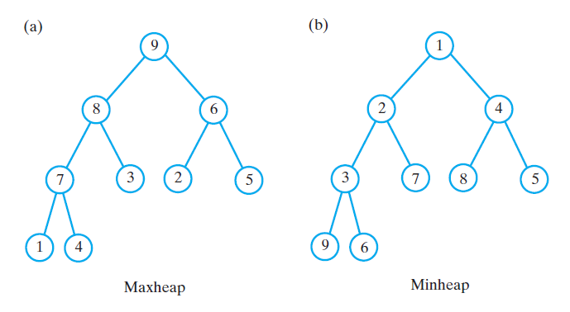
Heaps
(a) A maxheap and (b) a minheap that contain the same values

Slide 33
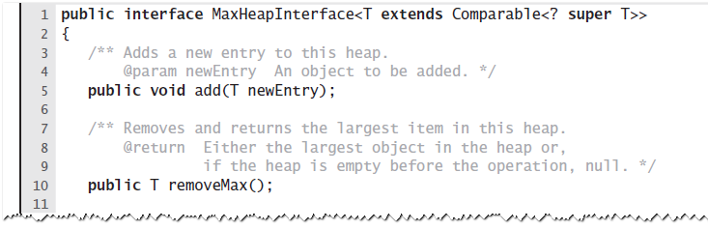
Heaps
An interface for a maxheap

Slide 34
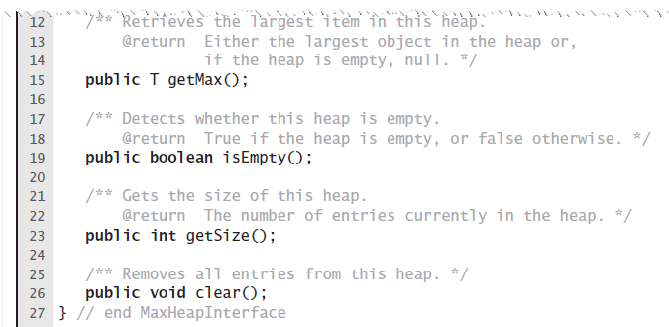
Heaps
An interface for a maxheap

