Slide 1

Week 12: Tree ADT
CS/COE 0445 - Data Structures
Sherif Khattab
http://www.cs.pitt.edu/~skhattab/cs0445
(Some slide contents are © 2016 Pearson Education, Ltd. All rights reserved.
Others are from Dr. Ramirez’s CS 445 course)

Slide 2
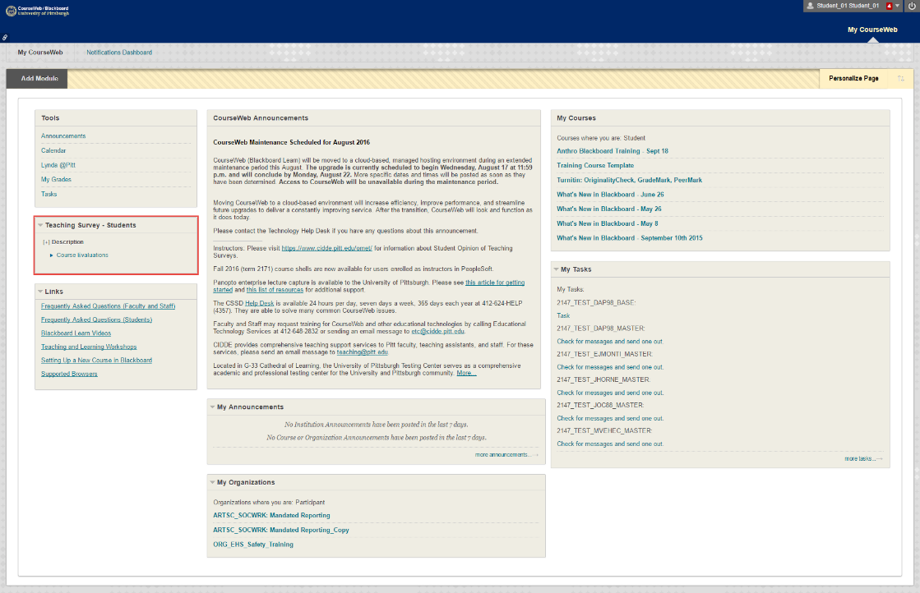
Administrivia
Assignment 4 due on 4/13 @11:59pm
OMET Teaching Survey
Email with subject Teaching Survey
My Pitt
CourseWeb

Slide 3
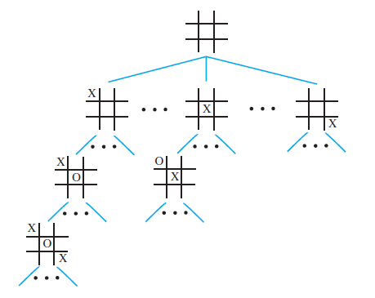
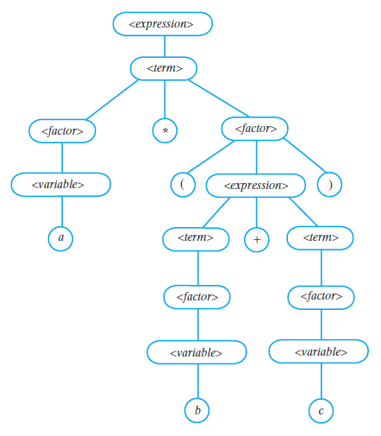
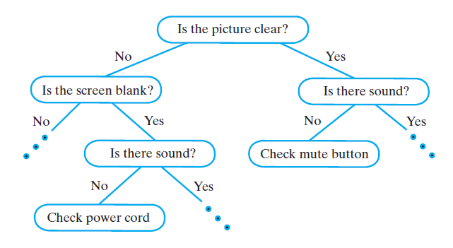
Examples of Trees
Game Tree
Parse Tree
Decision Tree

Slide 4
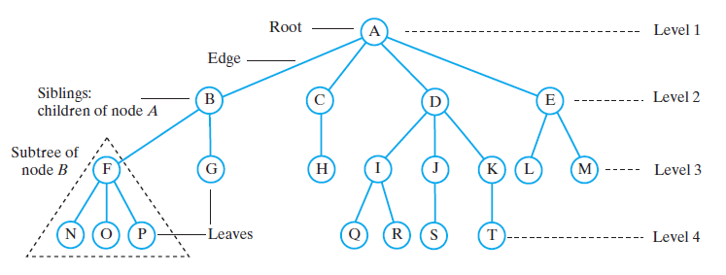
Tree Terminology

Slide 5
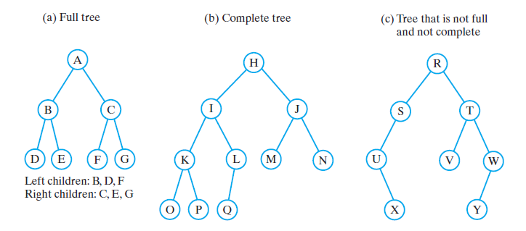
Binary Trees

Slide 6
Traversals of a Binary Tree
Preorder traversal
Visit root before we visit root’s subtrees
Inorder traversal
Visit root of a binary tree between visiting nodes in root’s subtrees.
Postorder traversal
Visit root of a binary tree after visiting nodes in root’s subtrees
Level-order traversal
Begin at root and visit nodes one level at a time

Slide 7
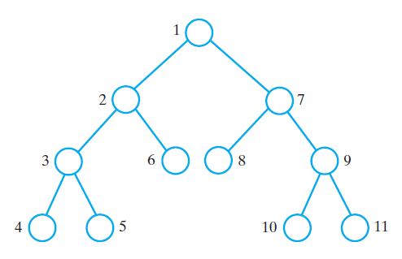
Traversals of a Binary Tree
The visitation order of a preorder traversal

Slide 8
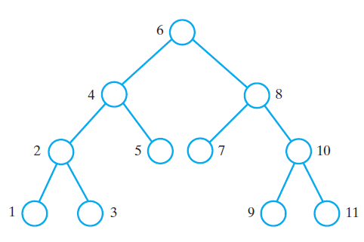
Traversals of a Binary Tree
The visitation order of an inorder traversal

Slide 9
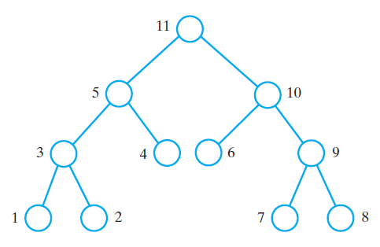
Traversals of a Binary Tree
The visitation order of a postorder traversal

Slide 10
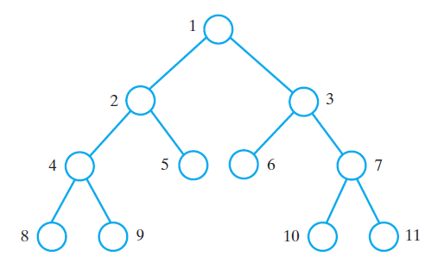
Traversals of a Binary Tree
The visitation order of a level-order traversal

Slide 11
Traversals of a General Tree
Types of traversals for general tree
Level order
Preorder
Postorder
Inorder not suited for general tree traversal

Slide 12
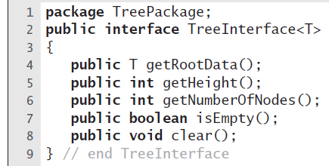
Interfaces for All Trees
An interface of methods common to all trees

Slide 13
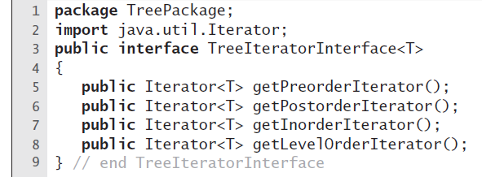
Traversals
An interface of traversal methods for a tree

Slide 14
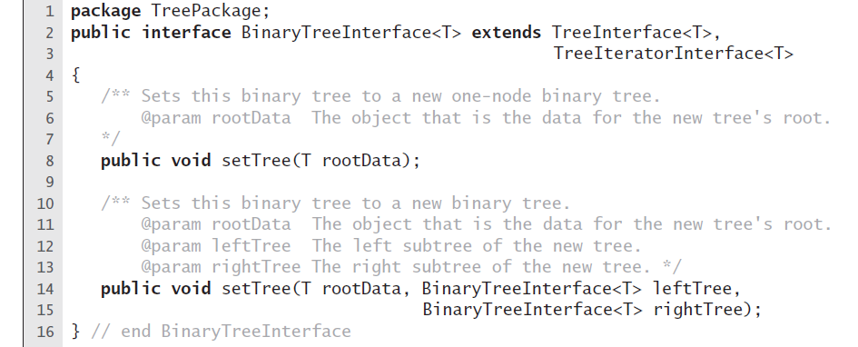
Interface for Binary Trees
An interface for a binary tree

Slide 15
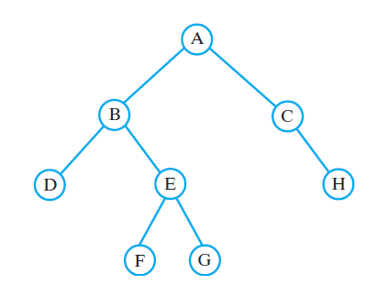
Example
A binary tree whose nodes contain one-letter strings

Slide 16
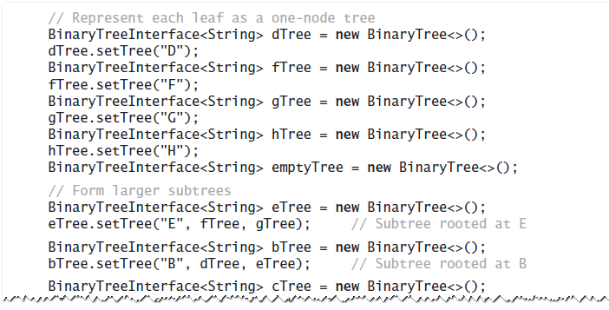
Example
Java statements that build a tree and then display some of its characteristics:

Slide 17
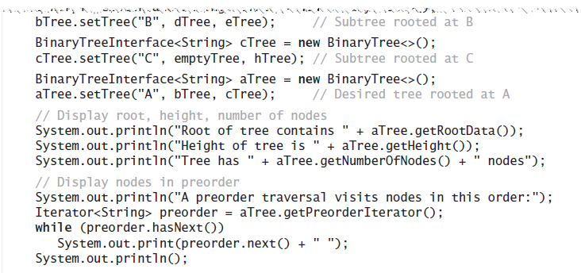
Example
Java statements that build a tree and then display some of its characteristics:

Slide 18
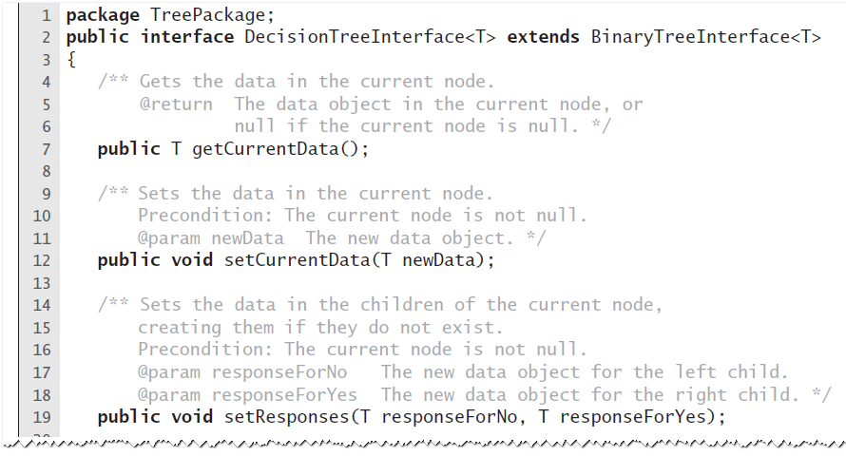
Expert System Uses A Decision Tree
An interface for a binary decision tree

Slide 19
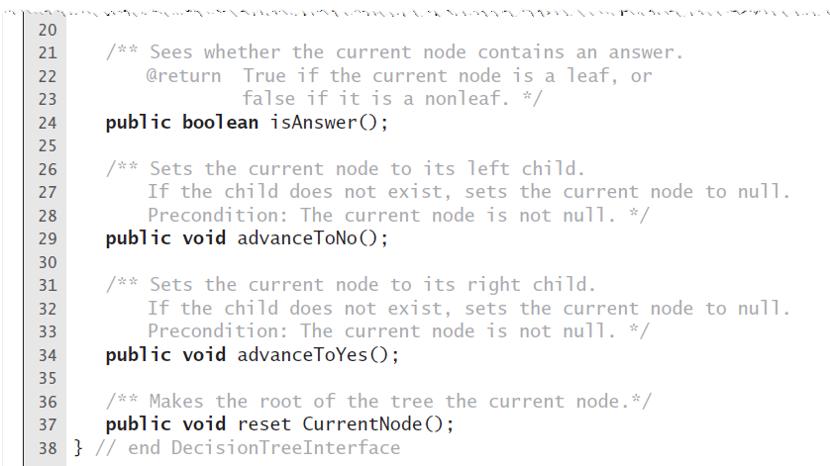
Expert System Uses A Decision Tree
An interface for a binary decision tree

Slide 20
Expert System Uses A Decision Tree
A portion of a binary decision tree

Slide 21
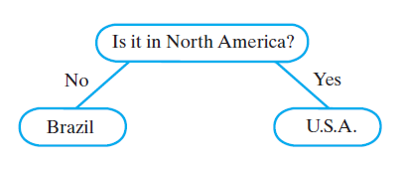
Expert System Uses A Decision Tree
An initial decision tree for a guessing game

Slide 22
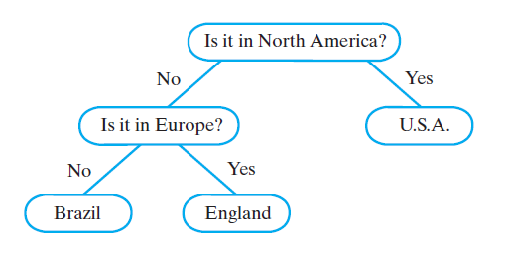
Expert System Uses A Decision Tree
The decision tree for a guessing game after acquiring another fact

Slide 23
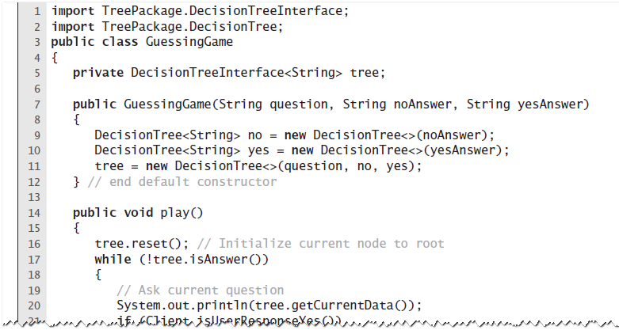
Expert System Uses A Decision Tree
The class GuessingGame

Slide 24
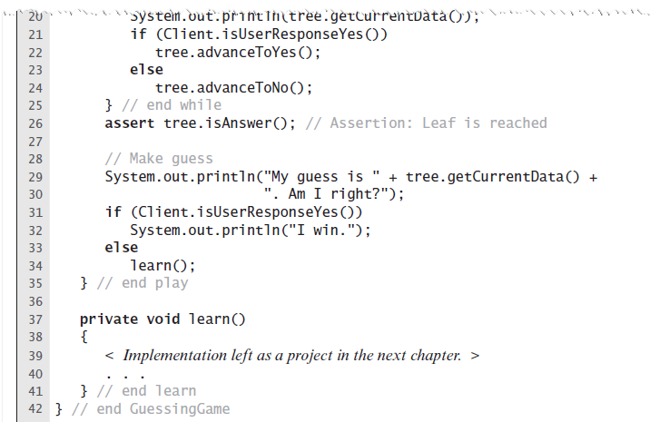
Expert System Uses A Decision Tree
The class GuessingGame

Slide 25
Tree implementation

Slide 26
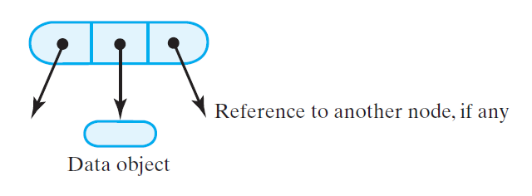
Nodes in a Binary Tree
A node in a binary tree

Slide 27
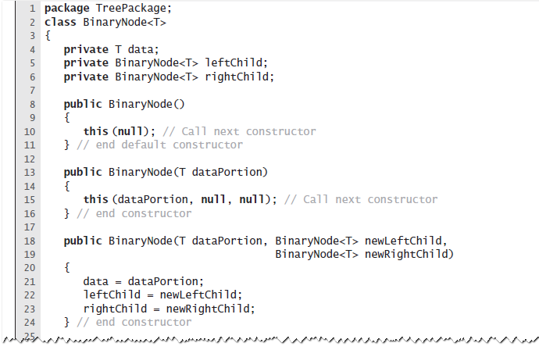
Nodes in a Binary Tree
The class BinaryNode

Slide 28
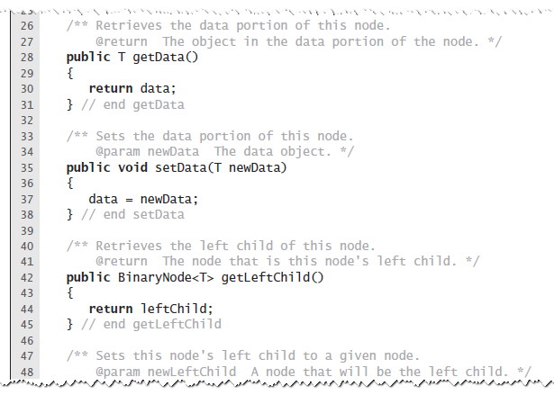
Nodes in a Binary Tree
The class BinaryNode

Slide 29
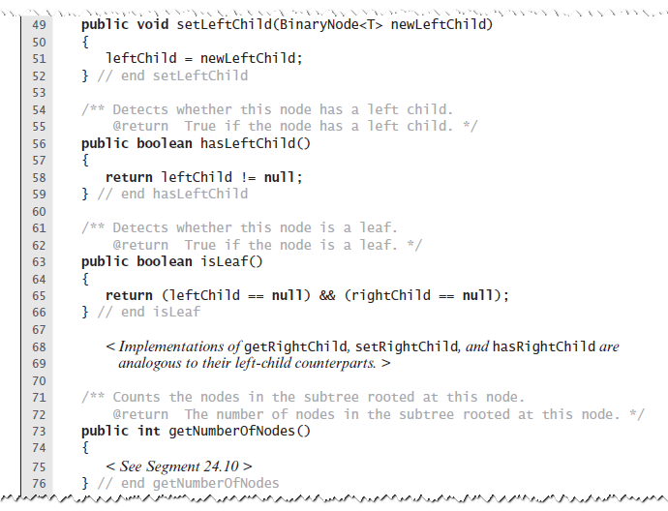
Nodes in a Binary Tree
The class BinaryNode

Slide 30
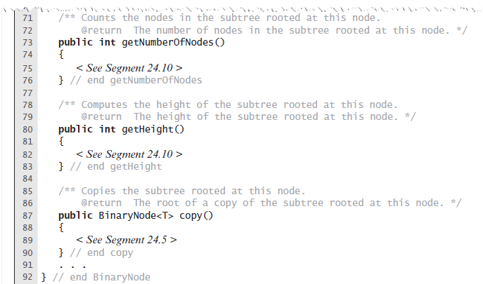
Nodes in a Binary Tree
The class BinaryNode

Slide 31
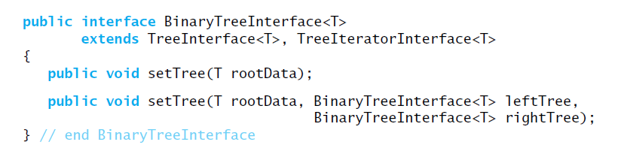
Creating a Basic Binary Tree
Interface for a class of binary trees

Slide 32
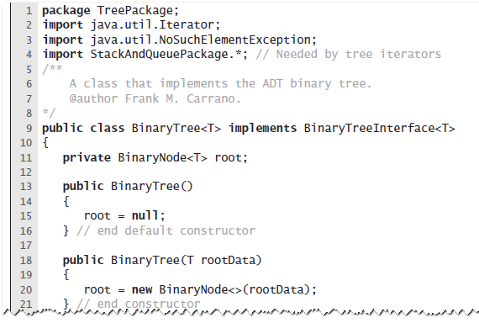
Creating a Basic Binary Tree
A first draft of the class BinaryTree

Slide 33
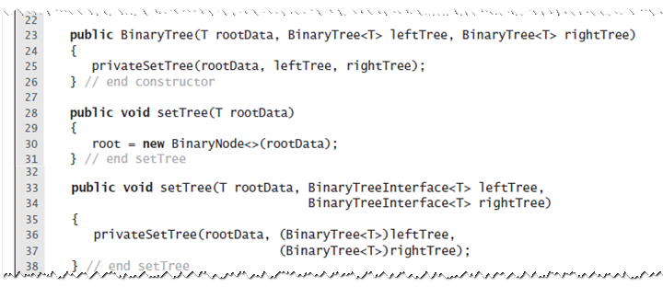
Creating a Basic Binary Tree
A first draft of the class BinaryTree

Slide 34
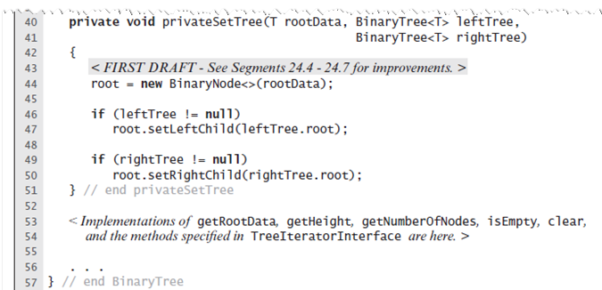
Creating a Basic Binary Tree
A first draft of the class BinaryTree

Slide 35
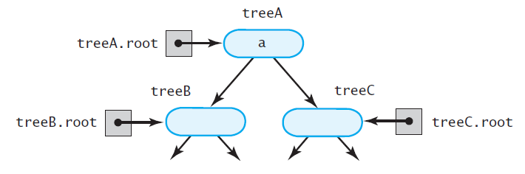
The Method privateSetTree
The binary tree treeA shares nodes with treeB and treeC

Slide 36
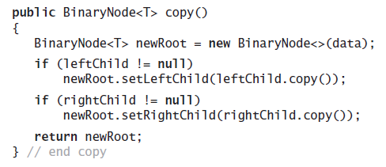
The Method privateSetTree
Definition of the method copy in the class BinaryNode

Slide 37
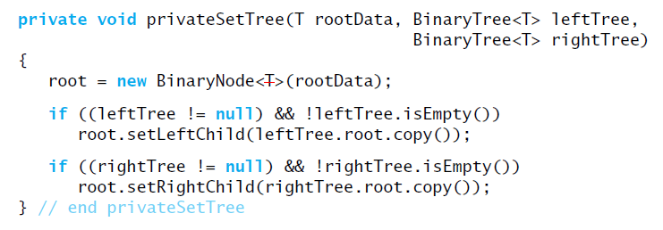
The Method privateSetTree
Method privateSetTree can invoke copy to copy the nodes from the two given subtrees

Slide 38
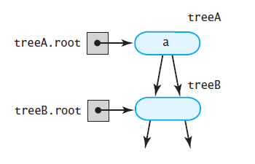
The Method privateSetTree
Another approach, more problems
treeA has identical subtrees

Slide 39
The Method privateSetTree
The second solution:
Create root node r containing given data.
If left subtree exists and not empty, attach root node to r as left child.
If right subtree exists, not empty, and distinct from left subtree, attach root node to r as a right child. But if right and left subtrees are same, attach copy of right subtree to r instead.
If the left subtree exists and differs from the tree object used to call privateSetTree, set the subtree’s data field root to null.
If right subtree exists and differs from the tree object used to call privateSetTree, set subtree’s data field root to null.

Slide 40
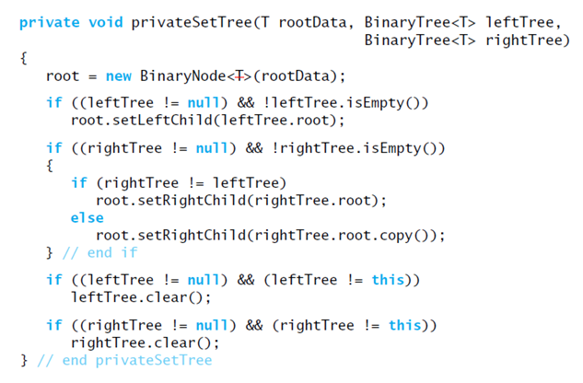
The Method privateSetTree
An implementation of privateSetTree

Slide 41
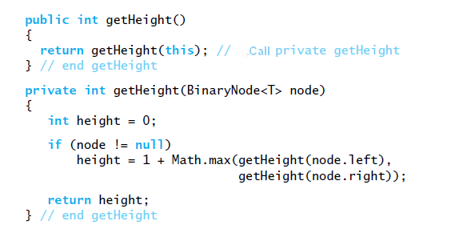
Methods within BinaryNode.

Slide 42
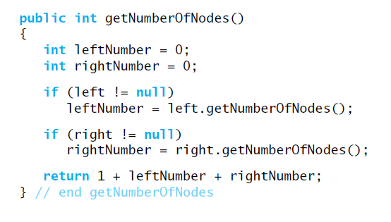
Methods within BinaryNode.

Slide 43
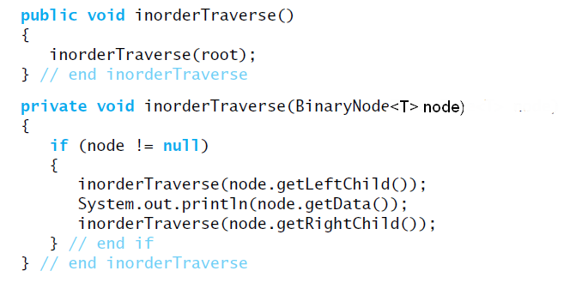
Traversals
Traversing a binary tree recursively

Slide 44
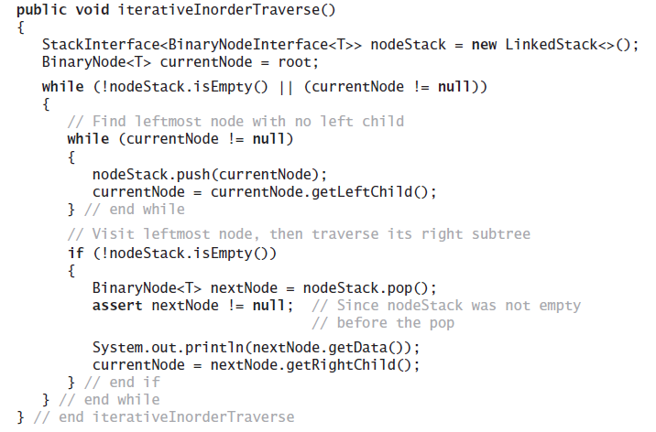
Traversals That Use An Iterator
Iterative version …

Slide 45
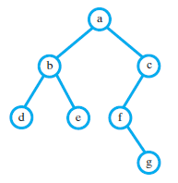
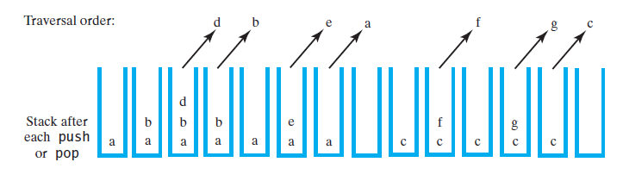
Traversals That Use An Iterator
Using a stack to perform an inorder traversal of a binary tree

Slide 46
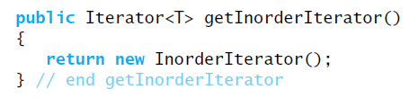
Traversals That Use An Iterator
Method getInorderIterator can be implemented within BinaryTree

Slide 47
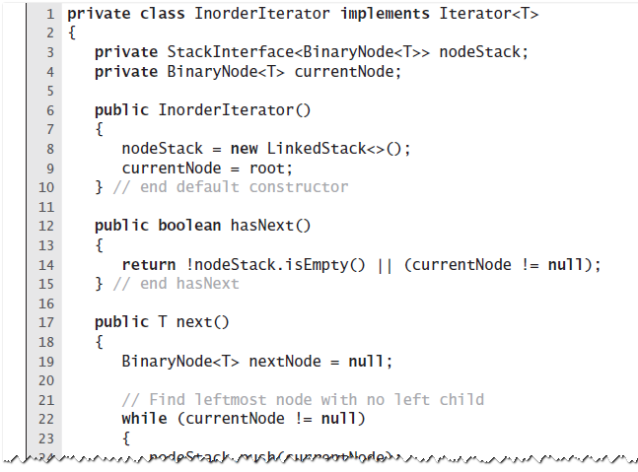
Private Class InorderIterator
The private inner class InorderIterator

Slide 48
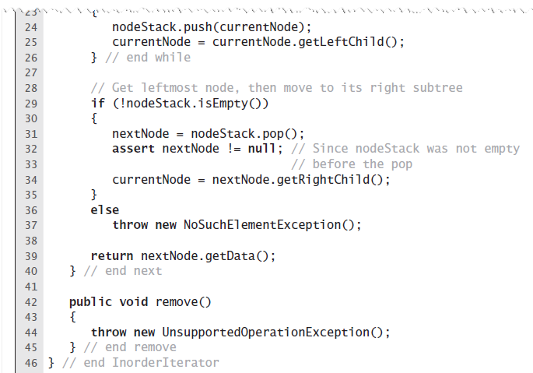
Private Class InorderIterator
The private inner class InorderIterator

Slide 49
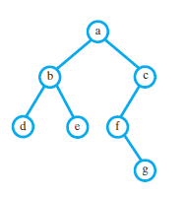
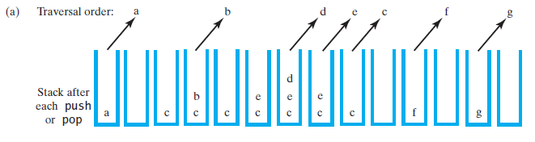
Postorder, and Level-order Traversals
Using a stack to traverse a binary tree in (a) preorder

Slide 50
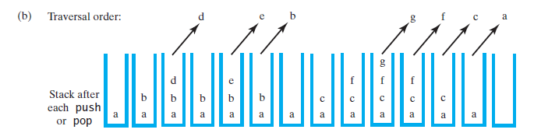
Postorder, and Level-order Traversals
Using a stack to traverse a binary tree in (b) postorder

Slide 51
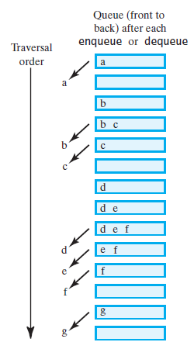
Postorder, and Level-order Traversals
Using a queue to traverse a binary tree in level order

