Slide 1
AlgoTrading Project Design

Slide 2
RedisTS
Datasource
(streaming or stored data)
Provides data
Simulator Code
(could be API or Script)
Grafana Dashboard
Account 1
Grafana Dashboard
Account n
creates
creates
creates
creates
creates
Account_1
Account_2
Account_n
has
has
has
TradingStrategy_34
TradingStrategy_86
TradingStrategy_n
Pushes data
RedisTS
(Trading output data)
Pushes data
Provides data
Provides data

Slide 3
Strategy
TradingStrategy
Abstract Base Class, new strategy classes should inherit from it and implement “decide” function with the logic of when to buy or sell.
Buy and Sell function implementations are here.
Helper function to call VisAPI’s put_annotation method

Slide 4
Account
Attributes
Start cash
dict of trading strategy parameters
A concrete TradingStrategy
two grafana dashboards ids to dynamically update dashboard panels while trading
Methods
get_portfolio_value: Calculates and returns current total value of the owned stocks
run_strategy_daily: Expects a list of the stock values with associated timestamps for a day and runs the account strategy on that list, returns the last profit and list of the portfolio values throughout the day

Slide 5
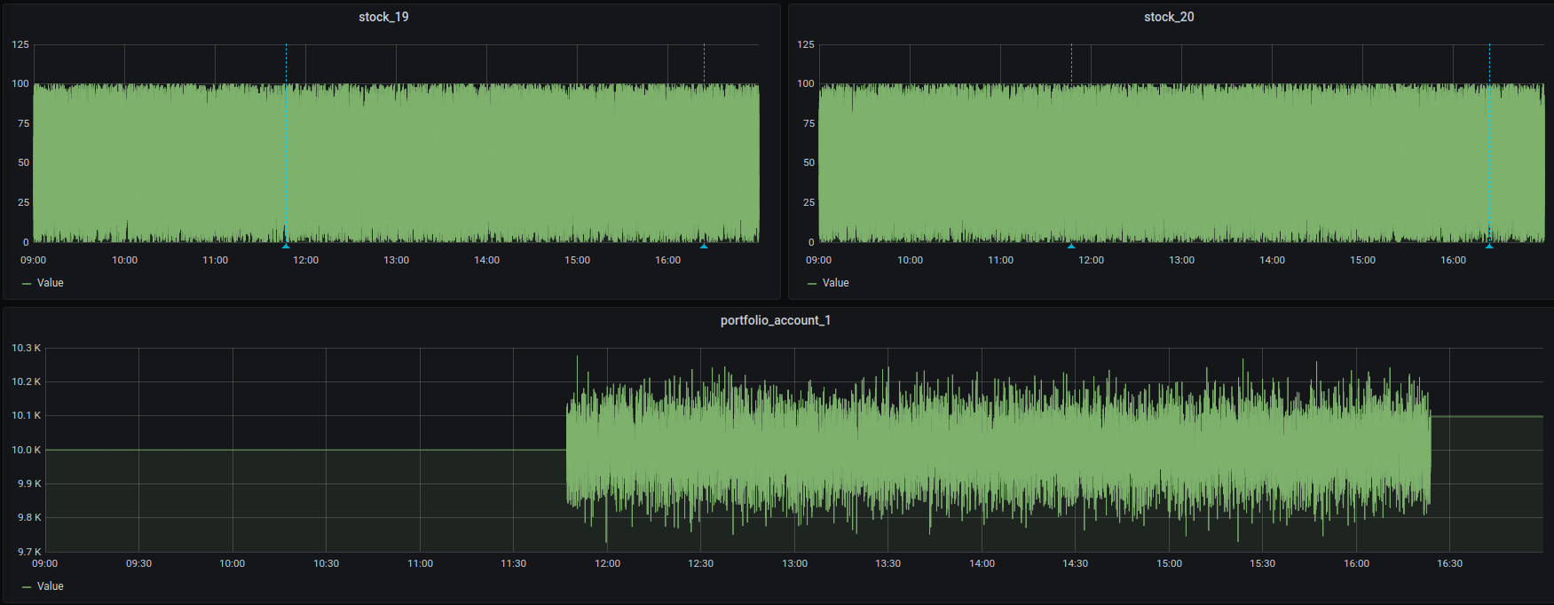
Grafana Dashboards

Slide 6
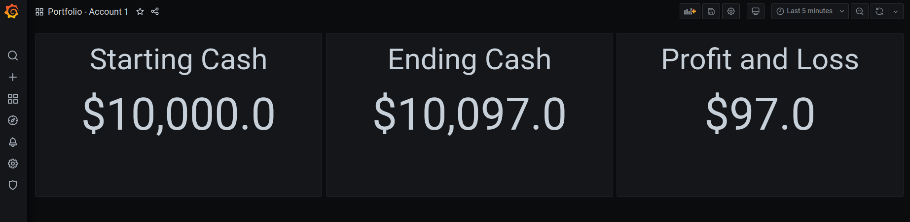
Grafana Dashboards

