Slide 1

ANY-TIME ALGORITHM TO SOLVE COGNITIVE TASKS IN REAL TIME
SAMET KAYA

Slide 2
What is Algorithm?
A finite sequence of well-defined, computer-implementable instructions.
An algorithm is a list of rules to follow in order to solve a problem.
A sequence of steps to be carried out for a required output from a certain given input.

Slide 3
Three Main Features of Algorithm Definitions
The essential aim of an algorithm is to get a specific output.
An algorithm involves with several continuous steps.
The output comes after the algorithm finished the whole process.
https://www.edrawsoft.com/algorithm-definition.html

Slide 4
What is Any-Time Algorithm?
An algorithm that can return a valid solution to a problem even if it is interrupted before it ends.
The system can always access a solution while the algorithm continues to work.
Any-time algorithm is a system that can be applied on an algorithm.
An other name of this algorithm is “interruptible algorithm”.
https://en.wikipedia.org/wiki/Anytime_algorithm

Slide 5
Why Systems Need Any-time Algorithm
Some real time systems can not wait end of all process.
Worst decision is better than indecision. This means there is always a decision in hand.
While applying the available best solution, better solutions can be searched.

Slide 6
What Should Be In Any-time Algorithm
Interruptability
Algorithm can be stoptable
Monotonicity
The quality of the result improves over time
Disminishing Returns
The increase in the quality of the solution is high when the ahlgorithm starts working. Over time, this increase rate decreases.
Preemptability
Algorithm can be suspended and resumed.

Slide 7
Which Algorithms is Suitable For Anytime Algorithm?
Greedy search
Random Search
Simulated-Annealing
Genetic Algorithm
Etc…
Algorithms must be everytime able to keep a solution in order to apply anytime algorithm.

Slide 8
How Can Be Applied
While applying the algorithm, the most critical point is that while the best solution is using, the best solution must be updated.
To ensure this, the normal algorithm must be interrupted and other action taken(for example displaying solution).

Slide 9
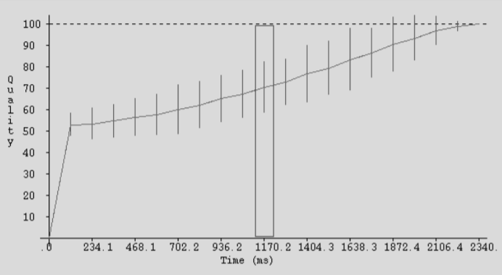
Time-Quality Graph
Best solution in time
Grass, Joshua & Zilberstein, Shlomo. (1995). Programming with Anytime Algorithms.

Slide 10
Hyper-Heuristic Genetic Algorithm With Any-time
Genetic algorithms work with the logic of improving genes over time.
From this perspective, it always keeps the best chromatid of genes in memory.
As genes continue to improve, the best chromatid in the population can be used for solution.

Slide 11
Genetic Algorithm
A genetic algorithm is a search heuristic that is inspired by Charles Darwin's theory of natural evolution.
Genetic algorithm applies mutation, recombination and natural selection functions on the genes respectively.
Mutation: This function is used to avoid local optima.
Recombination: This function allows the chromatites to match and create a new generation
Natural selection: Determines which individuals will survive and their ability to reproduce.

Slide 12
Hyper-Heuristic Genetic Algorithm
The normal genetic algorithm uses uniform functions for mutation, recombination and natural selection. In addition, performs these operations sequentially.
Hypter-Heursitic uses multiple algorithms for each transaction.
It also does these operations randomly.

Slide 13
Postal Worker Problem
There is a postman in the problem.
The postman will leave the post office and stop by all of the delivery addresses and go home.
The problem is finding the shortest path between post office and home.

Slide 14
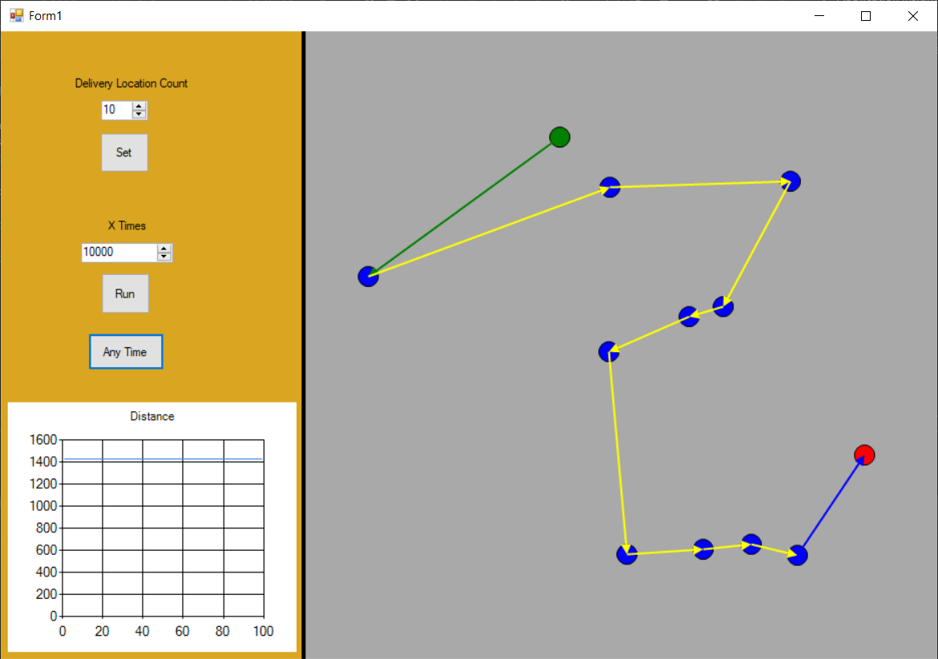
Post Office
Delivery Locations
Home

Slide 15
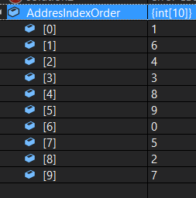
Genes and Fitness Function
int[] AddresIndexOrder;
double distance;
Fitness function is the total distance of the sequence calculated by the two-point distance formula.

Slide 16
Mutations
Inversion:
Random two different index are selected
Swap their contents.
Adjacent:
Random one index is selected
Swap contents with it’s next neighbour.
Reinsertion:
Random one index is selected.
Pop it from list.
Push it in random index.

Slide 17
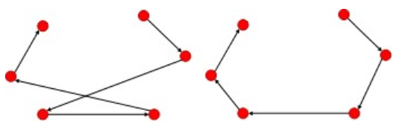
Local Search
NextDescent:
Select random one index
If its second neighbor is closer than the first one, swap them.
Continue until there is an improvement or full turn.
Hill Climbing:
Randomly choose two indexes.
Swap them.
Continue until there is an improvement or all binary matches are tried

Slide 18
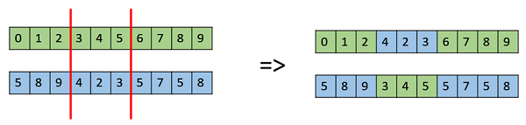
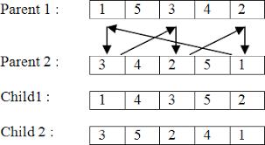
Crossovers
Ordered:
Pick two cut point and paste it on new child.
Fill child from other parent orderly numbers which not in cut genes
Cycle:
Pick random index from parent1
Get number inside parent2 index
Use the number as index on prarent1
Continue until parent 2 number index content is equal to parent 1 start content
https://www.tutorialspoint.com/genetic_algorithms/genetic_algorithms_crossover.htm

Slide 19
Hyper-Heuristic Selection
int heu = rnd.Next(7);
Console.WriteLine(i + ". time heu=" + heu);
switch ((heuristics)heu)
{
case heuristics.mutation_Inversion:
level = (level % 3) + 1;
solution1 = this.solutionList[mut];
this.MutationInversion(ref solution1, level);
break;
case heuristics.mutation_AdjacentSwap:
level = (level % 3) + 1;
solution1 = this.solutionList[mut];
this.MutationAdjacentSwap(ref solution1, level);
break;
case heuristics.mutation_Reinsertion:
level = (level % 3) + 1;
solution1 = this.solutionList[mut];
this.MutationReinsertion(ref solution1, level);
break;
case heuristics.localSearch_NextDescent:
solution1 = this.solutionList[loc];
this.LocalSearchNextDescent(ref solution1, level);
break;
case heuristics.localSearch_HillClimbing:
solution1 = this.solutionList[loc];
this.LocalSearchHillClimbing(ref solution1, level);
break;
case heuristics.crossover_Ordered:
solution1 = this.solutionList[cros_other];
solution2 = solutionList[cros_best];
this.CrosoverOrdered(ref solution1, ref solution2, level);
break;
case heuristics.crosover_Cycle:
solution1 = this.solutionList[cros_other];
solution2 = solutionList[cros_best];
this.CrosoverCycle(ref solution1, ref solution2, level);
break;
default:
break;
}

Slide 20
Any-time Implementation
According to the algorithm, the best solution is constantly updated.
This update needs to be suspended before Anytime can be applied.
Threads and Mutex, one of the synchronization mechanisms, is used to implement any-time algorithm.

Slide 21
Mutex 1
Mutual exclusion
Mutex is a program object that allows multiple program threads to share the same resource.
When one thread enters the critical zone, the other thread cannot enter.
The critical zones of our system are updating the best solution and drawing the best solution on the screen.
System can not update best solution while drawing <> The system can not draw while updating best solution.

Slide 22
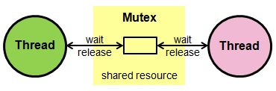
Mutex
Best Solution Drawing
Best Solution Update
https://www.keil.com/pack/doc/cmsis/RTOS/html/group__CMSIS__RTOS__MutexMgmt.html

Slide 23
Result
The hyper-heuristic algorithm can find the shortest path.
The best solution can be seen at any time with a button.
The algorithm works in the background while drawing the best solution.

Slide 24
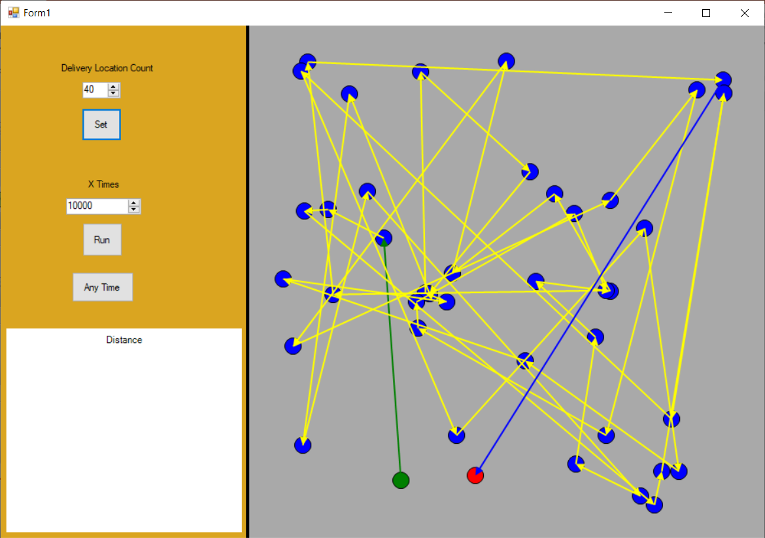

Slide 25
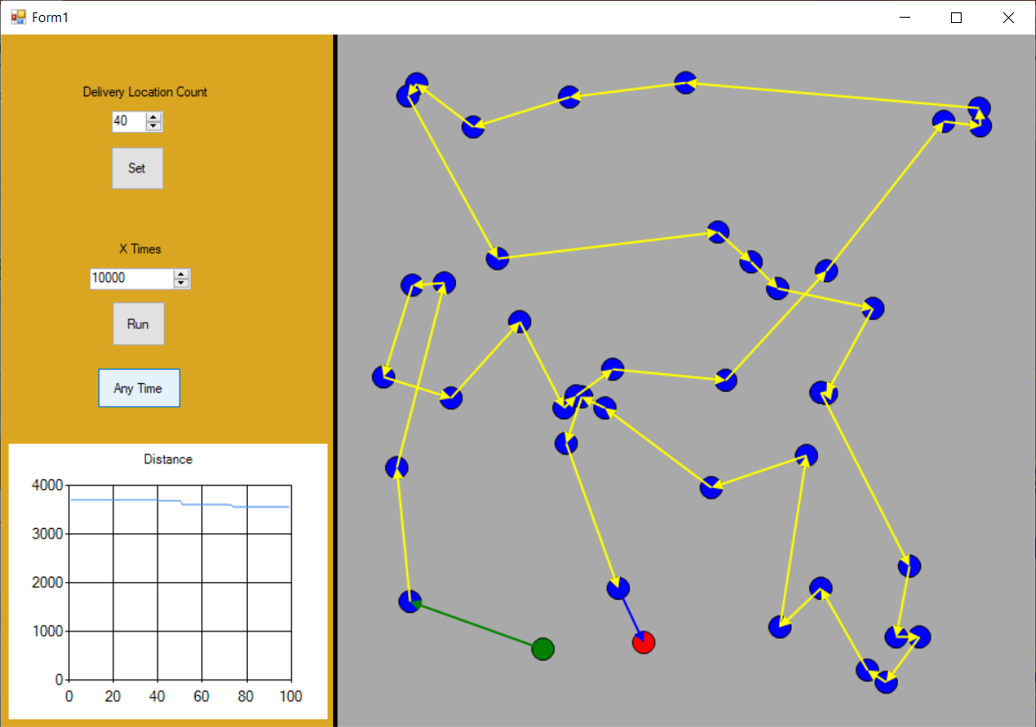

Slide 26
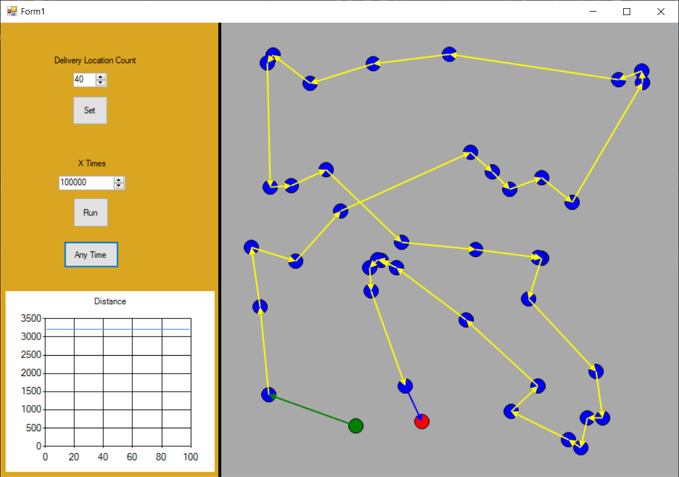

Slide 27
SAMET KAYA kysamet@gmail.com
THANKS FOR YOUR ATTENTION

