Slide 1

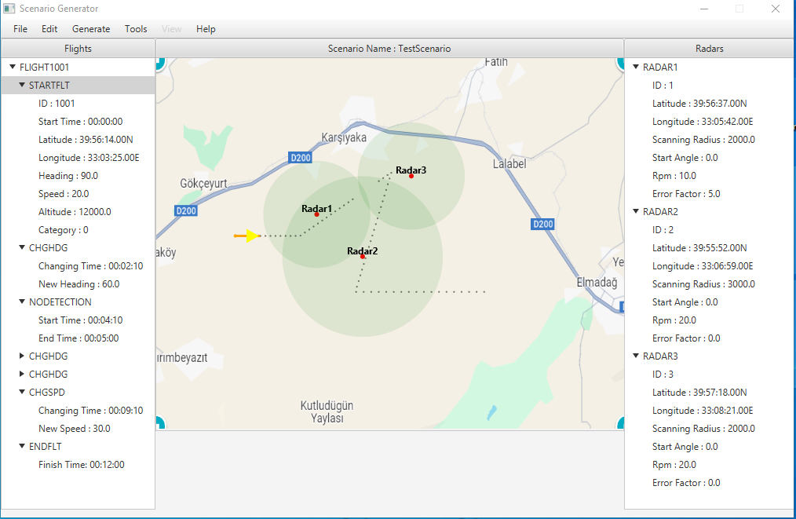
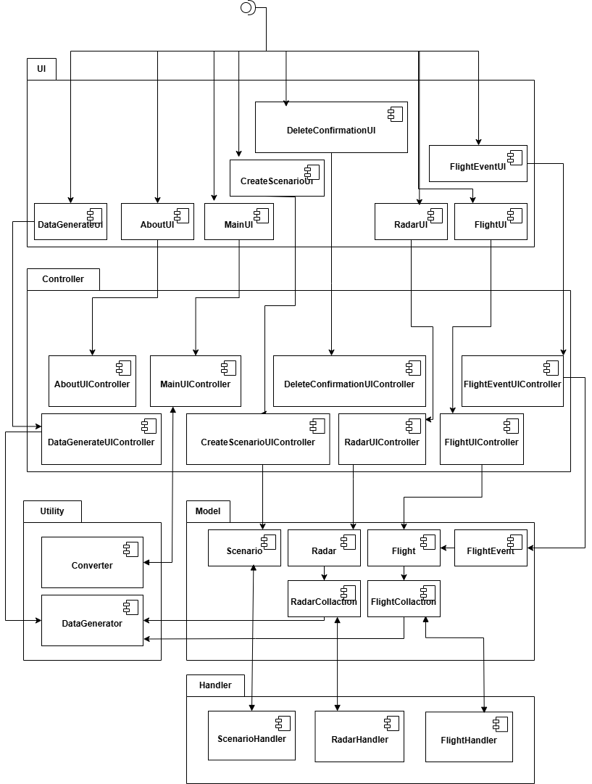
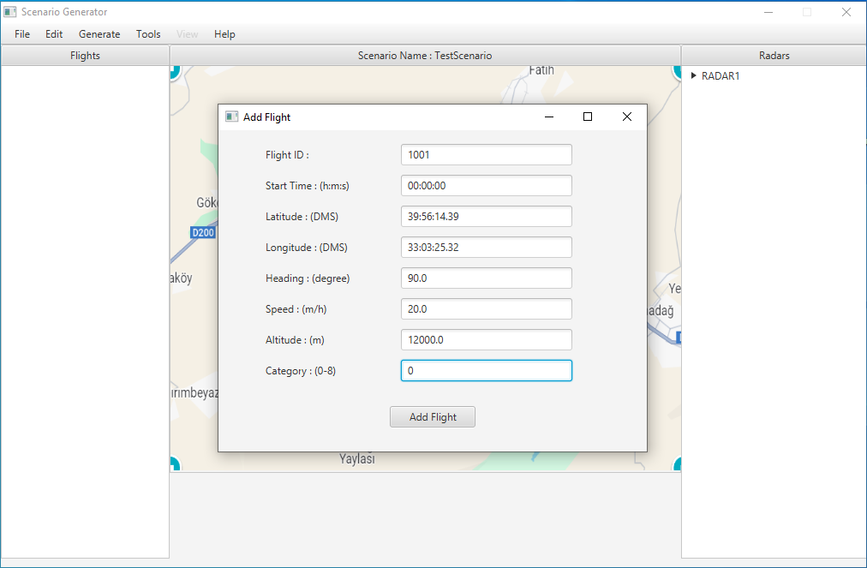
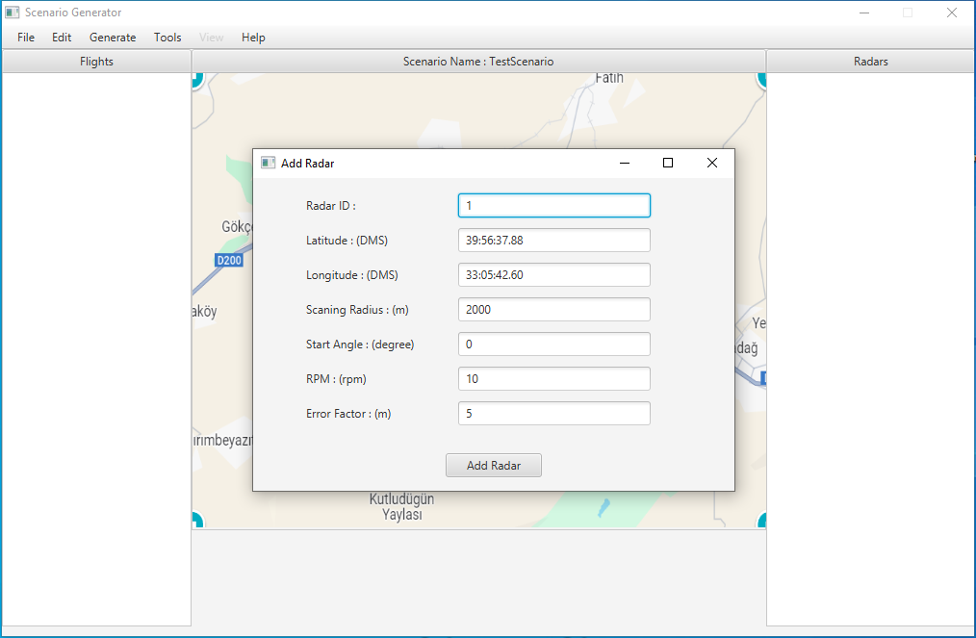
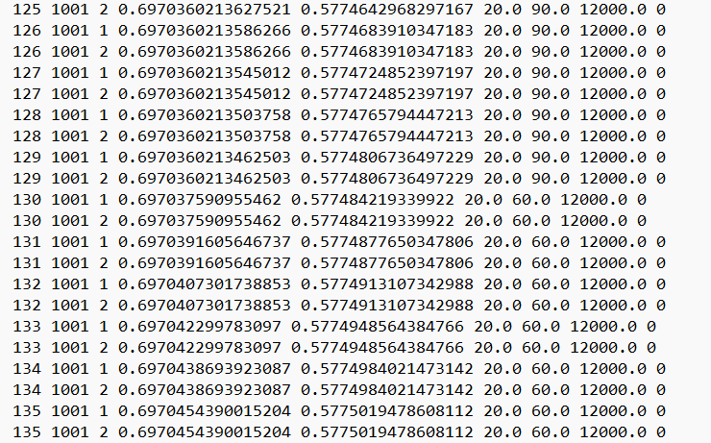








Radar and Track Scenario Generator
Prof. Dr. Ali Yazıcı
Program Manager Murat Aykan
SE 494 Senior Project
Team
Software Design and Architecture
User Interfaces
Samet Çolak – 20244710030 - SE
Objective
RTSG is a software project aimed at simulating radar and moving object data to create realistic scenarios for testing tracking fusion algorithms and generating data from them.
Application Areas
ssda
The RTSG project, developed within AYESAŞ, is designed to test the track fusion algorithms by using scenarios created with RTSG and the data generated from these scenarios
Conclusion
The Radar and Track Scenario Generator (RTSG) project generates realistic data for testing track fusion algorithms by defining flight and radar scenarios. This allows for the evaluation of the effectiveness of the fusion algorithms and enables the development of more reliable algorithms. The project aims to make the algorithms ready for any type of realistic scenario.
Methods
The RTSG (Radar and Track Scenario Generator) project adopts an Incremental methodology, which focuses on breaking the project into smaller, manageable parts. Each phase adds new features and improvements based on user feedback, allowing for continuous refinement. The first increment introduces core functionalities such as radar and track scenario creation, while the second increment enhances these features, optimizes system performance, and improves user experience. This methodology ensures that the final product evolves to better meet the needs of its users, offering a more accurate and efficient solution.
Tools
References
Pressman, R. S. (2014). Software Engineering: A Practitioner's Approach (8th ed.). McGraw-Hill.
AYESAŞ. (2025). Corporate Information. AYESAŞ. Retrieved from https://www.ayesas.com/en/about-us

