Slide 1


Son Motor Bükücüler
Musa Ulusoy 2305555
Muhammet Samet Yakut 2305647
Berna Corak 2304392

Slide 2
Overview
Topology Selection
Simulations
Thermal Calculations

Slide 3
Topology Selection
Centre-tap transformer
Single phase full bridge diode rectifier with buck converter
Single phase thyristor rectifier
Three phase full bridge diode rectifier with buck converter
Three phase thyristor rectifier

Slide 4
Topology Selection
Centre-tap transformer
-expensive & not practical
Single phase full bridge diode rectifier with buck converter
-DC of 90% is needed for max. output
Single phase thyristor rectifier
-two gate driver ~more error-prone
Three phase full bridge diode rectifier with buck converter
-cheaper & single gate driver
Three phase thyristor rectifier
-expensive & complex

Slide 5
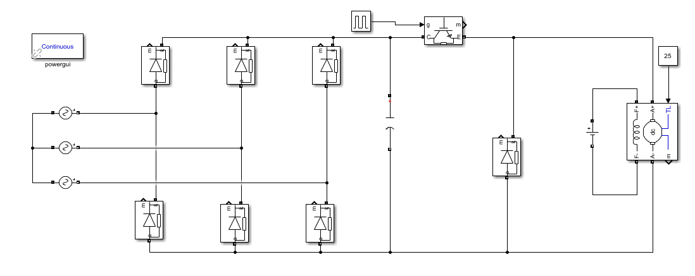
Simulations

Slide 6
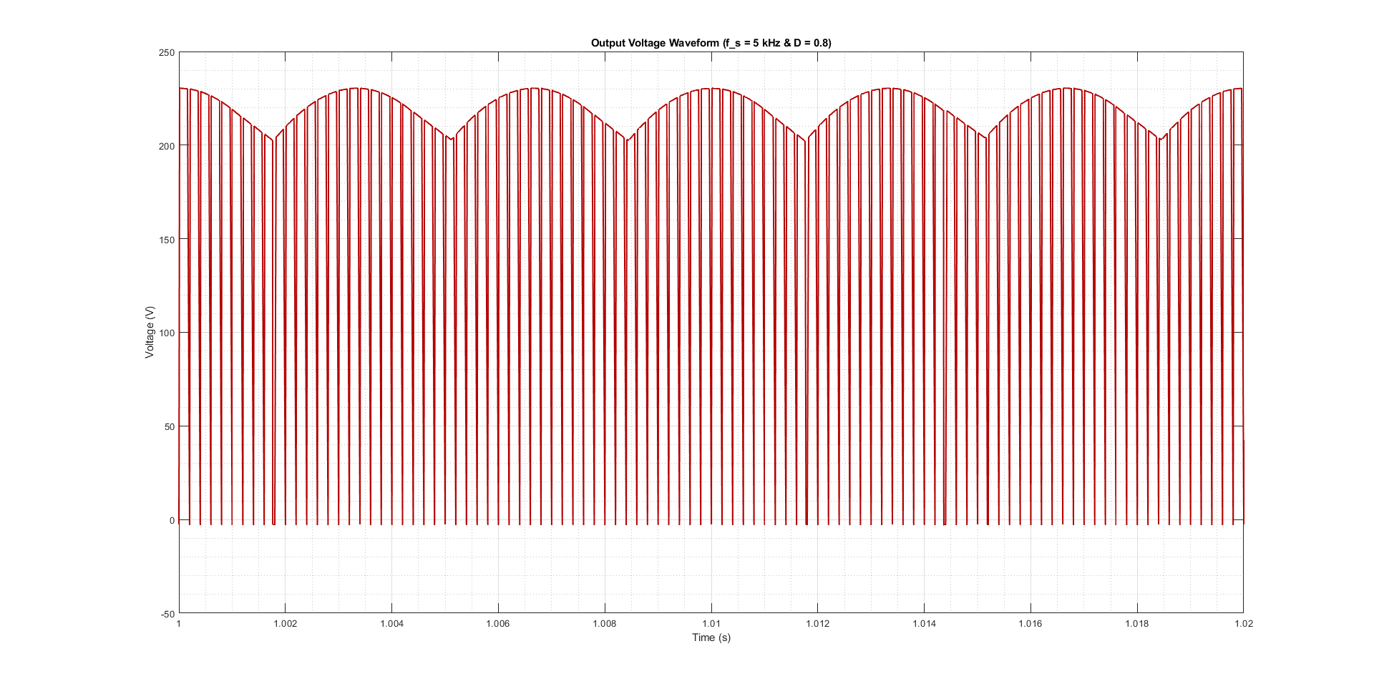
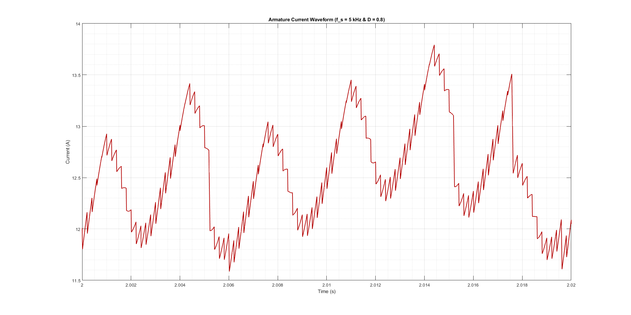
Simulations

Slide 7
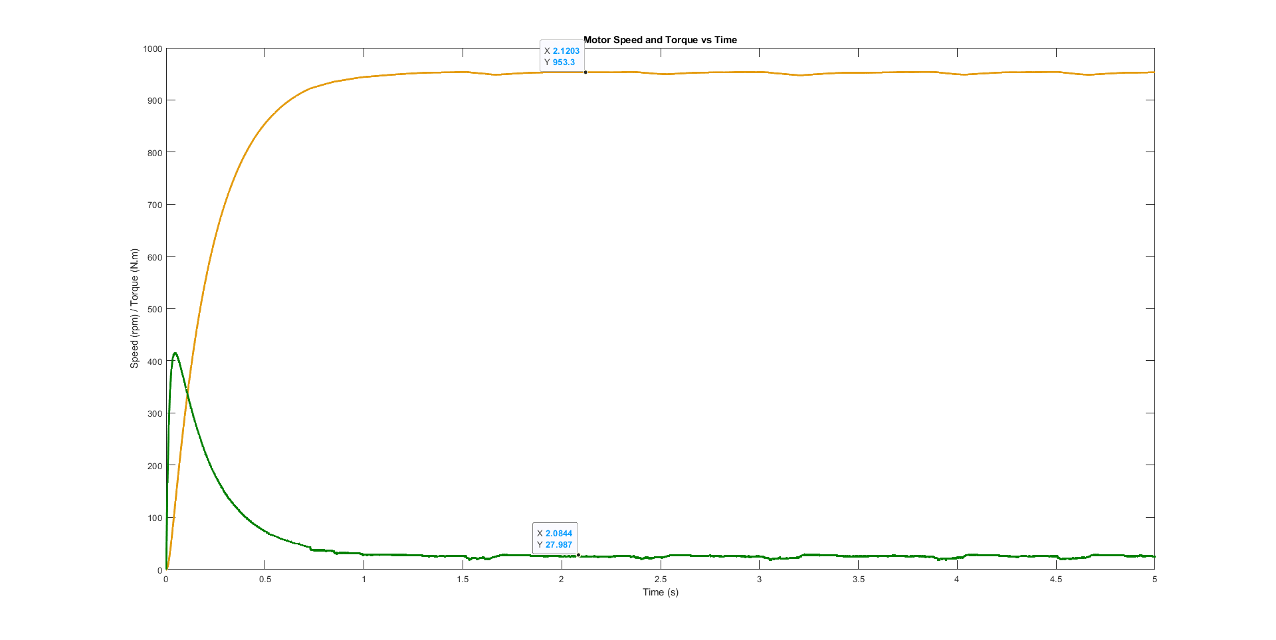
Simulations

Slide 8
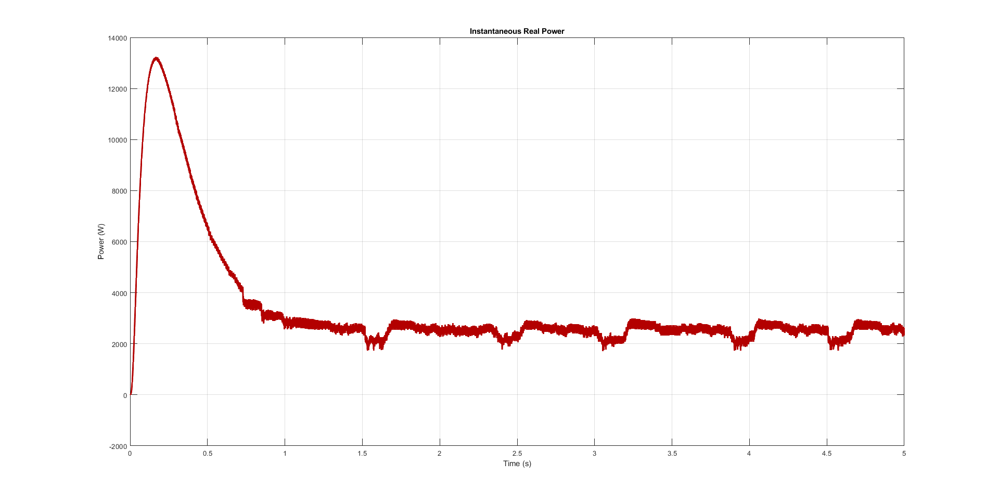
Simulations

Slide 9
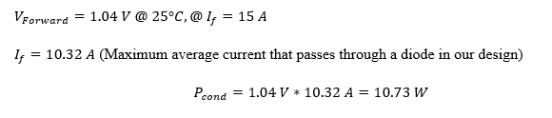
Thermal Calculations
For Three-phase rectifier unit

Slide 10
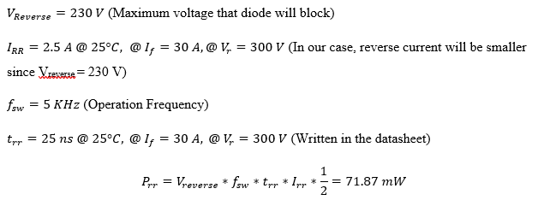
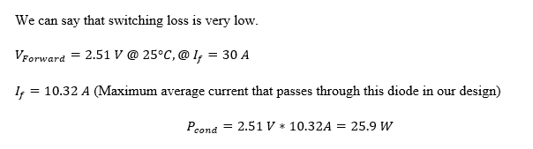
Thermal Calculations
For the free-wheeling diode

Slide 11
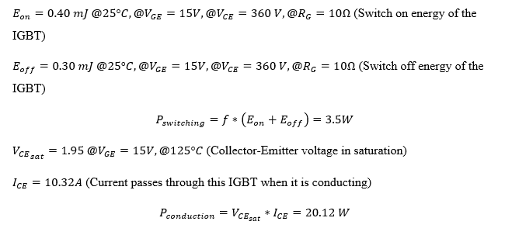
Thermal Calculations
For the IGBT

