Slide 1


Slide 2
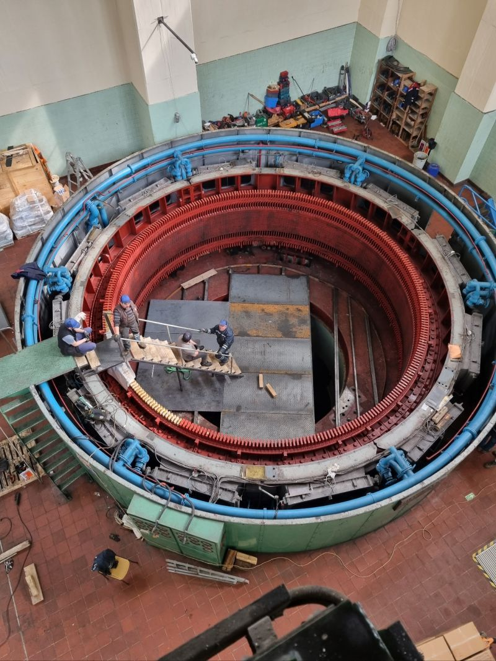
REFURBISHMENT AND ALTERNATING WINDING TYPE OF 44 MVA HYDRO GENERATOR
M. Samet YAKUT
Advisor: Ozan Keysan
November 23, 2023
METU EEE Department

Slide 3
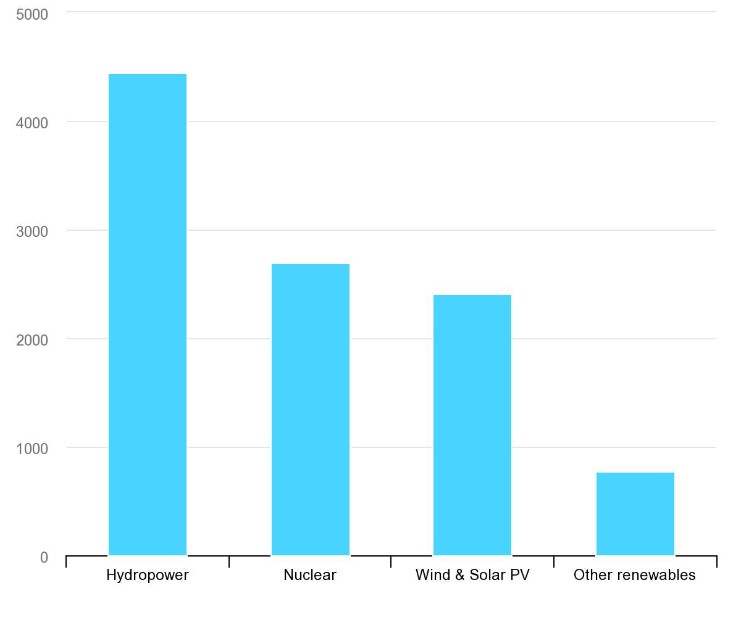
TWh
Largest low-carbon electricity generation technology is hydropower [1]
IEA, Low-carbon electricity generation by technology, 2020, IEA, Paris https://www.iea.org/data-and-statistics/charts/low-carbon-electricity-generation-by-technology-2020, IEA. Licence: CC BY 4.0

Slide 4
Outline
Introduction
Methodology
Alternating Winding Type
Design of Roebel Bars
Optimization
Results
Conclusion

Slide 5
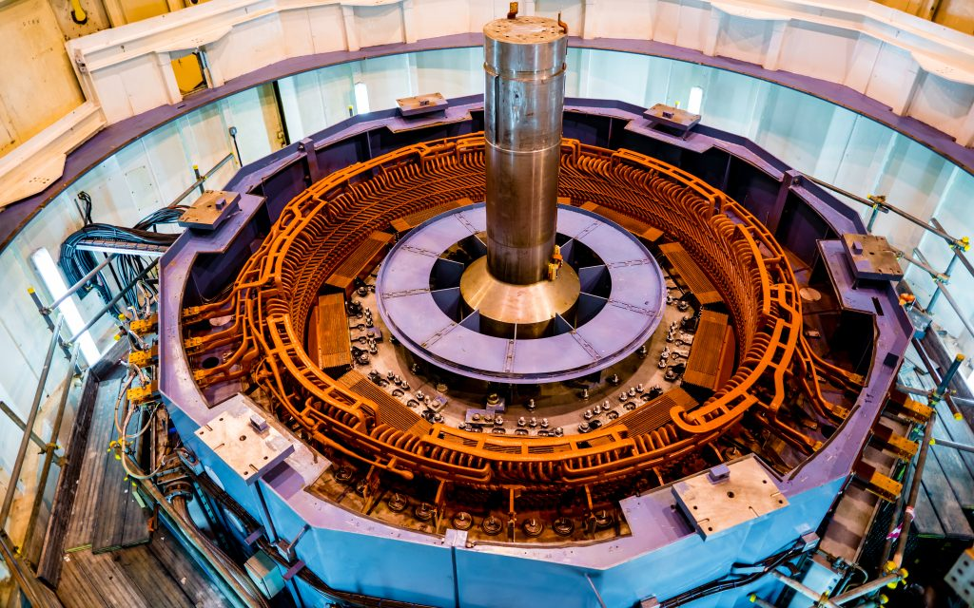
Introduction
Salient pole synchronous machines
High voltage stator

Slide 6
Winding Types

Slide 7
Upgrading & Uprating

Slide 8
Design of Roebel Bars

Slide 9
Optimization

Slide 10
Results

Slide 11
Conclusion

