Slide 1


Slide 2
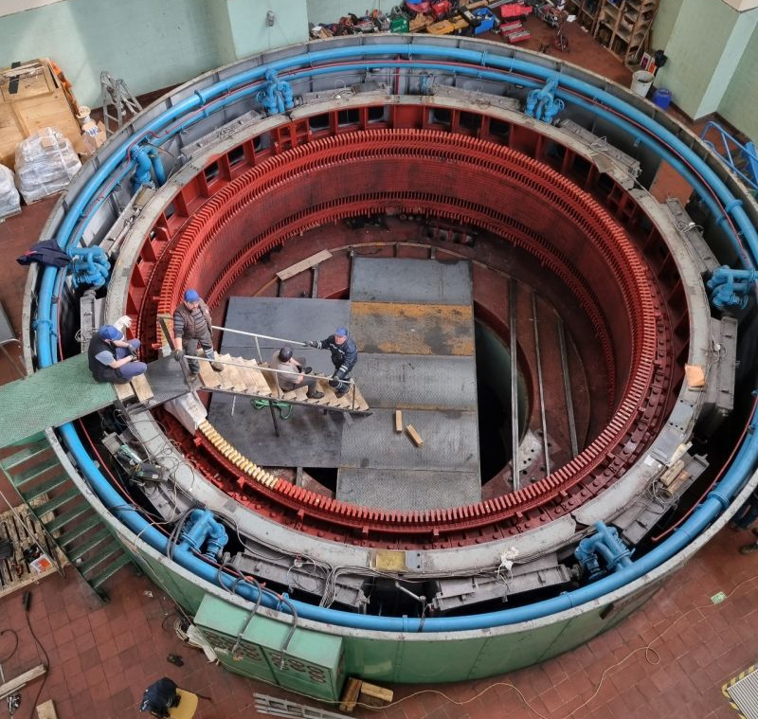
Vibrational Forces in Hydro Generators
M. Samet Yakut
11.03.2024

Slide 3
Outline
Background Information
Airgap Magnetic Field
Force Density
Comparison
Past & Future Plans

Slide 4
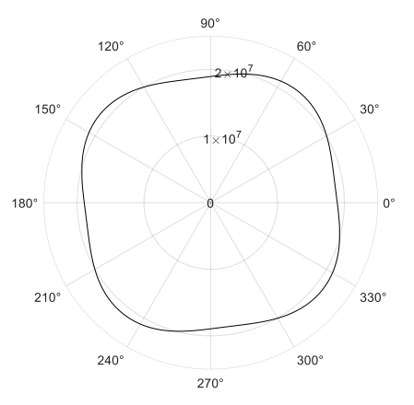
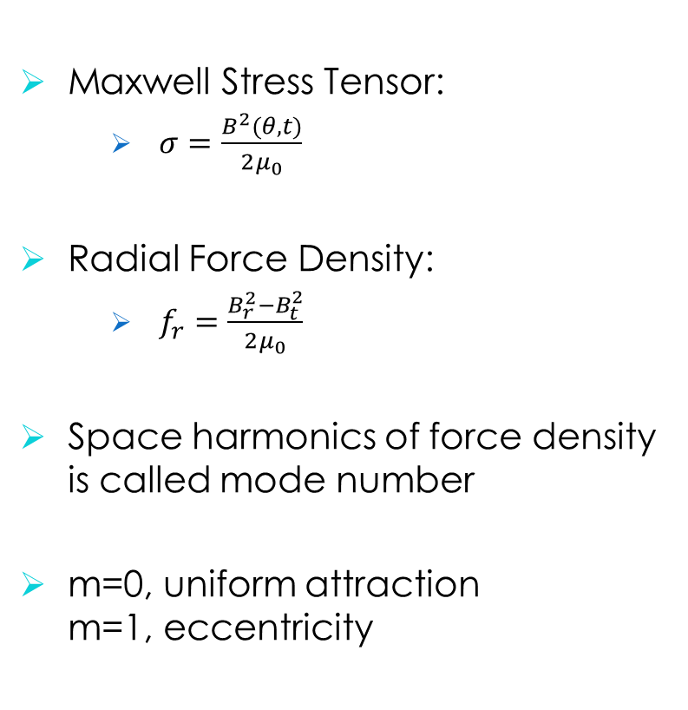
Background Information
Maxwell Stress Tensor:
$σ=\frac{B^{2}(θ,t)}{2μ_{0}}$
Radial Force Density:
$f_{r}=\frac{B_{r}^{2}−B_{t}^{2}}{2μ_{0}}$
Space harmonics of force density is called mode number
m=0, uniform attraction m=1, eccentricity

Slide 5
Airgap Magnetic Field
No Load

Slide 6
Airgap Magnetic Field
Inductive Load

Slide 7
Radial Force Density

Slide 8
Cogging Torque

Slide 9
Comparison

Slide 10
Past & Future Plans

Slide 11
Past Plans
Completing winding design (as well as its alternatives)
Eccentricity analyses
Creating basis for advanced design and optimization
Future Plans
Completing optimization studies
Creating manufacturing documents
Manufacturing mock generator

