Slide 1


Slide 2
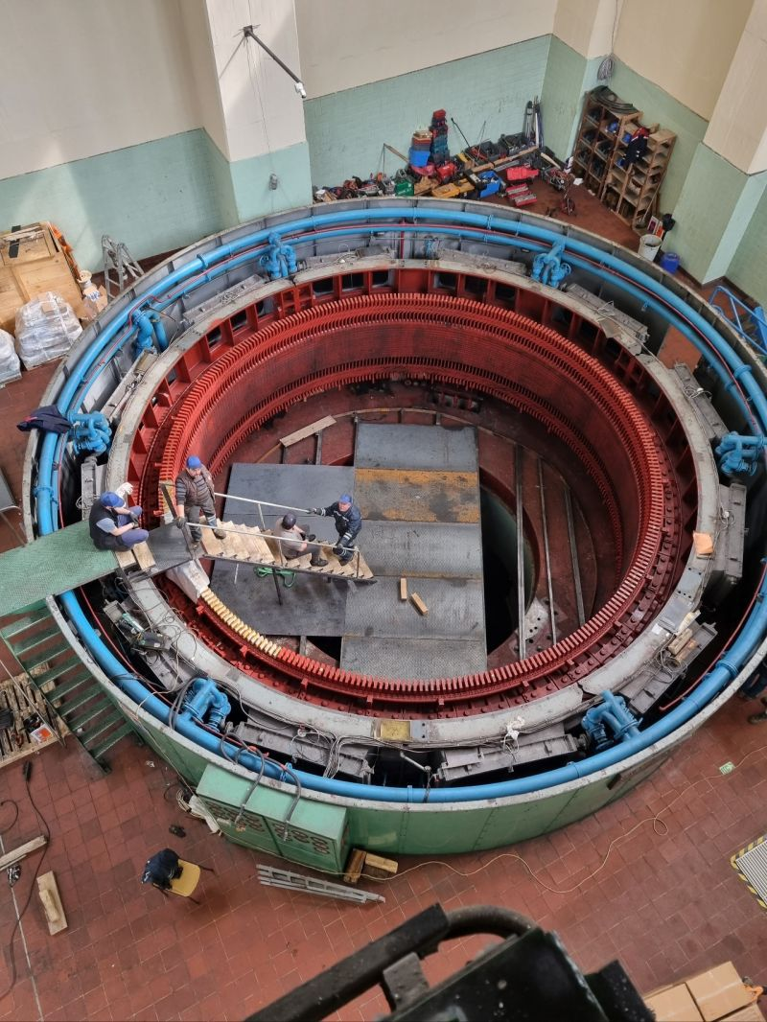
ALTERNATING WINDING TYPE OF 44 MVA HYDRO GENERATOR
M. Samet YAKUT
Advisor: Ozan Keysan
November 23, 2023
EE590 Seminar, METU EE Dep.

Slide 3
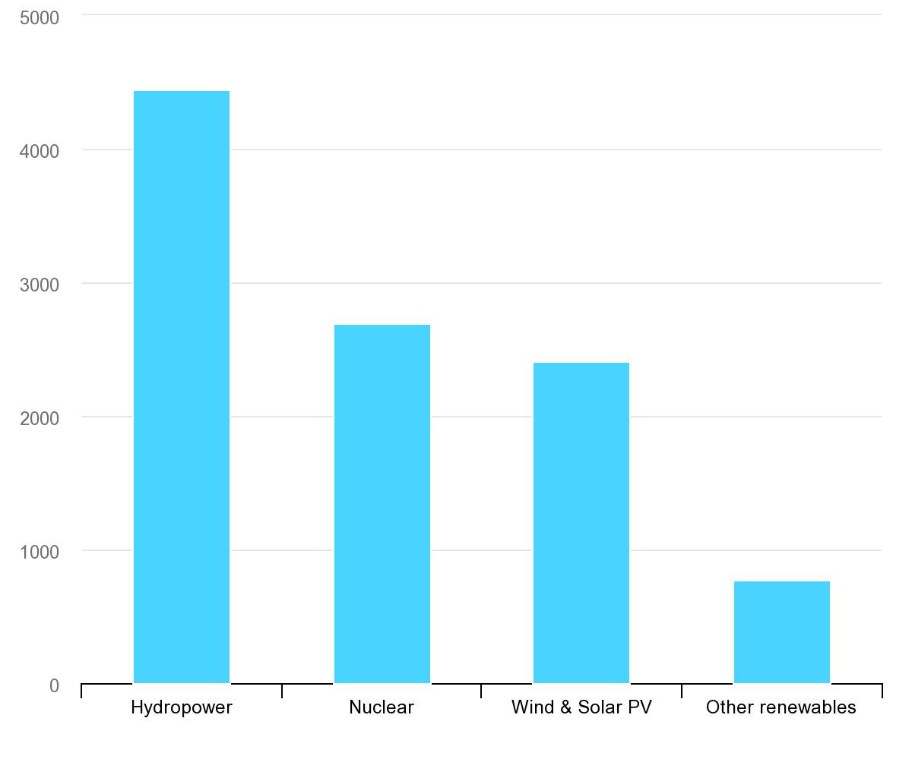
TWh
Largest low-carbon electricity generation technology is hydropower ^{[1]}
IEA, Low-carbon electricity generation by technology, 2020, IEA, Paris https://www.iea.org/data-and-statistics/charts/low-carbon-electricity-generation-by-technology-2020, IEA. Licence: CC BY 4.0

Slide 4
Outline
Introduction
Basic Terms & Definitions
Refurbishment Process
Optimization
Design of Roebel Bars
Conclusion

Slide 5
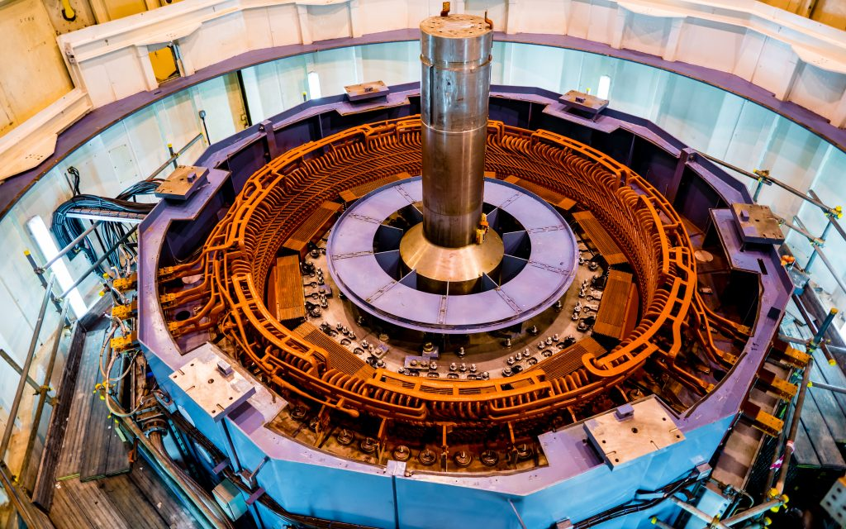
Introduction
Salient pole synchronous machines
High voltage stator
Tens of kVA to hundreds of MVA

Slide 6
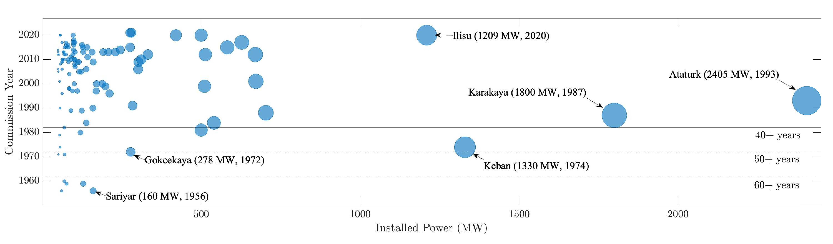
Refurbishment
Installed capacity older than 30 years: 6205 MWs
which accounts for 31.9% of large hydro generators ^{[1]}
Most old generators are over – designed
cheapest way of increasing installed power
N. Tosun, G. Gülletutan, M. S. Yakut, D. Alp Yilmaz, Ö. Bayer and O. Keysan, "Winding Type Alternation of a Refurbished Old Generator," 2023 IEEE Workshop on Electrical Machines Design, Control and Diagnosis (WEMDCD), Newcastle upon Tyne, United Kingdom, 2023, pp. 1-6, doi: 10.1109/WEMDCD55819.2023.10110941.

Slide 7
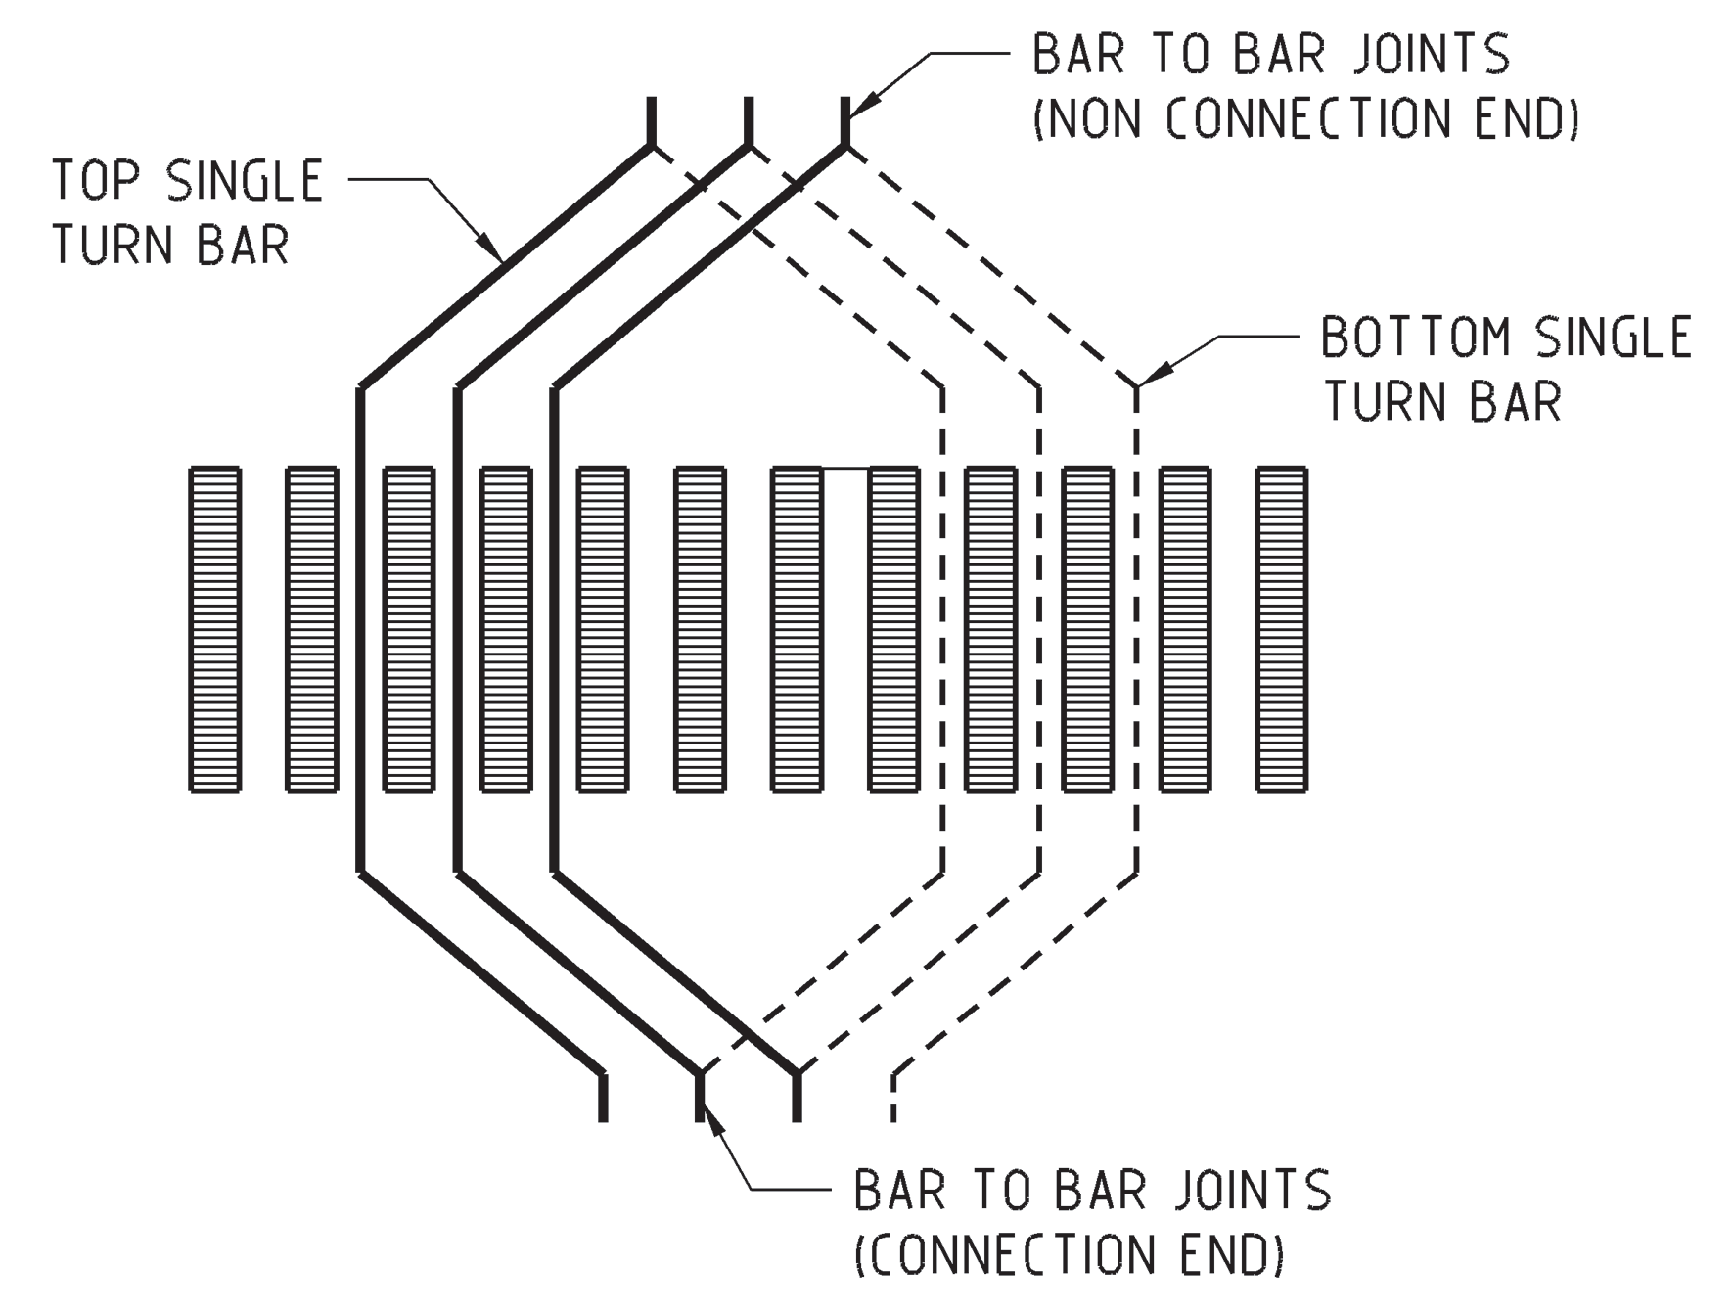
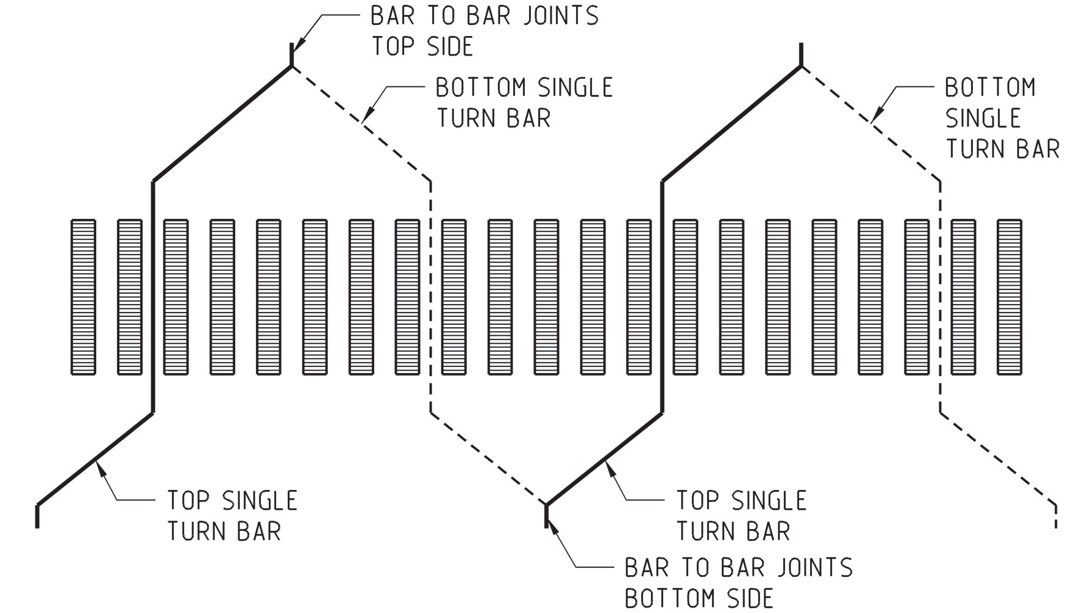
Winding Types
Lap Winding Wave Winding
M.M. Znidarich (2008) Hydro Generator High Voltage Stator Windings: Part 1 – Essential Characteristics and Degradation Mechanisms, Australian Journal of Electrical and Electronics Engineering, 5:1, 1-17, DOI: 10.1080/1448837X.2008.11464196

Slide 8
Winding Types
Wave Winding |  | Lap Winding
Advantage | Disadvantage | Advantage | Disadvantage
Less outage duration | Complicated design | Simple winding schematic design | Complicated end connections
Simple end connection | Generally requires more coil types | Less type of coils | More outage time
Low number of external connection | Longer average winding pitches, therefore longer end windings | Allows bypass | Sophisticated production

Slide 9
Problem Definition
Refurbishment of an old 44 MVA hydro generator by changing winding type from lap to wave
Constraints
Constant outer diameter
Same rotor geometry
Challenge
Increasing efficiency

Slide 10
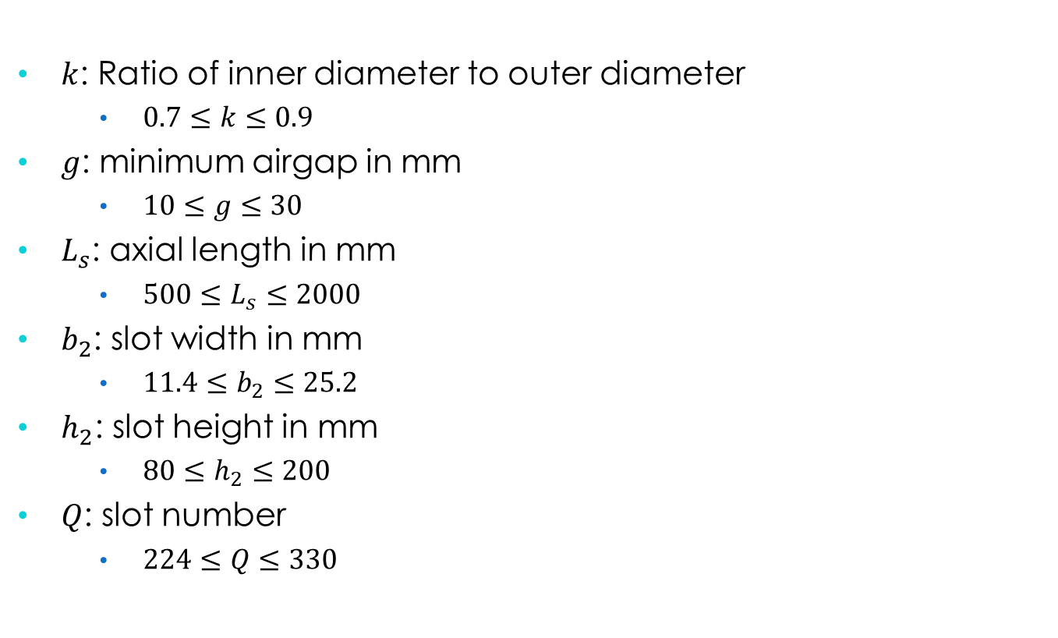
Optimization: Variables
$k$: Ratio of inner diameter to outer diameter
$0.7≤k≤0.9$
$g$: minimum airgap in mm
$10≤g≤30$
$L_{s}$: axial length in mm
$500≤L_{s}≤2000$
$b_{2}$: slot width in mm
$11.4≤b_{2}≤25.2$
$h_{2}$: slot height in mm
$80≤h_{2}≤200$
$Q$: slot number
$224≤Q≤330$

Slide 11
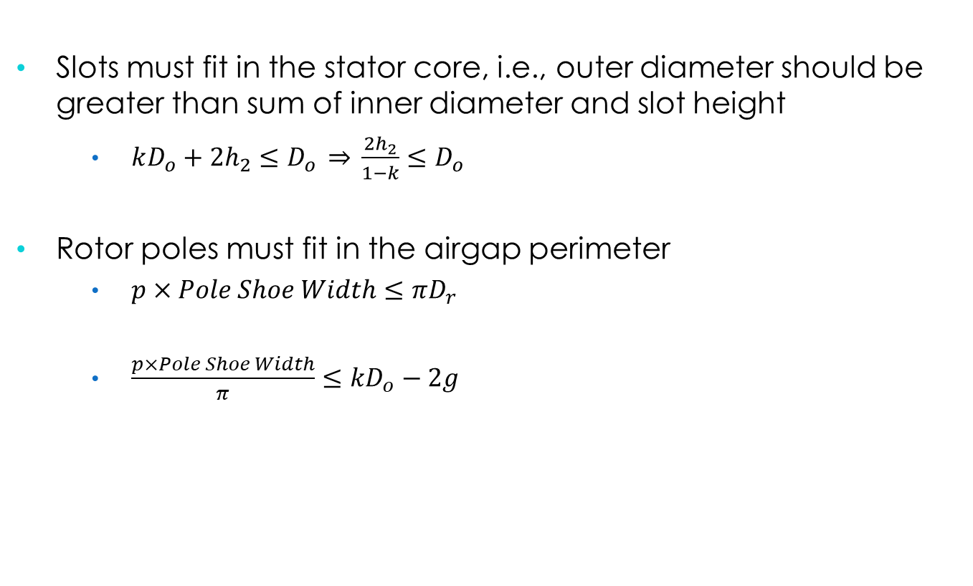
Optimization: Constraints
Slots must fit in the stator core, i.e., outer diameter should be greater than sum of inner diameter and slot height
$kD_{o}+2h_{2}≤D_{o} \underset{⇒}{} \frac{2h_{2}}{1−k}≤D_{o}$
Rotor poles must fit in the airgap perimeter
$p×Pole Shoe Width≤πD_{r}$
$\frac{p×Pole Shoe Width}{π}≤kD_{o}−2g$

Slide 12

Optimization: Objective Function
Objective functions are
Initial cost
$f_{1} (k,g,L_{s},b_{2},h_{2} )={(m}_{steel} C_{steel}+m_{copper} C_{copper})×2.5$
Efficiency
$f_{2} (k,g,L_{s},b_{2},h_{2} )=η=\frac{P_{out}}{P_{in}} ×100$
Subject to
$\frac{2h_{2}}{1−k}≤D_{o}$
$\frac{p×Pole Shoe Width}{π}≤kD_{o}−2g$

Slide 13

Optimization: Penalty Function
SCR should not be less than 0.8
Hence
$p(k,g,L_{s},b_{2},h_{2},Q)=\left\{\begin{aligned}A{\left(\frac{1}{SCR}\right)}^{4}=A{\left(X_{d,pu}\right)}^{4}, if SCR<0.8 \\ 0, otherwise\end{aligned}\right.$
where A is a very large number compared to initial cost

Slide 14
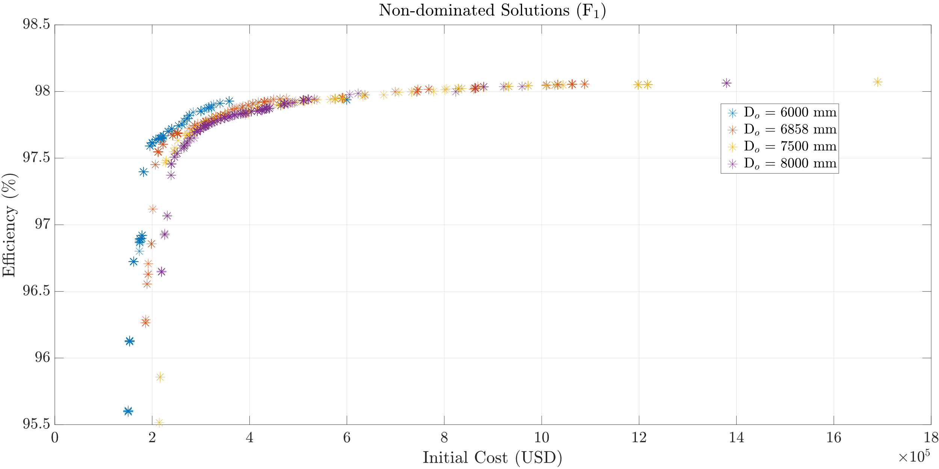
Optimization: Results

Slide 15
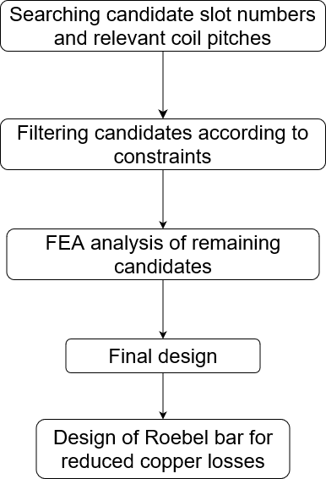
Design Methodology
Old Generator | Final Design
240 Slots | 300 Slots
Lap Winding | Wave Winding
Same rotor geometry, air gap, and outer diameter

Slide 16
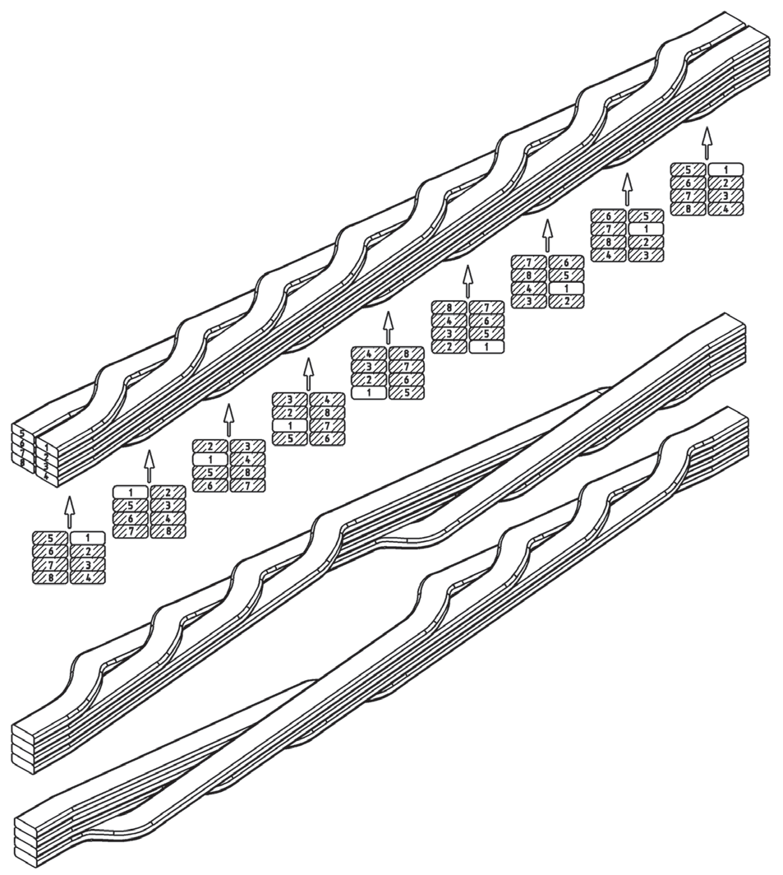
Roebel Bars
Single turn coils
Composed of multiple strands to reduce AC losses
Transposition is applied to minimize circulating currents

Slide 17
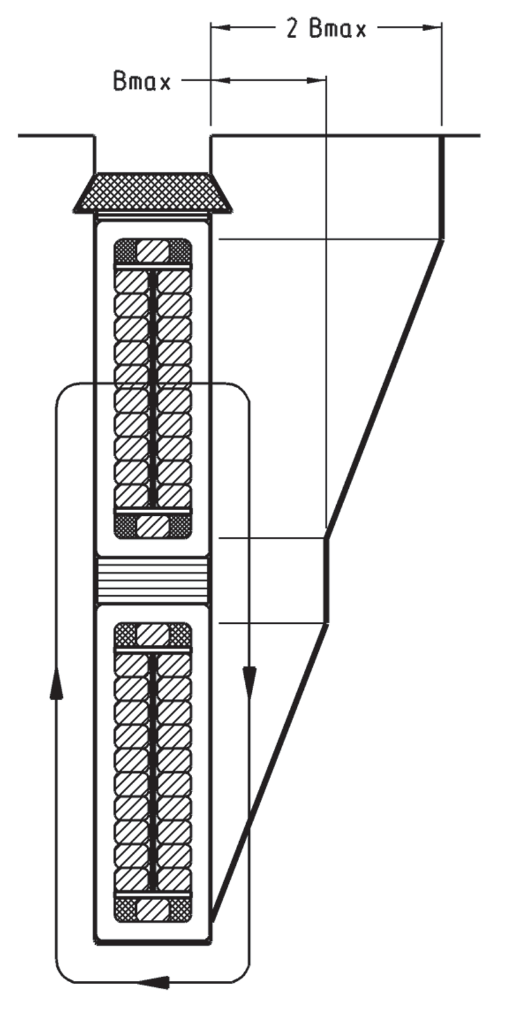
Design of Roebel Bars
Different induced voltages in each strand
Circulating currents
Eddy losses

Slide 18
Design of Roebel Bars
Selection of strand number
Selection of transposition angle
Limitations:
Axial length
Material strength

Slide 19
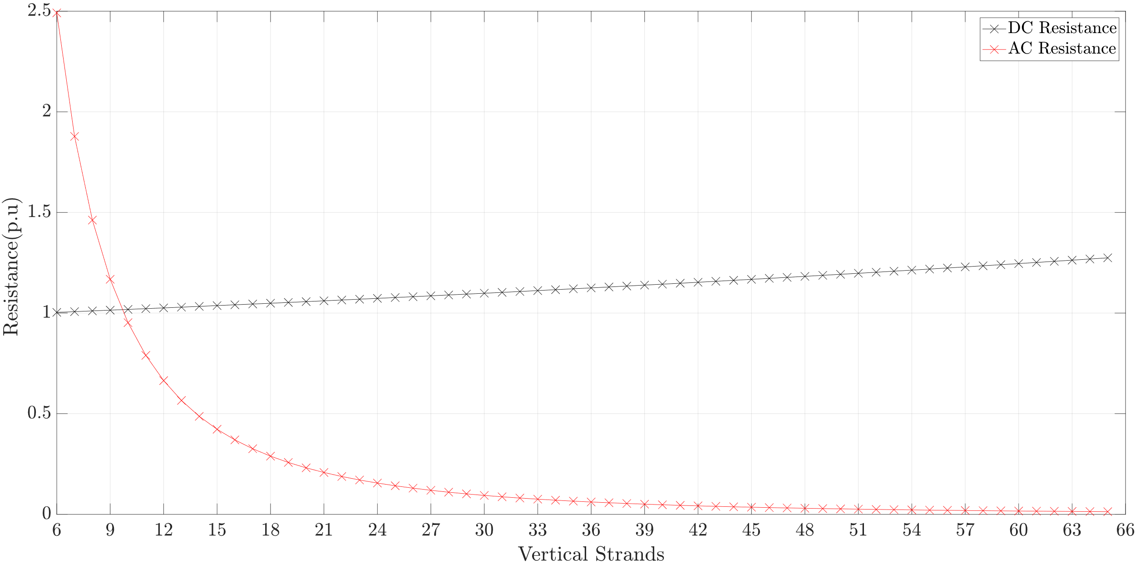
Design of Roebel Bars

Slide 20
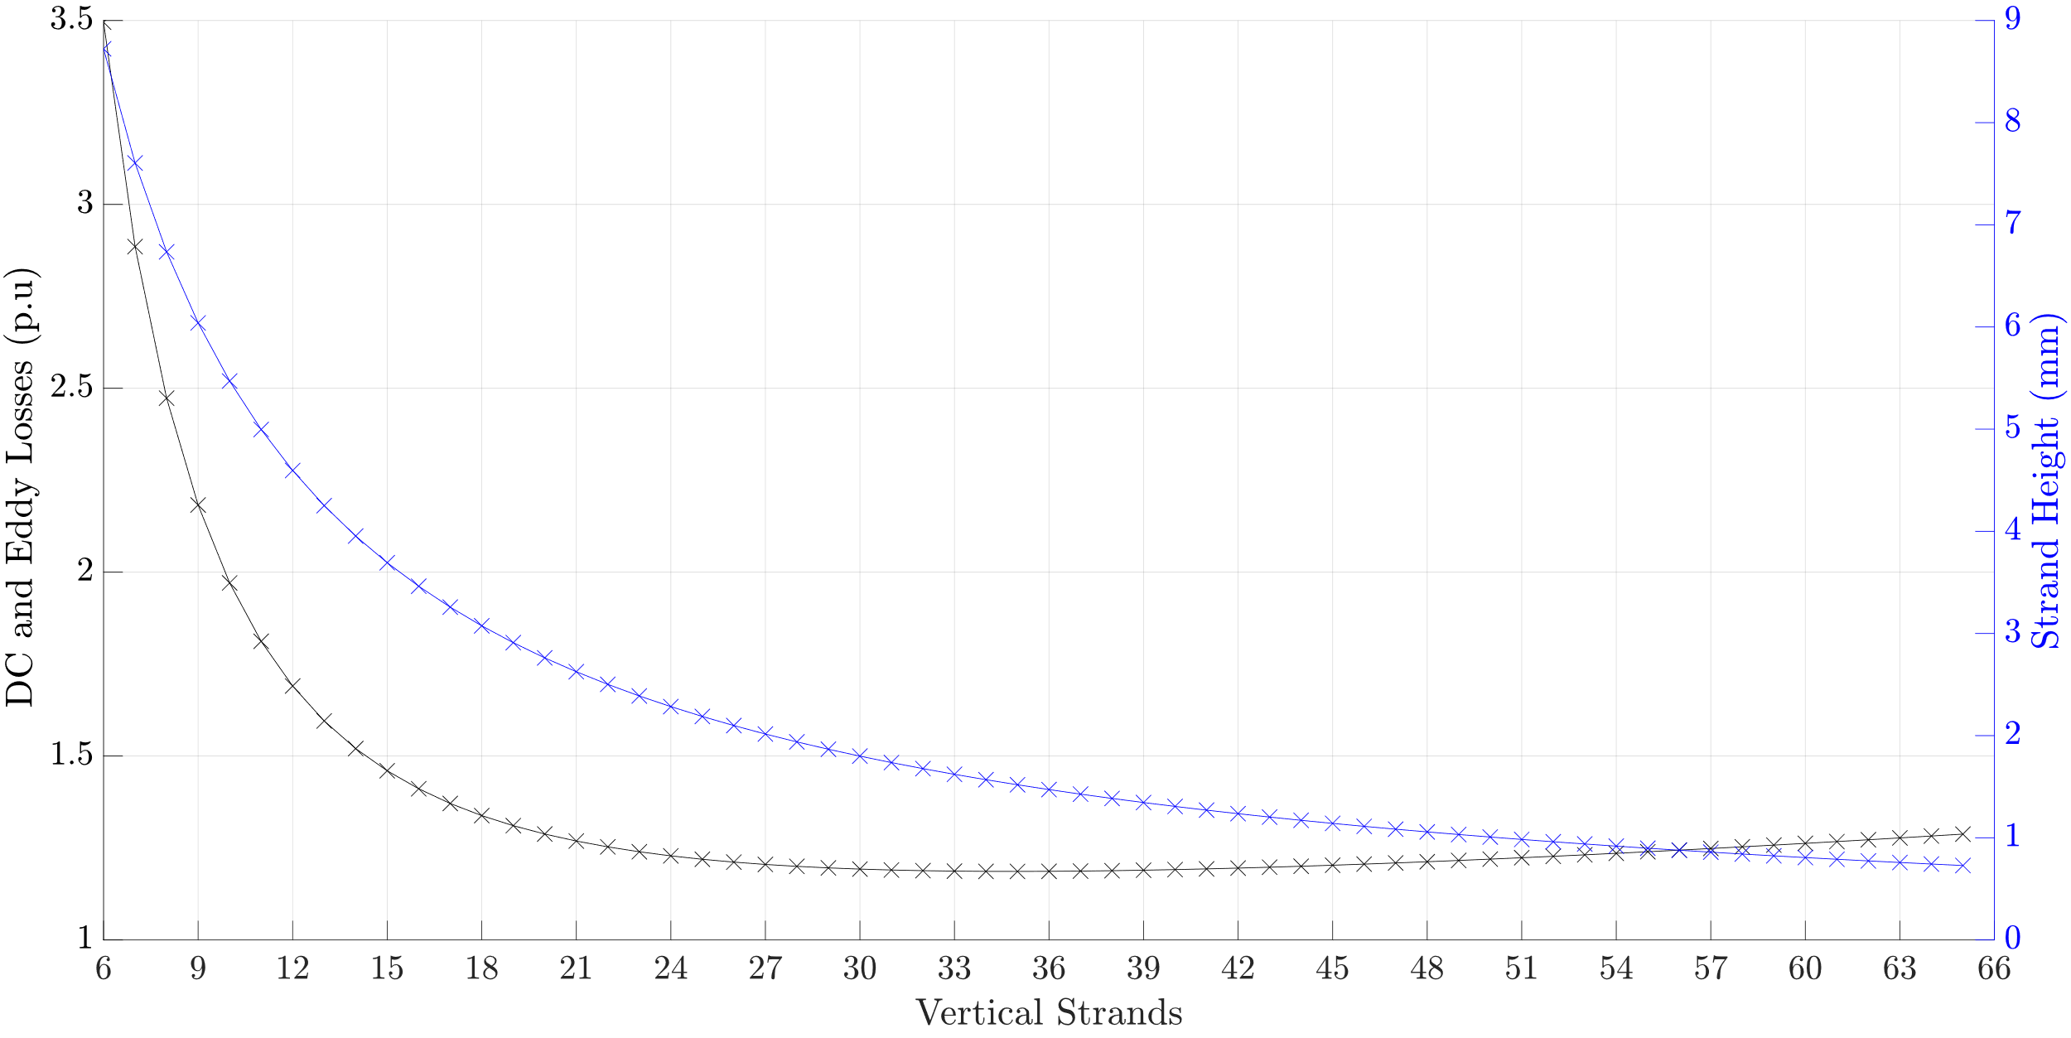
Design of Roebel Bars

Slide 21
Conclusion & Future Work
Refurbishment is important for sustanability
Cheapest way of increasing installed power
Roebel bars are used to cancel circulating currents
As well as reduce AC losses
Future Work: Optimization with different rotor geometries

