Slide 1


Slide 2
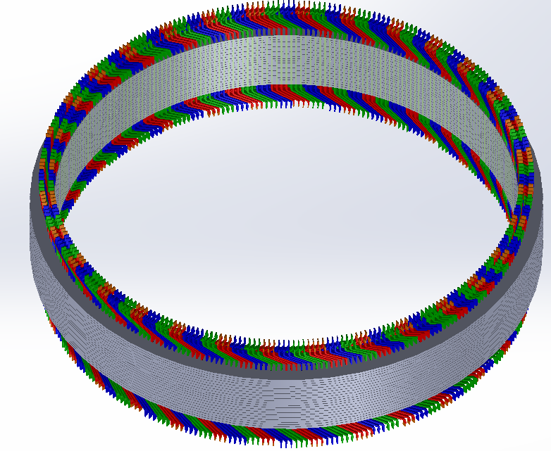
Advanced Design and Optimization in Hydro Generators
M. Samet Yakut
03.10.2023

Slide 3
Outline
Previously
Interactive Link Between MATLAB/ANSYS
Optimization Algorithm
Variables
Constraints
Objective Functions
Penalty
Results
Conclusion
Future Plans

Slide 4


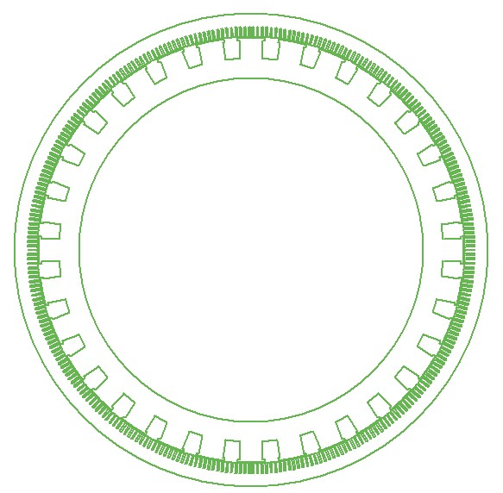
Interactive Link Between MATLAB/ANSYS
No direct connection between MATLAB and ANSYS
VBS is used as medium
MATLAB runs main algorithm
Individuals are written in VBS
VBS runs ANSYS
Simulation results are obtained
Postprocessing is conducted in MATLAB
Variables, Constraints
Individual
Results
Simulation

Slide 5
Optimization Algorithm
Non-dominated Sorting Genetic Algorithm – II is used

Slide 6
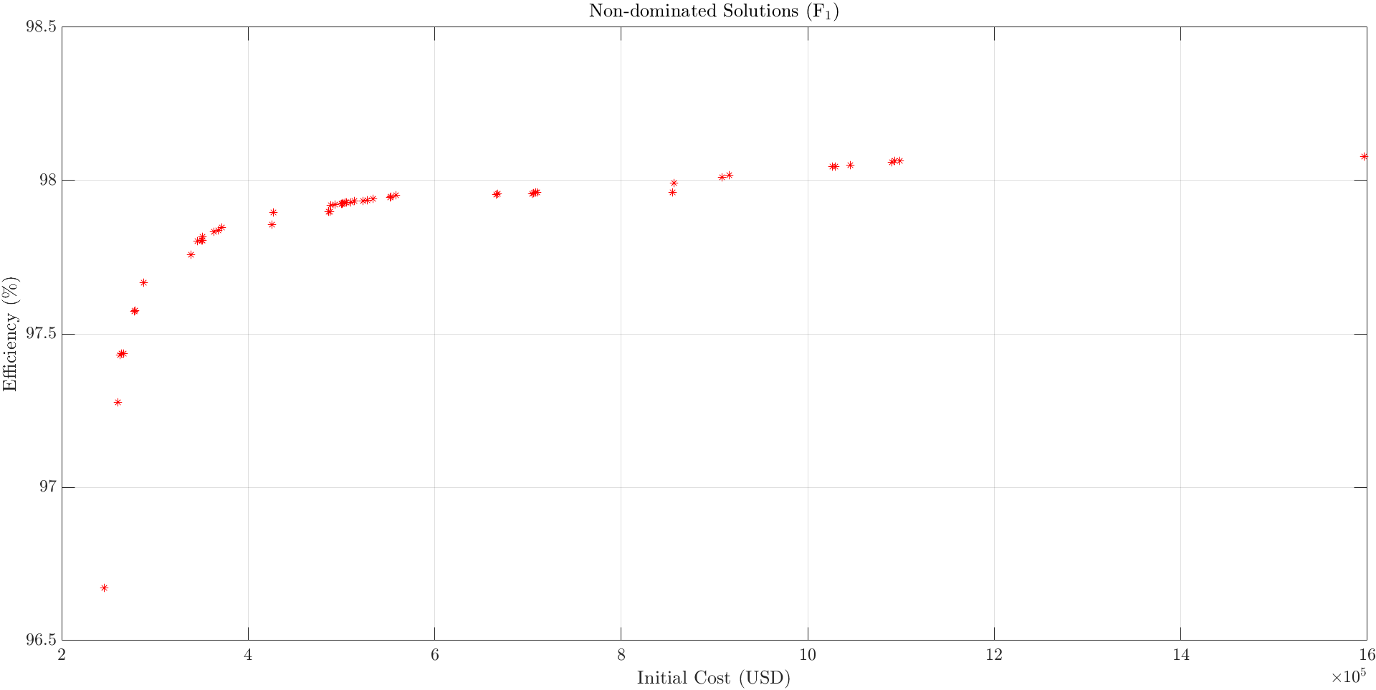
Results
20 Iteration, 150 Population with constant outer diameter

Slide 7
Past Plans
Completing winding design (as well as its alternatives)
Calibration of models
FEA Training Videos (cont.)
Future Plans
Creating manufacturing documents
Eccentricity Analyses
Journal article until end of June
Advanced Design and Optimization

