Slide 1


Slide 2
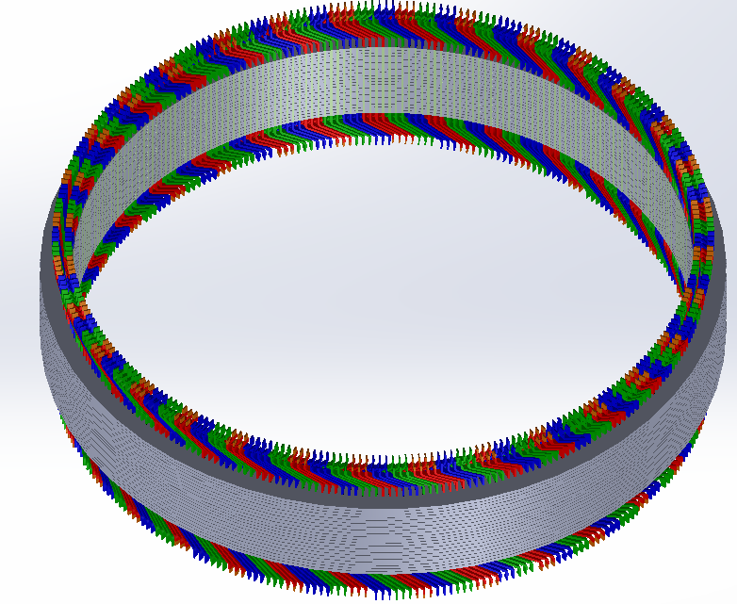
Basis of Advanced Design and Optimization in Hydro Generators
M. Samet Yakut
03.10.2023

Slide 3
Outline
Previously
Interactive Link Between MATLAB/ANSYS
Optimization Algorithm
Variables
Objective Functions
Penalty
Results
Conclusion
Future Plans

Slide 4
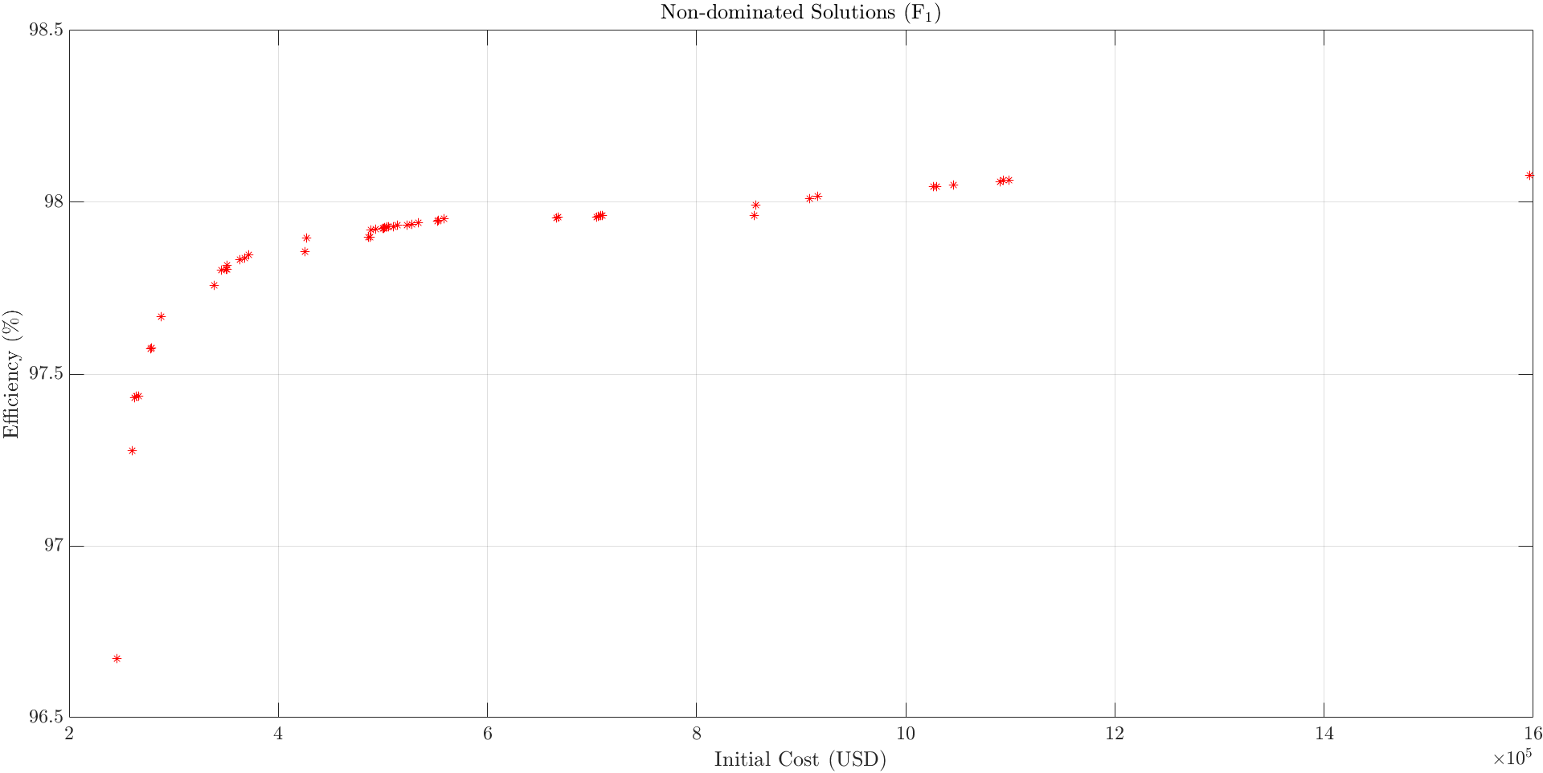
Results
20 Iteration, 150 Population with constant outer diameter

Slide 5
Past Plans
Completing winding design (as well as its alternatives)
Calibration of models
FEA Training Videos (cont.)
Future Plans
Creating manufacturing documents
Eccentricity Analyses
Journal article until end of June
Advanced Design and Optimization

