Slide 1
Problems in 3D-2D Calibration

Slide 2
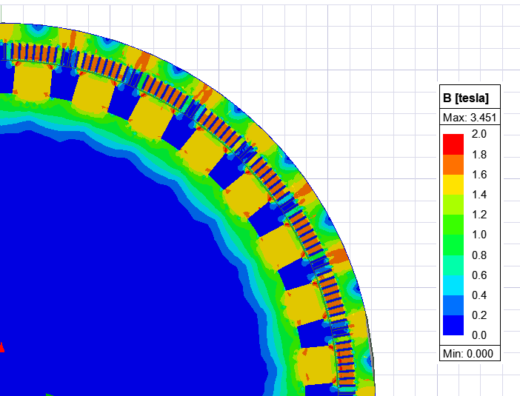
Previous Model

Slide 3
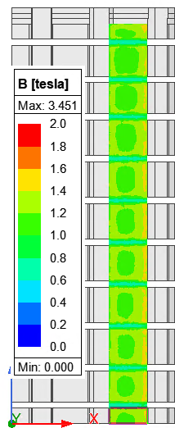
Previous Model
Lamination model was wrong!
There is eddy phenomenon: Difference in B throughout a tooth is quite big (ΔB = 0.7-0.8 T)
Boundary Conditions was wrong: Normal boundaries are used in previous model, which did not meet the symmetry requirements (see Slide 2)

Slide 4
New Model

