Slide 1


Slide 2
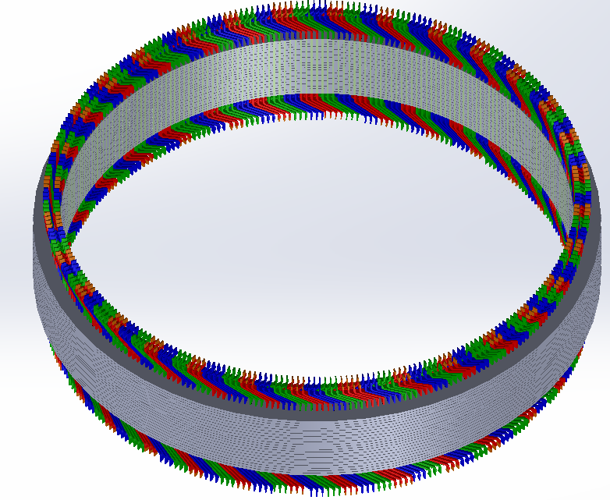
3D/2D FEA Model Calibration and Winding Manufacturing
M. Samet Yakut
12.06.2023

Slide 3
Outline
3D – 2D Model Calibration
Problems Faced
Results
Parametric Winding Modelling
Manufacturing Concerns
Generator Winding Assembly
Past & Future Plans

Slide 4
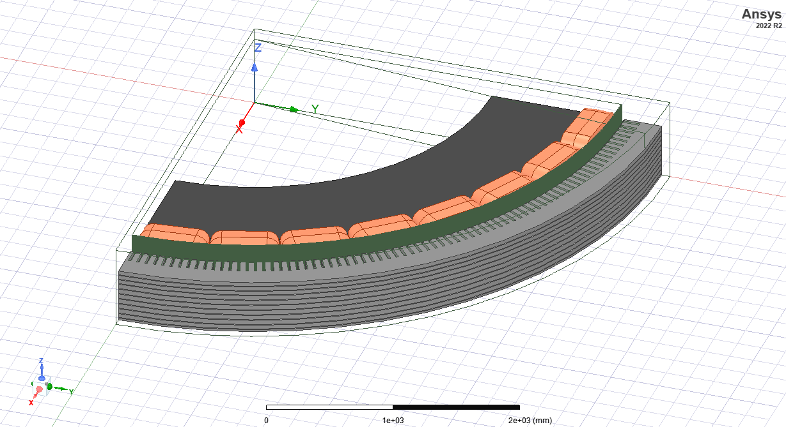
3D – 2D Model Calibration
Magnetostatic
1/8 Model
Lamination Model Included

Slide 5
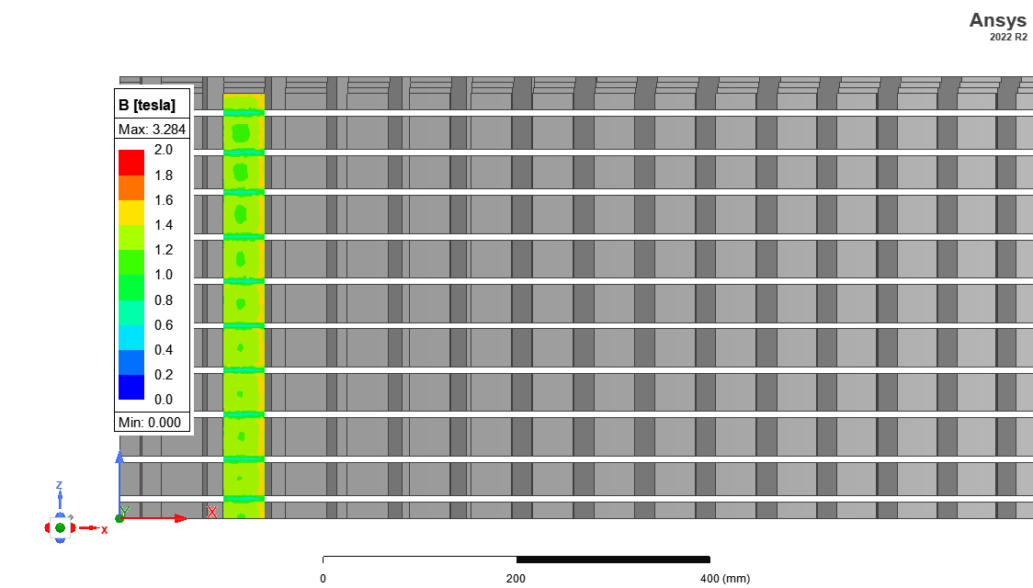
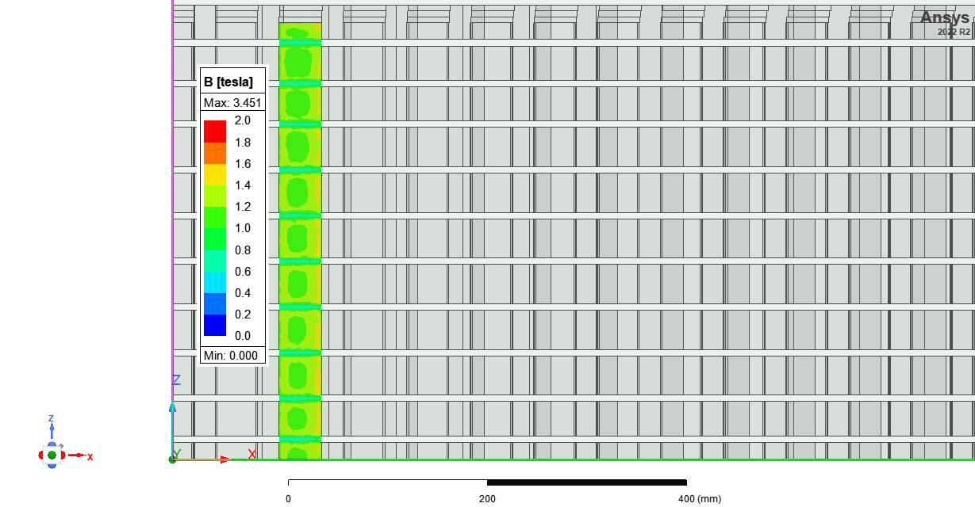
3D – 2D Model Calibration
Conductivity in z – direction is creating large Eddy currents
Eddy currents opposing rotor field
Resulting in smaller B in teeth

Slide 6
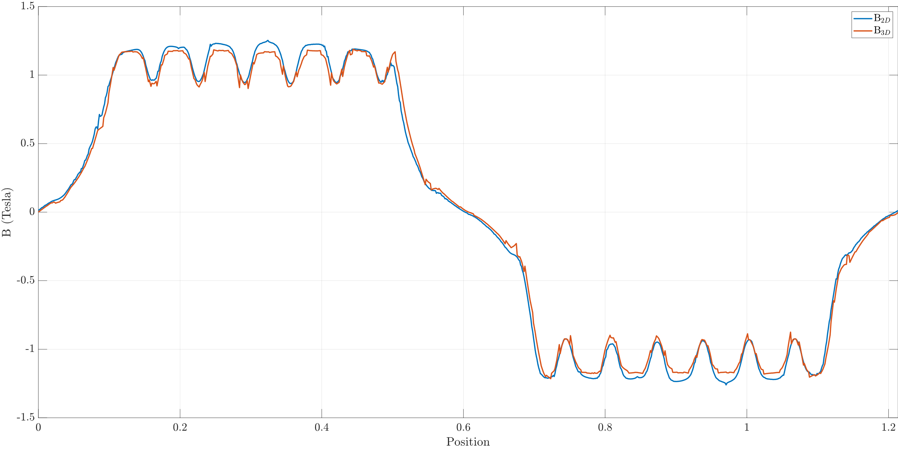
3D – 2D Model Calibration

Slide 7
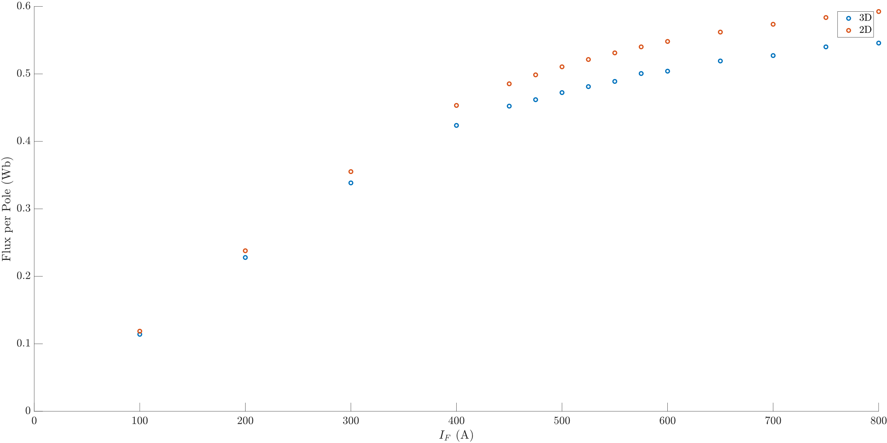
3D – 2D Model Calibration
Model depth in 2D is 913.46 mm
Calibrated model depth is 840 mm

Slide 8
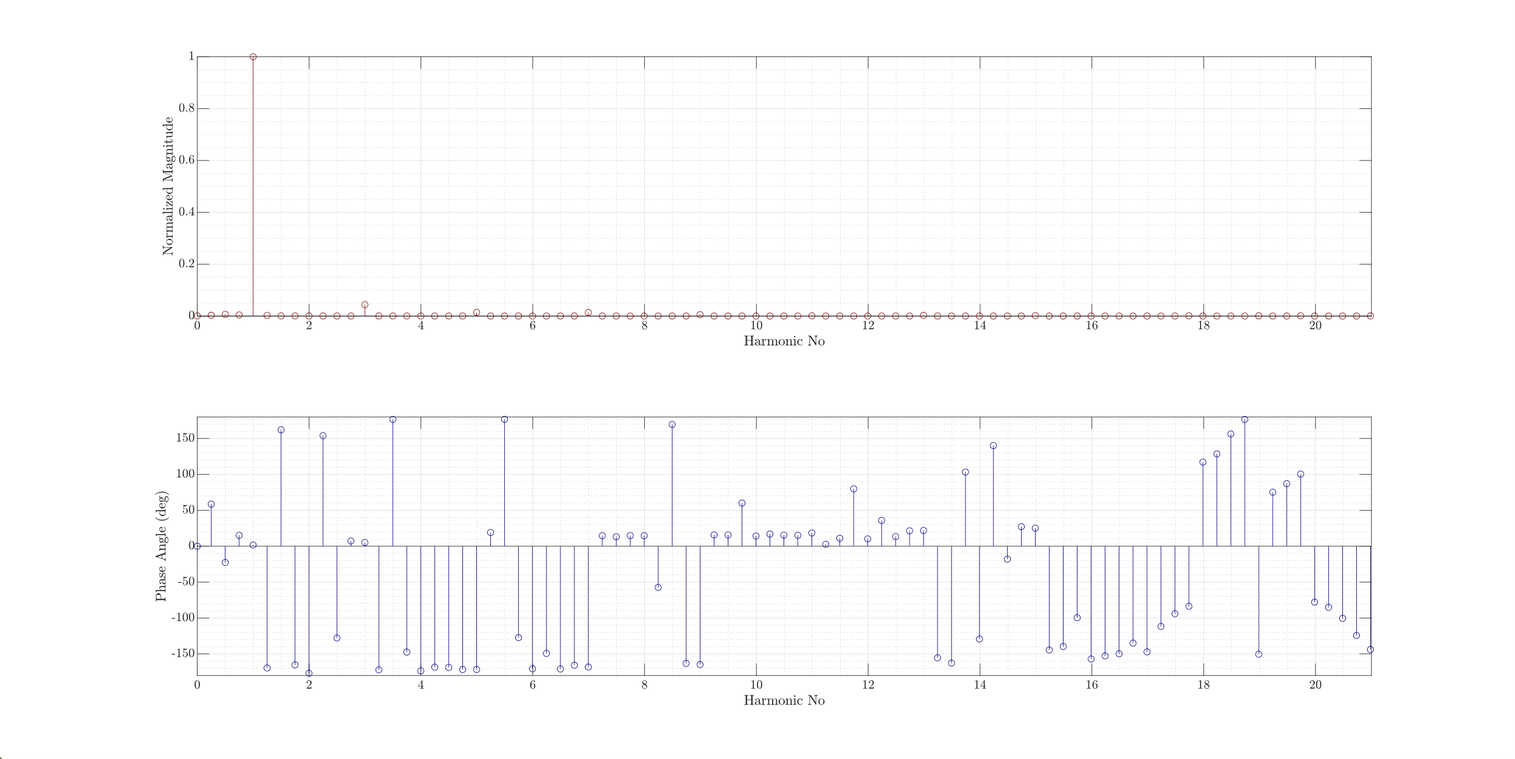
3D – 2D Model Calibration

Slide 9
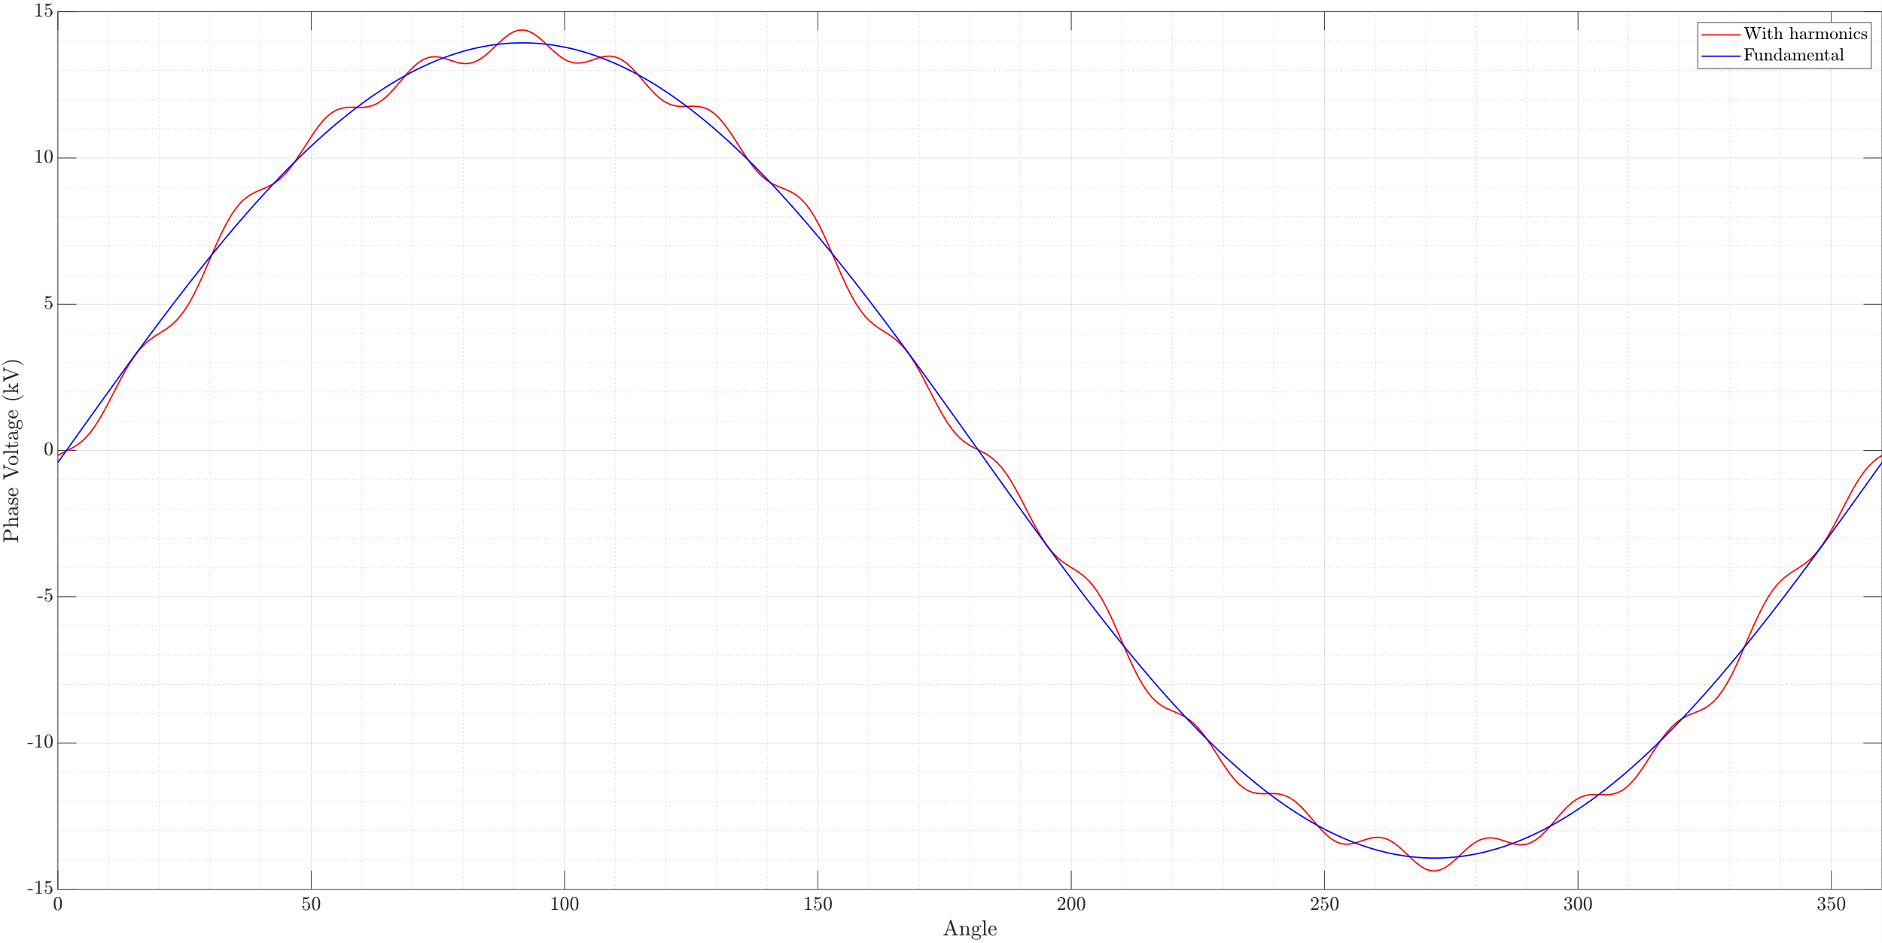
3D – 2D Model Calibration

Slide 10
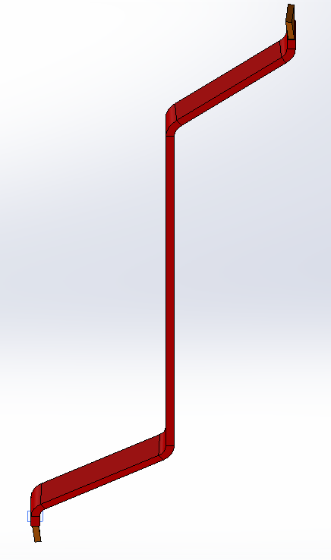
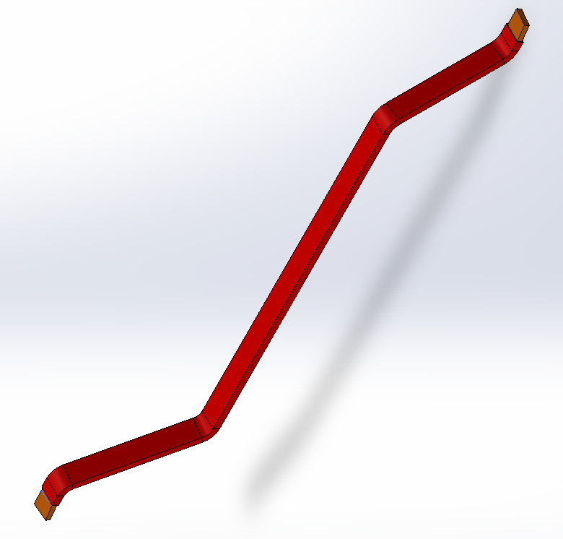
Parametric Winding Modelling

Slide 11
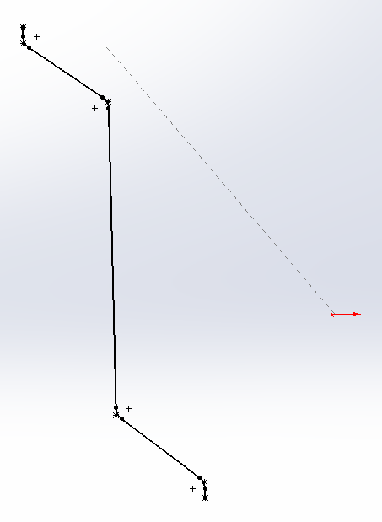
Parametric Winding Modelling

Slide 12
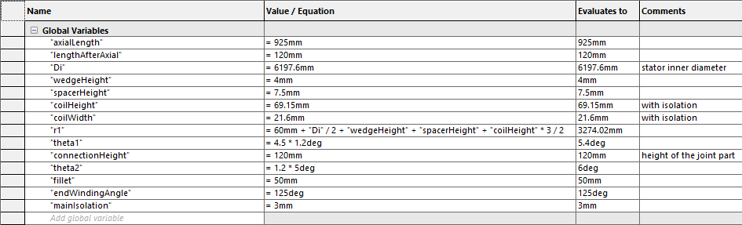
Parametric Winding Modelling

Slide 13
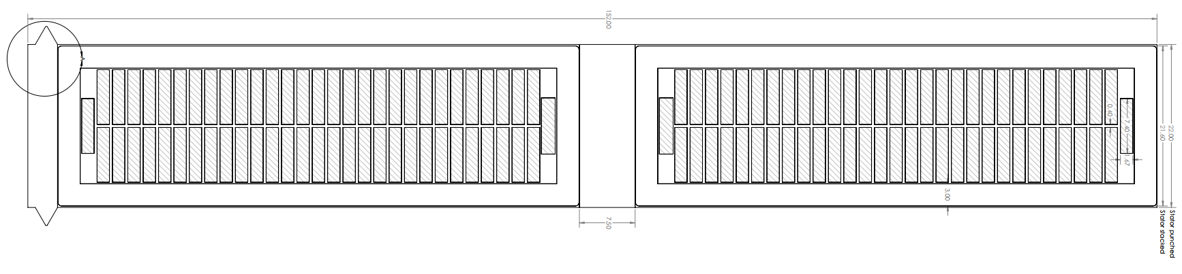
Manufacturing Concerns
Lamination manufacturing tolerance
Spring
Semiconductive Layer: Prevent from slot discharge
Nomex: Between Roebel pairs
Votafix: Between Roebel transpositions

Slide 14
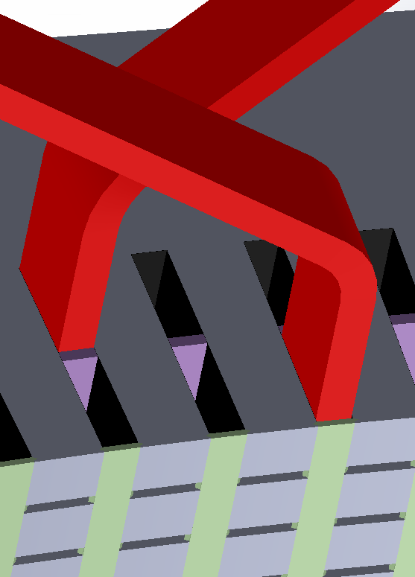
Generator Winding Assembly
Semiconductive Layer
Bottom Coil
Spacer
Wedge
Top Coil

Slide 15
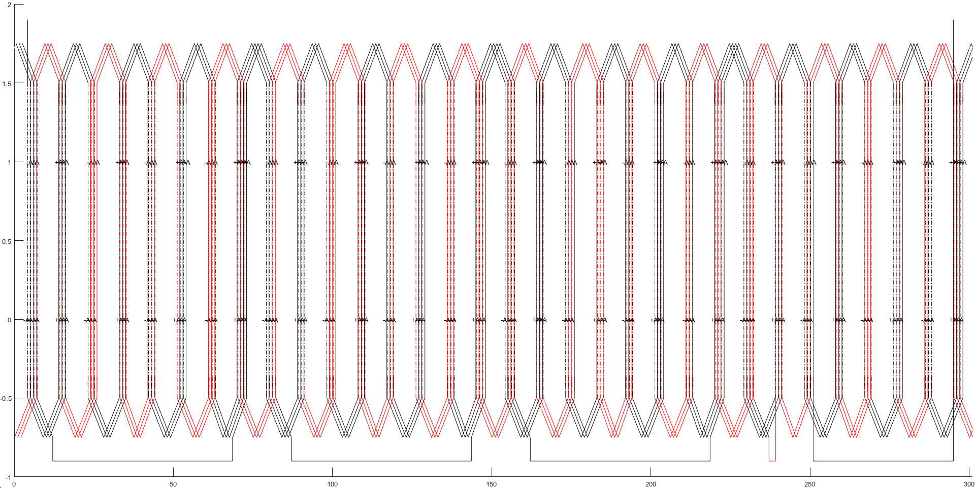
Generator Winding Assembly

Slide 16
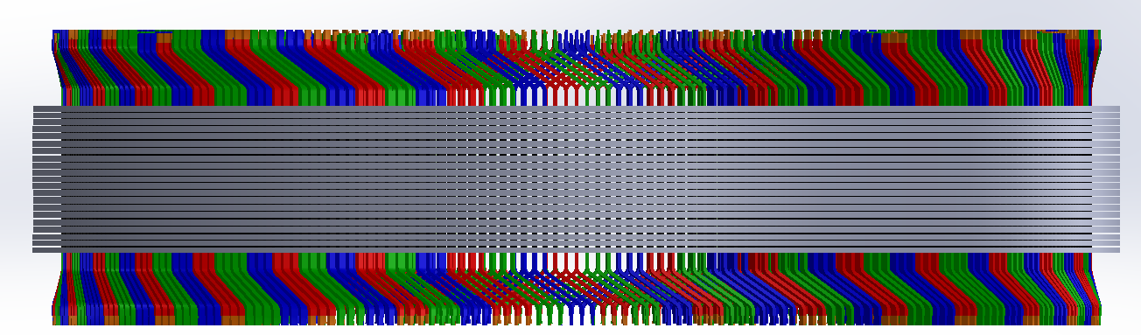
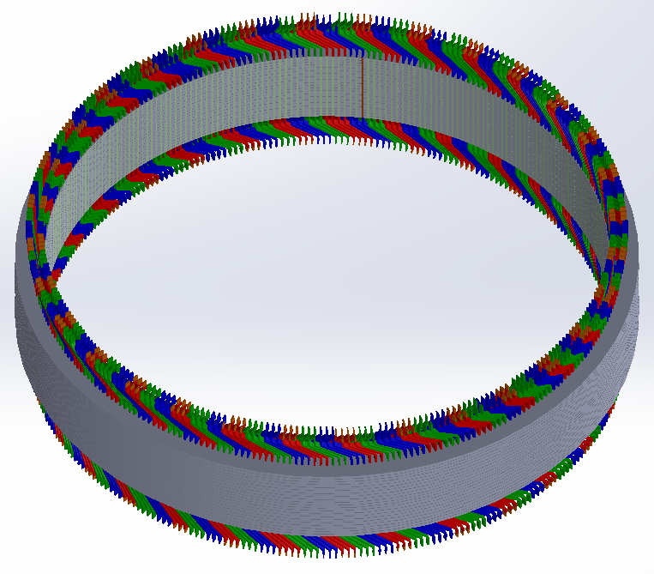
Generator Winding Assembly

Slide 17
Past Plans
Completing winding design (as well as its alternatives)
Calibration of models
FEA Training Videos (cont.)
Future Plans
Creating manufacturing documents
Eccentricity Analyses
Journal article until end of June
Advanced Design and Optimization

