Slide 1


Slide 2
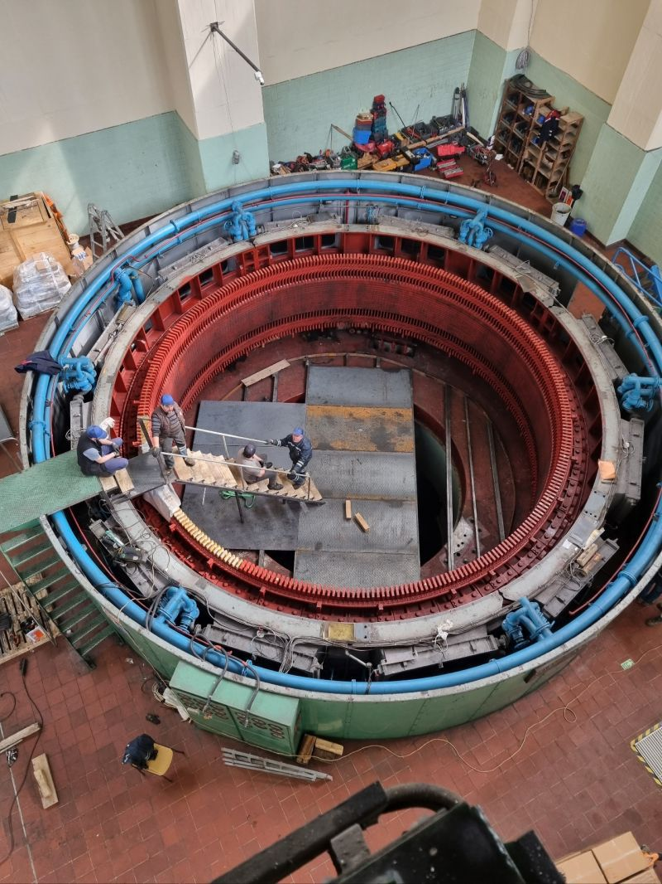
REFURBISHMENT & ALTERNATING WINDING TYPE OF A 44 MVA HYDRO GENERATOR
M. Samet YAKUT
Advisor: Assoc. Prof. Ozan Keysan
November 23, 2023
EE590 Seminar, METU EE Dep.

Slide 3
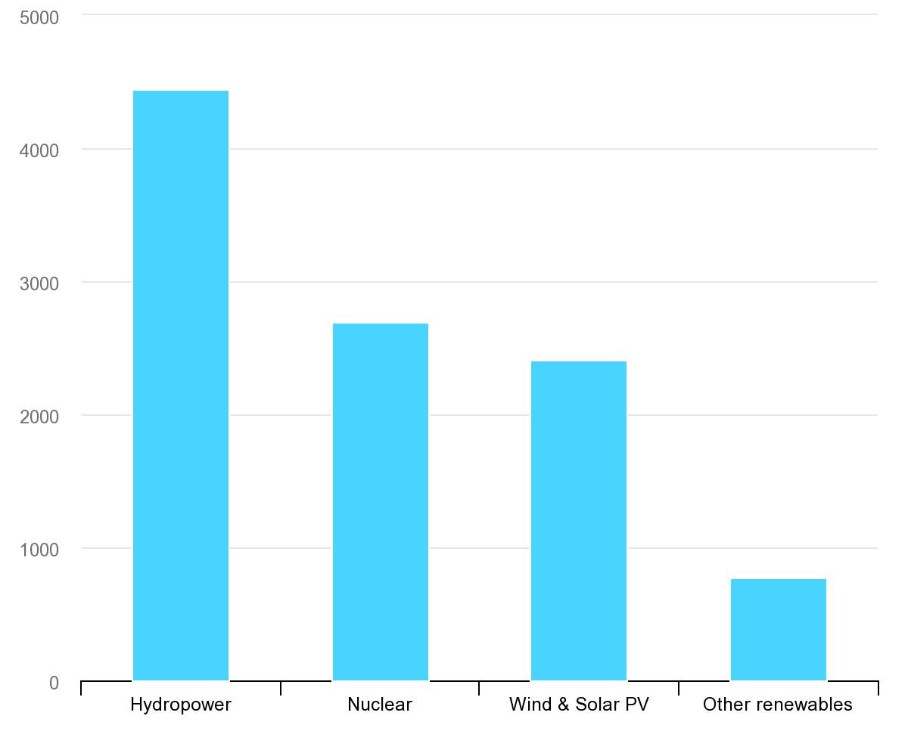
TWh
Largest low-carbon electricity generation technology is hydropower ^{[1]}
IEA, Low-carbon electricity generation by technology, 2020, IEA, Paris https://www.iea.org/data-and-statistics/charts/low-carbon-electricity-generation-by-technology-2020, IEA. Licence: CC BY 4.0
Notes:
The importance of the hydro generators arises from the fact that the largest low carbon electricity source is the hydro power according to a research conducted in 2020 by International Energy Agency. The installed capacity of the hydro power is more than 4000 TWh which is higher than the total installed capacity of the other renewable energy resources.

Slide 4
Outline
Introduction
Basic Terms & Definitions
Refurbishment Process
Optimization
Design of Roebel Bars
Conclusion
Notes:
Here is my outline. I will first start with introduction by defining the basic terms. Then, I will move on to the refurbishment process. I will talk about the optimization methodology used in refurbishment and design of windings. Afterwards, I will conclude my presentation.

Slide 5
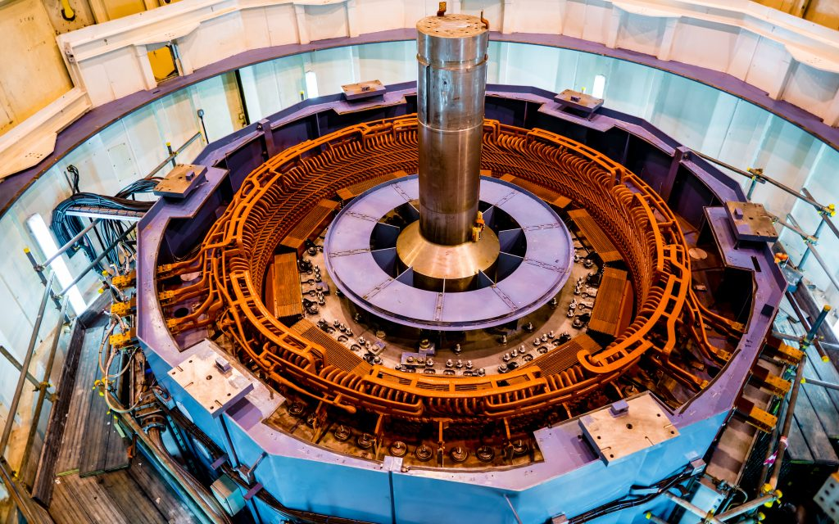
Hydro Generators
Salient pole synchronous machines
High voltage stator
Tens of kVA to hundreds of MVA
Notes:
Hydro generators are large scale salient pole synchronous machines. Their outer diameter may reach the order of 10s of meter depending on the output power. They are composed of rotating part that creates magnetic field and a high voltage stator where the voltage is induced and power is sent to the grid. Their power ratings are varying between tens of kVA to hundreds of MVA. For example, focus of this research is a 44 MVA hydro generator located in Sarıyar, Ankara. Let me define the refurbishment and its importance.

Slide 6
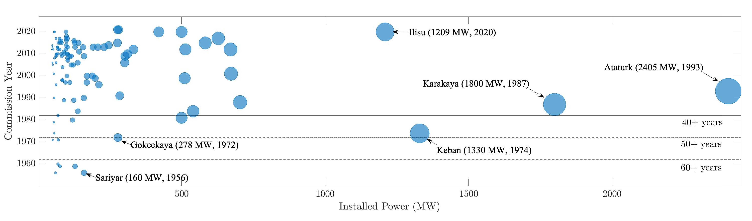
Refurbishment
Installed capacity older than 30 years: 6205 MWs
which accounts for 31.9% of large hydro generators
Most old generators are over – designed
cheapest way of increasing installed power
N. Tosun, G. Gülletutan, M. S. Yakut, D. Alp Yilmaz, Ö. Bayer and O. Keysan, "Winding Type Alternation of a Refurbished Old Generator," 2023 IEEE Workshop on Electrical Machines Design, Control and Diagnosis (WEMDCD), Newcastle upon Tyne, United Kingdom, 2023, pp. 1-6, doi: 10.1109/WEMDCD55819.2023.10110941.
Notes:
Refurbishment is nothing but re-producing the installed hydro generator because of its age and/or increasing installed power. If the output power is kept same during the refurbishment, it is called upgrading. If the power is increased, then it is called uprating. Generators older than 30 years may be refurbished depending on their condition. The importance of the refurbishment can be understood from two facts: first one is nearly 6.2 GW of installed power in Turkey, accounts for 31.9% of the installed large hydro generators, is older than 30 years which may need refurbishment depending on the condition. The second one is that older generators are generally over-designed, which means the output power can be increased with small changes. This gives us the opportunity to increase installed power more cheaper. The second main focus of this research is alternating the winding type. So, let us define the winding types and their properties.

Slide 7
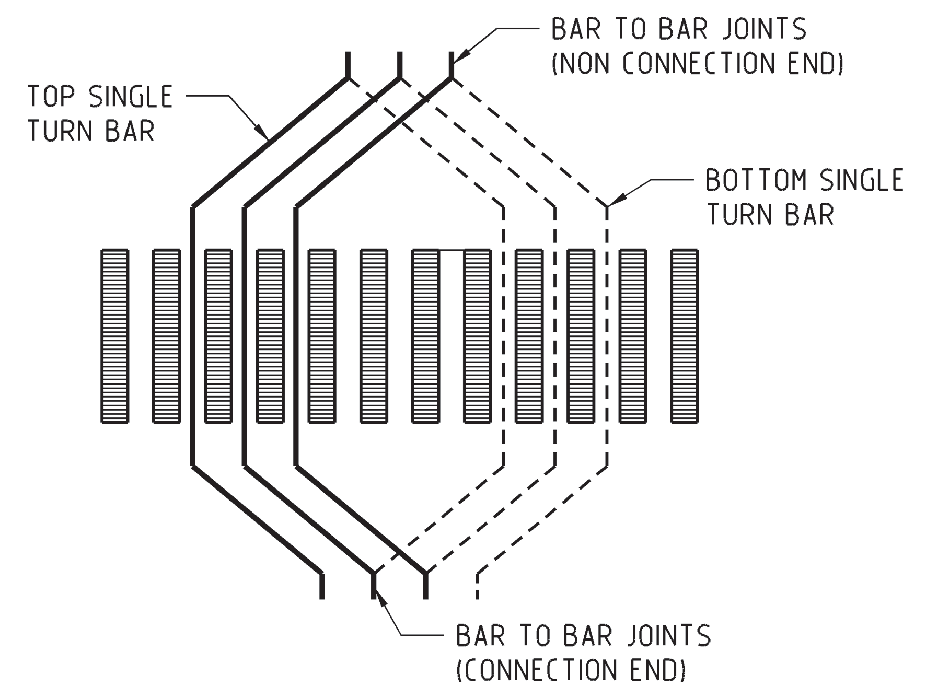
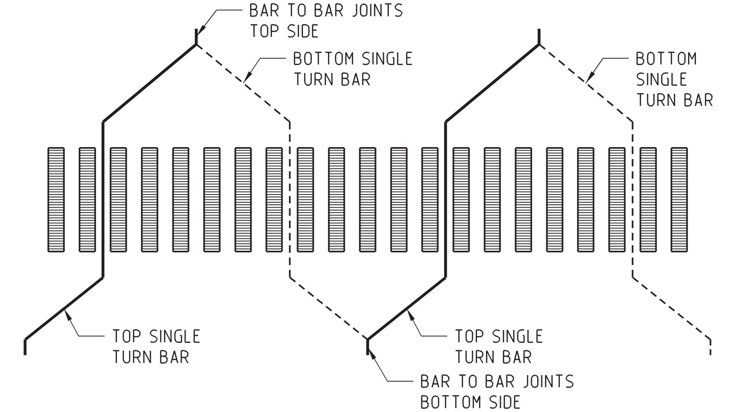
Winding Types
Lap Winding Wave Winding
M.M. Znidarich (2008) Hydro Generator High Voltage Stator Windings: Part 1 – Essential Characteristics and Degradation Mechanisms, Australian Journal of Electrical and Electronics Engineering, 5:1, 1-17, DOI: 10.1080/1448837X.2008.11464196
Notes:
There are two types of windings used in hydro generators, which are lap and wave windings. As the names imply the lap windings are closed turned windings whereas the wave windings are open turned. From the figure, it is easily seen that wave windings are seem like sea waves where the name comes from. Both types of windings are composed of a number of strands to eliminate the skin effect and reduce the losses. This will be covered in the upcoming slides. Lastly, mentioning that there is no electromagnetical difference between those windings, let us move to the properties of those windings.

Slide 8
Winding Types
Wave Winding
Less outage duration
Simple end connection
Low number of external connections
Lap Winding
Simple winding schematic design
Less type of coils
Allows bypass
Notes:
Both types have advantages and disadvantages. The choice is depending on the production habits of the related company. Generally, Europe is familiar with wave windings whereas the America with lap windings. The most important advantage of wave windings on the lap windings is the less outage duration. During a fault, workers need to disassemble less coils when compared to the lap windings. However, in terms of design of winding schematic, lap windings are more advantegous choice. Last but not least wave windings offer low number of external connection during assemblying of the generator. Being sad those, let us define the problem under concern.

Slide 9
Wave Winding |  | Lap Winding
Advantage | Disadvantage | Advantage | Disadvantage
Less outage duration | Complicated design | Simple winding schematic design | Complicated end connections
Simple end connection | Generally requires more coil types | Less type of coils | More outage time
Low number of external connection | Longer average winding pitches, therefore longer end windings | Allows bypass | Sophisticated production

Slide 10
Problem Definition
Refurbishment of an old 44 MVA hydro generator by changing winding type from lap to wave
Constraints
Constant outer diameter
Same rotor geometry
Challenge
Increasing efficiency
Notes:
The problem of this research topic is the alternating winding type of a large hydro generator during refurbishment. The installed generator is lap winding and operator wants to change the winding type to the wave windings due to production habits as previously mentioned. There are two constraints that operator mentioned: the first one is the keeping the outer diameter constant and rotor geometry same. The challenging part is the increasing efficiency by sticking those constraints because conventionally as the machine starts to get larger, its power and efficiency are increasing. This challenge will be the concern of the optimization.

Slide 11
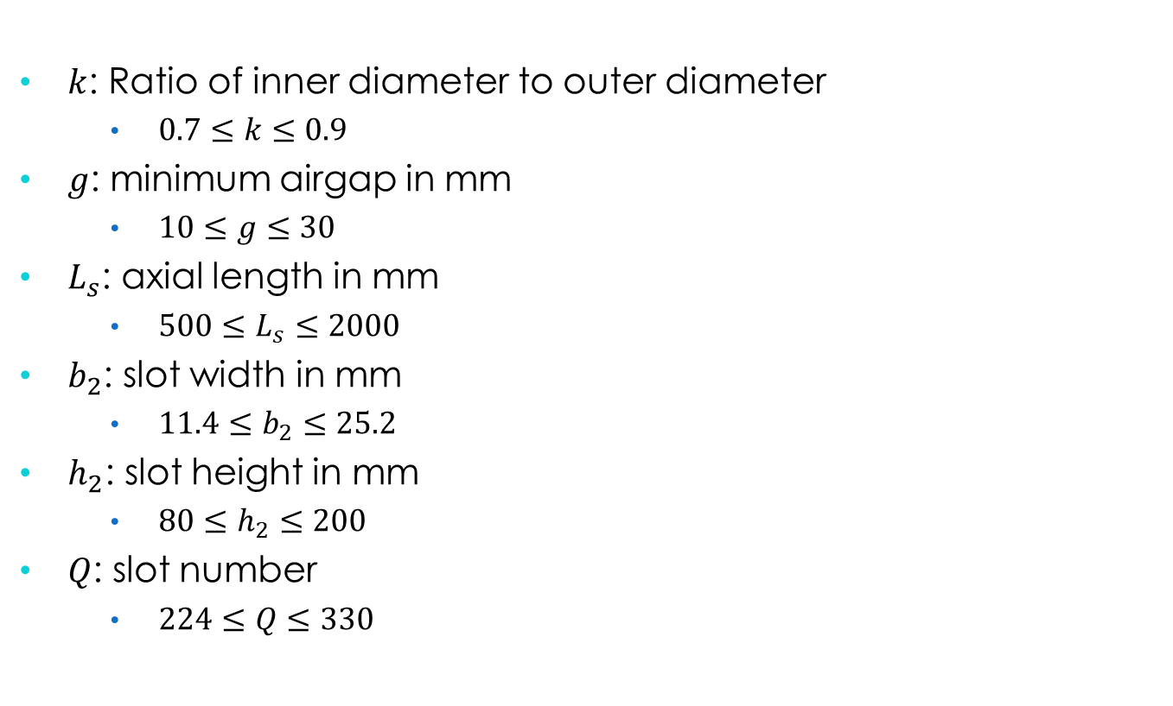
Optimization: Variables
$k$: Ratio of inner diameter to outer diameter
$0.7≤k≤0.9$
$g$: minimum airgap in mm
$10≤g≤30$
$L_{s}$: axial length in mm
$500≤L_{s}≤2000$
$b_{2}$: slot width in mm
$11.4≤b_{2}≤25.2$
$h_{2}$: slot height in mm
$80≤h_{2}≤200$
$Q$: slot number
$224≤Q≤330$
Notes:
Non dominated sorting genetic algorithm – II will be used for optimization process. The variables of the optimization is nothing but geometry of the machine. Our variables are a constant k, which is the ratio of inner diameter to outer diameter, airgap length between stator and rotor, axial length of the machine, slot dimensions both depth and opening, and finally number of slots. The maximum and minimum values of those parameters are selected such that the impossible geometries are filtered to save time. Remaining part for optimization is defining objective functions, constraints and penalty functions.

Slide 12
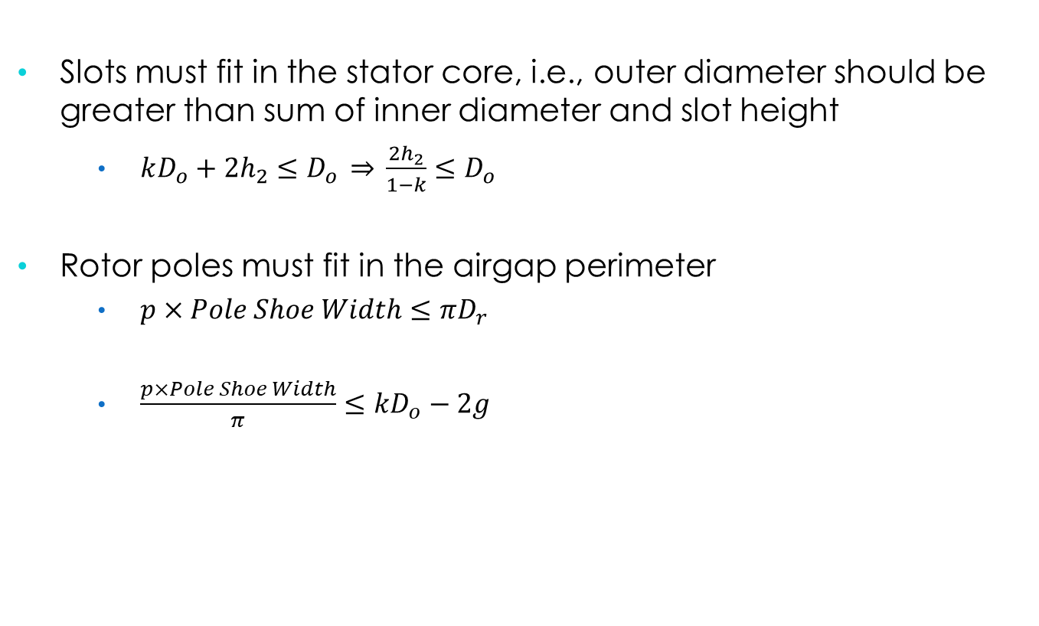
Optimization: Constraints
Slots must fit in the stator core, i.e., outer diameter should be greater than sum of inner diameter and slot height
$kD_{o}+2h_{2}≤D_{o} \underset{⇒}{} \frac{2h_{2}}{1−k}≤D_{o}$
Rotor poles must fit in the airgap perimeter
$p×Pole Shoe Width≤πD_{r}$
$\frac{p×Pole Shoe Width}{π}≤kD_{o}−2g$

Slide 13

Optimization: Objective Function
Objective functions are
Initial cost
$f_{1} (k,g,L_{s},b_{2},h_{2},Q)={(m}_{steel} C_{steel}+m_{copper} C_{copper})×2.5$
Efficiency
$f_{2} (k,g,L_{s},b_{2},h_{2},Q)=η=\frac{P_{out}}{P_{in}} ×100$
Subject to
$\frac{2h_{2}}{1−k}≤D_{o}$
$\frac{p×Pole Shoe Width}{π}≤kD_{o}−2g$
Notes:
There are two objective functions for the optimization algorithm. The first one is the initial cost of installation of the machine. This is calculated via the steel and copper mass with wastage. To include the cost of other equipments and labor work, the material cost is multiplied with 2.5. The second objective function is the efficiency of the machine, and it is output of the simulation. One important thing is that AC losses in the windings are neglected for now. The constraints are calculated from the geometrical rules. In other words, rotor must fit in the stator. This is the only constraint. Other than that, there exists a penalty function which is defined to ensure the stability of the generator.

Slide 14

Optimization: Penalty Function
SCR should not be less than 0.8
Hence
$p(k,g,L_{s},b_{2},h_{2},Q)=\left\{\begin{aligned}A{\left(\frac{1}{SCR}\right)}^{4}=A{\left(X_{d,pu}\right)}^{4}, if SCR<0.8 \\ 0, otherwise\end{aligned}\right.$
where A is a very large number compared to initial cost
Glenn Mottershead; Stefano Bomben; Isidor Kerszenbaum; Geoff Klempner, "OPERATION AND CONTROL," in Handbook of Large Hydro Generators: Operation and Maintenance , IEEE, 2021, pp.177-240, doi: 10.1002/9781119524205.ch4.
Notes:
Our penalty function is actually limiting the short circuit ratio. SCR is a metric of stability of the generator, and it is the inverse of the generator characteristic impedance. It is a very important parameter because it directly determines the short circuit fault currents of the generator. There exist a lower limit for SCR due to stability, which is around 0.8. Algorithm takes the variables and creates the candidates. Simulate them and process the cost and penalty. The only remaining thing is the running the algorithm and taking the results.

Slide 15
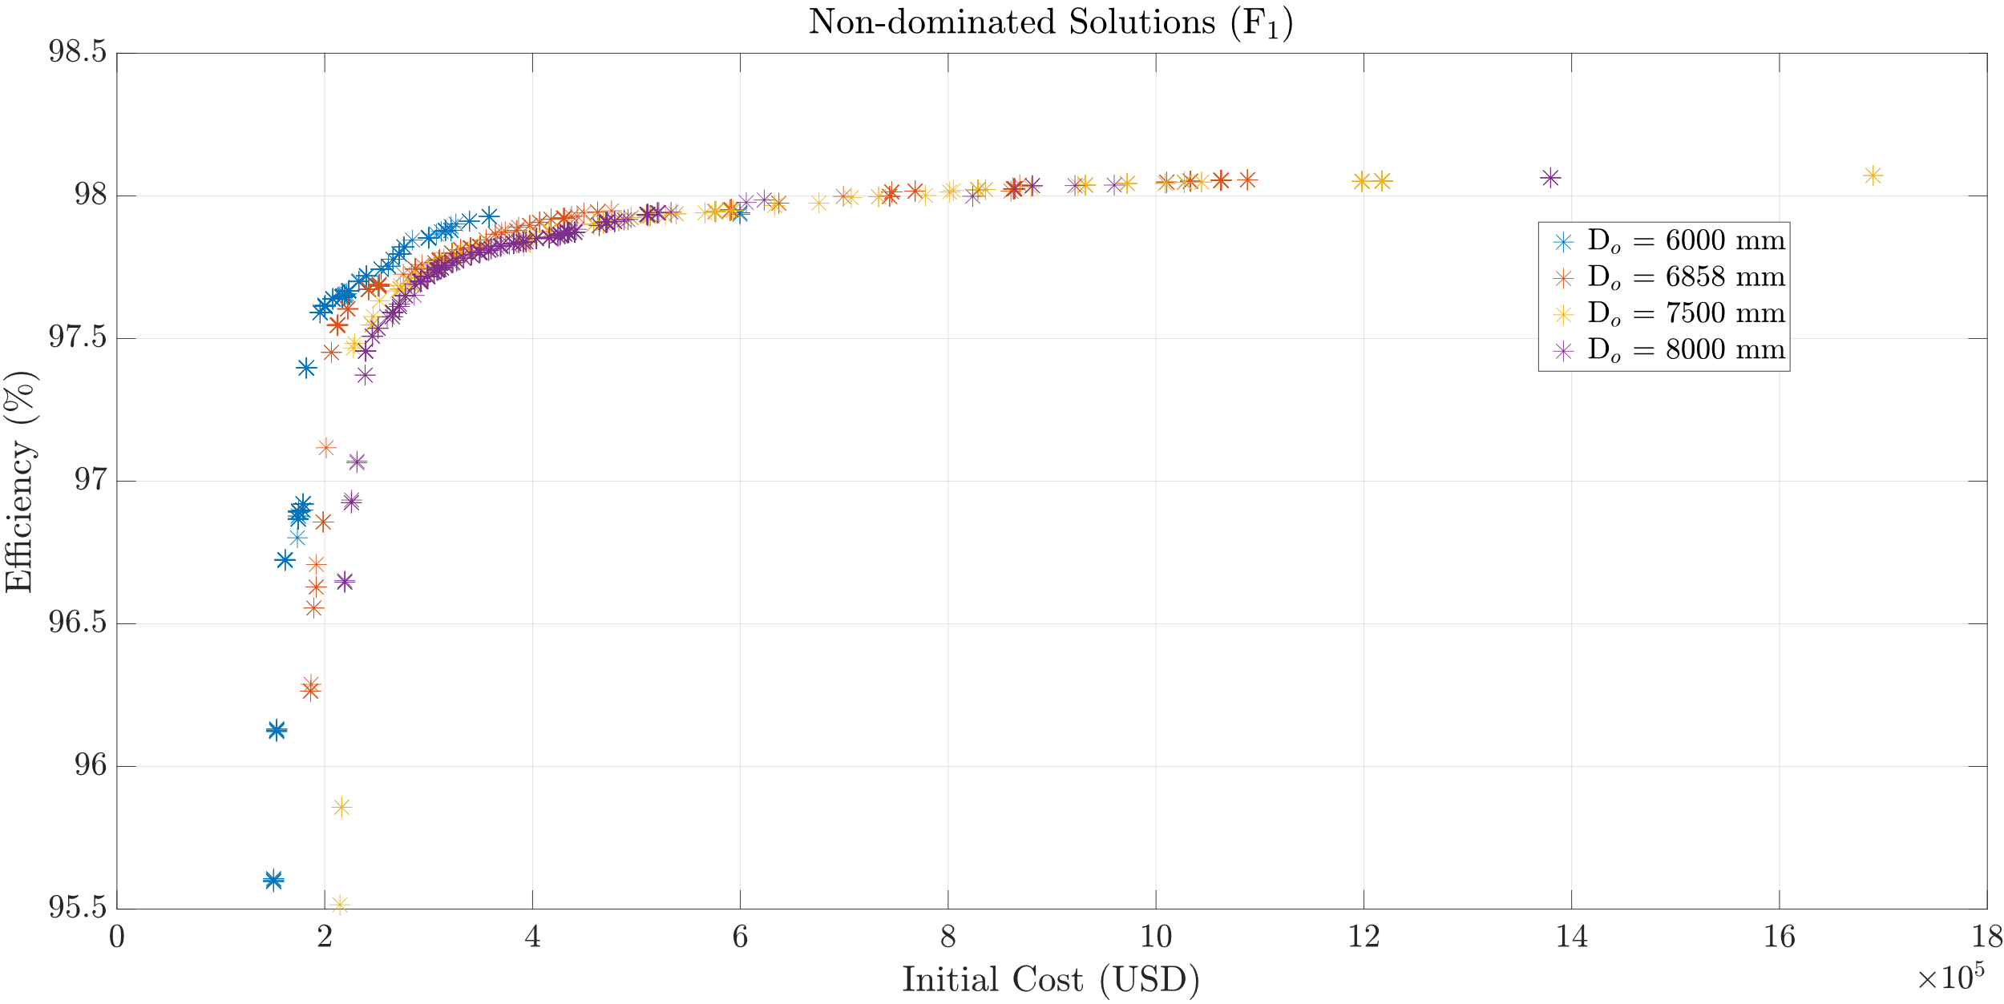
Optimization: Results
Notes:
As previously mentioned, the algorithm is run for different outer diameters and results are shown here. 6858 mm is the nominal outer diameter. The results show that if there is not 98% efficiency constraint, there is no need to increase the outer diameter. The same efficiency can be reached with nominal diameter with less cost. However, to reach a certain efficiency levels such that 98.1 98.2%, we need to increase the outer diameter to reach that values. The remaining part is to design the windings to reduce the AC losses. For that purpose, we are utilizing Roebel transposition.

Slide 16
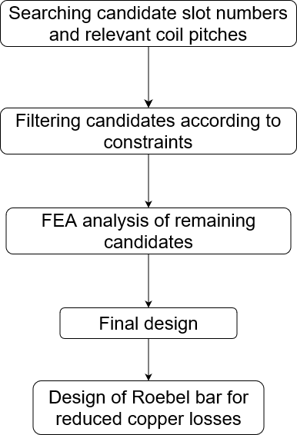
Design Methodology
Old Generator | Final Design
240 Slots | 300 Slots
Lap Winding | Wave Winding
Same rotor geometry, air gap, and outer diameter

Slide 17
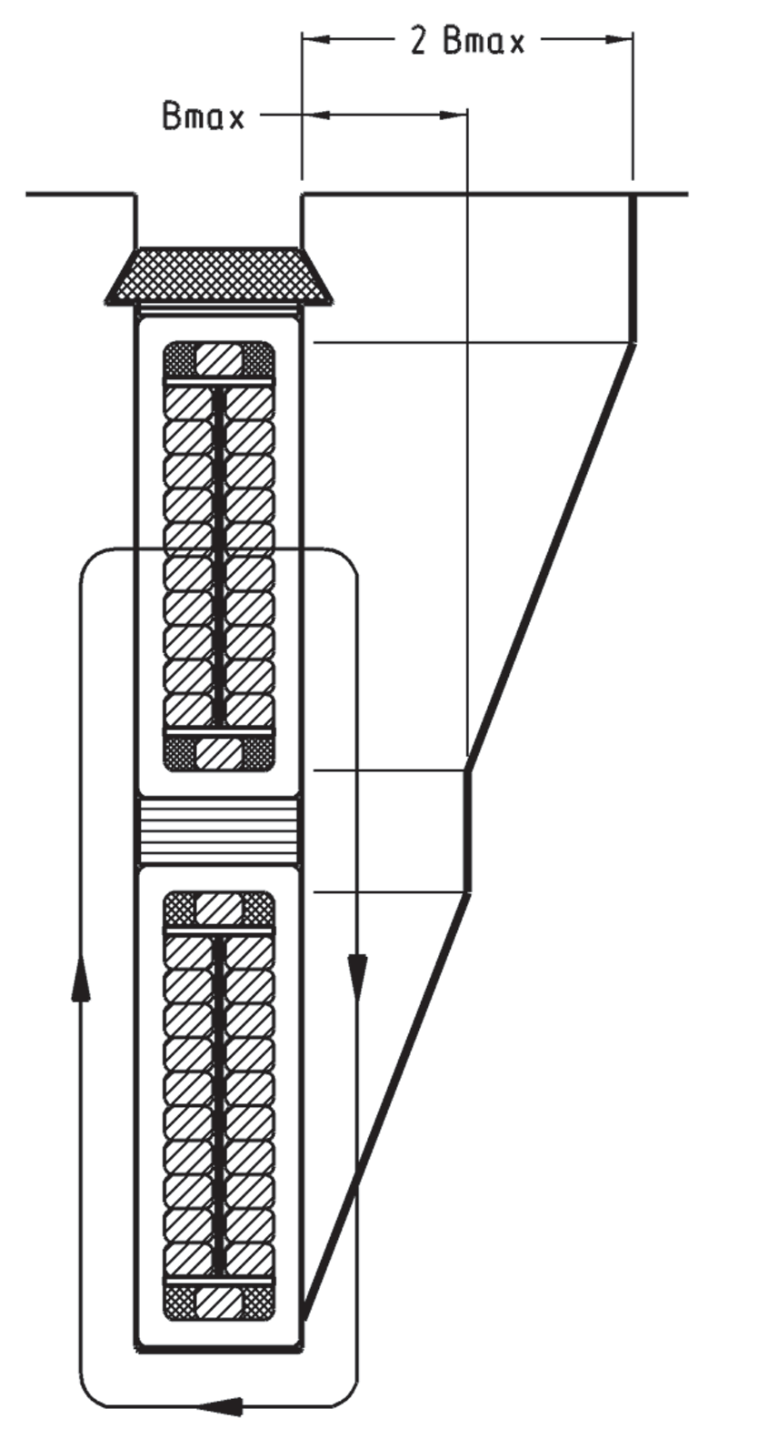
Roebel Bars
Different induced voltages in each strand
Circulating currents
Eddy losses
Notes:
Due to the leakage flux throughout the slot, the induced voltages in each strand is different. Hence, circulating currents are present and cause extra losses in the windings. Roebel transposition is used to minimize these losses.

Slide 18
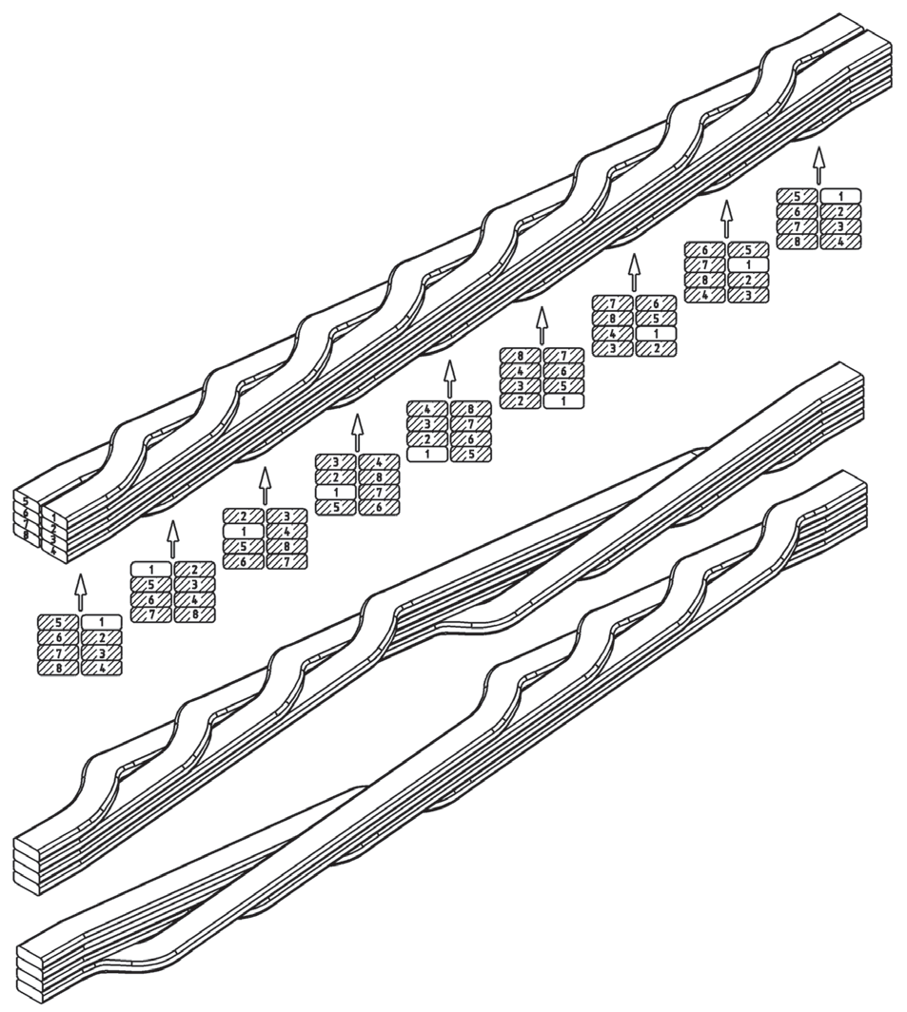
Roebel Bars
Single turn coils
Composed of multiple strands to reduce AC losses
Transposition is applied to minimize circulating currents
Notes:
Roebel bars are composed of a number of strands, and they are single turn coils. The transposition is applied to minimize eddy and circulating currents. The transposition is defined with an angle such that if the transposition is 360 degree, the strands are transposed in a way that figure shows. There are 180, 540 and 720 degree transpositions as well but 360 degree is the common practice in hydro generators. The larger values are used in turbo generators.

Slide 19
Design of Roebel Bars
Selection of strand number
Selection of transposition angle
Limitations:
Axial length
Material strength
Notes:
The applicable minimum number of strands are determined by the skin depth of the copper. However, maximum number is limited by the transposition angle and axial length. To find an optimum value in between them, the slot leakage flux is calculated for different number of strands and at each strand number AC resistance and losses are calculated as well as DC losses. The optimum point is selected via the obtained results. Let us look at the results of a case study.

Slide 20
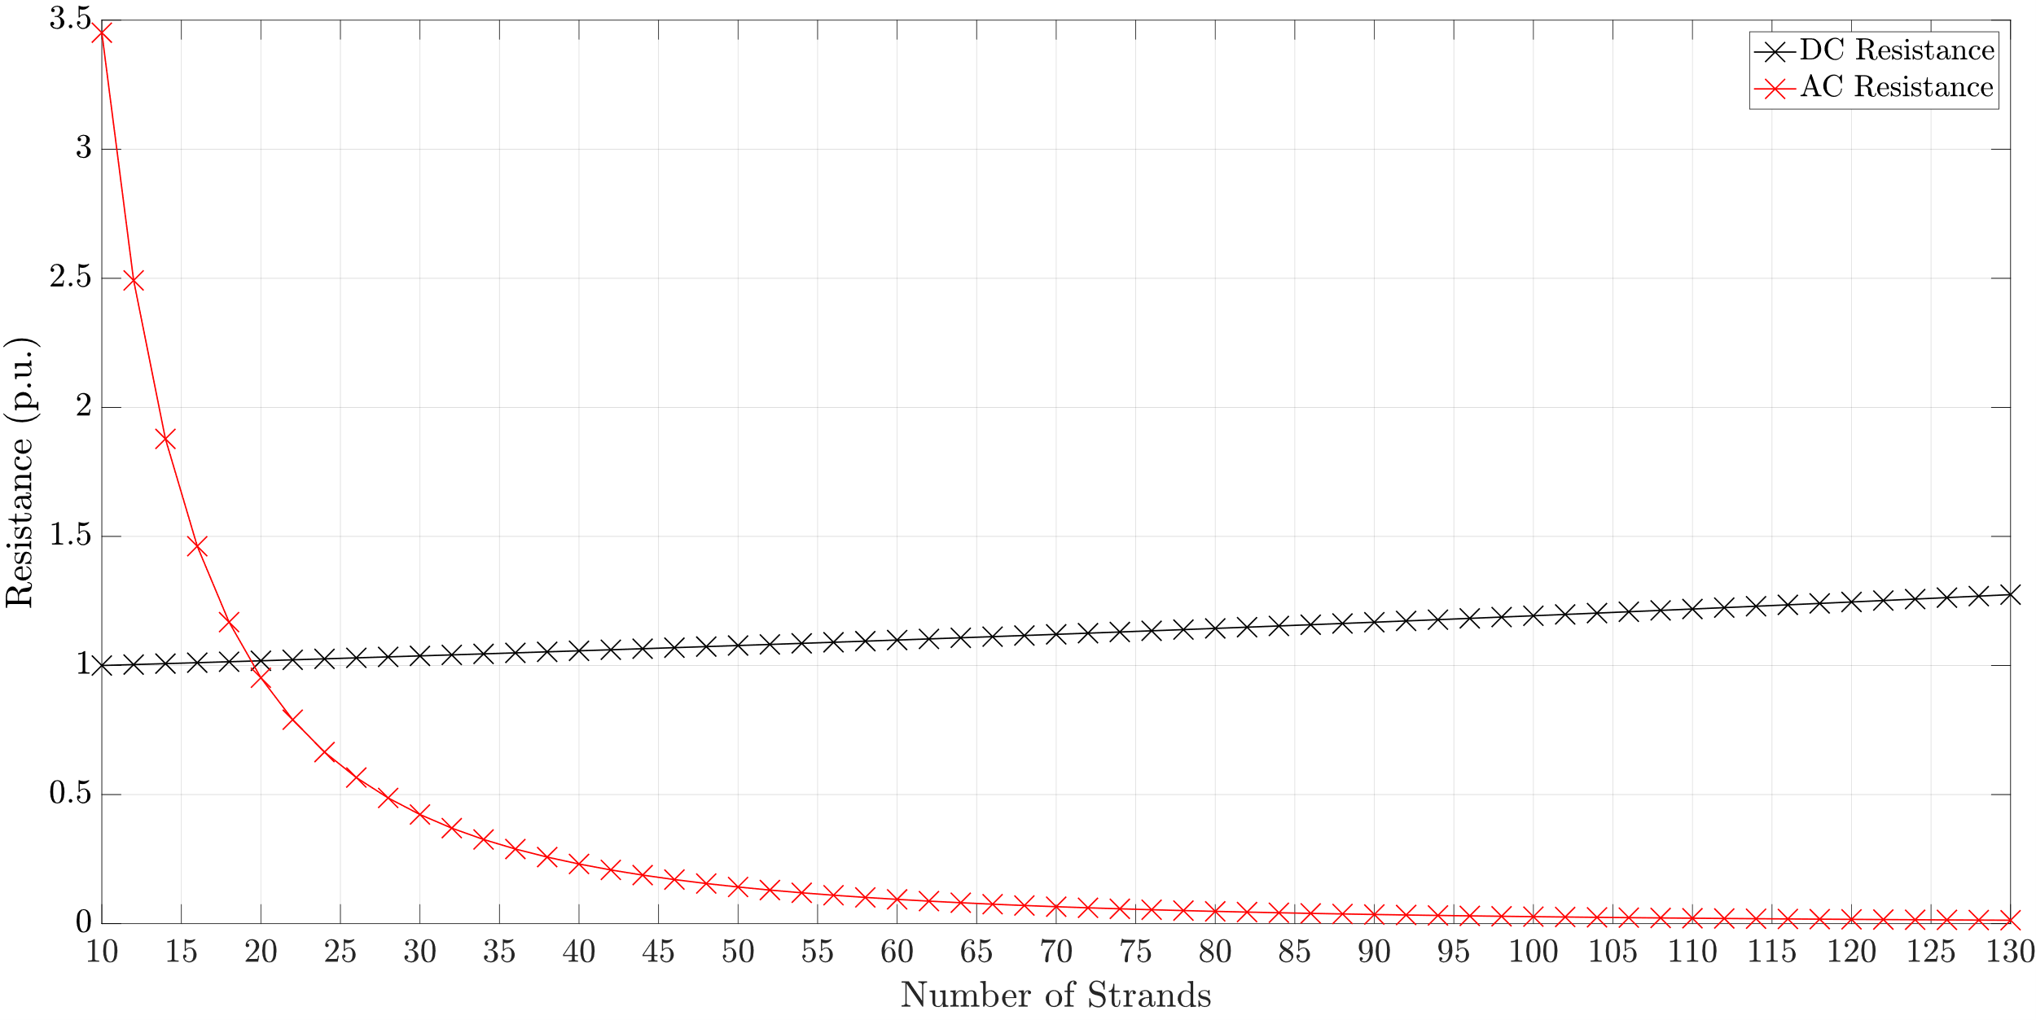
Design of Roebel Bars
$$D_{o}=6858 mm, k=0.9,g=18 mm, L_{s}=925 mm, b_{2}=22 mm, h_{2}=152 mm, Q=300$$
Notes:
Variables of the candidate is shown above the figure. The important parameters for us is the axial length which is 925 mm, slot width which is 22 mm and slot depth which is 152 mm. The black line shows the change in the DC resistance with respect to strand number. As expected, DC resistance is monotonously increasing with the strand number due to reduced copper area. On the other hand, the AC resistance is significantly decreases up to 80 strands. Once the resistances are calculated, only thing remaining is the calculating the copper losses, and strand dimensions to create the production document.

Slide 21
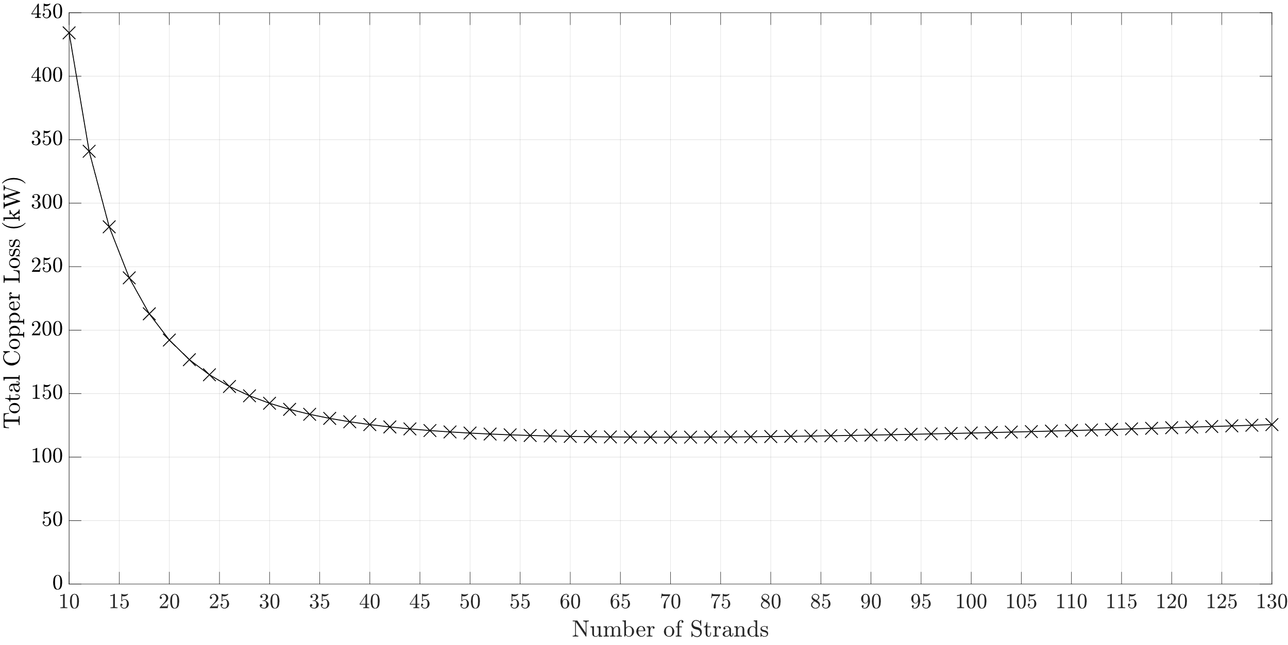
Design of Roebel Bars
$$D_{o}=6858 mm, k=0.9,g=18 mm, L_{s}=925 mm, b_{2}=22 mm, h_{2}=152 mm, Q=300$$
Notes:
Since the resistances are already known, the losses are calculated via the simples formula I^2*R. As the graph indicates, reasonable region for number of strands are between 42 and 60. As previously mentioned, there is a production limit due to axial length. With the help of the workers of company, we concluded that at most 48 strands can be produced with this axial length. Thus, the number of strands is selected as 48. If we compare the losses between 48 and 60 strands, losses increase only 3 kWs.

Slide 22
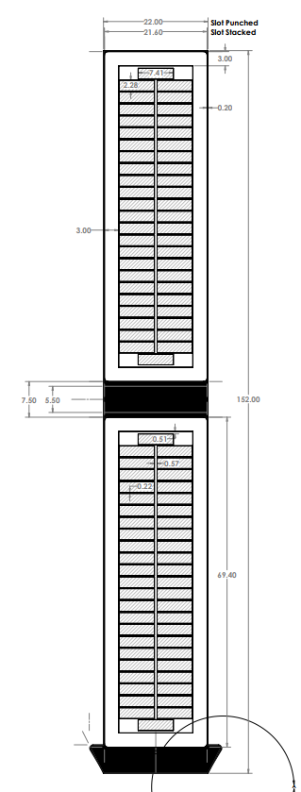
Design of Roebel Bars

Slide 23
Conclusion & Future Work
Refurbishment is important for sustanability
Cheapest way of increasing installed power
Roebel bars are used to cancel circulating currents
As well as reduce AC losses
Future Work: Optimization with different rotor geometries

