Slide 1
Winding Design in Hydro Generators
M. Samet yakut – 14.03.2023

Slide 2
Content
Winding Types
Wave Winding Design
Roebel Transposition
Conclusion
Past Plans
Future Plans
References

Slide 3
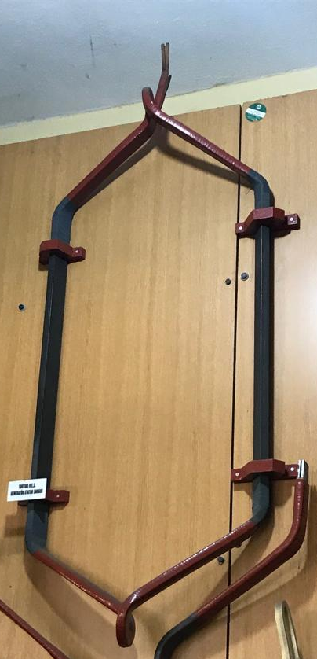
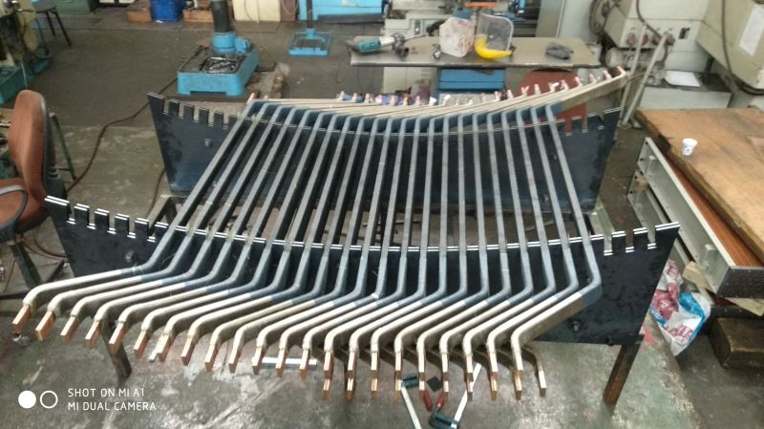
Winding Types

Slide 4
Winding Types
Wave Winding |  | Lap Winding
Advantage | Disadvantage | Advantage | Disadvantage
Less outage duration | Complicated design | Simple winding schematic design | Complicated end connections
Simple end connection | Generally requires more coil types | Less type of coils | More outage time
Low number of external connection | Longer average winding pitches, therefore longer end windings | Allows bypass | Sophisticated production

Slide 5
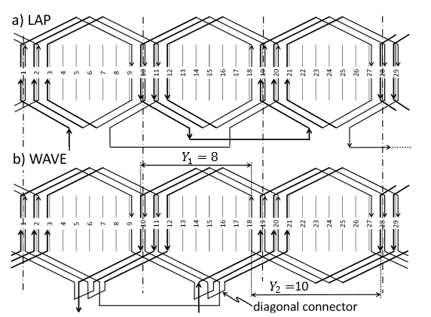
Winding Types

Slide 6
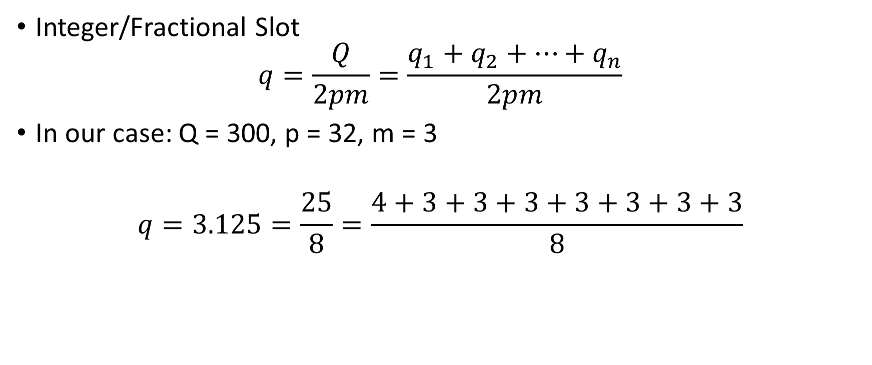
Wave Winding Design
Integer/Fractional Slot
$$q=\frac{Q}{2pm}=\frac{q_{1}+q_{2}+…+q_{n}}{2pm}$$
In our case: Q = 300, p = 32, m = 3
$$q=3.125=\frac{25}{8}=\frac{4+3+3+3+3+3+3+3}{8}$$

Slide 7
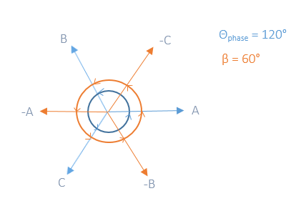
Wave Winding Design
Alternatively:

Slide 8
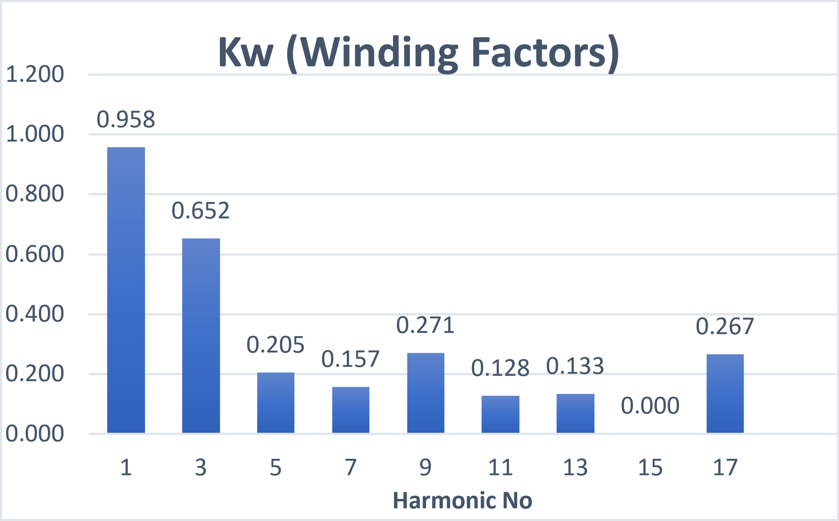
Wave Winding Design
Selection of coil pitch (Y):
Winding factor (> 0.95)
If possible, eliminating dominant harmonics or reducing
Y = 9 is suitable for 300 slots 32 poles

Slide 9
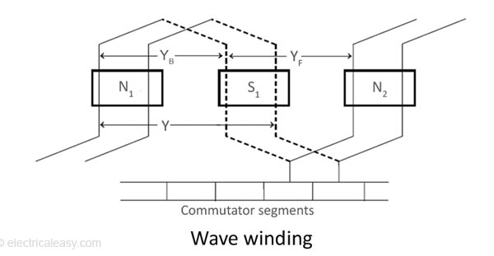

Wave Winding Design
Problem: Constant throw of Y = 9 is not possible!
Solution: $Y_{1}+Y_{2}=2mq≈2Y$, $Y_{1}$ and $Y_{2}$ are integers
$Y_{1}=9$, and $Y_{2}$=10
Result: $\frac{Y_{1}+Y_{2}}{2}=9.375≈Y=9$
Design the top windings and shift bottoms by Y number of slots
Alternatively: Zone Displacement

Slide 10
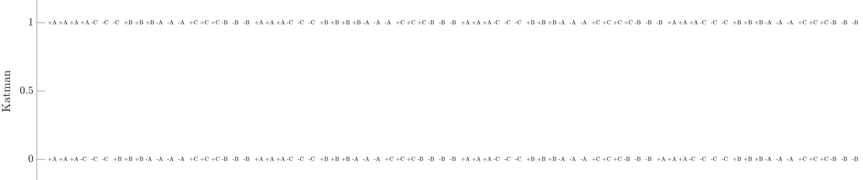
Wave Winding Design

Slide 11
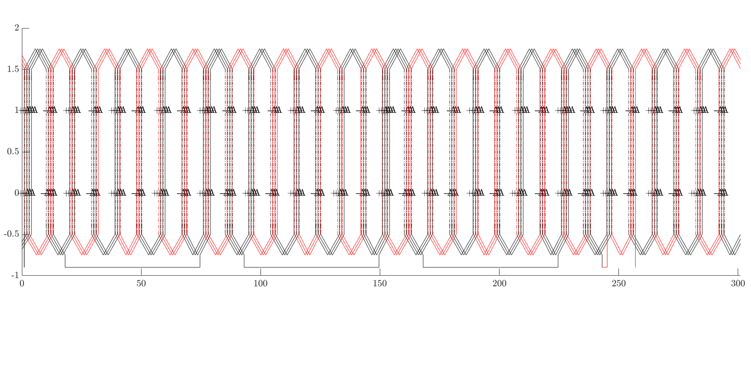
Wave Winding Design

Slide 12
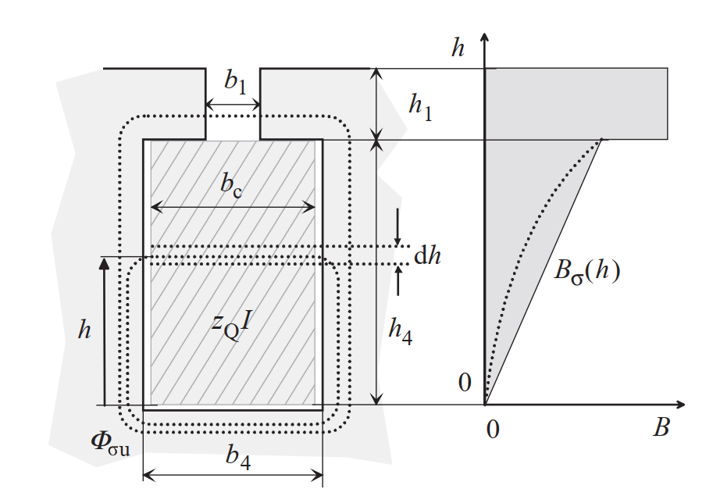
Roebel Transposition

Slide 13
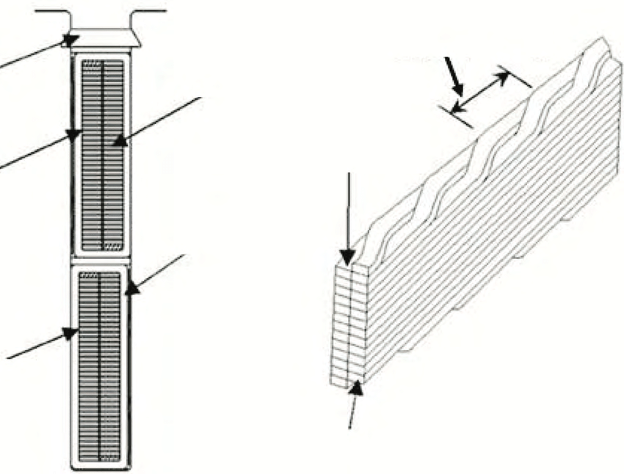
Roebel Transposition
Aim: Reducing AC losses
Method: Strands and transposition
180°, 360°, 540° or 720°
360° is common in hydro generators

Slide 14
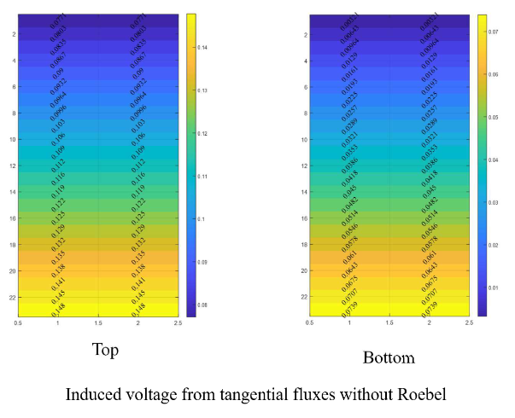
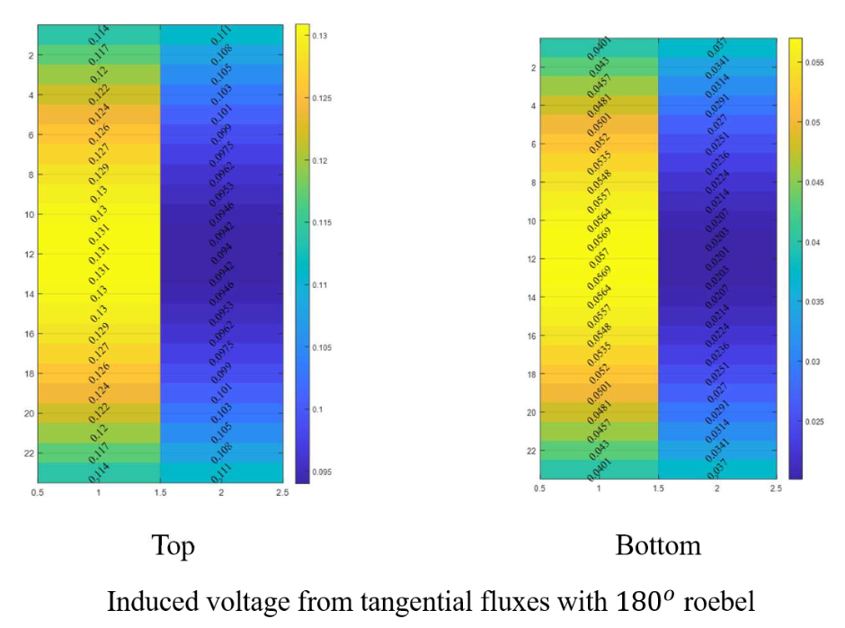
Roebel Transposition

Slide 15
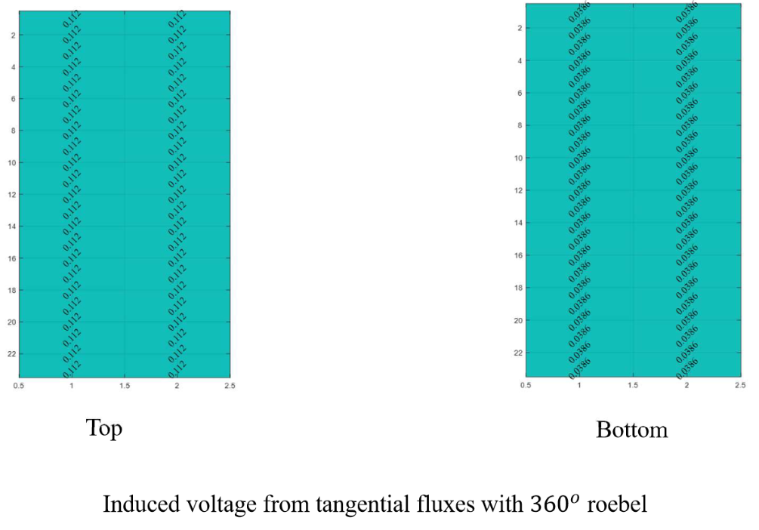
Roebel Transposition

Slide 16
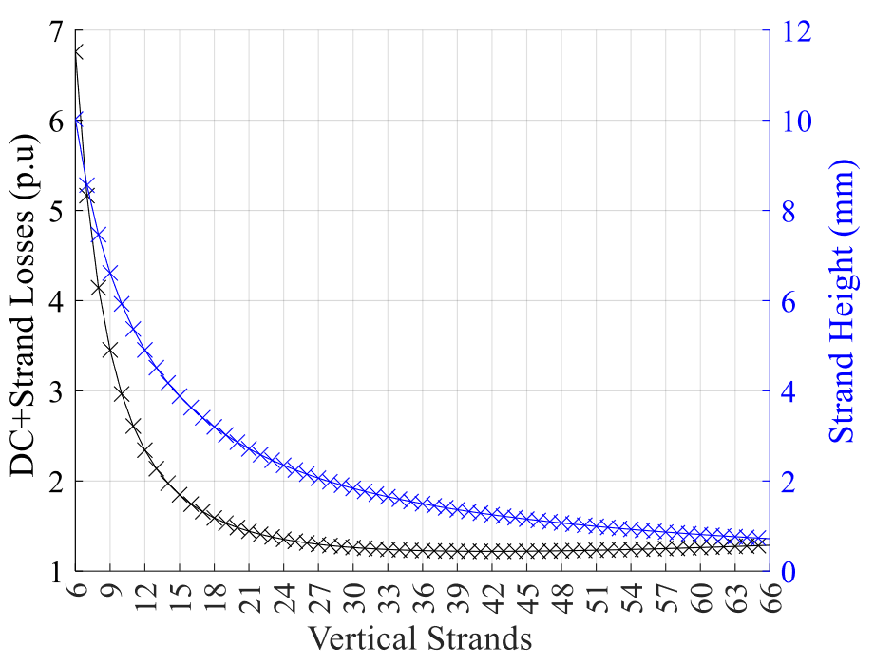
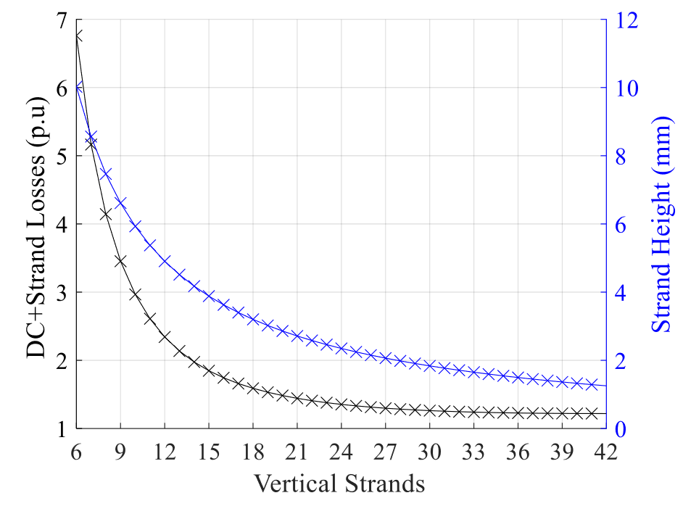
Roebel Transposition

Slide 17
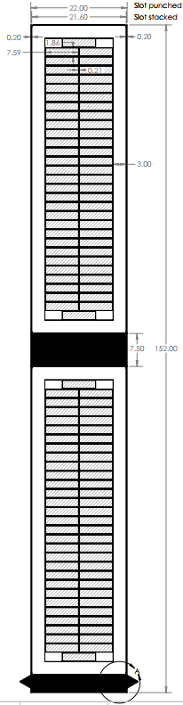
Roebel Transposition

Slide 18
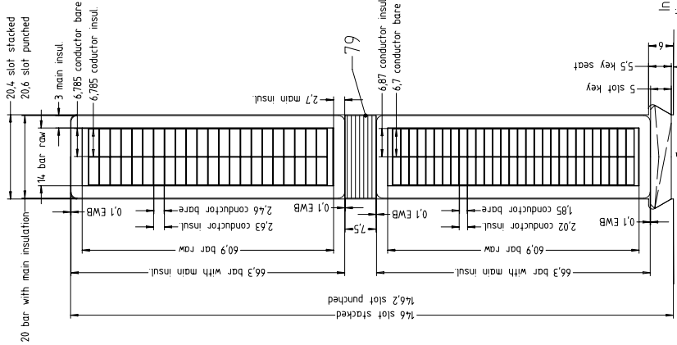
Roebel Transposition

Slide 19
Conclusion
Electromagnetically, there is no difference between wave and lap windings.
Again, there is no difference between zone-short pitching and conventionally short pitching.
360º Roebel transposition is generally suitable for hydro generators, as well as our case.

Slide 20
Past Plans
3D Stepping Model
Roebel Design
Conference paper published: WEMDCD23 / Winding Type Alternation of a Refurbished Old Generator

Slide 21
Future Plans
Completing winding design (as well as its alternatives)
Calibration of analytical model with Maxwell 3D
Journal article until end of June

Slide 22
References
[1] G. Traxler-Samek and M. Lecker, "Three-Phase Winding Design for Large Hydro-Generators," 2020 International Conference on Electrical Machines (ICEM), Gothenburg, Sweden, 2020, pp. 2657-2663, doi: 10.1109/ICEM49940.2020.9271049.
[2] Pyrhonen, Juha, Tapani Jokinen and Valéria Hrabovcová. “Design of Rotating Electrical Machines.” (2009).

