Slide 1


Slide 2
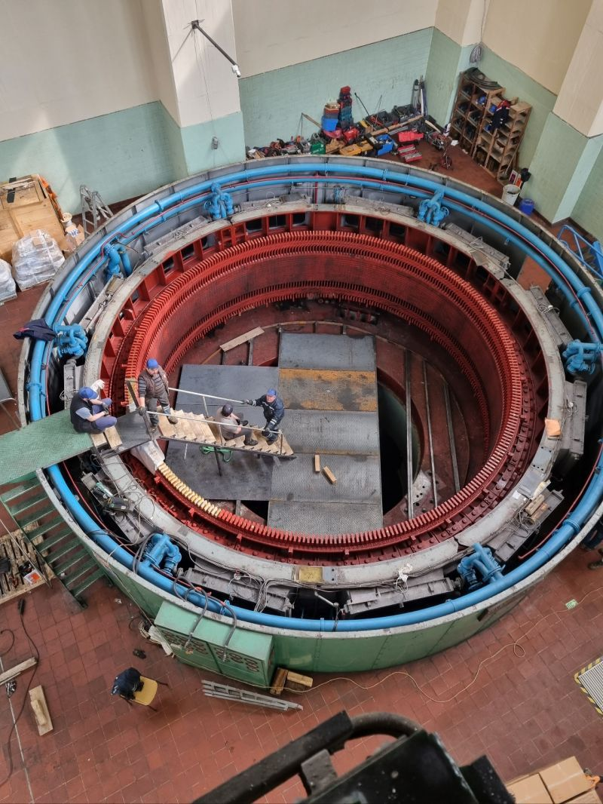
REFURBISHMENT & ALTERNATING WINDING TYPE OF A 44 MVA HYDRO GENERATOR
M. Samet YAKUT
Advisor: Assoc. Prof. Ozan Keysan
November 23, 2023
EE590 Seminar, METU EE Dep.

Slide 3
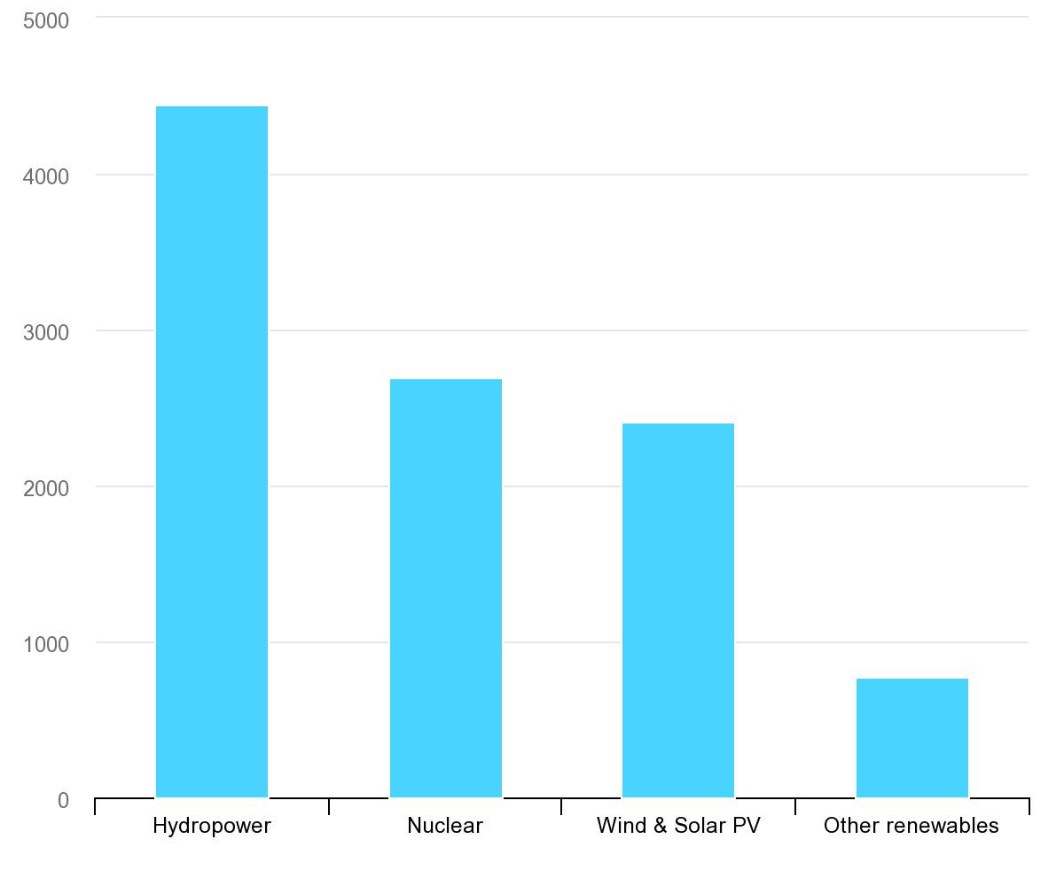
TWh
Largest low-carbon electricity generation technology is hydropower ^{[1]}
IEA, Low-carbon electricity generation by technology, 2020, IEA, Paris https://www.iea.org/data-and-statistics/charts/low-carbon-electricity-generation-by-technology-2020, IEA. Licence: CC BY 4.0
Notes:
The importance of the hydro generators arises from the fact that the largest low carbon electricity source is the hydro power according to a research conducted in 2020 by International Energy Agency. The installed capacity of the hydro power is more than 4000 TWh which is higher than the total installed capacity of the other renewable energy resources.

Slide 4
Outline
Introduction
Basic Terms & Definitions
Refurbishment Process
Optimization
Design of Windings
Conclusion

Slide 5
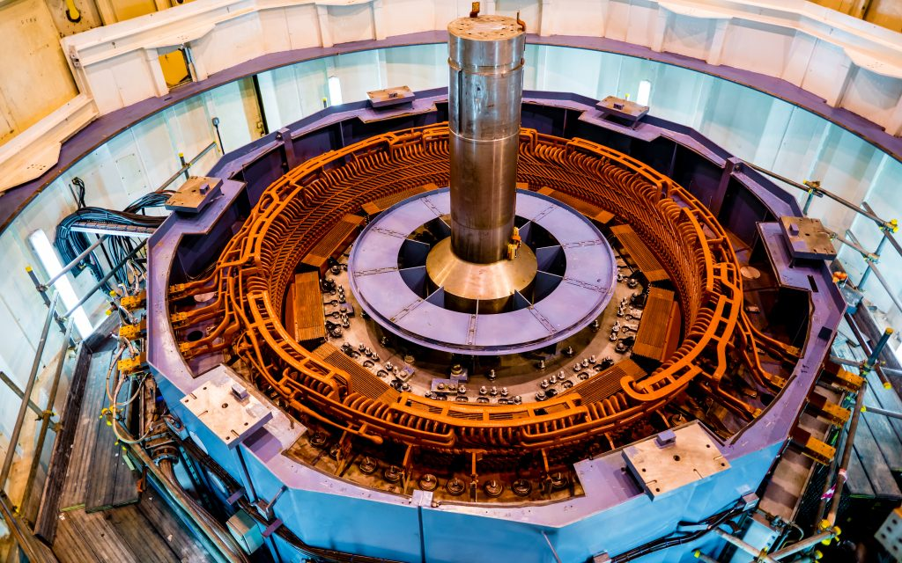
Hydro Generators
Largest low carbon energy resource
Salient pole synchronous machines
High voltage stator
Tens of kVA to hundreds of MVA
IEA, Low-carbon electricity generation by technology, 2020, IEA, Paris https://www.iea.org/data-and-statistics/charts/low-carbon-electricity-generation-by-technology-2020, IEA. Licence: CC BY 4.0

Slide 6
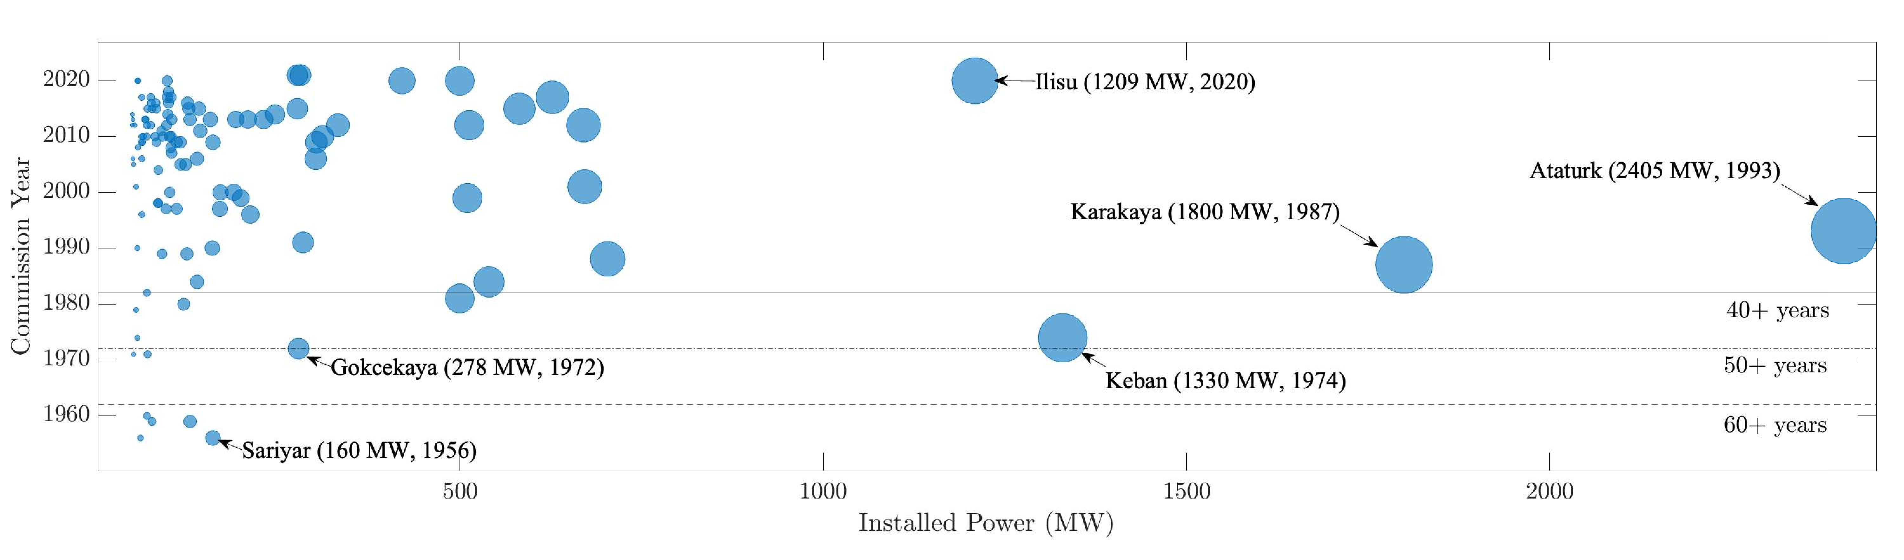
Refurbishment
Installed capacity older than 30 years: 6205 MWs
which accounts for 31.9% of large hydro generators
Most old generators are over – designed
cheapest way of increasing installed power
N. Tosun, G. Gülletutan, M. S. Yakut, D. Alp Yilmaz, Ö. Bayer and O. Keysan, "Winding Type Alternation of a Refurbished Old Generator," 2023 IEEE Workshop on Electrical Machines Design, Control and Diagnosis (WEMDCD), Newcastle upon Tyne, United Kingdom, 2023, pp. 1-6, doi: 10.1109/WEMDCD55819.2023.10110941.

Slide 7
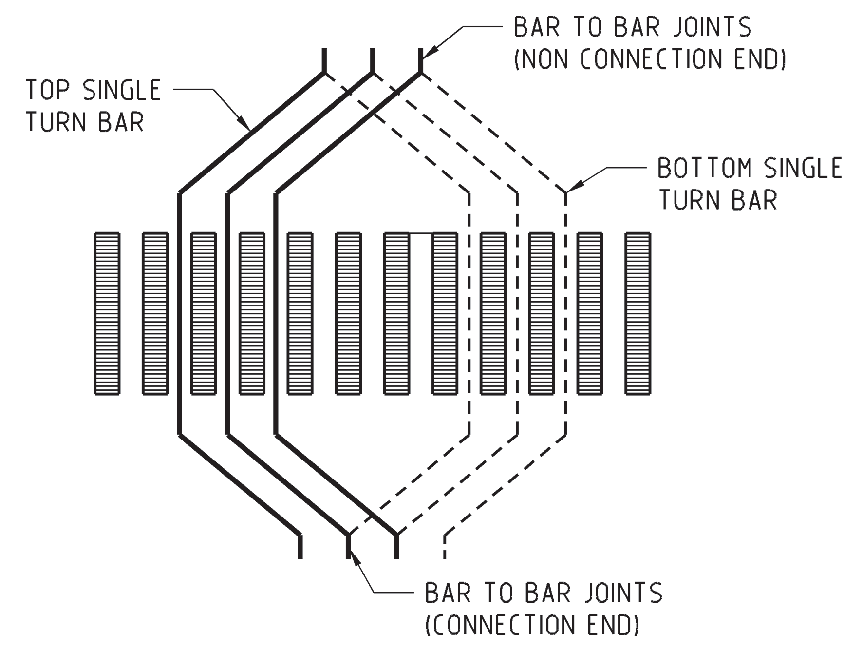
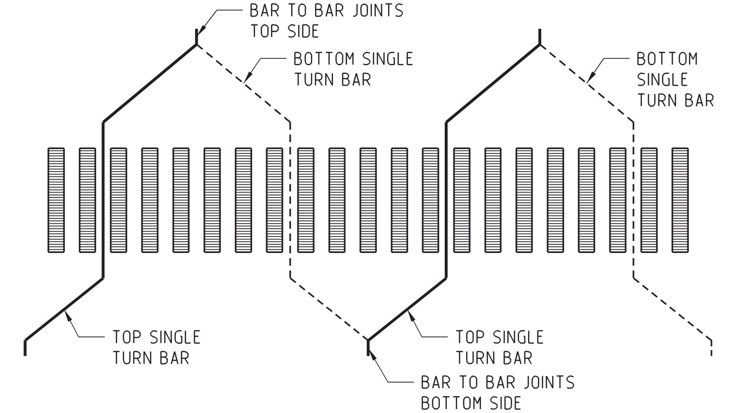
Winding Types
Lap Winding Wave Winding
M.M. Znidarich (2008) Hydro Generator High Voltage Stator Windings: Part 1 – Essential Characteristics and Degradation Mechanisms, Australian Journal of Electrical and Electronics Engineering, 5:1, 1-17, DOI: 10.1080/1448837X.2008.11464196

Slide 8
Winding Types
Wave Winding
Less outage duration
Simple end connection
Low number of external connections
Lap Winding
Simple winding schematic design
Less type of coils
Allows bypass

Slide 9
Problem Definition
Refurbishment of an old 44 MVA hydro generator by changing winding type from lap to wave
Constraints
Constant outer diameter
Same rotor geometry

Slide 10
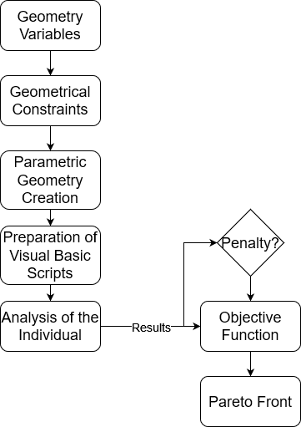
Optimization: Method
NSGA – II
Variables are machine geometry parameters
Simulations in RMxprt

Slide 11

Optimization: Objective Function
Objective functions are
Initial cost
$f_{1} (k,g,L_{s},b_{2},h_{2},Q)={(m}_{steel} C_{steel}+m_{copper} C_{copper})×2.5$
Efficiency
$f_{2} (k,g,L_{s},b_{2},h_{2},Q)=η=\frac{P_{out}}{P_{in}} ×100$
Subject to
$\frac{2h_{2}}{1−k}≤D_{o}$
$\frac{p×Pole Shoe Width}{π}≤kD_{o}−2g$

Slide 12

Optimization: Penalty Function
SCR should not be less than 0.8
Hence
$p(k,g,L_{s},b_{2},h_{2},Q)=\left\{\begin{aligned}A{\left(\frac{1}{SCR}\right)}^{4}=A{\left(X_{d,pu}\right)}^{4}, if SCR<0.8 \\ 0, otherwise\end{aligned}\right.$
where A is a very large number compared to initial cost
Glenn Mottershead; Stefano Bomben; Isidor Kerszenbaum; Geoff Klempner, "OPERATION AND CONTROL," in Handbook of Large Hydro Generators: Operation and Maintenance , IEEE, 2021, pp.177-240, doi: 10.1002/9781119524205.ch4.

Slide 13
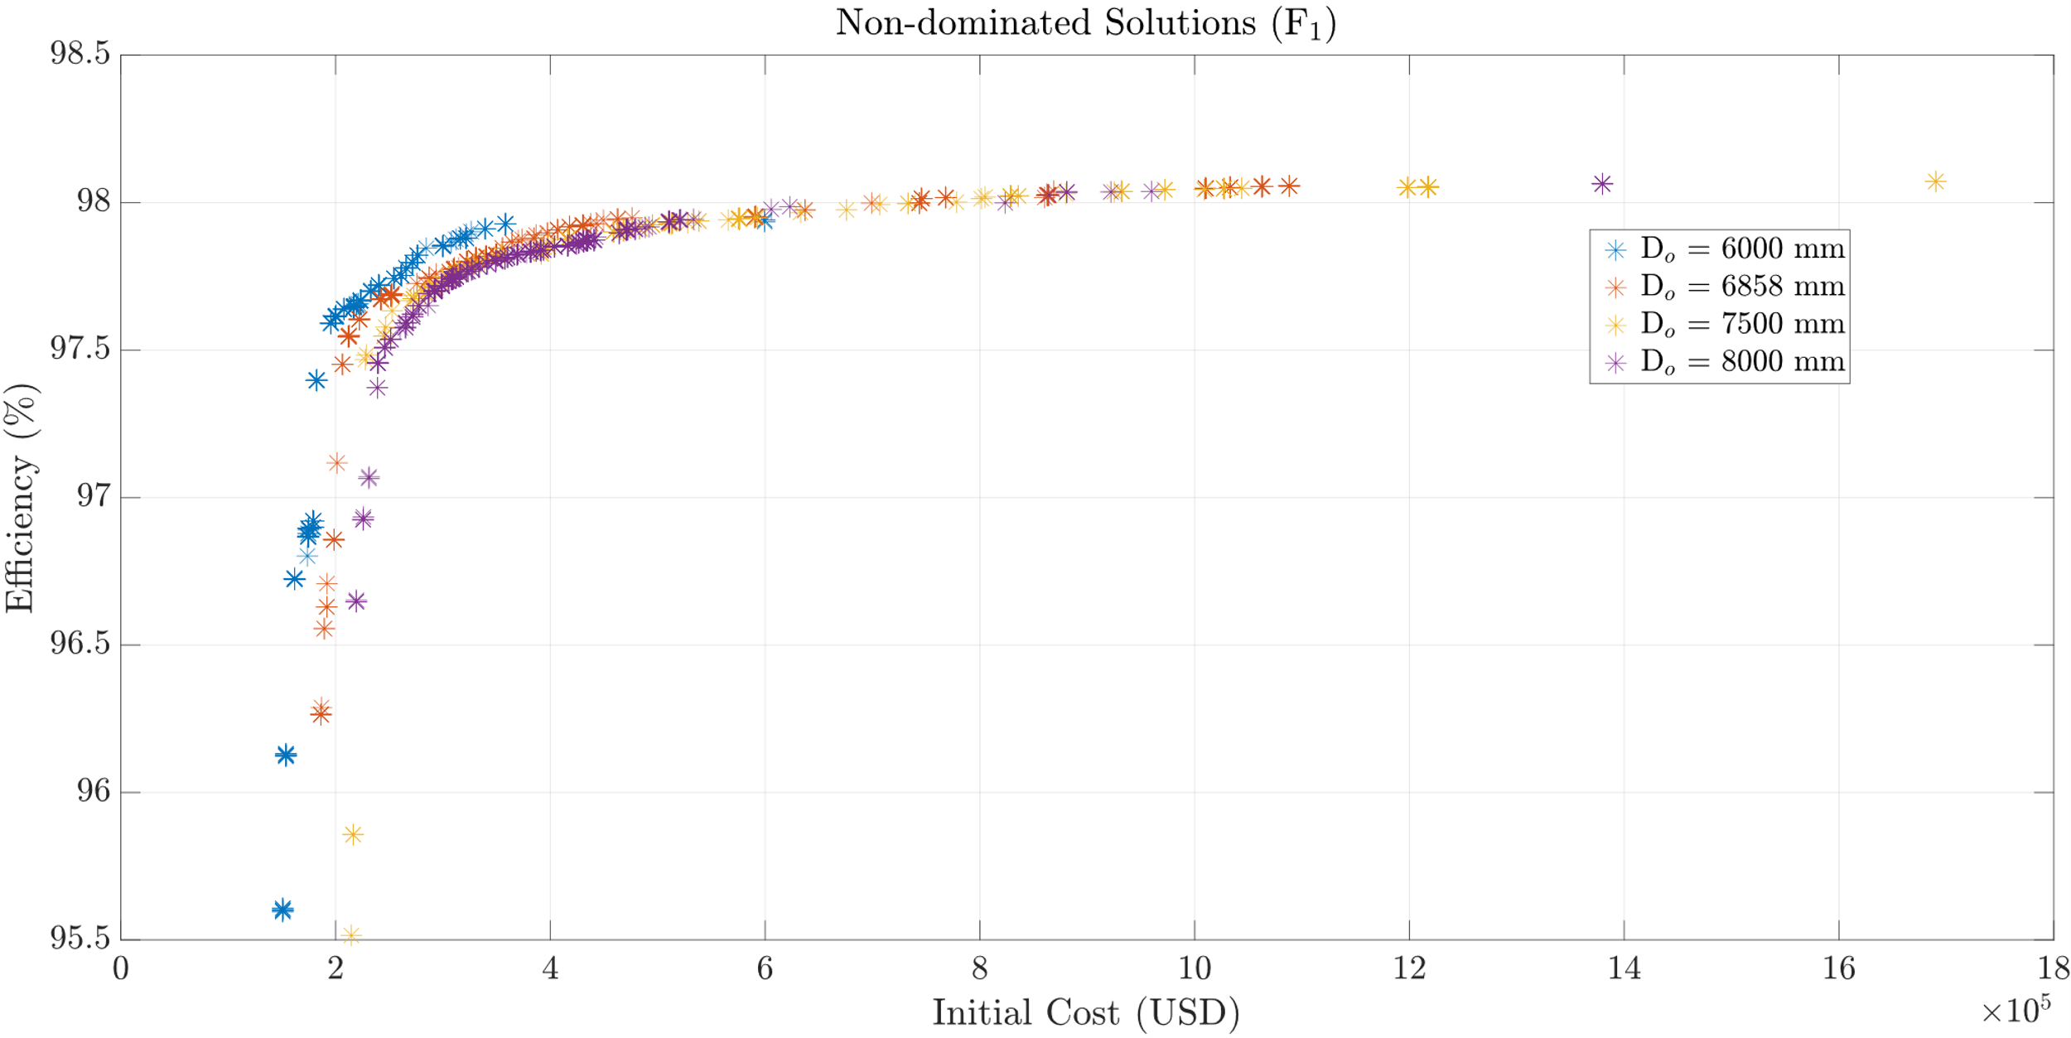
Optimization: Results
Notes:
As previously mentioned, the algorithm is run for different outer diameters and results are shown here. 6858 mm is the nominal outer diameter. The results show that if there is not 98% efficiency constraint, there is no need to increase the outer diameter. The same efficiency can be reached with nominal diameter with less cost. However, to reach a certain efficiency levels such that 98.1 98.2%, we need to increase the outer diameter to reach that values. The remaining part is to design the windings to reduce the AC losses. For that purpose, we are utilizing Roebel transposition.

Slide 14
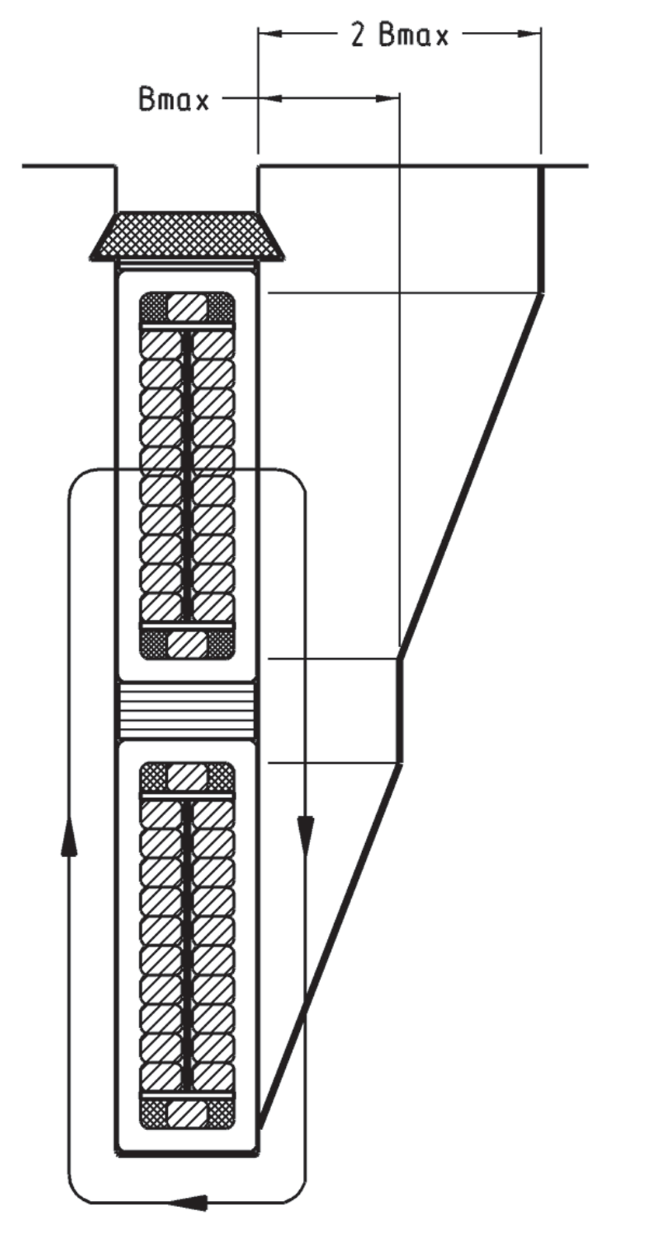
Roebel Bars
Different induced voltages in each strand
Circulating currents
Eddy losses

Slide 15
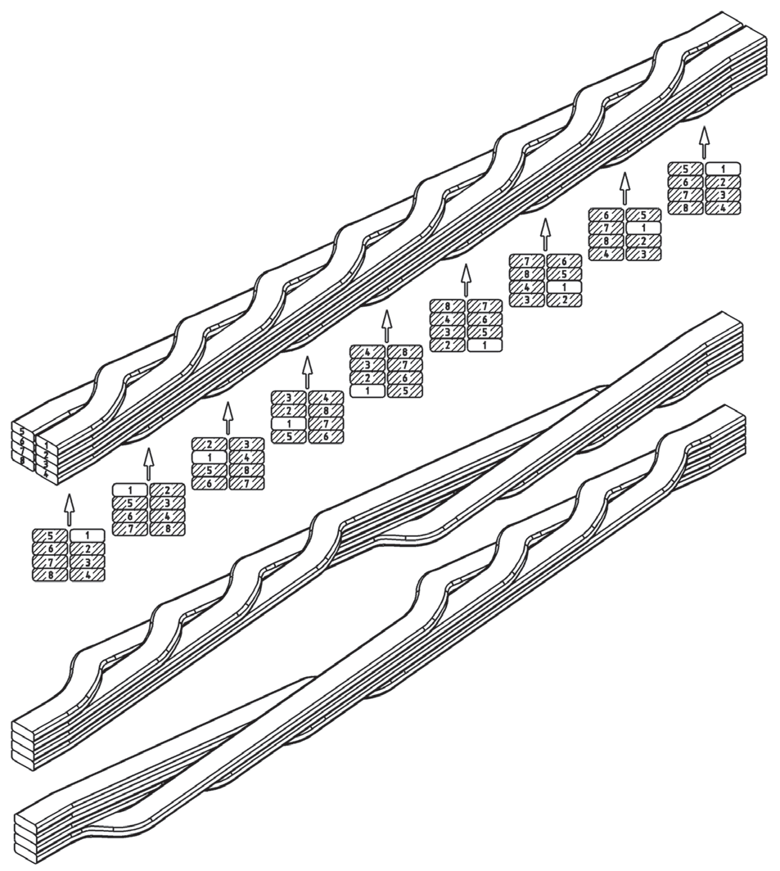
Roebel Bars
Transposition is applied to minimize circulating currents
Common transposition angles: 180, 360, 540 and 720
Transposed in active region
Notes:
Roebel bars are composed of a number of strands, and they are single turn coils. The transposition is applied to minimize eddy and circulating currents. The transposition is defined with an angle such that if the transposition is 360 degree, the strands are transposed in a way that figure shows. There are 180, 540 and 720 degree transpositions as well but 360 degree is the common practice in hydro generators. The larger values are used in turbo generators.

Slide 16
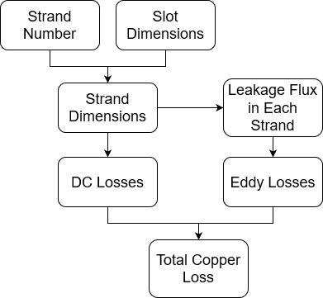
Design of Roebel Bars
Strand number is swept
Strand dimensions are calculated by including manufacturing details
AC and DC resistances are also calculated

Slide 17
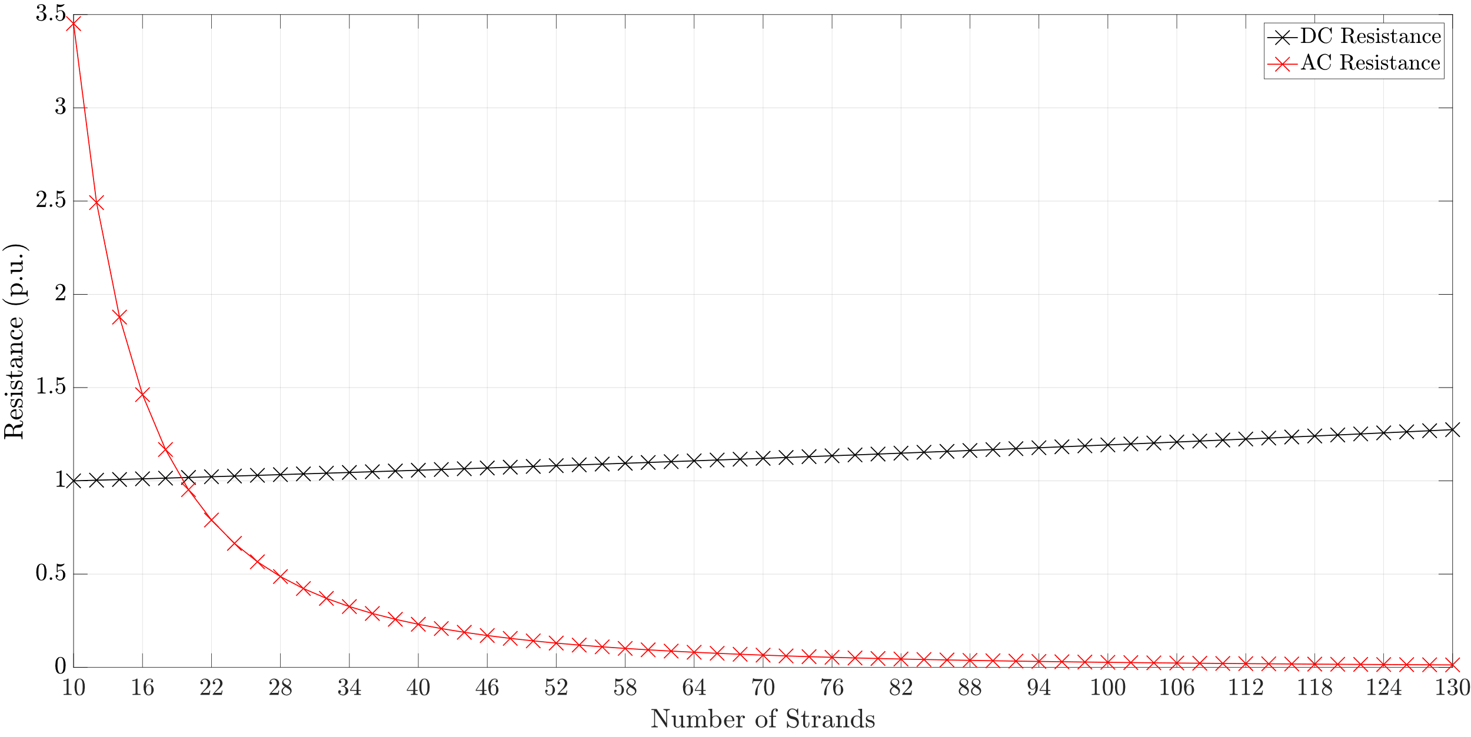
Design of Roebel Bars
$$D_{o}=6858 mm, k=0.9,g=18 mm, L_{s}=925 mm, b_{2}=22 mm, h_{2}=152 mm, Q=300$$

Slide 18
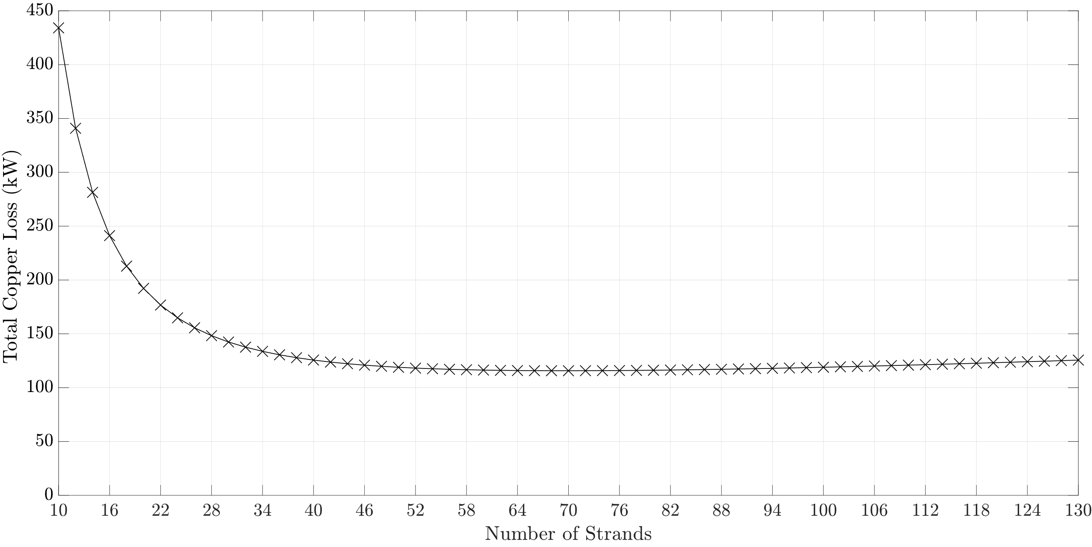
Design of Roebel Bars
$$D_{o}=6858 mm, k=0.9,g=18 mm, L_{s}=925 mm, b_{2}=22 mm, h_{2}=152 mm, Q=300$$

Slide 19
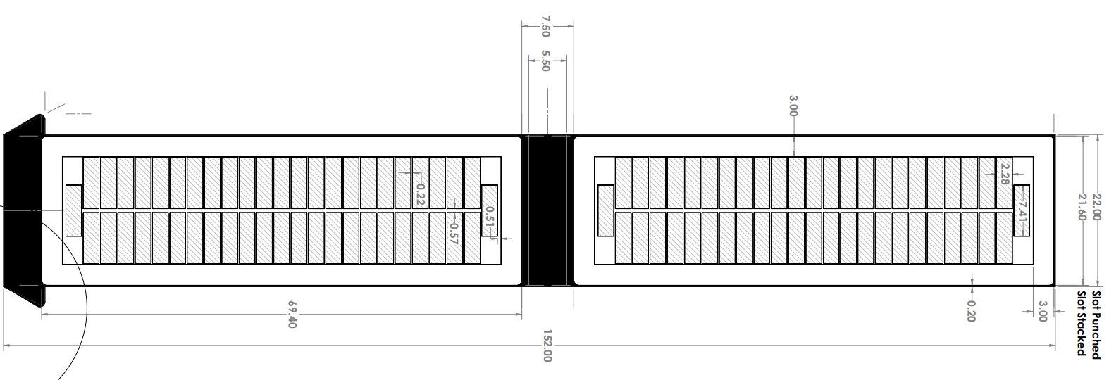
Design of Roebel Bars

Slide 20
Conclusion & Future Work
Refurbishment is important for sustanability
Cheapest way of increasing installed power
Roebel bars are used to cancel circulating currents
Future Work: Optimization with different rotor geometries
Production and test of different insulation materials

