Slide 1


Slide 2
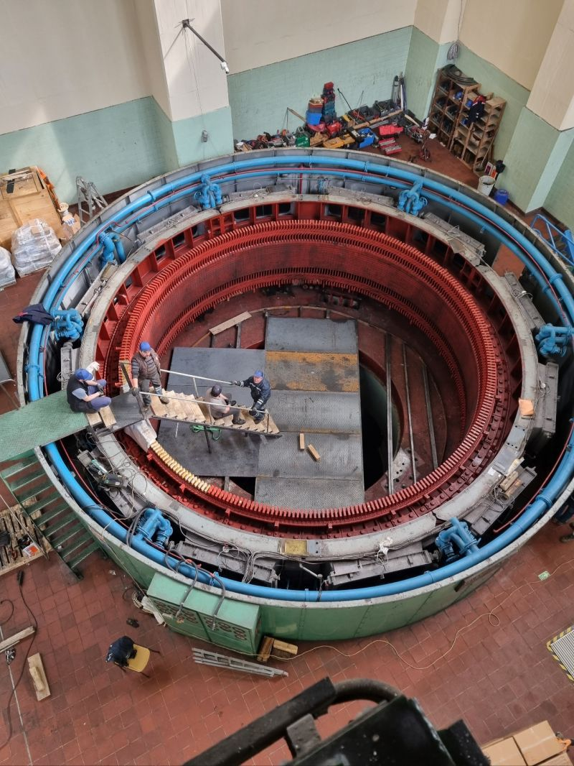
REFURBISHMENT AND ALTERNATING WINDING TYPE OF 44 MVA HYDRO GENERATOR
M. Samet YAKUT
Advisor: Ozan Keysan
November 23, 2023
EE590 Seminar, METU EE Dep.

Slide 3
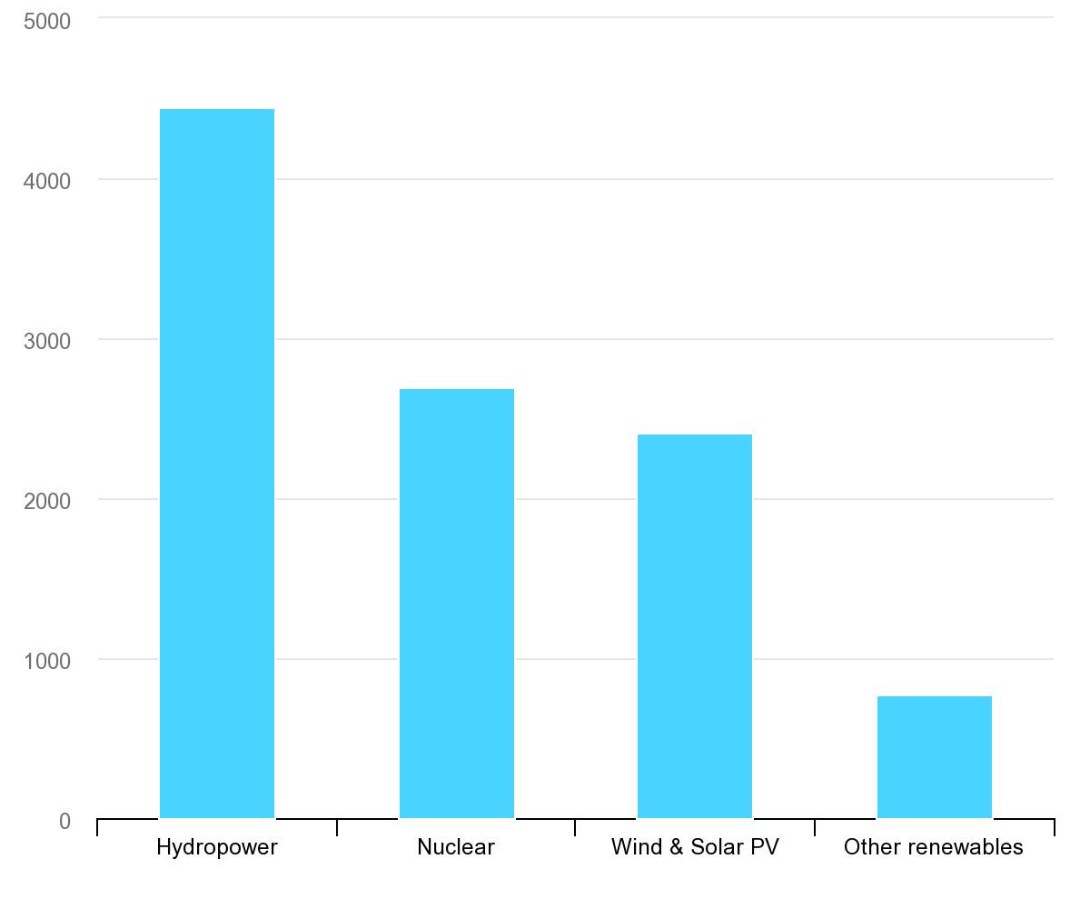
TWh
Largest low-carbon electricity generation technology is hydropower ^{[1]}
IEA, Low-carbon electricity generation by technology, 2020, IEA, Paris https://www.iea.org/data-and-statistics/charts/low-carbon-electricity-generation-by-technology-2020, IEA. Licence: CC BY 4.0

Slide 4
Outline
Introduction
Methodology
Alternating Winding Type
Design of Roebel Bars
Optimization
Results
Conclusion

Slide 5
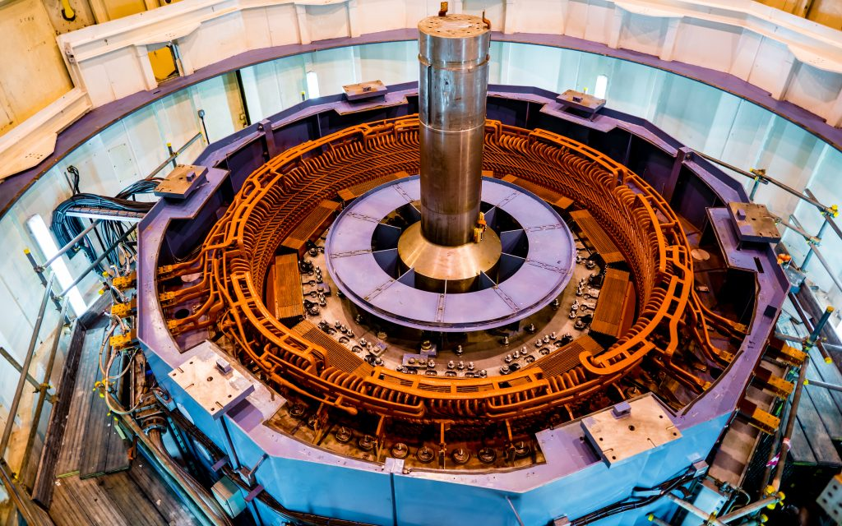
Introduction
Salient pole synchronous machines
High voltage stator
A couple of kVA to hundreds of MVA

Slide 6
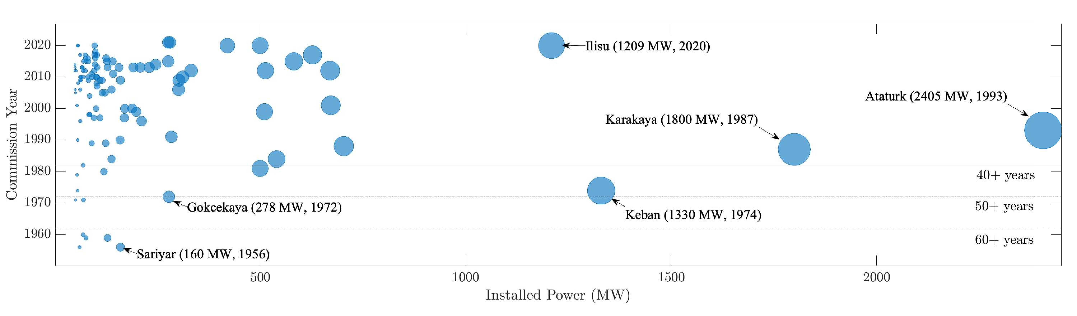
Refurbishment
Installed capacity older than 30 years: 6205 MWs
which accounts for 31.9% of large hydro generators ^{[1]}
Most old generators are over – designed
cheapest way of increasing installed power
N. Tosun, G. Gülletutan, M. S. Yakut, D. Alp Yilmaz, Ö. Bayer and O. Keysan, "Winding Type Alternation of a Refurbished Old Generator," 2023 IEEE Workshop on Electrical Machines Design, Control and Diagnosis (WEMDCD), Newcastle upon Tyne, United Kingdom, 2023, pp. 1-6, doi: 10.1109/WEMDCD55819.2023.10110941.

Slide 7
Winding Types
Lap Winding
Wave Winding

Slide 8
Upgrading & Uprating

Slide 9
Design of Roebel Bars

Slide 10
Optimization

Slide 11
Results

Slide 12
Conclusion

