Slide 1
Winding Design in Hydro Generators
M. Samet yakut – 14.03.2023

Slide 2
Content
Winding Types
Wave Winding Design
Roebel Transposition
Conclusion
Future Plans

Slide 3
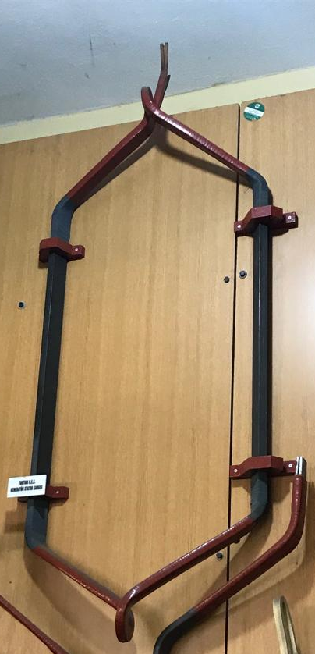
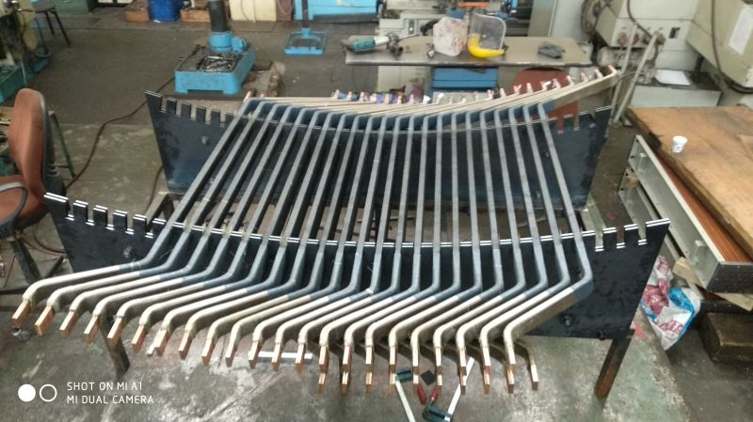
Winding Types

Slide 4
Winding Types
Wave Winding |  | Lap Winding
Advantage | Disadvantage | Advantage | Disadvantage
Less outage duration | Complicated design | Simple winding schematic design | Complicated end connections
Simple end connection | Generally requires more coil types | Less type of coils | More outage time
 |  |  | Sophisticated production

Slide 5

Wave Winding Design
Integer/Fractional Slot
$$q=\frac{Q}{2pm}$$
In our case: Q = 300, p = 32, m = 3
$$q=3.125=\frac{25}{8}=\frac{4+3+3+3+3+3+3+3}{8}$$

Slide 6
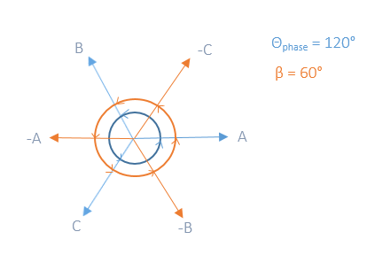
Wave Winding Design
Alternatively:

Slide 7
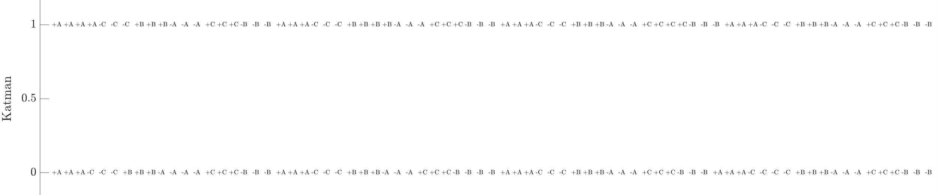
Wave Winding Design

Slide 8
Wave Winding Design

Slide 9
Roebel Transposition

Slide 10
Conclusion

Slide 11
Past Plans
Conference paper published: WEMDCD23 / Winding Type Alternation of a Refurbished Old Generator

Slide 12
Future Plans
Completing winding design
Journal article until end of June

