Slide 1


Slide 2
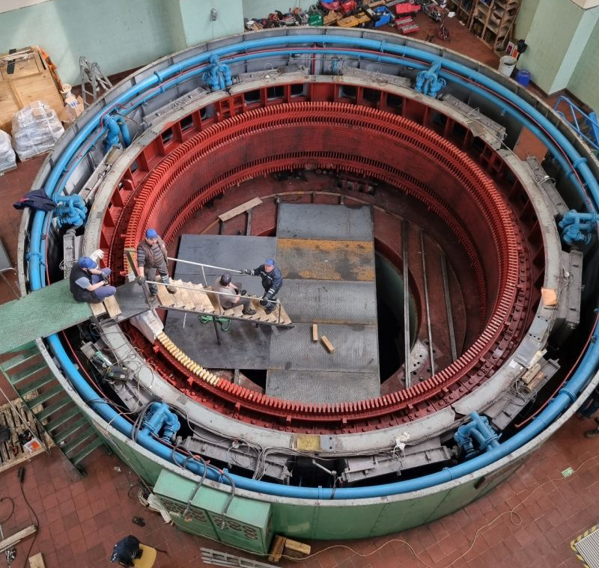
Advanced Design and Optimization in Hydro Generators
M. Samet Yakut
10.10.2023

Slide 3
Outline
Interactive Link Between MATLAB/ANSYS
Optimization Algorithm
Variables
Constraints
Objective Functions
Penalty Function
Results
Future Plans

Slide 4


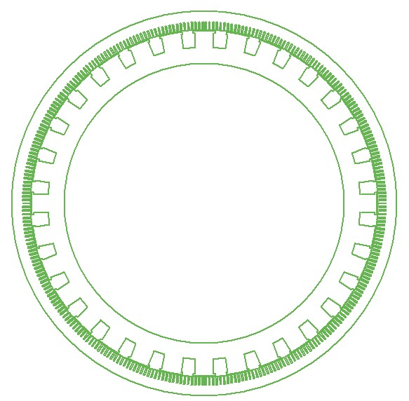
Interactive Link Between MATLAB/ANSYS
No direct connection between MATLAB and ANSYS
VBS is used as medium
MATLAB runs main algorithm
Variations are written in VBS
VBS runs ANSYS
Simulation results are obtained
Postprocessing is conducted in MATLAB
Variables, Constraints
Variation
Results
Simulation

Slide 5
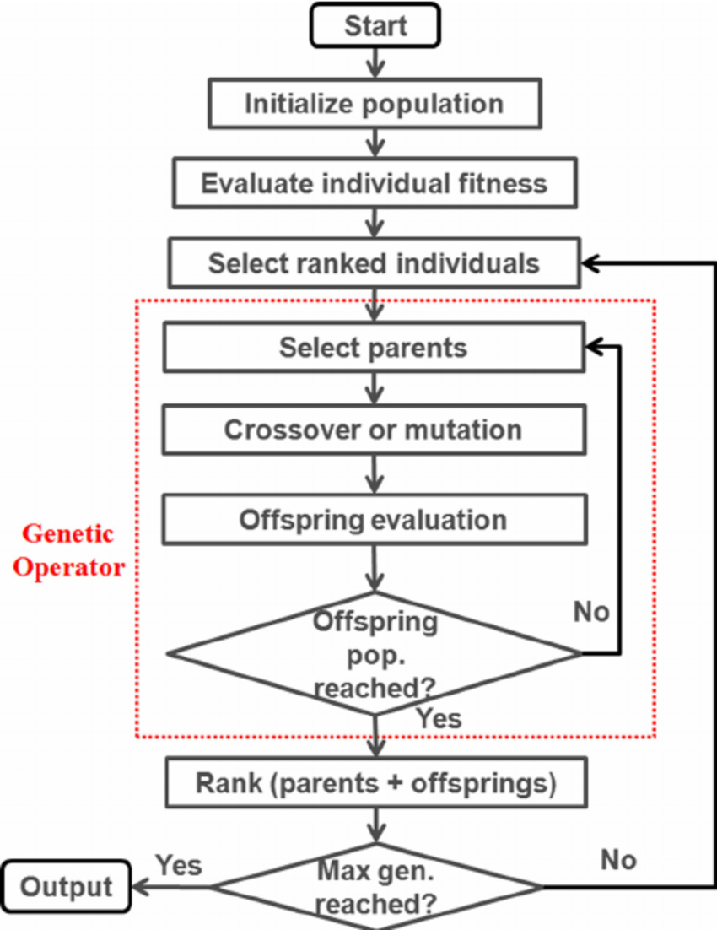
Optimization Algorithm
Genetic algorithm
Pros
Used when derivative is not available
Provides good enough solutions fast enough
Can be multi-objective
Applicable in both continuous and discrete problems

Slide 6
Optimization Algorithm
Genetic algorithm cons
Can be computationally expensive depending on objective function
Does not guarantee the optimality of the solution
If not tuned properly, GA does not converge
Parameters tuned with trial-error methodology ^{[1]}
[1] https://www.sciencedirect.com/science/article/pii/S2210650211000022

Slide 7
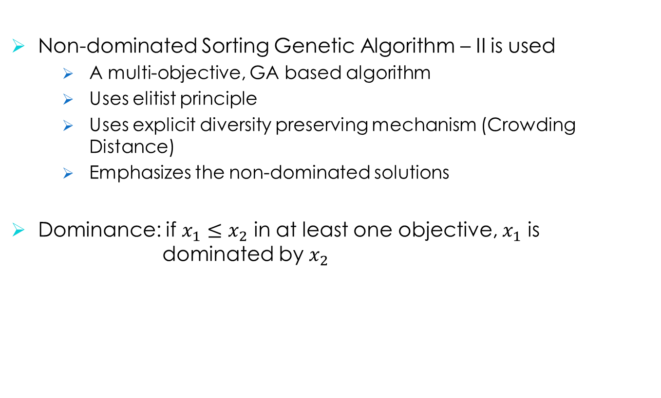
NSGA – II
Non-dominated Sorting Genetic Algorithm – II is used
A multi-objective, GA based algorithm
Uses elitist principle
Uses explicit diversity preserving mechanism (Crowding Distance)
Emphasizes the non-dominated solutions
Dominance: if $x_{1}≤x_{2}$ in at least one objective, $x_{1}$ is dominated by $x_{2}$
[1] https://oklahomaanalytics.com/data-science-techniques/nsga-ii-explained/

Slide 8
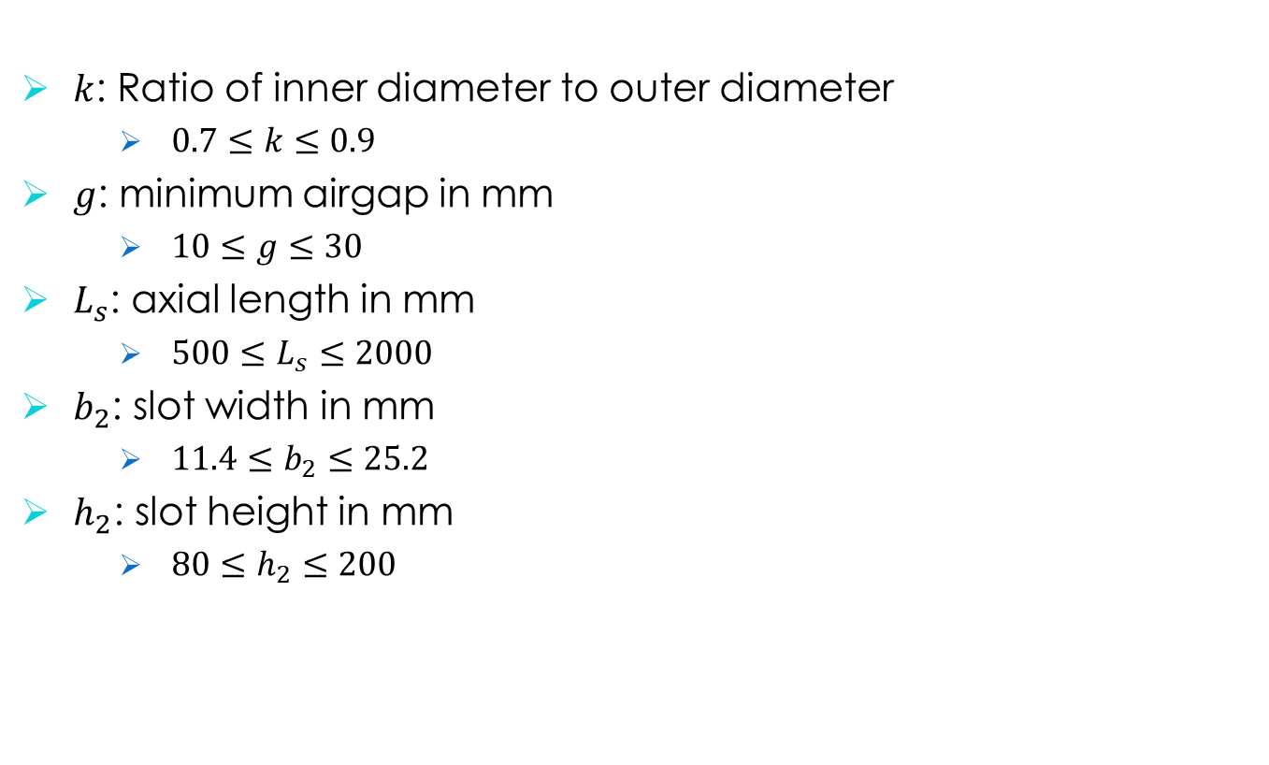
NSGA – II: Variables
$k$: Ratio of inner diameter to outer diameter
$0.7≤k≤0.9$
$g$: minimum airgap in mm
$10≤g≤30$
$L_{s}$: axial length in mm
$500≤L_{s}≤2000$
$b_{2}$: slot width in mm
$11.4≤b_{2}≤25.2$
$h_{2}$: slot height in mm
$80≤h_{2}≤200$

Slide 9
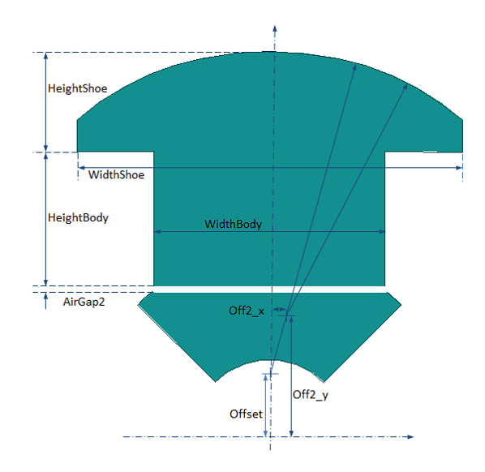
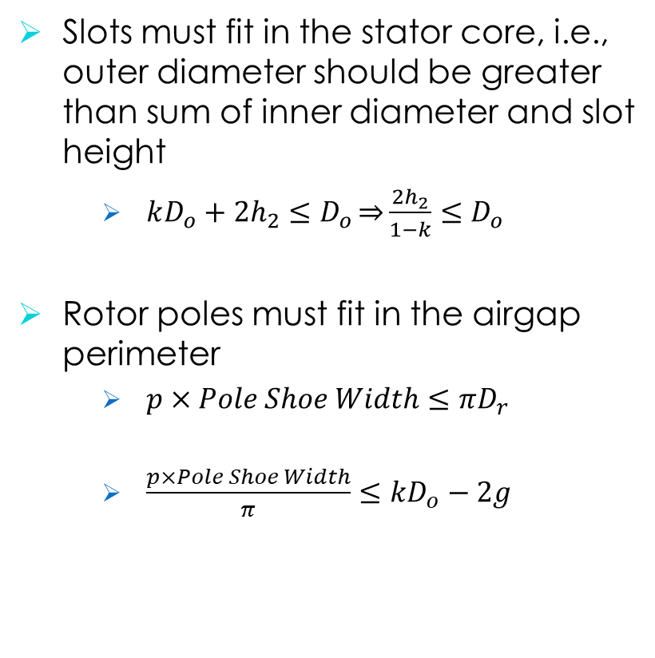
NSGA – II: Constraints
Slots must fit in the stator core, i.e., outer diameter should be greater than sum of inner diameter and slot height
$kD_{o}+2h_{2}≤D_{o}\underset{⇒}{}\frac{2h_{2}}{1−k}≤D_{o}$
Rotor poles must fit in the airgap perimeter
$p×Pole Shoe Width≤πD_{r}$
$\frac{p×Pole Shoe Width}{π}≤kD_{o}−2g$

Slide 10
NSGA – II: Objective Functions
Problem – I: Refurbishment of hydro-generator by alternating winding type
Constraints – I: Constant outer diameter, same rotor geometry
Problem – II: Design of a hydro-generator with Roebel bars
Constraints – II: Constant (but different from 1st problem) outer diameter, same rotor geometry
Problem – III: Design of a hydro-generator with Roebel bars
Constraints – III: Constant outer diameter (same as 2nd problem), integer slot

Slide 11

NSGA – II: Objective Functions
Objective functions are
Initial cost
$$f_{1}\left(k,g,L_{s},b_{2},h_{2}\right)={(m}_{steel}C_{steel}+m_{copper}C_{copper})×2.5$$
$$f_{1}\left(k,g,L_{s},b_{2},h_{2}\right)=η=\frac{P_{out}}{P_{in}}×100$$
Efficiency
$$f_{2}\left(k,g,L_{s},b_{2},h_{2}\right)=η=\frac{P_{out}}{P_{in}}×100$$
Subject to
$$\frac{2h_{2}}{1−k}≤D_{o}$$
$$\frac{p×Pole Shoe Width}{π}≤kD_{o}−2g$$

Slide 12
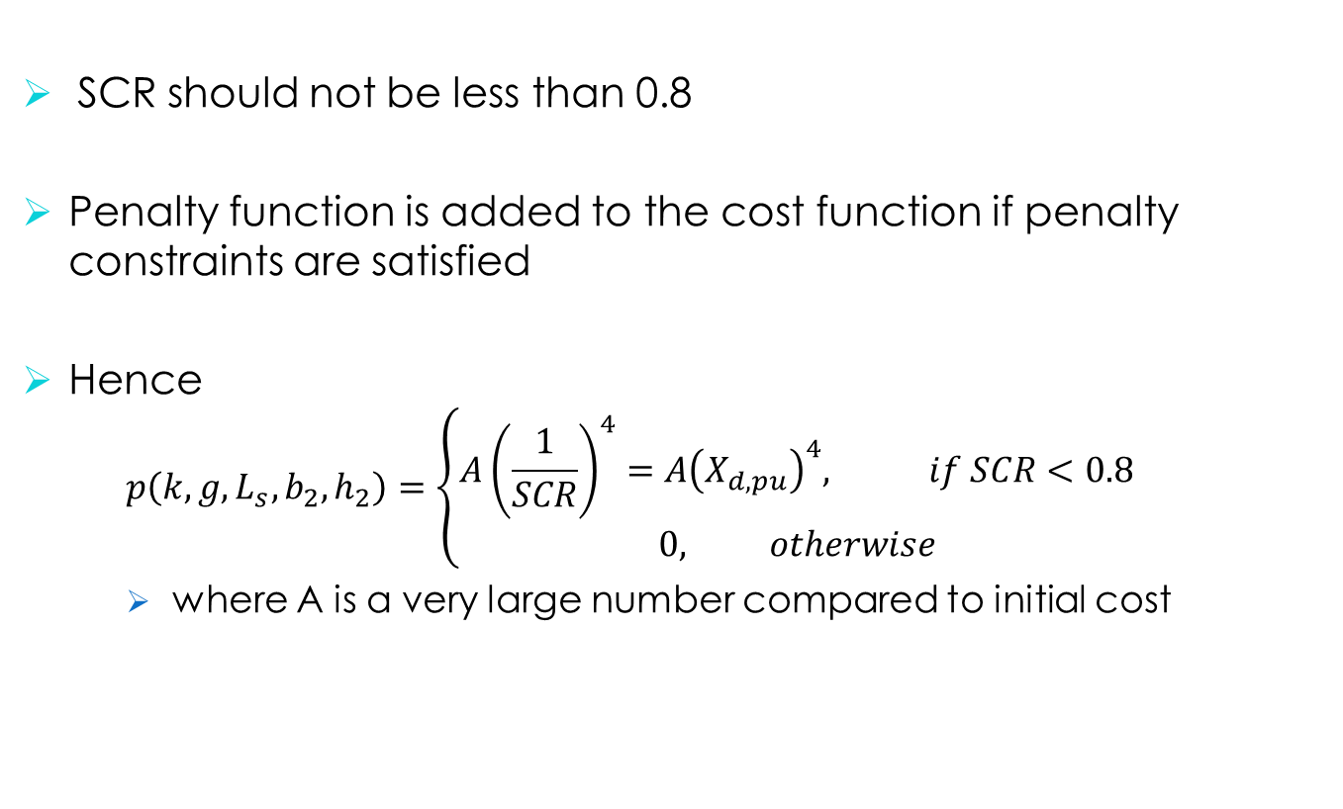
NSGA – II: Penalty Function
SCR should not be less than 0.8
Penalty function is added to the cost function if penalty constraints are satisfied
Hence
$$p\left(k,g,L_{s},b_{2},h_{2}\right)=\left\{\begin{aligned}A{\left(\frac{1}{SCR}\right)}^{4}=A{\left(X_{d,pu}\right)}^{4}, if SCR<0.8 \\ 0, otherwise\end{aligned}\right.$$
where A is a very large number compared to initial cost

Slide 13
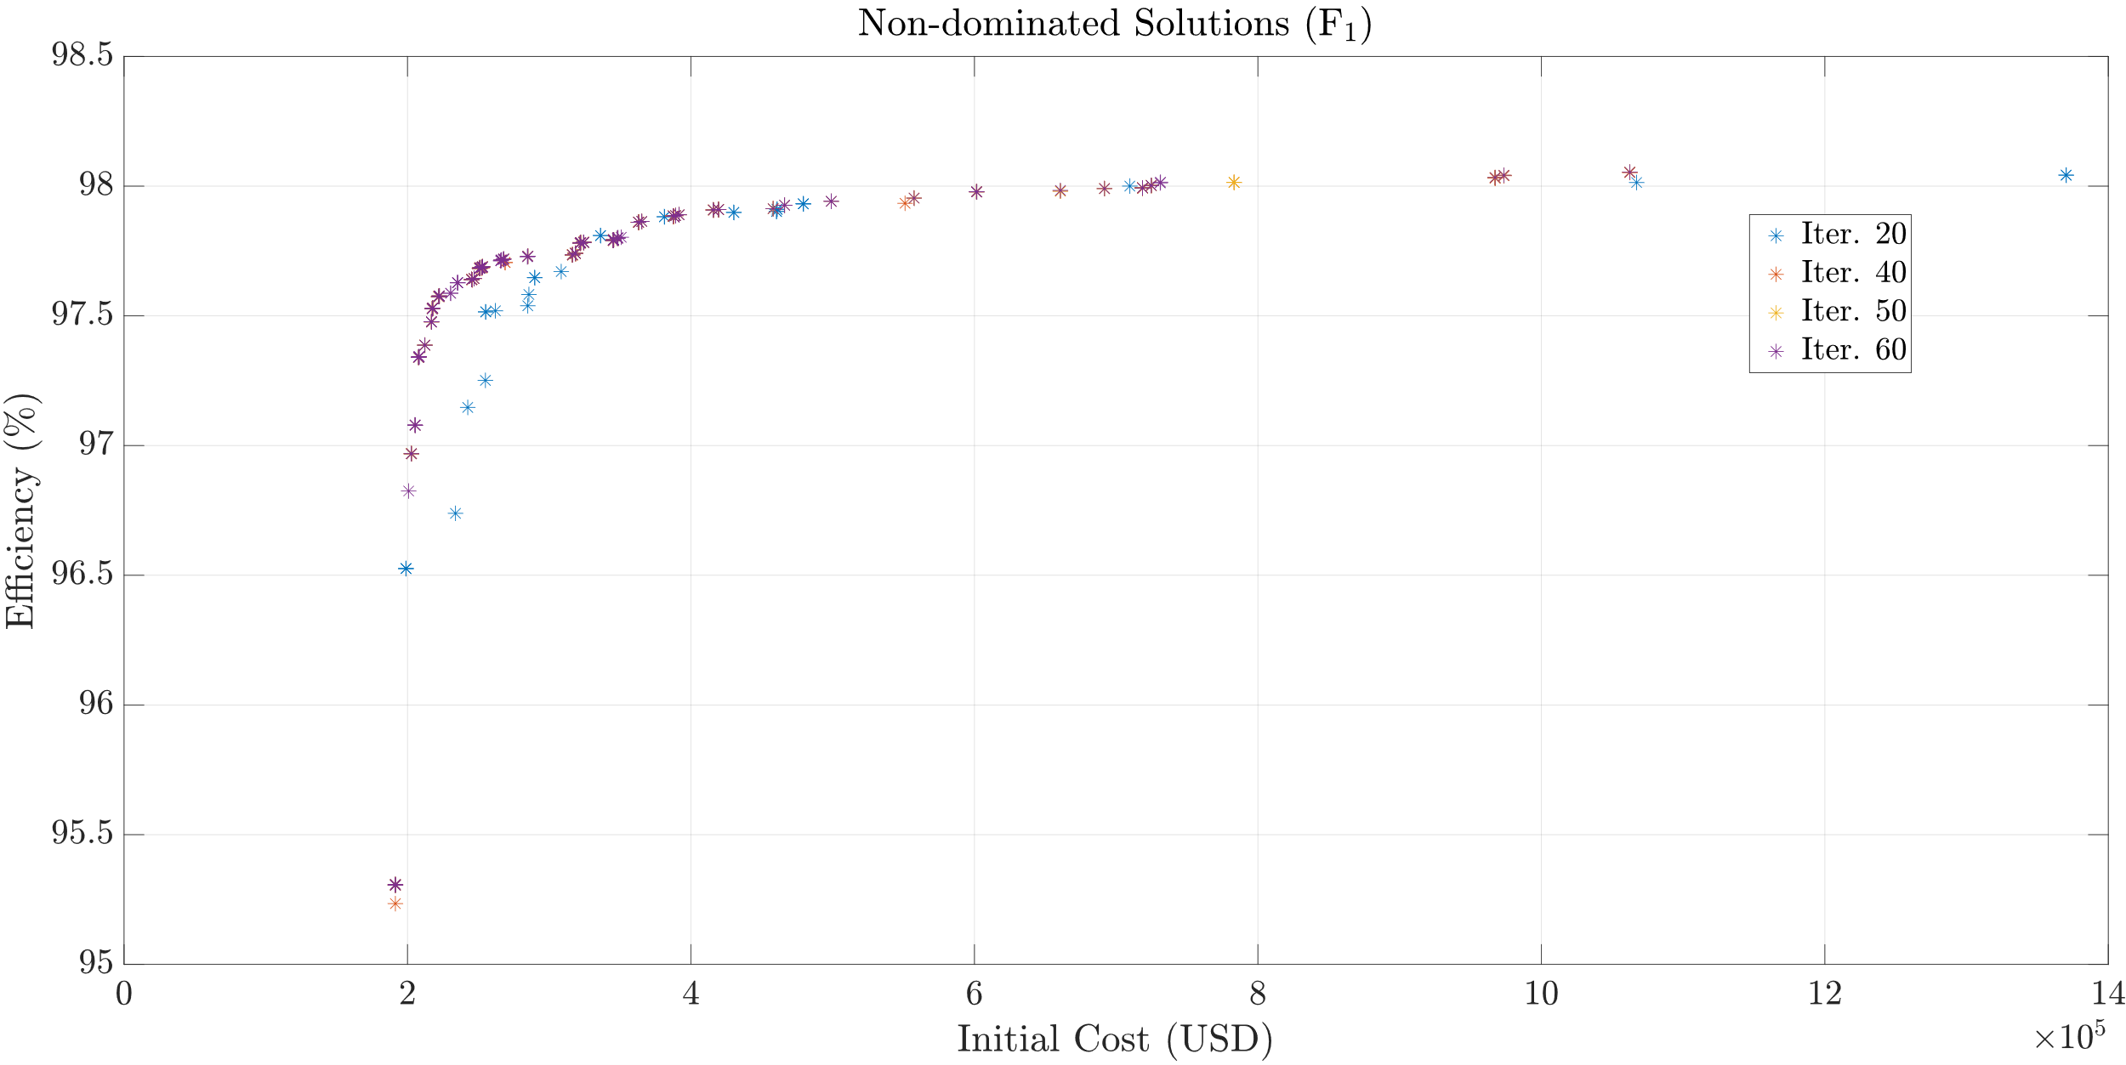
Results: Do = 6858 mm
150 Population (completed in 13h)

Slide 14
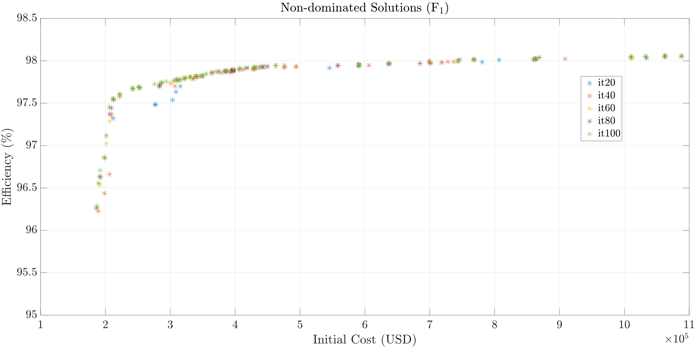
Results: Do = 6858 mm
300 Population (completed in 53h)

Slide 15
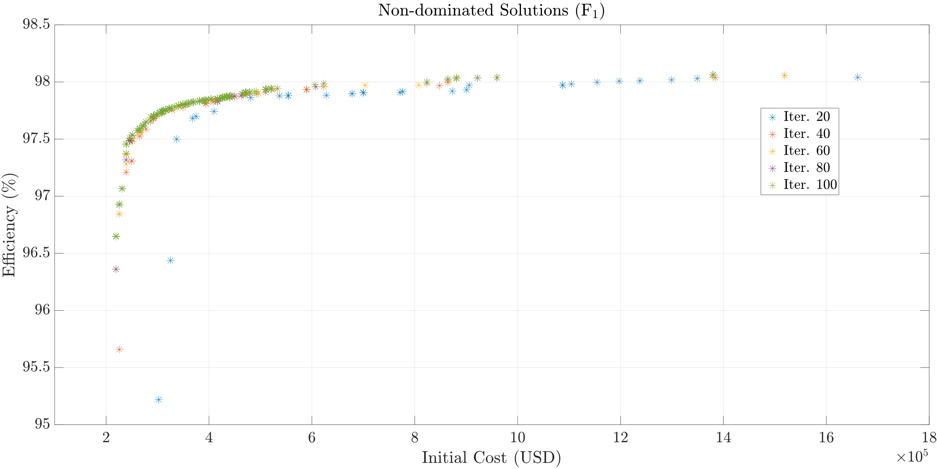
Results: Do = 8000 mm
300 Population (completed in 53h)

Slide 16
Past Plans
Completing winding design (as well as its alternatives)
Eccentricity analyses
Creating basis for advanced design and optimization
Future Plans
Completing optimization studies
Creating manufacturing documents
Manufacturing mock generator

