Slide 1
Operating Systems
OS Services & Architectures

Slide 2
Operating System Services
Services to both the users and to the programs.
Programs→ an environment to execute.
Users→ services to execute the programs in a convenient manner.
Following are few common services provided by operating systems.
Program execution
I/O operations
File System manipulation
Communication
Error Detection
Resource Allocation
Protection

Slide 3
Program Execution
Loads a program into memory.
Executes the program.
Handles program's execution.
Provides a mechanism for process synchronization.
Provides a mechanism for process communication.
Provides a mechanism for deadlock handling.
Each of these activities is encapsulated as a process.
Process: Complete execution context (code to execute, data to manipulate, registers, OS resources in use).

Slide 4
I/O Operation
I/O subsystem ???
Drivers hides the peculiarities of specific hardware devices from the user.
Operating System manages the communication between user and device drivers.
I/O operation means read or write operation with any file or any specific I/O device.
Program may require any I/O device while running.
Operating system provides the access to the required I/O device when required. How???

Slide 5
File System Manipulation
File: A collection of related information. Activities:
When the program needs to read a file or write a file, the operating system gives the permission??? to the program.
Operating System provides an interface to the user to create/delete files.
Operating System provides an interface to the user to create/delete directories.
Operating System provides an interface to create the backup of file system.

Slide 6
Communication
In case of distributed systems which are a collection of processors that do not share memory, peripheral devices, or a clock, operating system manages communications between processes.
OS handles routing and connection strategies, and the problems of contention and security.
Two processes often require data to be transferred between them.
The both processes can be on the one computer or on different computer but are connected through computer network.
Communication may be implemented by two methods either by Shared Memory or by Message Passing.

Slide 7
Error handling-Resource Management
Error Handling
Error can occur anytime and anywhere
OS constantly remains aware of possible errors.
OS takes the appropriate action to ensure correct and consistent computing.
Resource Management
In case of multi-user or multi-tasking environment, resources such as main memory, CPU cycles and files storage are to be allocated to each user or job.
OS manages all kind of resources using schedulers.
CPU scheduling algorithms are used for better utilization of CPU.

Slide 8
Protection
Computer systems having multiple users???
Processes must be protected from each another's activities.
Protection refers to mechanism or a way to control the access of programs, processes, or users to the resources defined by computer systems.
OS ensures that all access to system resources is controlled.
OS ensures that external I/O devices are protected from invalid access attempts.
OS provides authentication feature for each user.

Slide 9
A View of Operating System Services

Slide 10
User Operating System Interface - CLI
Command Line Interface (CLI) or command interpreter allows direct command entry
Sometimes implemented in kernel, sometimes by systems program
Sometimes multiple flavors implemented – shells
Primarily fetches a command from user and executes it
Sometimes commands built-in, sometimes just names of programs
If the latter, adding new features doesn’t require shell modification

Slide 11
User Operating System Interface - GUI
User-friendly desktop metaphor interface
Usually mouse, keyboard, and monitor
Icons represent files, programs, actions, etc
Various mouse buttons over objects in the interface cause various actions (provide information, options, execute function, open directory (known as a folder)
Many systems now include both CLI and GUI interfaces

Slide 12
System Calls
Programming interface to the services provided by the OS
Typically written in a high-level language (C or C++)
Mostly, accessed by programs via a high-level Application Program Interface (API) rather than direct system call use
Why use APIs rather than system calls?

Slide 13
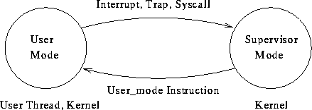
System Calls

Slide 14
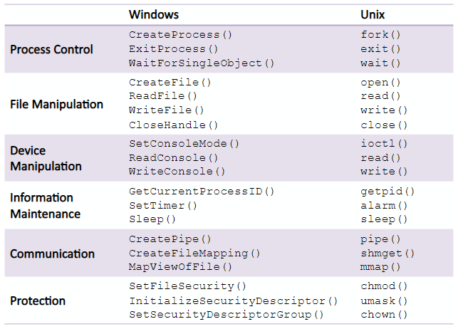
Some System Calls

Slide 15
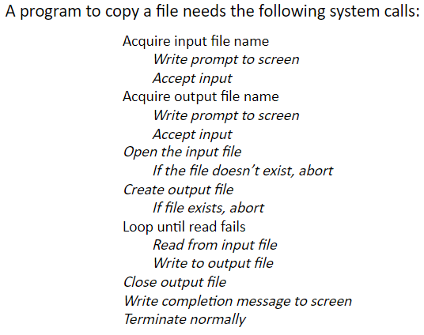
System Call Implementation - An Example

Slide 16
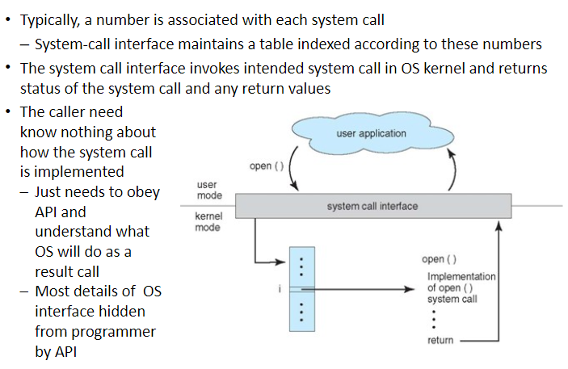
System Call Implementation

Slide 17
Example of Standard API
Consider the ReadFile() function
Win32 API—a function for reading from a file
A description of the parameters passed to ReadFile()
HANDLE file—the file to be read
LPVOID buffer—a buffer where the data will be read into and written from
DWORD bytesToRead—the number of bytes to be read into the buffer
LPDWORD bytesRead—the number of bytes read during the last read
LPOVERLAPPED ovl—indicates if overlapped I/O is being used

Slide 18
Standard C Library Example
C program invoking printf() library call, which calls write() system call

Slide 19
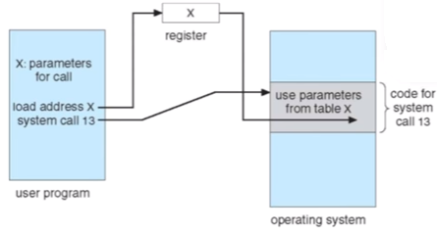
System Call Parameter Passing
Registers
Parameters stored in a block, or table, in memory and address of block passed as a parameter in a register
Parameters placed, or pushed, onto the stack by the program and popped off the stack by the operating system – Block and stack methods do not limit the number or length of parameters

Slide 20
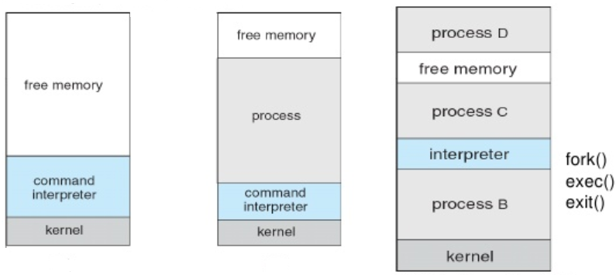

Slide 21
System Programs
System programs provide a convenient environment for program development and execution.
Categories
File management - create, delete, copy, rename, print, dump, list, and manipulate files and directories
Status information - date, time, available memory or disk space, no of users, performance, logging, and debugging information ◦
File modification - text editors to create and modify the content of files, search contents of files.
Programming language support - Compilers, assemblers, debuggers and interpreters
Program loading and execution - absolute loaders, relocatable loaders, linkage editors, overlay loaders and debuggers
Communications - Creating virtual connections among processes, users, and computer systems
System utilities Application programs - web browsers, word processors , text formatters, spreadsheets, database systems, compilers, plotting and statistical-analysis packages and games
Most users’ view of the operation system is defined by system programs, not the actual system calls

Slide 22
Operating System Design and Implementation
Design and Implementation of OS not “solvable”, but some approaches have proven successful
Internal structure of different Operating Systems can vary widely
Start by defining goals and specifications
Affected by choice of hardware, type of system
User goals and System goals
User goals – operating system should be convenient to use, easy to learn, reliable, safe, and fast
System goals – operating system should be easy to design, implement, and maintain, as well as flexible, reliable, error-free, and efficient

Slide 23
Operating System Design and Implementation (Cont.)
Important principle to separate
Policy: What will be done?
Mechanism: How to do it?
Mechanisms determine how to do something, policies decide what will be done
The separation of policy from mechanism is a very important principle, it allows maximum flexibility if policy decisions are to be changed later

Slide 24
OS Structures

Slide 25
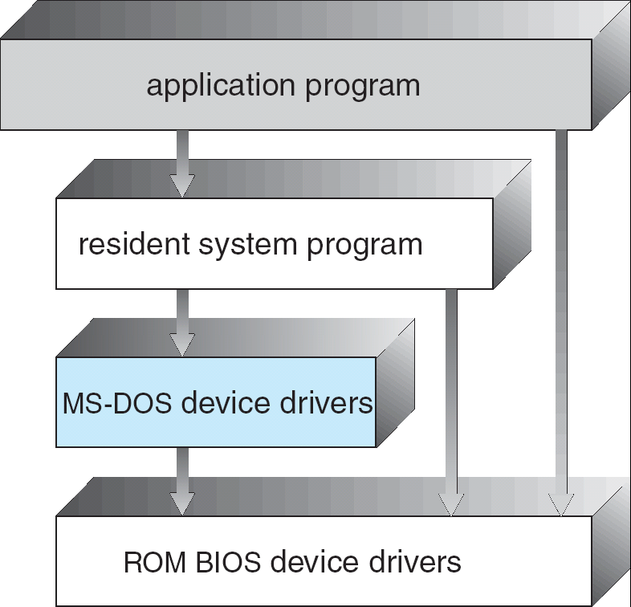
Simple Structure
Started as small, simple, and limited systems and then grown beyond their original scope
Example : MS-DOS – written to provide the most functionality in the least space
Not divided into modules
Although MS-DOS has some structure, its interfaces and levels of functionality are not well separated
Single Tasking - Single hardware
Vulnerable

Slide 26
Layered Approach
The operating system is divided into a number of layers (levels), each built on top of lower layers.
A layer is an implementation of an abstract object consists of data structures and a set of routines that can be invoked by higher-level layers
Advantage
Simplicity of construction and debugging
Each layer is implemented with only those operations provided by lower level layers
The first layer can be debugged without any concern for the rest of the system
Correct functioning of first layer can be assumed while the second layer is debugged, and so on

Slide 27
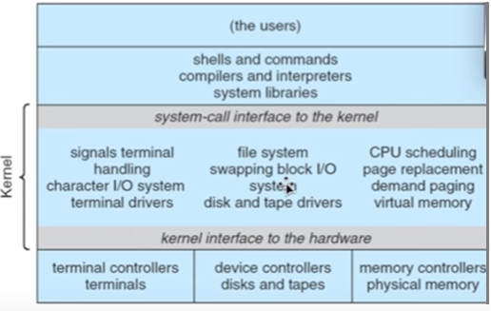
Example - Unix
The UNIX OS consists of two separable parts
Systems programs
The kernel
Consists of everything below the system-call interface and above the physical hardware
Provides the file system, CPU scheduling, memory management, and other operating-system functions; a large number of functions for one level

Slide 28
Microkernel System Structure
Structures the OS by removing all nonessential components from the kernel and implementing them as system and user-level programs.
Communication takes place between user modules using message passing
Benefits:
Easier to extend a microkernel
Easier to port the operating system to new architectures
More reliable (less code is running in kernel mode)
More secure
Detriments:
Performance overhead of user space to kernel space communication

Slide 29
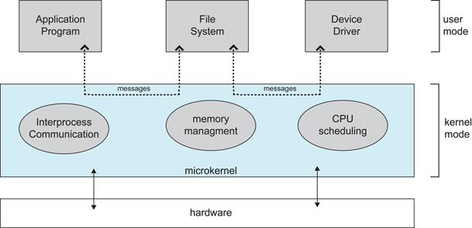
Microkernel System Structure

Slide 30
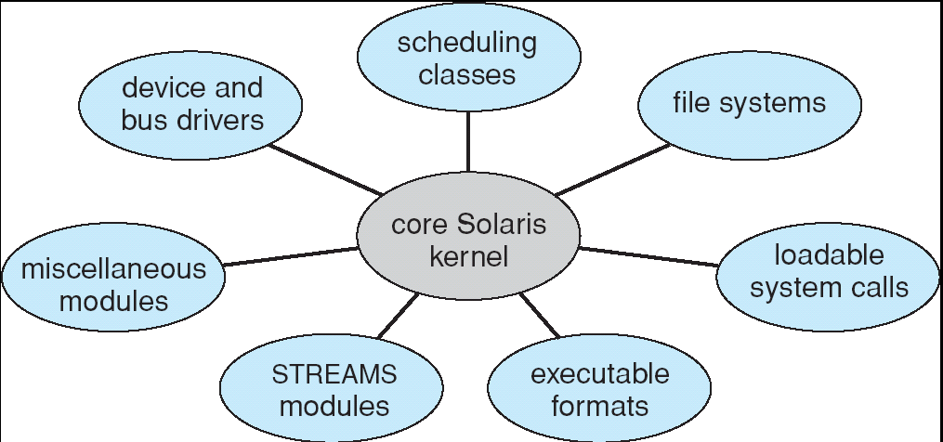
Modules
Uses object-oriented approach
Each core component is separate
Each talks to the others over known interfaces
Each is loadable as needed within the kernel – a core kernel with seven types of loadable kernel modules

Slide 31
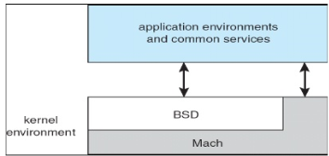
Mac OS X Structure(Darwin)
Uses a hybrid structure; layered technique with one layer consists of the Mach microkernel.
Top layers include application environments and a set of services providing a graphical interface to applications
Below these layers is the kernel consists primarily of the Mach microkernel and the BSD kernel
Mach provides m/y mgmt, support RPC and IPC facilities, including message passing and thread scheduling
BSD component provides a BSD CLI, support for networking and file systems, and an implementation of POSIX APIs, including Pthreads

Slide 32
Virtual Machines
It abstracts hardware of a single computer into several different execution environments i.e. creates illusion of separate execution environment is running its own private computer.
Provides an interface identical to the underlying bare hardware
The operating system creates the illusion of multiple processes, each executing on its own processor with its own (virtual) memory.
The resources of the physical computer are shared to create the virtual machines
A major difficulty is disk systems, solved using Virtual disks (minidisks in IBM)
Users are given their own virtual machines and they can run any of the operating systems or software packages that are available

Slide 33
(a) Nonvirtual machine (b) virtual machine ,

Slide 34
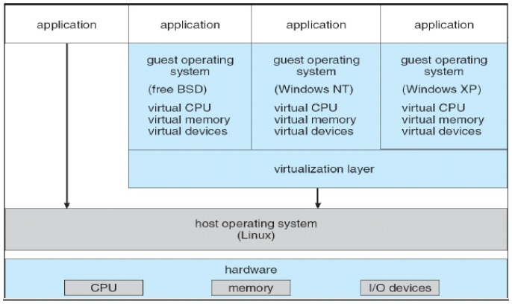
Example - Vmware
Abstracts Intel 80X86 hardware into isolated virtual machines.
Runs as an application on host OS and allows concurrently running several different guest operating systems as independent virtual machines

