Slide 1
OPERATING SYSTEMS
Deadlock

Slide 2
Deadlock
Each process uses a source(allocate) and at this time each one wants the other’ s source (request) →DEADLOCK!!!

Slide 3
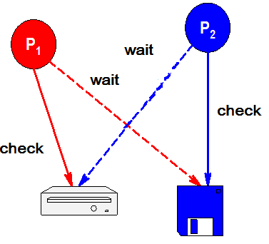
Deadlock
Consider that P1 and P2 has CD and floppy.
At this moment, P1 waits for floppy and P2 waits for CD
Both of the processes wait → Deadlock!!!

Slide 4
Deadlock-Formal Definition
Processes use limited resources in multitasking systems. A process requests a source and waits, if the source is not available.
If the concerning source is used by another processes at that moment, the process may not exit this waiting situation → Deadlock!!!
A) Reusable Sources
Used and then leaved by the concerning process for being used by the others.
CPU, main memory, I/O devices
B) Consumable Sourcess
Used and then removed by the concerning process.
Can not be used by the other processes.
Interrupts, signals, messages

Slide 5
Deadlock Example
Consider that the main memory has the part of 200 Kbytes. Consequtively, P1 and P2 request:
Does deadlock happen?
How is it prevented?
P1 | P2
80 KBytes | 70 KBytes
… | …
60 KBytes | 80 KBytes

Slide 6
Necassary Conditions for Deadlock
ALL of these four must happen simultaneously for deadlock:
Mutual exclusion: One or more than one resource must be held by a process in a non-sharable (exclusive) mode.
Hold and Wait: A process holds a resource while waiting for another resource.
No Preemption: There is only voluntary release of a resource after finishing - nobody else can make a process give up a resource.
Circular Wait: Process A waits for Process B waits for Process C .... waits for Process A.

Slide 7
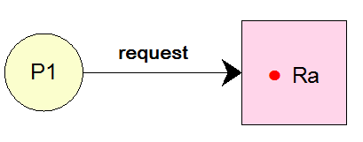
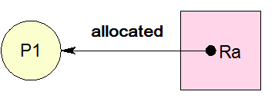
Source Allocation Graphs
Requests of the processes and allocation of the resurces are illustrated by source allocation graphs.
Circles for processes, squares for resources and dots for number of the available resources.

Slide 8
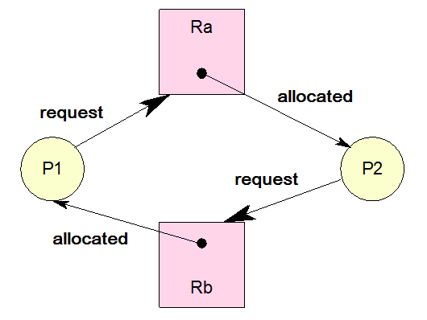
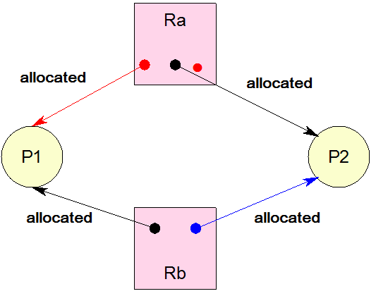
Deadlock – Circular wait

Slide 9
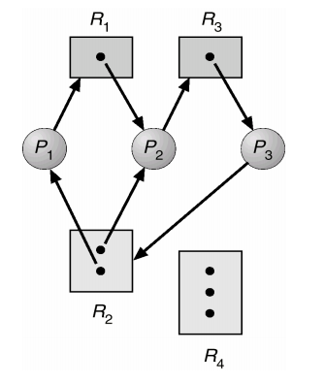
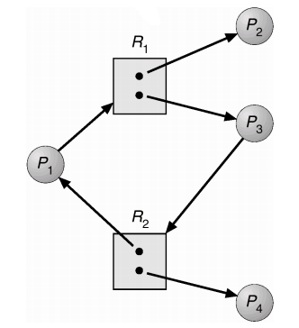
Example

Slide 10
How to Handle Deadlocks?
There are three methods:
Ignore Deadlocks ***
Ensure deadlock never occurs using either
Prevention: Prevent any one of the 4 conditions from happening.
Avoidance: Allow all deadlock conditions, but calculate cycles about to happen and stop dangerous operations.
Allow deadlock to happen. This requires using both:
Detection: Know a deadlock has occurred.
Recovery: Regain the resources.

Slide 11
Deadlock Preventation
Mutual exclusion:
Prevention is not possible, since it requires allocation of the resources.
Hold and wait:
a) Collect all resources before the execution of a process.
b) A particular resource can only be requested when no others are being held. A sequence of resources is always collected beginning with the same one.
c) Utilization is low, starvation possible.

Slide 12
Deadlock Preventation
No preemption:
a) Release any resource already being held if the process can't get an additional resource.
b) Allow preemption - if a needed resource is held by another process, which is also waiting on some resource, steal it. Otherwise wait.
Circular wait:
a) Number resources and only request in ascending order.
EACH of these prevention techniques may cause a decrease in utilization and/or resources. For this reason, prevention isn't necessarily the best technique.
Prevention is generally the easiest to implement.

Slide 13
Deadlock Avoidance
If we have prior knowledge of how resources will be requested, it's possible to determine if we are entering an "unsafe" state.
Possible states are:
Deadlock: No forward progress can be made.
Unsafe state: A state that may allow deadlock.
Safe state: A state is safe if a sequence of processes exist such that there are enough resources for the first to finish, and as each finishes and releases its resources there are enough for the next to finish.
The rule is simple: If a request allocation would cause an unsafe state, do not honor that request.
NOTE: All deadlocks are unsafe, but all unsafes are NOT deadlocks.
Banker’s Algorithm!!!

Slide 14
Deadlock Detection
No restriction for allocation of resources. Available resurces can ben allocated to the processes. The method is as follows:
1.Sign the row that consist of zeros in the A matrix.
2.Define W matrix and and make W=V for the available resources.
3. Check requested resources (Q) for the unsigned rows
a. Stop if Q>W
Add it to W, sign the row and go to step 3.

Slide 15
Deadlock Recovery
So, the deadlock has occurred???
PROCESS TERMINATION:
Could delete all the processes in the deadlock -- this is expensive.
Delete one at a time until deadlock is broken ( time consuming ).
Select who to terminate based on priority, time executed, time to completion, needs for completion, or depth of rollback
In general, it's easier to preempt the resource, than to terminate the process.
RESOURCE PREEMPTION:
Select a victim - which process and which resource to preempt.
Rollback to previously defined "safe" state.
Prevent one process from always being the one preempted ( starvation ).

