Slide 1
OPERATING SYSTEMS
Basic Structure of a Computer System & Introduction to Operating Systems

Slide 2
Why should we know?
Need to understand interaction between the hardware and applications
Need to understand basic principles in the design of computer systems
efficient resource management, security, flexibility
Increasing need for specialized operating systems
e.g. embedded operating systems for devices - cell phones, sensors and controllers
real-time operating systems - aircraft control, multimedia services

Slide 3
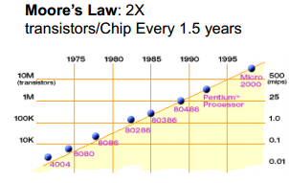

Slide 4
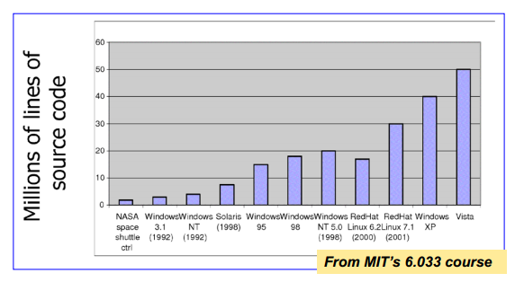

Slide 5
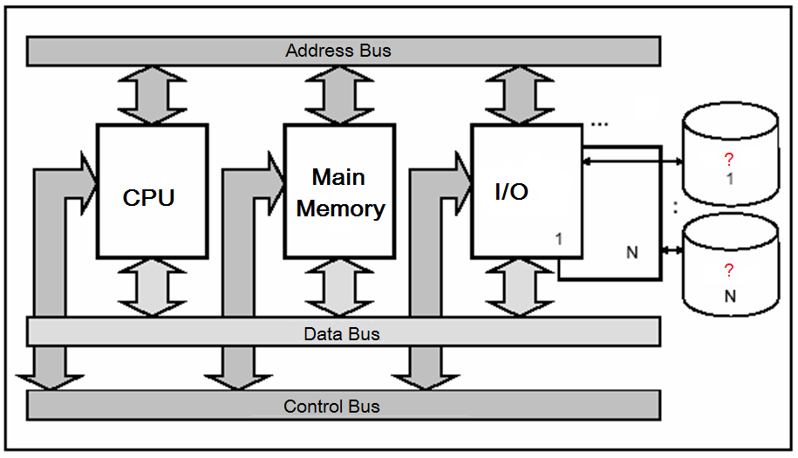
Components of a Computer System (Hardware)

Slide 6
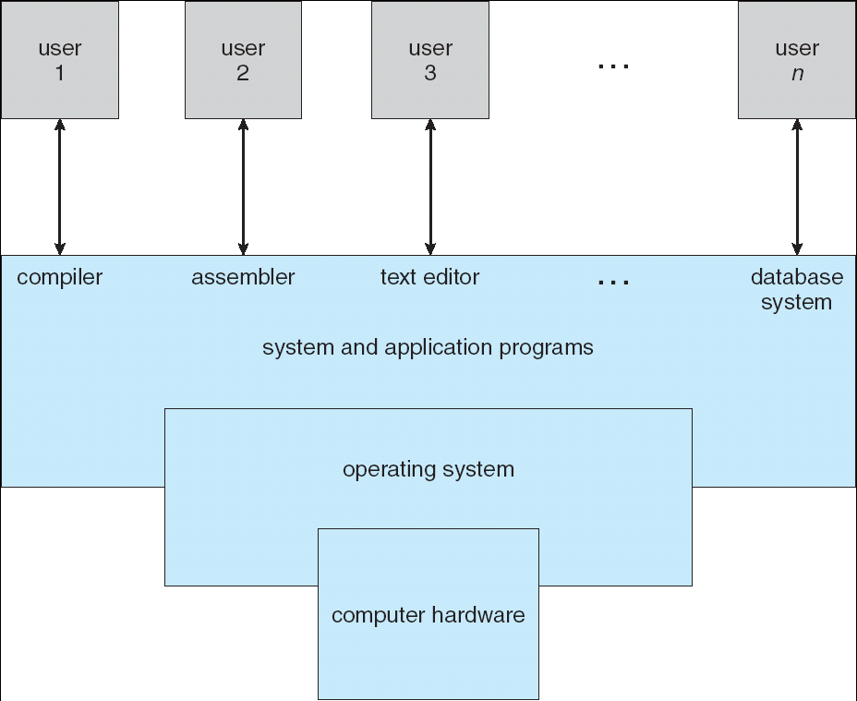
Components of a Computer System (Conceptional)
User???
Where is operating system?
Why is it used?

Slide 7
Operating System is…
A resource allocator:
Sources???
Distributing→By considering what?
A control program:
What does it control?
Why does it control?
The kernel:
What does this mean?

Slide 8
Goals
Simplify the execution of user programs and make solving user problems easier.
Use computer hardware efficiently.
Allow sharing of hardware and software resources.
Make application software portable and versatile.
Provide isolation, security and protection among user programs.
Improve overall system reliability
Error confinement, fault tolerance, reconfiguration.

Slide 9
While starting…
Bootstrap Program (Loader): A short program in ROM (Windows) that loads operating system.
Firmware: Software that is used by every kind of hardware (capable of digital data processing) to perform their concerning operations.
Read-only
Hardware of computer, in embedded systems, digital camera, cell phone.
Can be updated.

Slide 10
DEVELOPMENTS&KINDS
Historical Development and Classification of Operating Systems

Slide 11
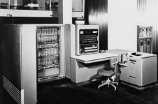
Early Systems - Bare Machine (1950s)
Structure
Large machines run from console
Single user system
Programmer/User as operator
Paper tape or punched cards
User is not the operator
Early software
Assemblers, compilers, linkers, loaders, device drivers, libraries of common subroutines.
Secure execution
Inefficient use of expensive resources
Low CPU utilization, high setup time.

Slide 12
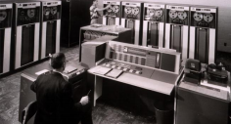
Simple Batch Systems (1960’s)
Reduce setup time by batching jobs with similar
requirements.
Add a card reader, Hire an operator
User is NOT the operator
Automatic job sequencing
Forms a rudimentary OS.
Resident Monitor
Holds initial control, control transfers to job and then back to monitor.
Problems
Need to distinguish job from job and data from program.
Lack of interaction between the user and job.
CPU is often idle, because the speeds of the mechanical
I/O devices are slower than CPU.
Difficult to provide the desired priority.
Notes:
The users of batch operating system do not interact with the computer directly. Each user prepares his job on an off-line device like punch cards and submits it to the computer operator. To speed up processing, jobs with similar needs are batched together and run as a group. Thus, the programmers left their programs with the operator. The operator then sorts programs into batches with similar requirements.

Slide 13
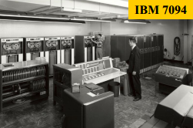
Supervisor/Operator Control
Secure monitor that controls job processing
Special cards indicate what to do.
User program prevented from performing I/O
Separate user from computer
User submits card deck
cards put on tape
tape processed by operator
output written to tape
tape printed on printer
Problems
Long turnaround time - up to 2 DAYS!!!
Low CPU utilization
I/O and CPU could not overlap; slow mechanical devices.

Slide 14
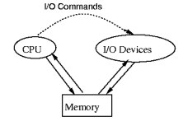
Batch System Solutions-Speeding Up I/O
Offline Processing
load jobs into memory from tapes, card reading and line printing are done offline.
Spooling
Use disk (random access device) as large storage for reading as many input files as possible and storing output files until output devices are ready to accept them.
Allows overlap - I/O of one job with computation of another.
Introduces notion of a job pool that allows OS choose next job to run so as to increase CPU utilization.
DMA (Direct Memory Access)
Used for high-speed I/O devices able to
transmit information at close to memory
speeds
Device controller transfers blocks of data
from buffer storage directly to main memory
without CPU intervention

Slide 15
Batch System Solutions-Speeding Up I/O
How do we know I/O is completed?
Polling:
Device sets a flag when it is busy.
Program tests the flag in a loop waiting for completion of I/O.
Interrupts:
On completion of I/O, device forces CPU to jump to a specific instruction address that contains the interrupt service routine.
After the interrupt has been processed, CPU returns to code it was executing prior to servicing the interrupt.

Slide 16
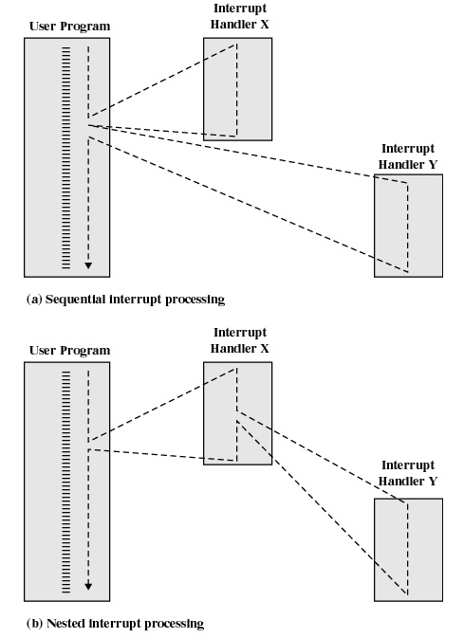
Interrupts

Slide 17
Multiprogramming
Use interrupts to run multiple programs simultaneously
When a program performs I/O, instead of polling, execute
another program till interrupt is received.
Requires secure memory, I/O for each program.
Requires intervention if program loops indefinitely.
Requires CPU scheduling to choose the next job to run.

Slide 18
Timesharing (Multitasking)
Enables many people, located at various terminals, to use a particular computer system at the same time.
Processor's time which is shared among multiple users simultaneously is termed as time-sharing.
The purpose is to minimize response time.
Multiple jobs are executed by the CPU by switching between them so frequently.

Slide 19
Personal Computer Systems
Single user systems, portable.
I/O devices - keyboards, mice, display screens, small printers.
Laptops and palmtops, Smart cards, Wireless devices.
Single user systems may not need advanced CPU utilization or protection features.
Advantages:
user convenience, responsiveness, ubiquitous

Slide 20
Parallel Systems
Multiprocessor systems with more than one CPU in close communication.
High processing
High security
Hard – CPUs share memory and clock. Communication via memory.
Asymmetric multiprocessing
Each CPU is dedicated to a specific problem.
The major CPU plans and distributes jobs.

Slide 21
Parallel Systems
Symmetric multiprocessing
Every CPU executes the same copy of operating system.
Many operating systems support SMP

Slide 22
Distributed Systems
Multiple central processors to serve multiple real time application and multiple users.
Processors in a distributed system may vary in size and function. These processors are referred as sites, nodes, and computers and so on.
Data processing jobs are distributed among the processors accordingly to which one can perform each job most efficiently.
The processors communicate with one another through various communication lines (such as high-speed buses or telephone lines).
Advantages:
Usage of resources collectively
Increasing processing time- sharing of load
Disadvantages
Safety
Communication
Requires network

Slide 23
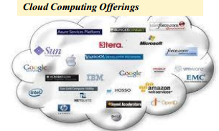
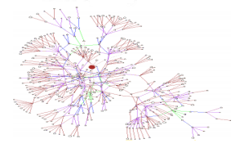
Distributed Systems

Slide 24

Real Time Operating Systems
A data processing system in which the time interval required to process and respond to inputs is so small.
Real-time operating system has well-defined, fixed time constraints otherwise system will fail.
For example Scientific experiments, medical imaging systems, industrial control systems, weapon systems, robots, and home-appliance controllers, Air traffic control system etc.

Slide 25
Real Time Operating Systems
Hard real-time systems
Guarantee that critical tasks complete on time.
Failure if response time too long.
Data are collected in main memory
Secondary storage is limited
Soft real-time systems
Less restrictive.
Less accurate if response time is too long.
Useful in applications such as multimedia, virtual reality.

