Slide 1
STORAGE AND DISPLAY OF SUSTAINABLE/LARGE DATA IN DATABASE SYSTEM FOR ONLINE DISPLAY
PROGRESS REVIEW
DECEMBER 12th, 2023
SAMIR SHRESTHA [001123544]
BEng (Hons) Computer Engineering (Extended)

Slide 2
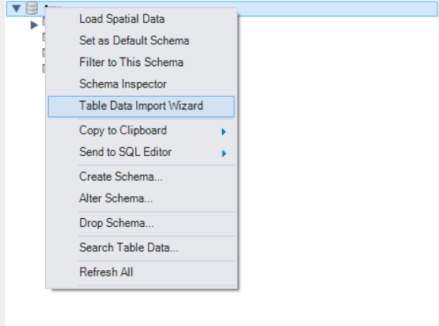
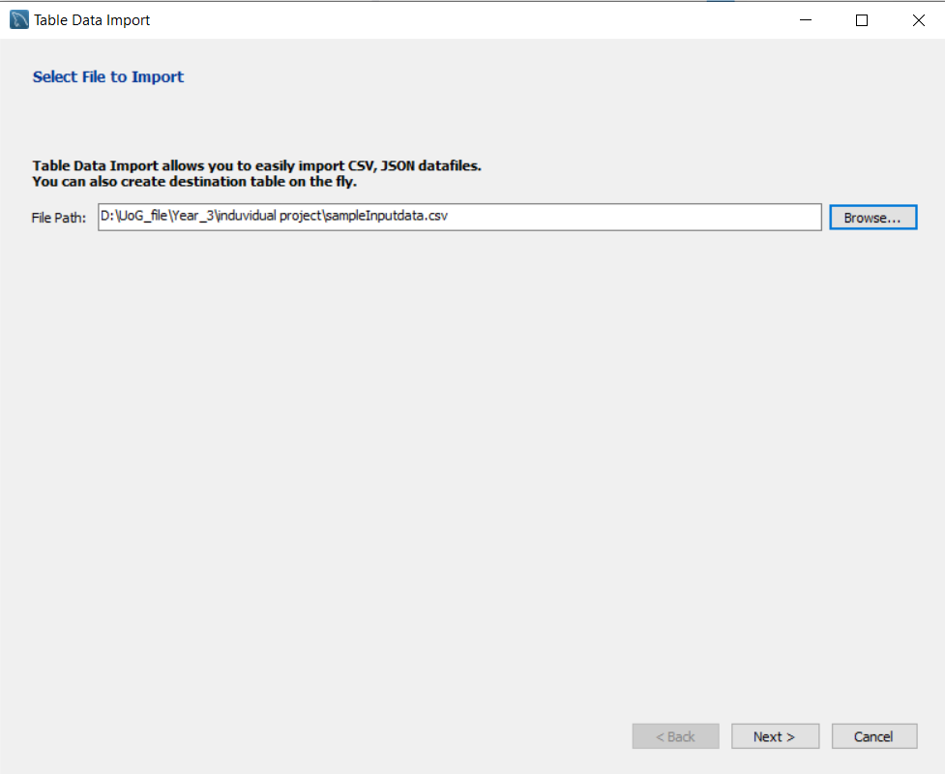
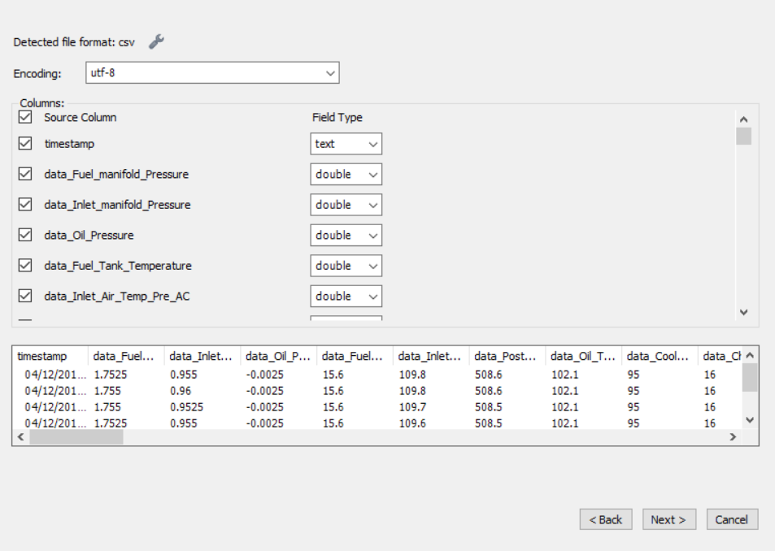
FIRST PHASE
IMPORTED THE EXCEL FILE TO MySQL USING TABLE IMPORT WIZARD.

Slide 3
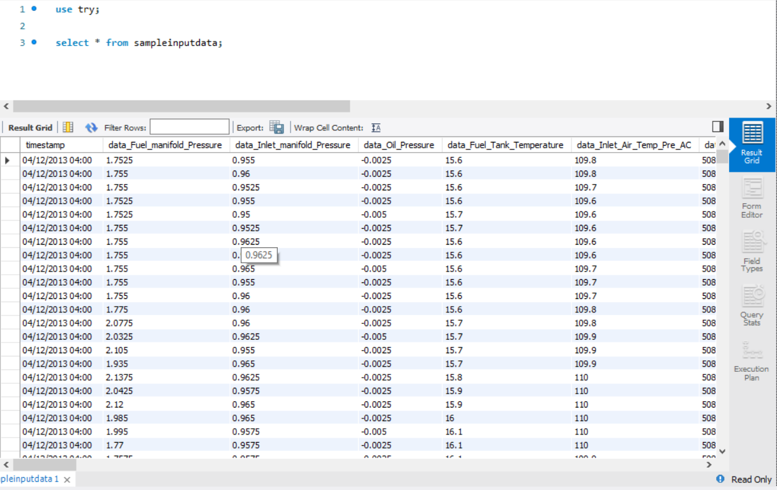
RESULT OF First Phase
Using SQL Query, we can access the data

Slide 4
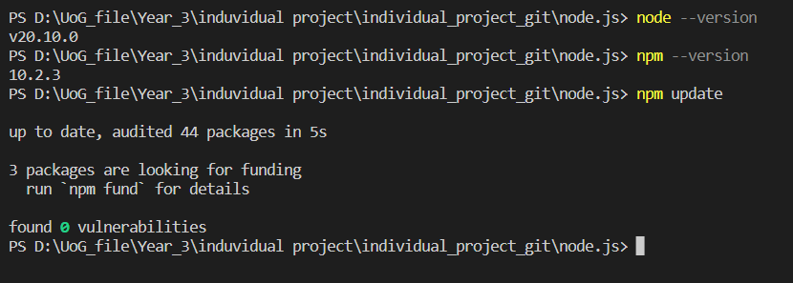
SECOND PHASE
Second Phase Comprises of connecting MySQL server to NodeJS and accessing the data directly from terminal.
To be able to connect NodeJS to MySQL, latest Version of NodeJS was downloaded and updated
Error might occur if NodeJS is not downloaded or updated to its latest version.
      NodeJS : JavaScript Runtime Environment.
      NPM(Node Packet Manager) : allows user to find and download JS package for web development. (similar functionality as “sudo apt” in Debian )

Slide 5
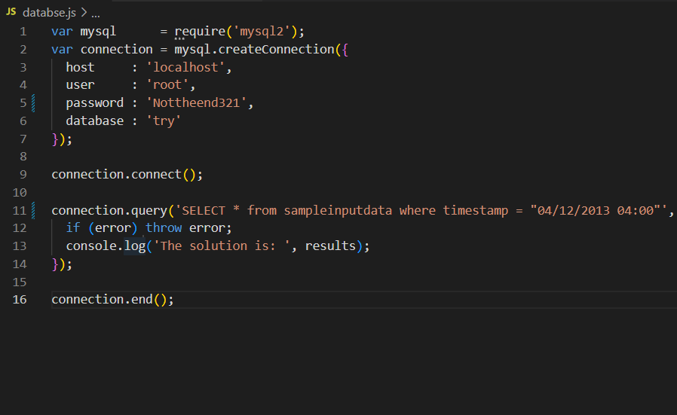
SECOND PHASE
Following Code was used while connecting MySQL server to NodeJS.
First Line of the code imports the ‘mysql2’ module, which is MySQL client for NodeJS.
From line 2-9, creates MySQL connection using user configuration.
From line 11-14, executes SQL query using ‘query’ method.
Line 16, closes the connection to MySQL database

Slide 6
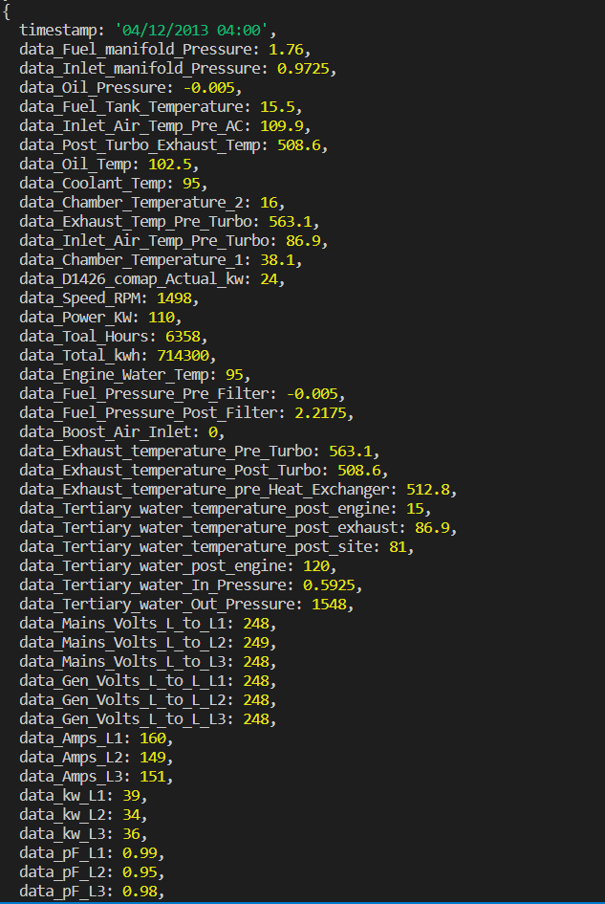
‘node .\database.js’ syntax is used to execute the code
RESULT OF Second Phase
Output of code :

Slide 7
NEXT PHASE ?
Server-Side Scripting .
    PHP/ BLAZOR(ASP.NET)
    PHP is popular general-purpose server-side scripting language (provides various option for database integration).
    Blazor is a .NET web framework which supports both server-side rendering and client interactivity in a single programming model. \
Client-Side Scripting .
    HTML , CSS & JAVASCRIPT
    React.JS

Slide 8
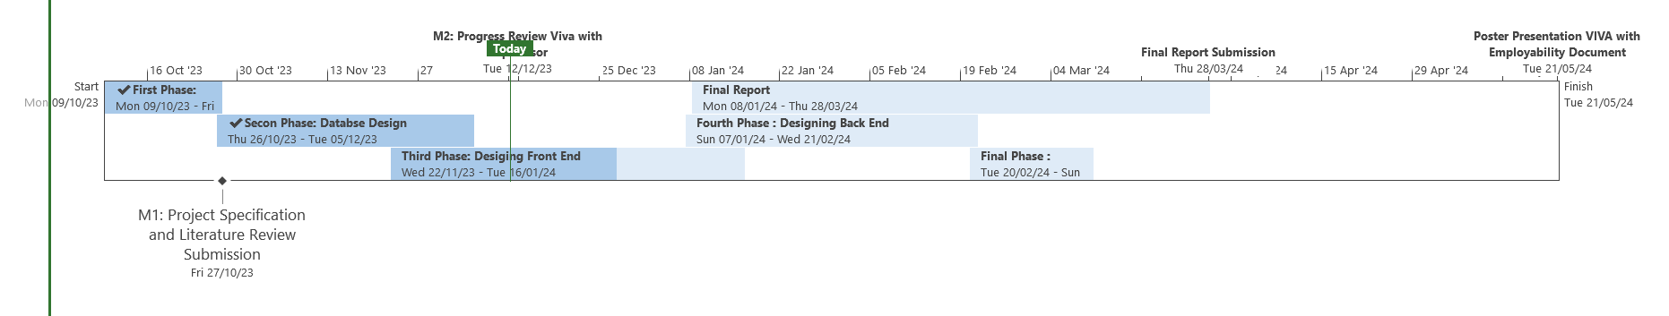
GANTT CHART

