Slide 1
Twitter stock analysis
Sam Fadrigalan
& Rachel Smith

Slide 2
System design
AWS EC2 Instances
6 – t2.medium instances
4GB – memory per node
80GB – storage per node
Hadoop Cluster (Hadoop 2.7.1, Java OpenJDK-8)
1 – NameNode
5 – DataNodes
2 – Replication Factor
128MB – Block Sizes
Pig (version 0.16.0)
Spark Cluster using YARN on top of Hadoop Cluster (Spark 2.1.0, Python 2.7, Scala 2.11.6)

Slide 3
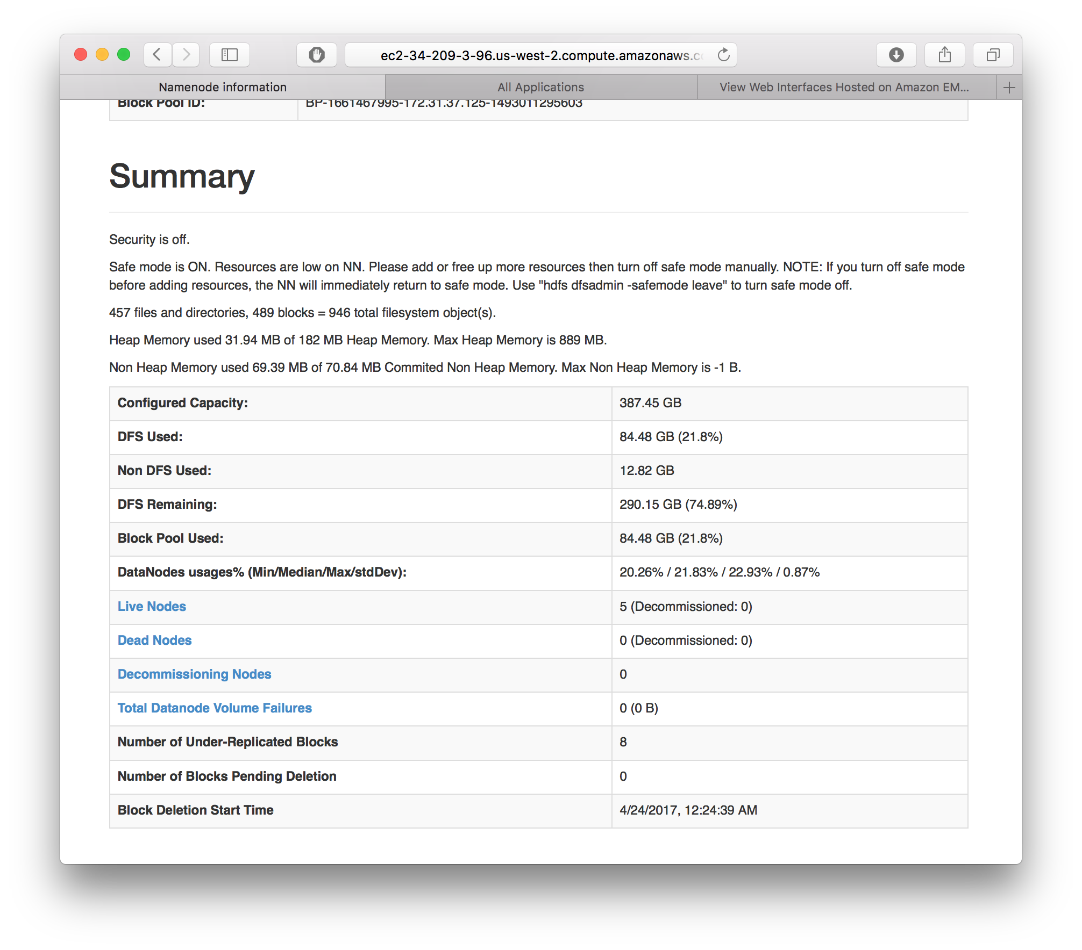
System design
Hadoop HDFS NameNode WebUI hosted on http://namenode_public_dns:50070

Slide 4
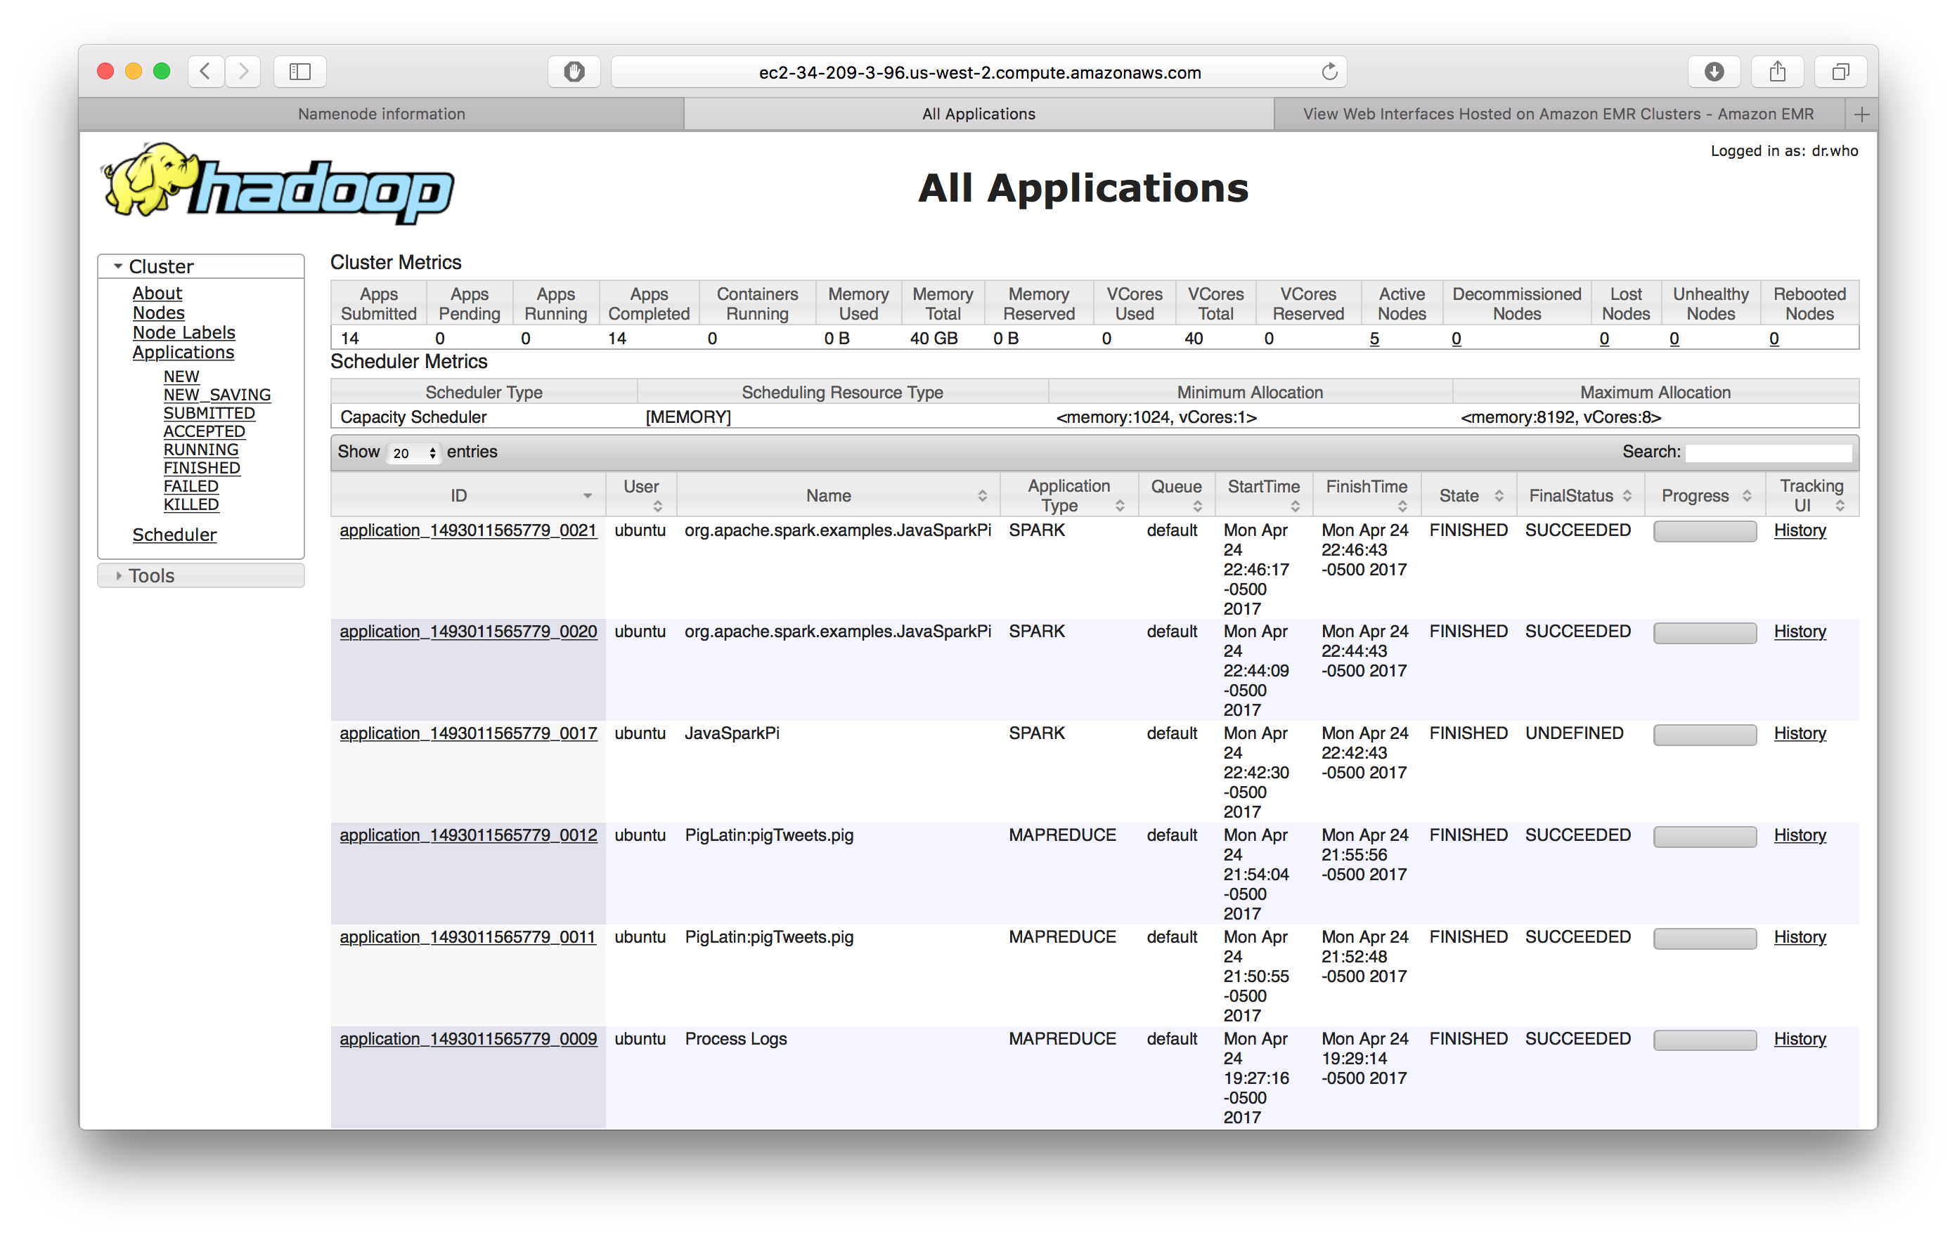
System design
YARN Resource Manager hosted on http://namenode_public_dns:8080

Slide 5
datasets
We collected daily datasets from September, 2009 from 3 sources.
Yahoo Finance: GOOGL, MSFT, AAPL, VZ
Actual stock prices for testing algorithm
SNAP Twitter Data: randSeptember 1-30, 2009
Over 20Gb worth of “random” Tweets from September 1-30, 2009
Google Trends: Google, Microsoft, Apple, Verizon
Datasets for Google Web, Shopping, and News results were collected for each

Slide 6
Tweet analysis
Language used: Python
Libraries/APIs used: Python Libraries, Natural Language Toolkit
Environments used: HDFS, Pig, Atom

Slide 7
Tweet analysis: Data preprocessing
Input Data (AWS s3 file)
Map Only Hadoop Job Output
T 2009-09-01 21:43:59
U http://twitter.com/burtonator
W @themadlad do you have the exact address? i'd like to see it in google street view.
T 2009-09-02 21:47:23
U http://twitter.com/tenscottie
W Yeah, you don't drive so crazy when there's a COP on the side of the road, do you scumbag?! Now
T 2009-09-02 01:15:44
U http://twitter.com/luisamermaid
W No Post Title
….
/output/tweets/2009-09/part-m-000xx
2009-09-01 @themadlad do you have the exact address? i'd like to see it in google street view.
2009-09-02 Yeah, you don't drive so crazy when there's a COP on the side of the road, do you scumbag?! Now
….
Text Input Format is set to delimit for every empty line conf.set("textinputformat.record.delimiter","\n\n");
Mapper does not context.write() Tweets with values with “No Post Title”

Slide 8
Tweet analysis: Data preprocessing
Map Only Hadoop Job Output
Pig Output to HDFS
/output/tweets/pig/2009-09/2009-09-01-0,0xx
/output/tweets/2009-09/part-m-000xx
2009-09-01 @themadlad do you have the exact address? i'd like to see it in google street view.
…
2009-09-01 @themadlad do you have the exact address? i'd like to see it in google street view.
2009-09-02 Yeah, you don't drive so crazy when there's a COP on the side of the road, do you scumbag?! Now
….
/output/tweets/pig/2009-09/2009-09-01-0,0xx
2009-09-01 @themadlad do you have the exact address? i'd like to see it in google street view.
…
Data is loaded from results of previous map job
data = LOAD '/output/tweets/2009-09/part-*' AS (date:chararray, tweet:chararray);
Pig MultiStorage is used to write grouped by date pairs to HDFS
STORE data INTO '/output/tweets/pig/2009-09' USING org.apache.pig.piggybank.storage.MultiStorage('/output/tweets/pig/2009-09','0', 'none', '\\t');

Slide 9
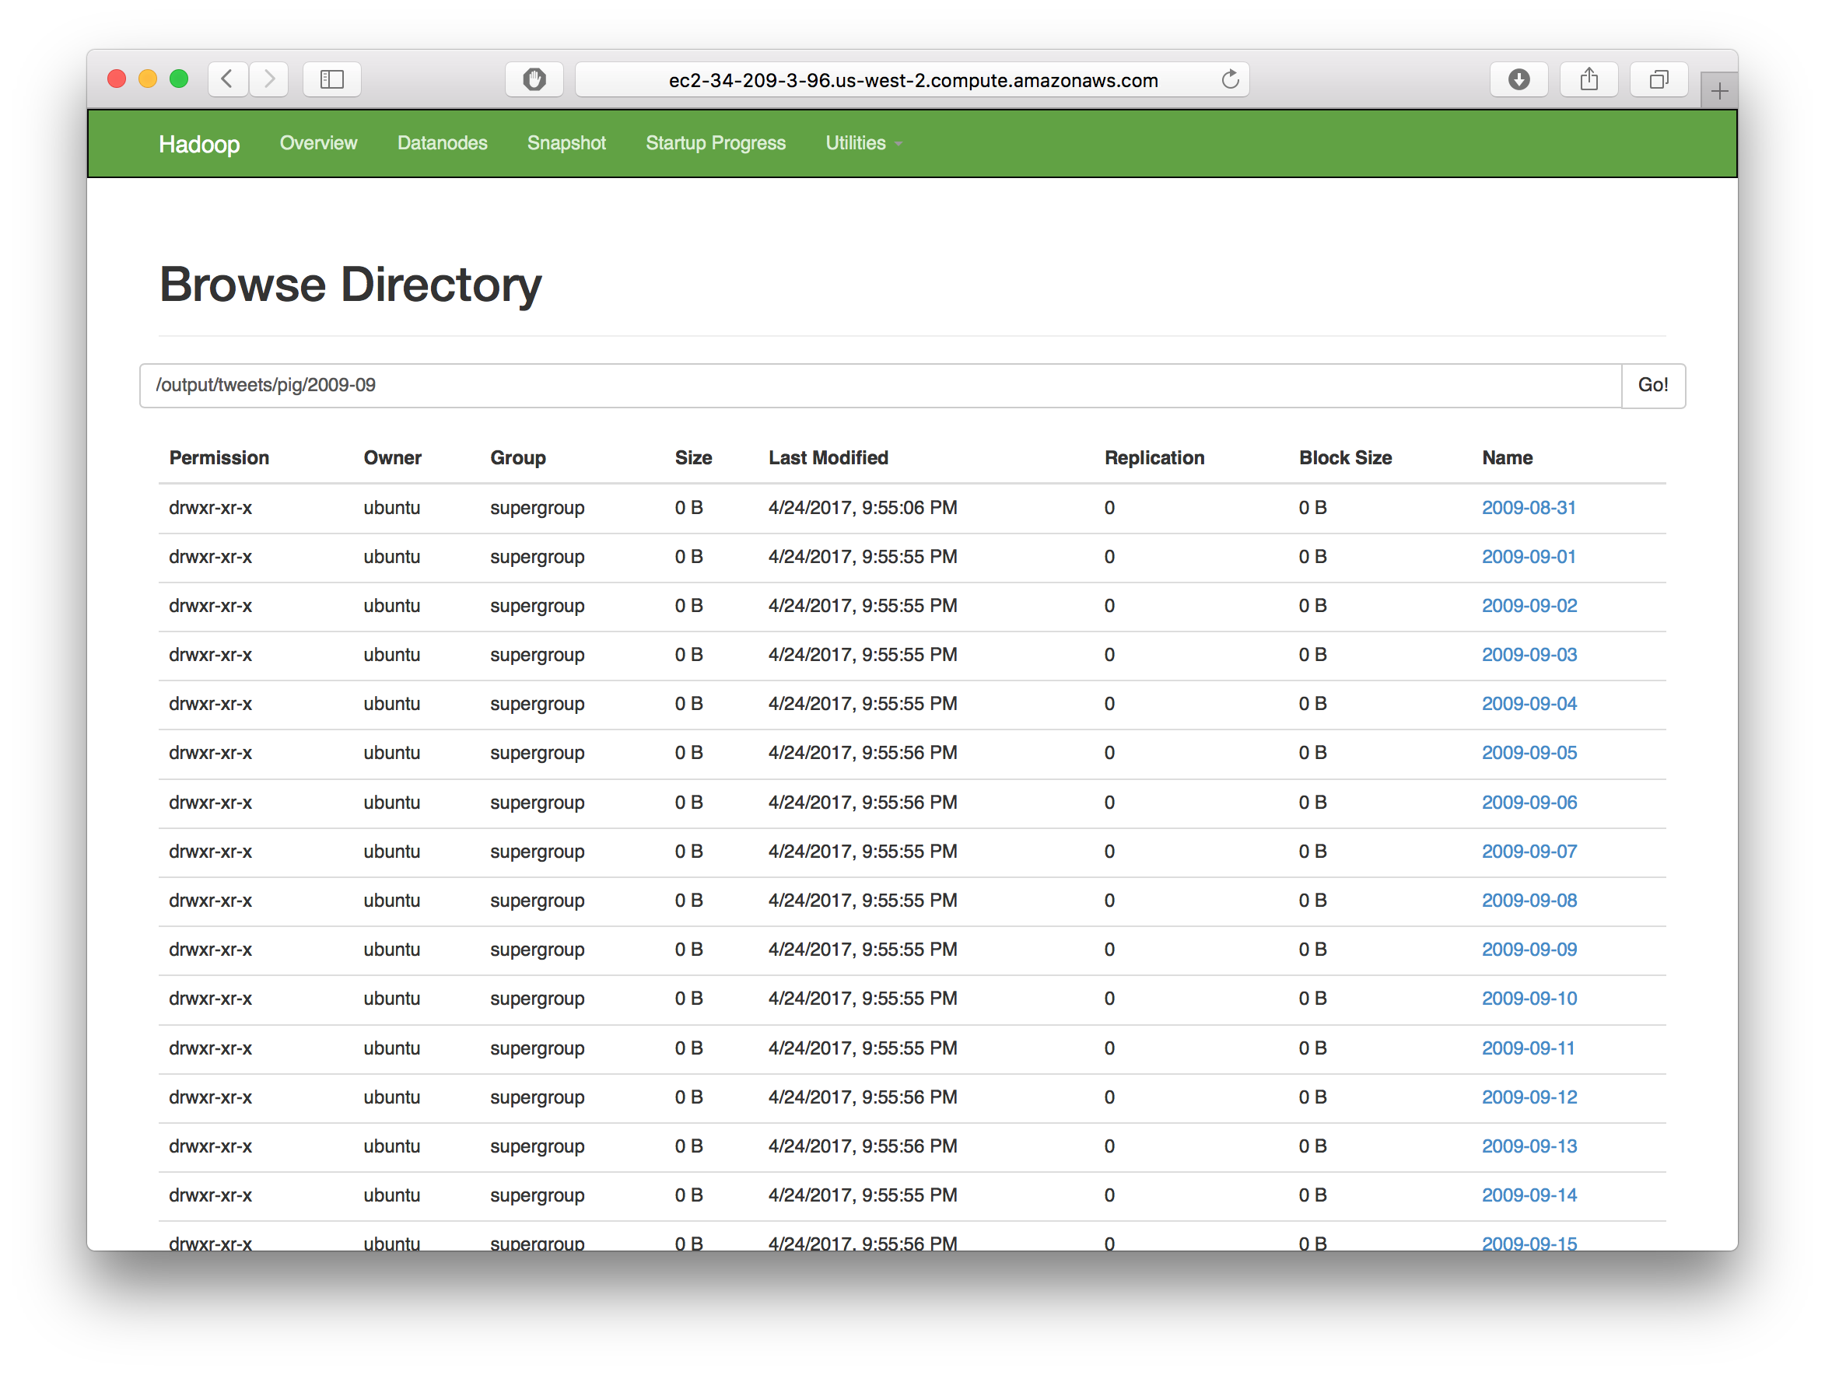
Tweet analysis: Data preprocessing

Slide 10
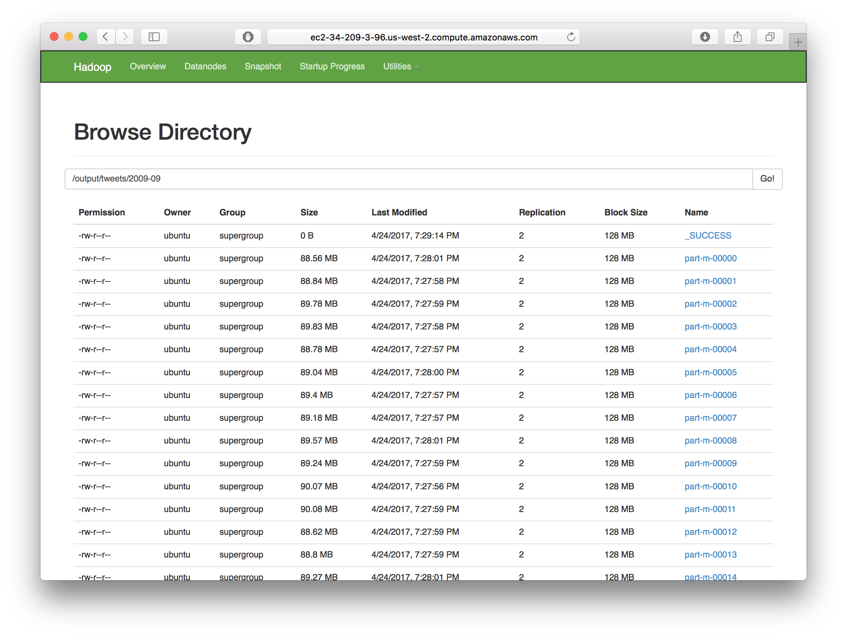
Tweet analysis: Data preprocessing

Slide 11
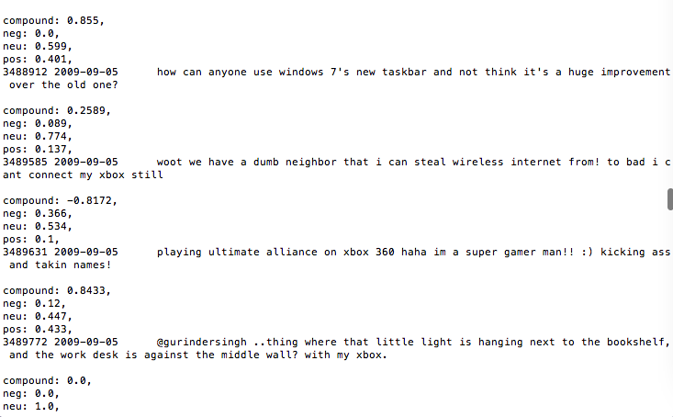
Tweet Analysis
Created keyword lists related to Apple, Google, Verizon, and Microsoft
Reduced the Tweet data to only Tweets containing specified keywords using the Levenshtein distance
Performed sentiment analysis on each Tweet

Slide 12
Tweet Analysis

Slide 13
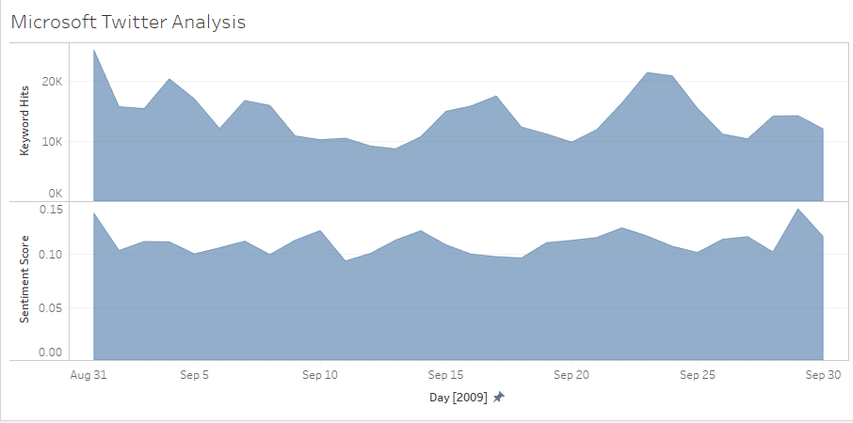
Interpreting data

Slide 14
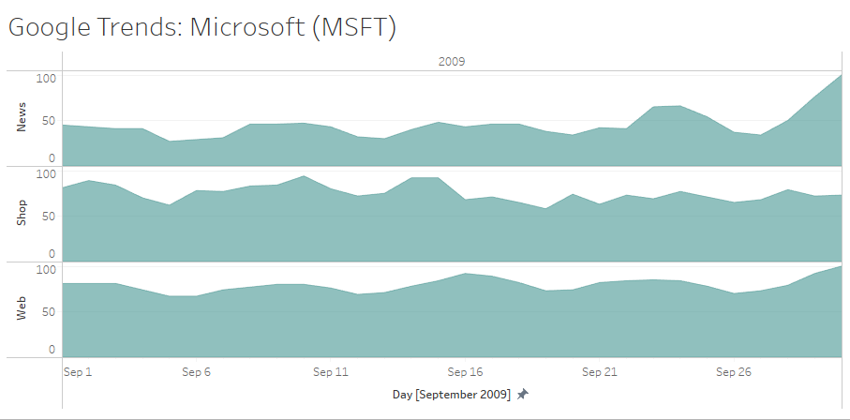
Interpreting Data

Slide 15
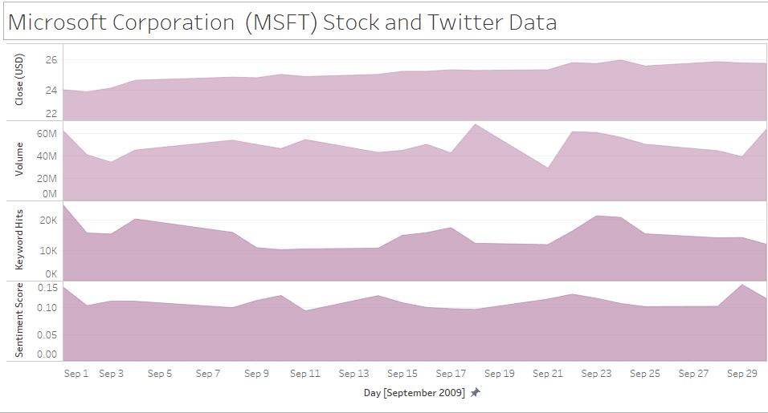
Conclusion

