Slide 1
AuraRoute AI
An advisory AI agent that makes cross-border tuition payments safe to plan
AI as a Financial Participant | Topic C: Cross-border & Student Finance Assistant
2026 Shenzhen FinTechathon, International Track | Team AuraRoute AI

Slide 2
THE PROBLEM
Paying tuition across borders hides three risks
1. Rules
2. Cash
3. Time
An annual foreign-exchange quota of USD 50,000 per person applies. Above it, a bank needs supporting documents. Splitting payments to stay under limits is something SAFE has acted against.
Paying the invoice can leave a student below a living-expense or proof-of-funds buffer. Few tools check the balance after paying.
Cross-border transfers take days to clear. A late payment can trigger a registration hold, so students need a safe latest start date.
Students today piece this together from bank pages, forums and guesswork.
Sources: SAFE Q&A on the annual quota (2007); SAFE circular on fund splitting (2009); Bank of China guidance on tuition documents.
AuraRoute AI | FinTechathon 2026, Topic C

Slide 3
AI AS A FINANCIAL PARTICIPANT
AI proposes, code decides, the student approves
The model reads
Code decides
The student approves
When an invoice layout breaks our parser, a model extracts the fields. It sees redacted text only, has no tools, and its output is schema-checked. It can only fill gaps.
Currency conversion, quota check, illustrative balance baseline and latest safe start date are computed by deterministic code, with each rule shown with its source.
Every parsed value is confirmed at a validation gate. Nothing moves downstream, and the orchestrator refuses unverified data.
Read > Redact > Confirm > Check > Advise | Advisory and read-only: never moves money
AuraRoute AI | FinTechathon 2026, Topic C

Slide 4
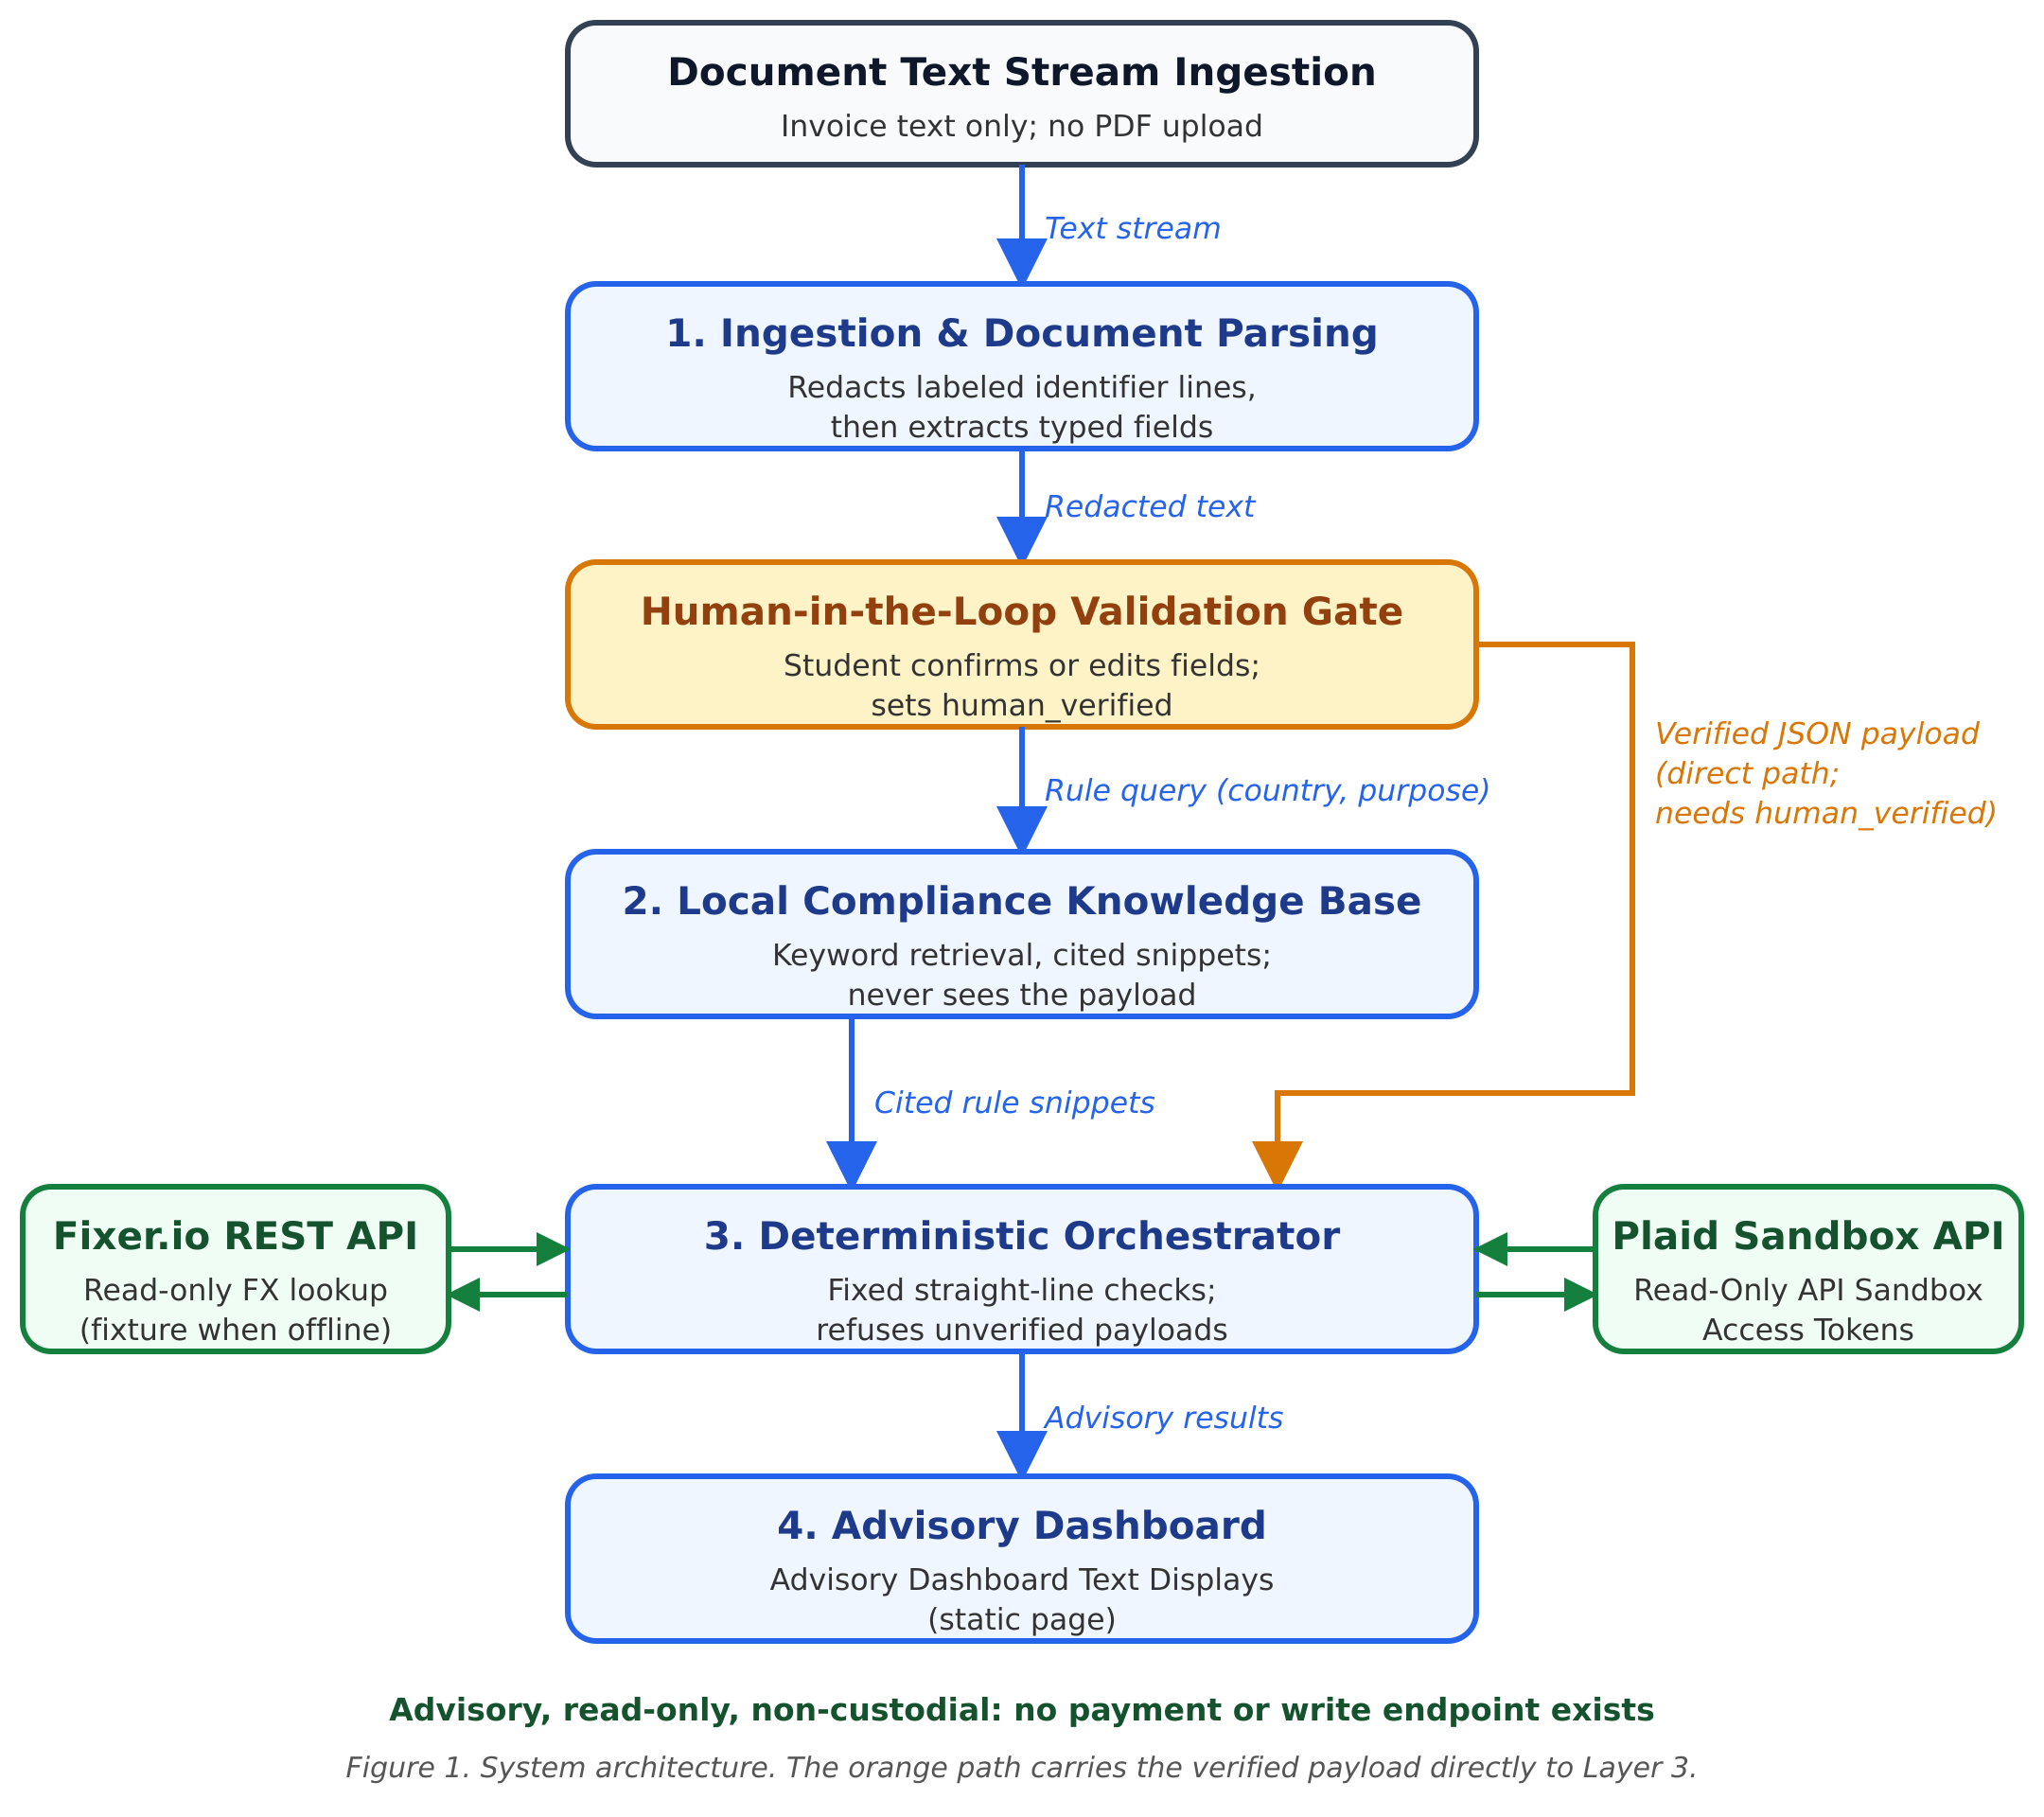
SYSTEM DESIGN
Architecture: data and rule lookups travel apart
Parallel routing
Verified payload goes straight to the orchestrator; only a rule query reaches the rule base.
Read-only tools
Exchange-rate lookup and sandbox balance read. No payment or write endpoint exists.
Tamper-evident audit
Hash-chained log of every check and every blocked payload.
AuraRoute AI | FinTechathon 2026, Topic C

Slide 5
TASK COMPLETION FRAMEWORK
Two problems caught before any money moves
15,240 USD
Over quota
1,260 USD
10 Dec
Invoice of 12,000 GBP, converted by the read-only FX tool
Exceeds the 8,000 USD left. Advises the documented bank route. Never splits.
Balance after paying, below the 2,500 USD illustrative framework baseline. Warning raised.
Latest safe start for a 15 Dec due date, with a 5-day clearing buffer
Evidence we submit
29 unit tests pass, including blocked unverified payloads and hostile model output
End-to-end run log from the actual code, with a verified audit chain
Fixer.io and Plaid Sandbox supported with keys; recorded fixtures offline
AuraRoute AI | FinTechathon 2026, Topic C

Slide 6
SECURITY & COMPLIANCE INFRASTRUCTURE
Security and compliance are built into the flow
No money movement
Redaction first
Untrusted model output
No payment or write endpoint. Only an FX read and a balance read.
Names, passport, phone, email, government ID, address, student ID and birth date removed before parsing or any model call.
Strict schema and allow-list. Cannot overwrite parsed values or verify itself.
Human gate
No structuring
Tamper-evident audit
No analysis until the student confirms. The orchestrator re-checks.
Over the quota, we point to the documented bank route and never suggest splitting.
Hash-chained entries. Alteration of earlier entries is detected.
Permission Tiers and a 14-item Known-Risk List (Item 5). Prompt injection is reduced, not eliminated.
AuraRoute AI | FinTechathon 2026, Topic C

Slide 7
INNOVATION & INTERACTION
What is new, what is built, what is next
What is new
Built and tested
Roadmap
A guardrail, not an optimizer: it prevents structuring instead of enabling it.
A bounded AI role: the model reads, code decides.
Honesty by design: sources, residual risks and data modes are shown.
Redaction, human gate, rule retrieval with citations, FX and balance tools, quota and baseline checks, advisory dashboard, hash-chained audit log, optional Gemini or Anthropic extraction fallback.
Verified rule corpus with article citations.
Plaid Link, authentication and encryption at rest.
More countries and embedding-based retrieval.
Pilot with a university international office.
AuraRoute AI: plan the payment before you make it.
AuraRoute AI | FinTechathon 2026, Topic C

