Slide 1

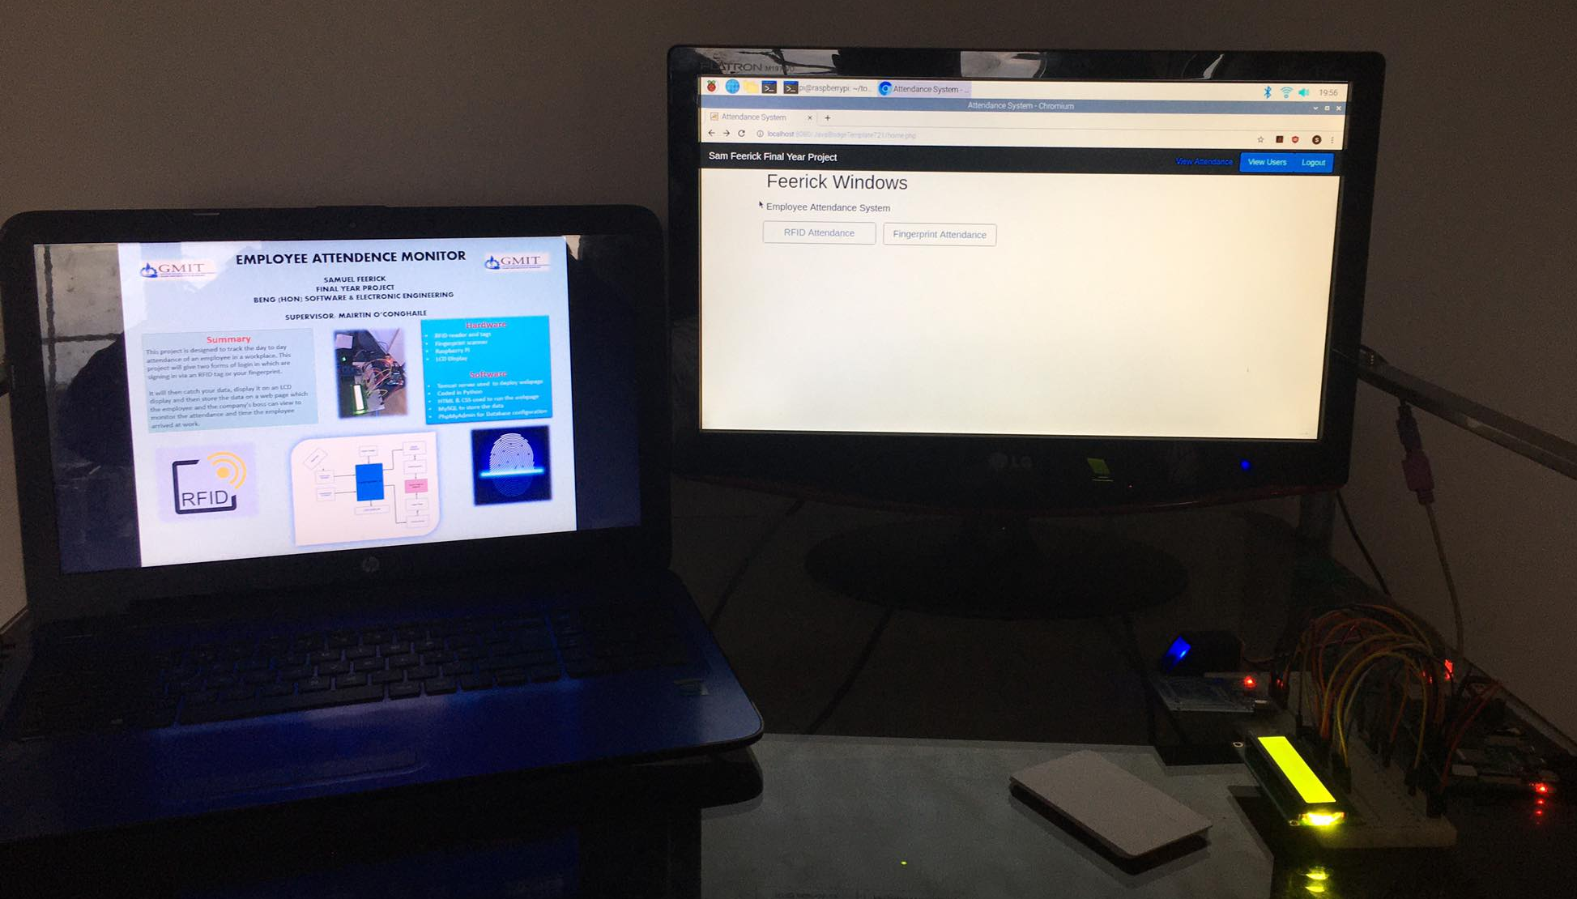
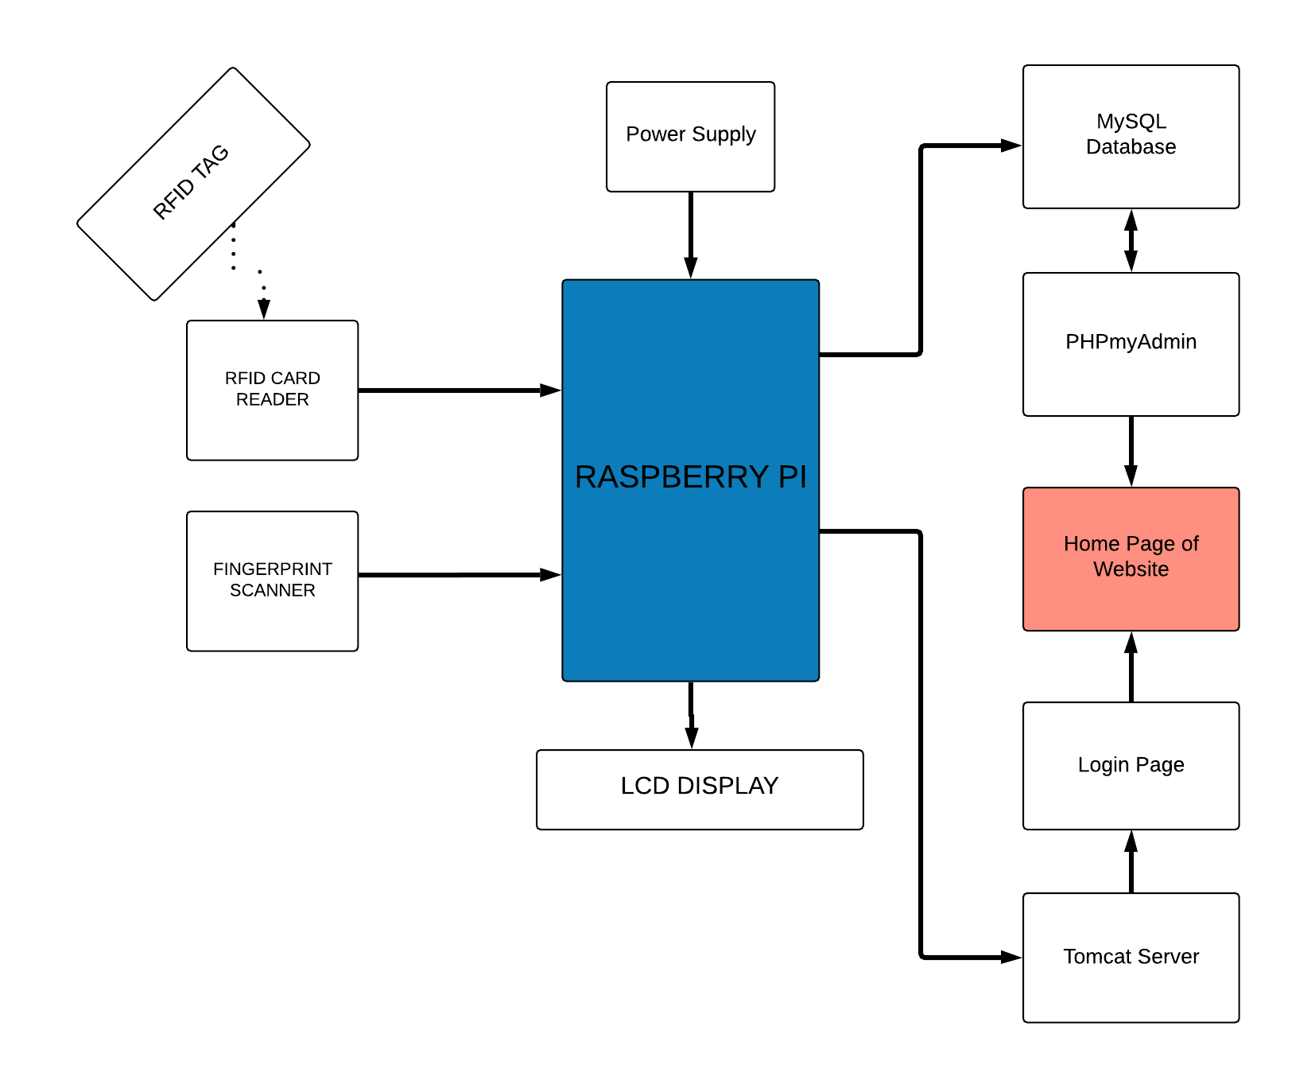


EMPLOYEE ATTENDENCE MONITOR SAMUEL FEERICK Final year project Beng (hon) Software & electronic engineering supervisor: Mairtin o’conghaile
Summary
This project is designed to track the day to day attendance of an employee in a workplace. This project will give two forms of login in which are signing in via an RFID tag or your fingerprint.
It will then catch your data, display it on an LCD display and then store the data on a web page which the employee and the company's boss can view to monitor the attendance and time the employee arrived at work.
This product takes the stress and worry of manually submitting employee's attendance away from the job.
Hardware
RFID reader and tags
Fingerprint scanner
Raspberry Pi
LCD Display
Software
Tomcat server used to deploy webpage
Coded in Python
HTML & CSS used to run the webpage
MySQL to store the data
PhpMyAdmin for Database configuration

