Slide 1
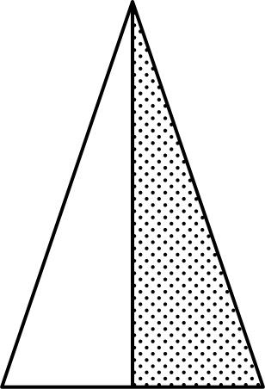
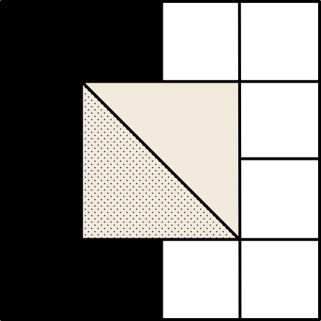
Boltz2
ChimeraX
Biopython
OpenMM
Protein minimisation
membrane construction
System coarse minimisation
System fine minimisation
NextFlow
Full-length FGFR2 sequence
(UniProt P21802, 821 aa)
Input
Boltz-2 protein-lipid complex prediction
TM-aware model with 20 PC-like lipids
ChimeraX domain & orientation editing
ECD/TM/ICD segmentation; TM axis as bilayer normal
Biopython linker straightening
ECD-TM and ICD linkers reshaped
Nextflow-coordinated preprocessing steps
OpenMM minimization in implicit and explicit solvent
PDBFixer repair; POPC bilayer; coarse/fine relaxation
Output
Membrane-embedded FGFR2 structural model

Slide 2
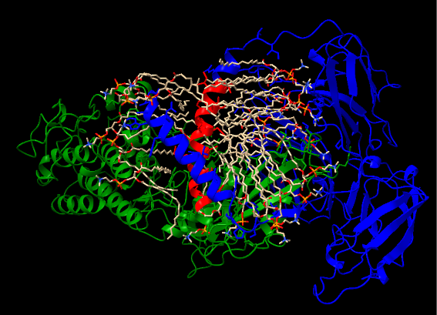
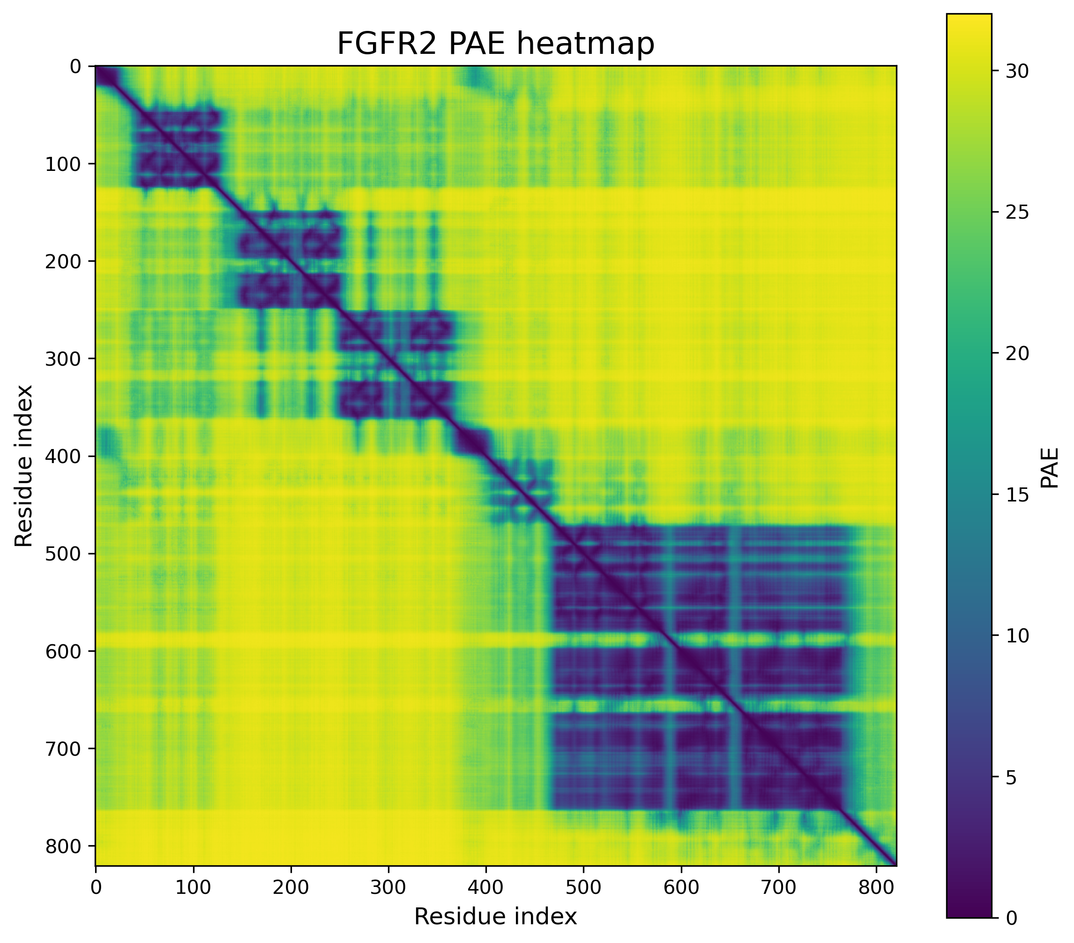
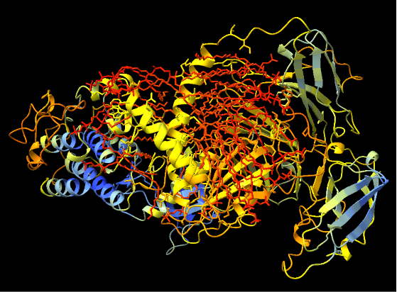
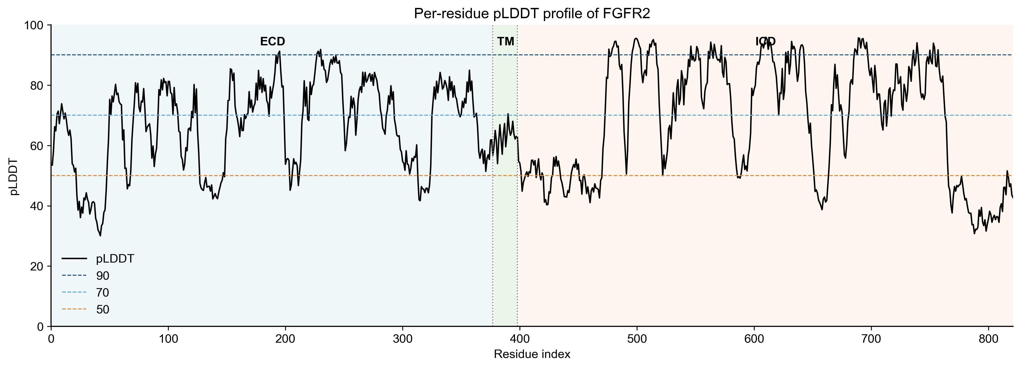
A
D
ECD
TM
ICD
B
Very high (pLDDT > 90)
Confident / high (90 > pLDDT > 70)
Low (70 > pLDDT > 50)
Very low (pLDDT < 50)
C

Slide 3
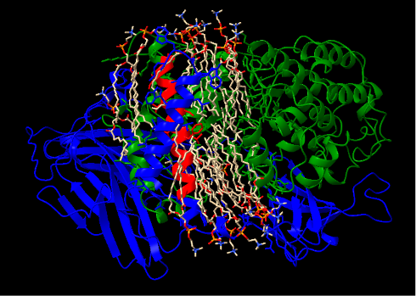
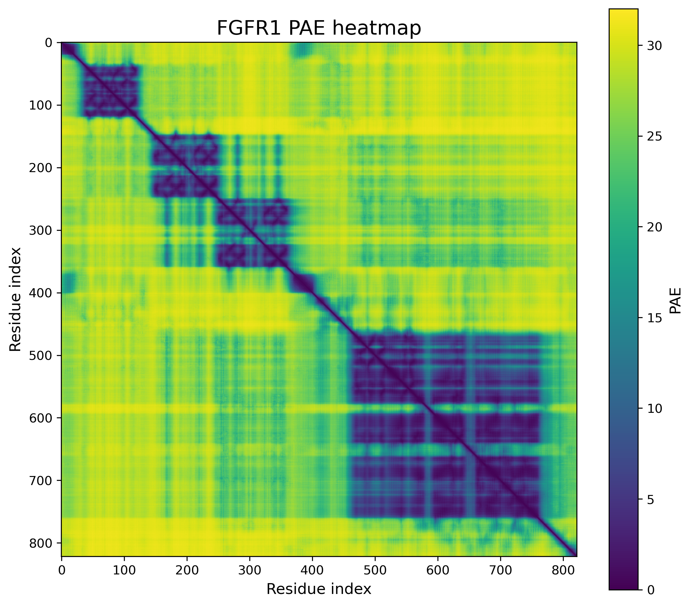
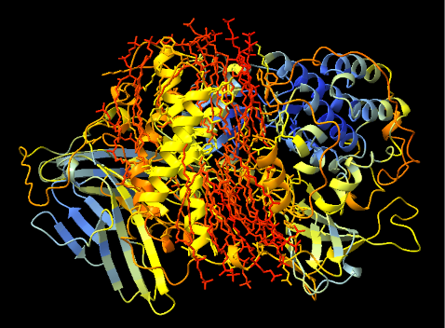
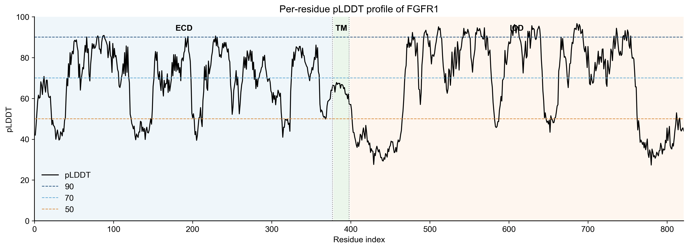
fgfr1
A
D
ECD
TM
ICD
B
Very high (pLDDT > 90)
Confident / high (90 > pLDDT > 70)
Low (70 > pLDDT > 50)
Very low (pLDDT < 50)
C

Slide 4
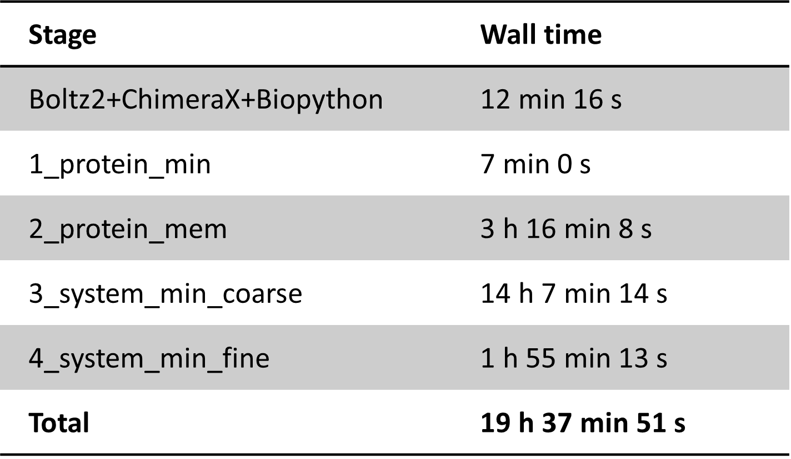
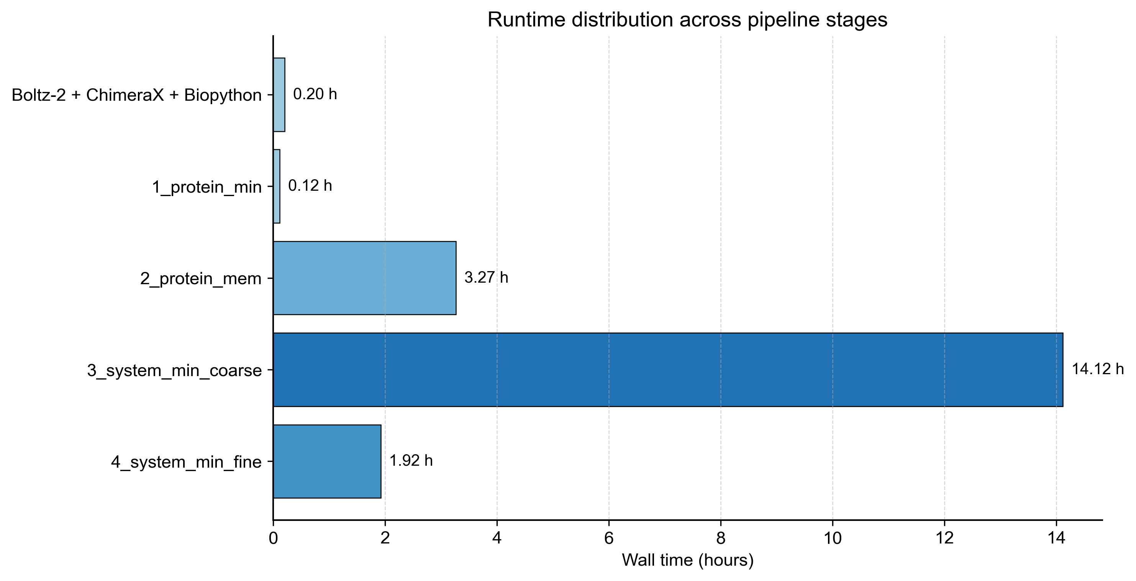
A
Stage | Wall time
Boltz2+ChimeraX+Biopython | 12 min 16 s
1_protein_min | 7 min 0 s
2_protein_mem | 3 h 16 min 8 s
3_system_min_coarse | 14 h 7 min 14 s
4_system_min_fine | 1 h 55 min 13 s
Total | 19 h 37 min 51 s
B

Slide 5
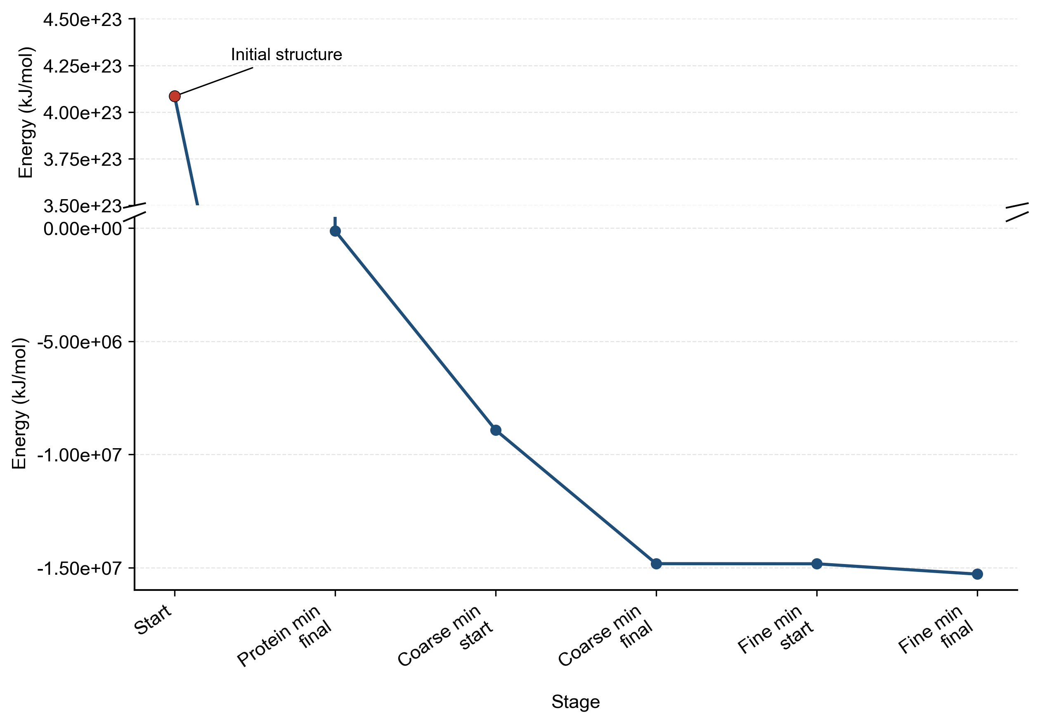
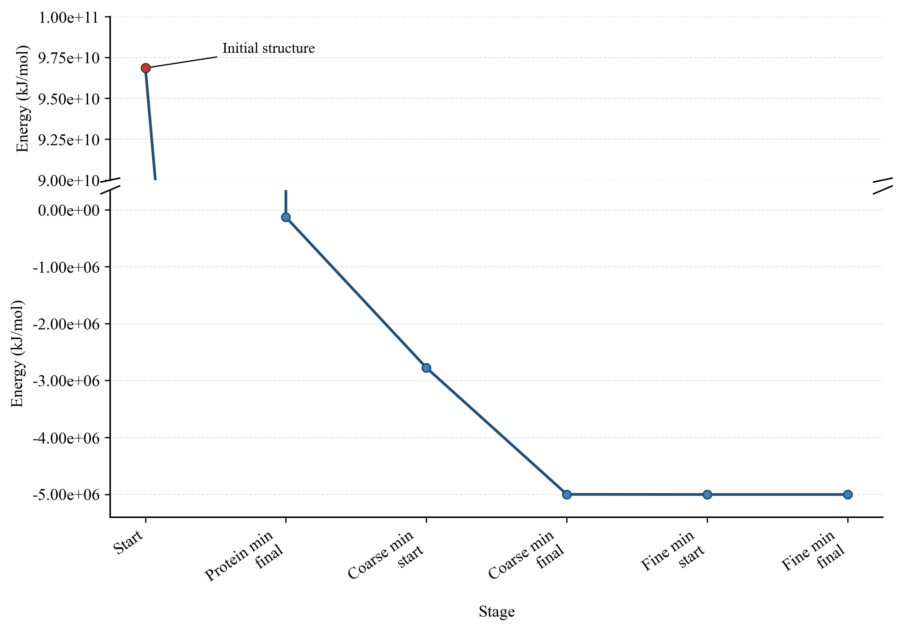
fgfr2
A
B
fgfr1

Slide 6
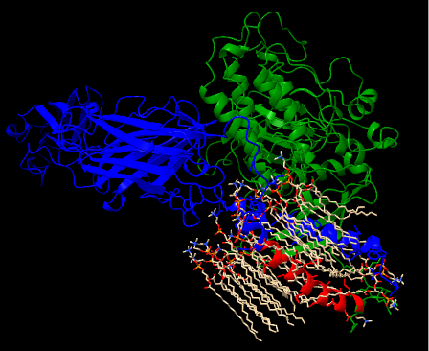
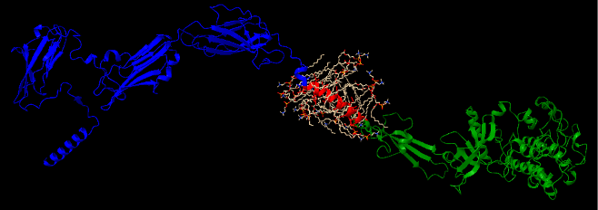
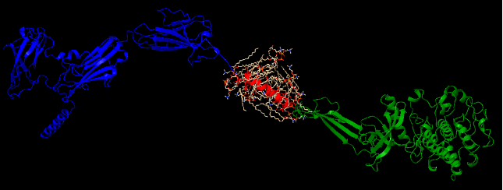
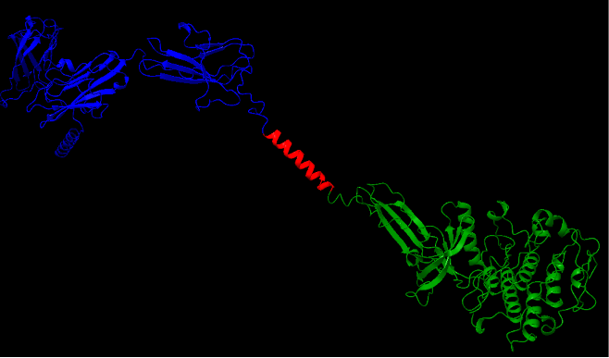
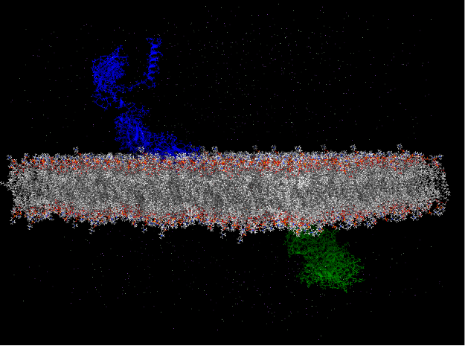
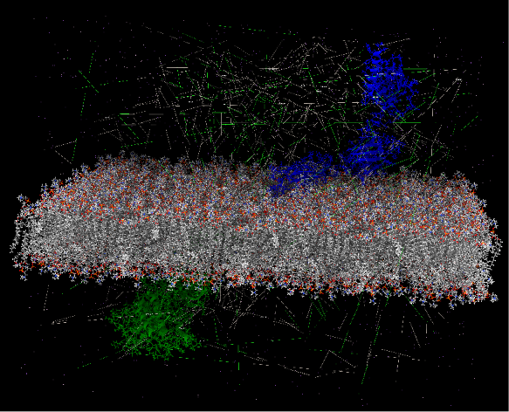
fgfr2
Boltz2
ChimeraX
Biopython
OpenMM
OpenMM
Minimisation
Membrane construction
Coarse Minimisation
Fine Minimisation
015_fgfr1/results/05_openmm/3_fgfr1_clean_minimized.pdb
015_fgfr1/results/05_openmm/4_membrane_no_water.pdb
015_fgfr1/results/05_openmm/
6_fgfr1_membrane_minimized_no_water.pdb

Slide 7
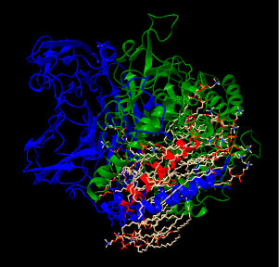
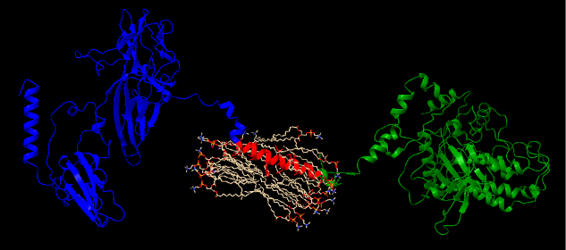
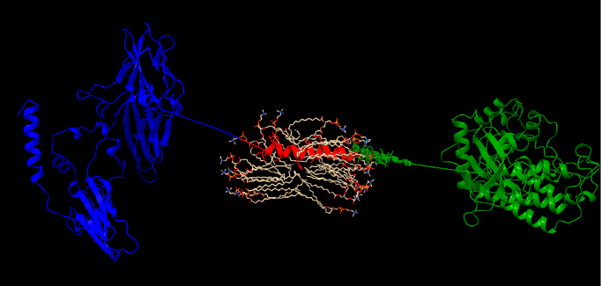
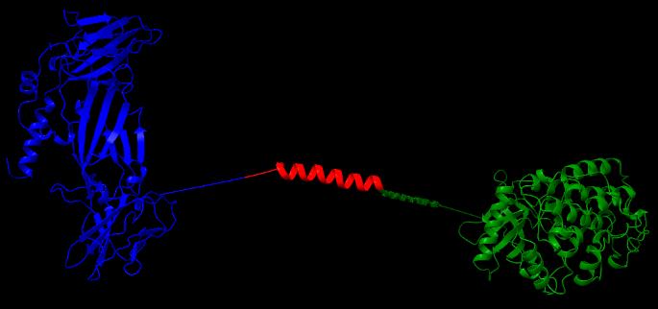
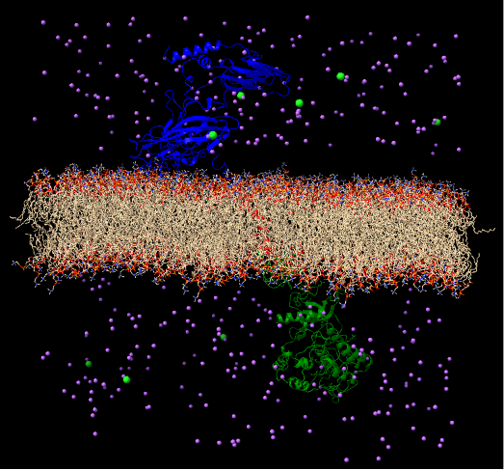
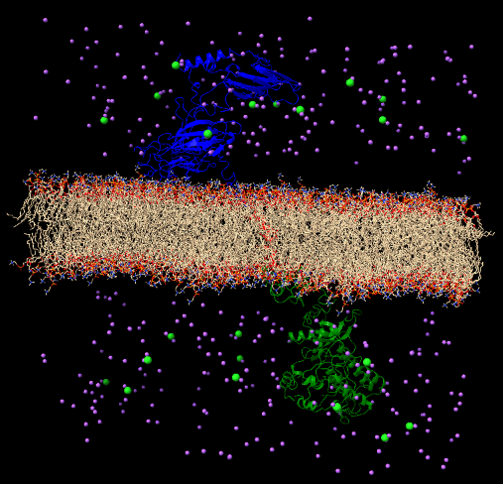
fgfr1
Boltz2
ChimeraX
Biopython
OpenMM
OpenMM
Minimisation
Membrane construction
Coarse Minimisation
Fine Minimisation
015_fgfr1/results/05_openmm/3_fgfr1_clean_minimized.pdb
015_fgfr1/results/05_openmm/4_membrane_no_water.pdb
015_fgfr1/results/05_openmm/
6_fgfr1_membrane_minimized_no_water.pdb

