Slide 1
Gathering E-mail Addresses
Tips from the CDS Global 2010 Preferred Showcase

Slide 2
E-mail
Webinars, whitepapers, handbooks, conferences with e-mail best practices
We’ve attended, read, reviewed and utilized much of that information to build our templates
We all know that e-mails are an economical communication vehicle
E-mail used in conjunction with direct mail could increase response rates by up to 40%*
*SubscriberMail’s: Top 10 Things you Need to Know about the E-mail Opt-in Process
Notes:
Can’t go a day without an invitation to a webinar, etc.
But you don’t have to worry about learning the 26 Essential E-Mail Best Practices because we have a team that is dedicated to being specialist in emails and email deployment and they have attended, ,...
We all know the advantages of using emails, it’s a cost effective communication vehicle and used as a part of an integrated marketing campaign, it can boost results. E-mail used in conjunction with direct mail could increase response rates by up to 40% according to SubscriberMail’s whitepaper: Top 10 Things You Need to Know About E-mail Opt-in Process (May 2008)
But today we’re going to focus on one main topic regarding e-mails – How do you gather e-mail addresses?

Slide 3
How do you gather e-mail addresses?
Notes:
Right now, we’re going to focus on ways to gather e-mail addresses.

Slide 4
Recommendations
Ask on every communication with your customer
Provide a value proposition
Reassure them
Make it easy
Notes:
Challenges:
People are increasingly reluctant to accept offers from online marketers.
Overcome the epidemic of too frequent mailings and irrelevant messages
Capturing addresses without lowering response.
Let’s look at each one of these and then look at some real samples.

Slide 5
Ask for e-mail addresses on every communication with your customer
Consider every point of contact with customers and prospects.
Test an e-mail request on order forms
Test promotions on invoices and statements
Request it at several different points on your website – sign up opportunities should be ubiquitous throughout your site
Ask for it during customer service calls
Include “Send to a Friend” options
*Lyris HQ Guru’s Guide to Email Marketing Success 2009
Notes:
Direct mail pieces, website, order pages, encourage readers to ask their friends to subscribe by using Send to a Friend Options.

Slide 6
Subscribers are happy to provide you their valuable e-mail address in exchange for something of value
Create a free e-newsletter
Let them know if they will get “special access” to articles, blogs, discussion groups, etc
Provide early or “priority access” to new products
Offer sneak peeks at future developments or upcoming articles
Entice them with advance notice of sales
Offer a downloadable editorial premium like an e-book or special article
Run a sweepstakes and tie entries to an e-mail
Provide discount coupons
*Circulation Management: 16 Ways to Capture Customer and Prospect E-Mail Address
Notes:
Provide incentives
Just asking for their e-mail address isn’t enough. WIIFM? Tell them what they’ll get, sell them on the value of signing up. Give them a reason to give their e-mail by providing valuable content.
Can I talk about Rolling Stone’s All access membership?

Slide 7
Include a brief reassuring phrase about your privacy policy and tell them why you need their address
Reassure them that you respect their confidentiality and privacy
Put a link to your privacy policy next to point of commitment
Indicate how the e-mail address will be used
“You’ll receive an order confirmation”
“You’ll be e-mailed your personal password”
“You’ll get a link to download your premium”
*MarketingSherpa Landing Page Handbook, second edition
Notes:
Tell them how often they’ll get emails - provide email frequency upfront.
Provide a sample email, testimonial and strong call to action

Slide 8
Include a brief reassuring phrase about your privacy policy and tell them why you need their address
Request e-mail addresses for different types of events
Create a secondary conversion opportunity
Digital article
something free with real value
Only ask for e-mail address, no credit card info or billing info
If you intend to use for other purposes
Add a separate checkbox to the form asking for specific permission
Notes:
Leave the other questions to later in the process. The more you ask them to fill in, the lower your opt-in rate will be.
Checkbox for contacting about their subscription, another for an e-newsletter, another for 3rd party e-mails. This helps alleviate them giving you one big fat “no” when they may have given you 2 out of 3 “yeses”

Slide 9
Make It Easy
Put the e-mail sign up form where they can see it
Place it in the natural flow of completing the order form
Place in numerous locations on your homepage and throughout the site – make it easy to opt in
Test different locations
Important to have on all communications
*CoreMetrics: Pull Visitors Back to Your Website, 2009
Notes:
Don’t give up prime position if it could take away from other revenue

Slide 10
Make It Easy
If not required, don’t say “optional” or “not required”
If required, indicate how the e-mail address will be used
If required and the customer doesn’t provide, put a noticeable error message next to the e-mail request
Have a preference center in your customer care site
Test, analyze, adjust and retest
*CoreMetrics: Pull Visitors Back to Your Website, 2009
Notes:
Just takes up space and gives them an excuse not to.

Slide 11
Gathering E-Mail Addresses
Example:
e-mail address ___________________________
(for Customer Service and other information)
When tested, this language improved the % of e-mail addresses collected from about 8% to 15% for one of our partners
Notes:
Several of our clients have had success with gathering e-mail addresses. Hearst has, Marc’s going to show you a Meredith example, Conde, ESPN.
Hearst – ask Karen if she would want to give a quick description

Slide 12
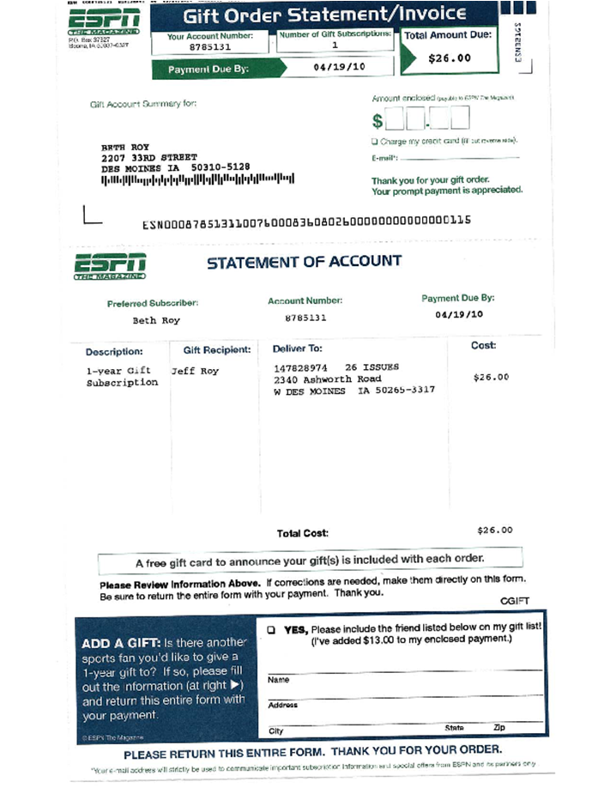
Notes:
http://insider.espn.go.com/insider/magazine/index
Your e-mail address will strictly be used to communicate important subscription information and special offers from ESPN and its partners only.

Slide 13
