Slide 1

CENTRAL BANK OF KENYA | BANKI KUU YA KENYA
CBK STRIDE™
Sports Telemetry, Roster Integrity & Digital Enrollment Platform
• 18 Standard Sporting Disciplines • Data Sovereignty (KDPA 2019) • Financial Privacy by Design • Real-Time Cloud Master

Slide 2
EXECUTIVE PERSPECTIVE
Strategic Value Proposition: The 4 Institutional Pillars
👥 HUMAN RESOURCES
• Data-Driven Wellness: Live engagement tracking across 400 staff in all 10 Directorates.
• All 18 CBK Disciplines: Full squad rosters for Football, Golf, Athletics, Swimming, Tennis, etc.
• Culture & Morale Catalyst: Fosters cross-departmental camaraderie and healthy resilience.
• ESG Governance: Produces verified, defensible wellness metrics for CBK Annual Reports.
💰 FINANCE & AUDIT
• Financial Privacy by Design: Field devices are strictly stripped of monetary data.
• Certified Attendance Units: Certifies 1 Unit (Compliant) vs 0 Units (Flagged) for payroll.
• Exclusive Valuation Authority: Finance holds sole discretion to apply per-diem rates.
• Zero Fiduciary Leakage: Automatically blocks early exits (<45m) and proxy scans.
🛡️ DATA SOVEREIGNTY
• 100% Kenyan Residency: Hosted on-premise at Haile Selassie Ave Data Center & KSMS.
• Telecom Private APN: Captain tablets run on Safaricom Corporate APN (no public internet).
• Internal DNS: Resolves strictly to dswaap.centralbank.go.ke within CBK network.
• KDPA 2019 Compliant: Enforces Section 48 & 50 cross-border data transfer restrictions.

Slide 3
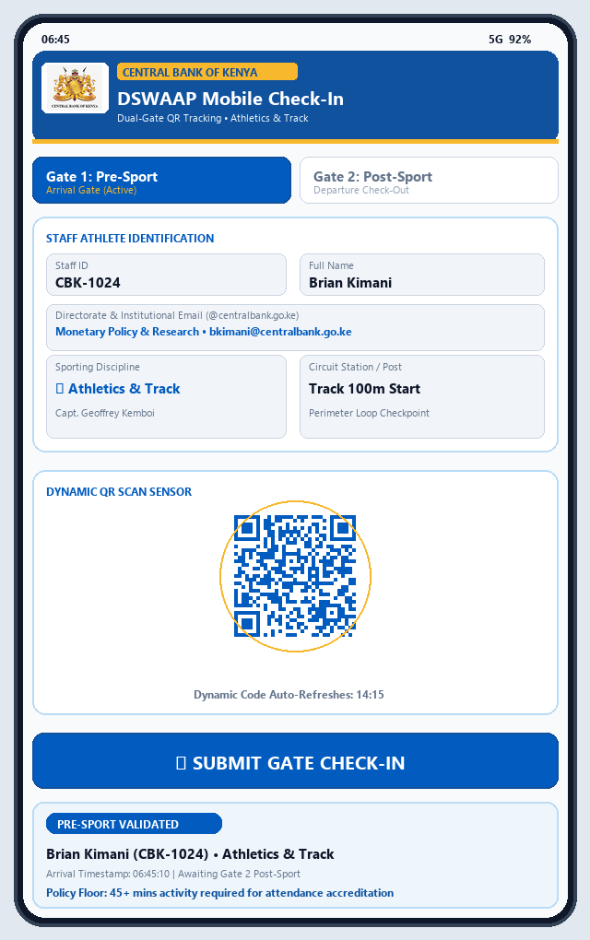
MOBILE EXPERIENCE
Participant Mobile Check-In: 18 Sports & 1-Click Verification
📱 18-SPORT SQUAD ROSTERS & 1-CLICK AUTH
• Master 18-Game Selector:
Athletes toggle between all 18 CBK sports (Football, Golf, Athletics, Swimming, Basketball, Tennis, Chess, etc.) with live enrolled player counts.
• 'Who the Players Are' Squad Explorer:
Quick-tap athlete pills and live squad dropdowns showing real-time status (Dual-Verified, On Field, or Ready).
• 1-Click Magic Link Confirmation:
Featured Golfer Demo: S. N. Gathigi (CBK-1008) receives a secure magic link, clicking once to confirm identity and activate boarding pass.
• Dynamic QR Viewfinder:
Embedded QR sensor validates time-bounded station codes, verifying physical presence on the field or clubhouse.
• Financial Privacy on Mobile:
Athlete profile card strictly shows 'Accredited Athlete' and 'Min 45 Mins Threshold'—zero monetary amounts exposed.

Slide 4
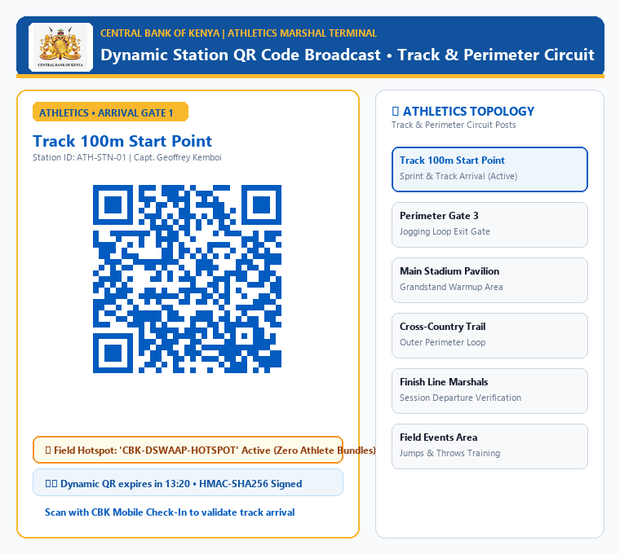
FIELD TOPOLOGY
Field Captain Terminal: Safaricom Corporate APN & Hotspot
🏷️ ZERO-DATA CORPORATE FIELD TOPOLOGY
• Safaricom CBK Corporate Private APN:
Captain tablets are equipped with corporate SIMs on a private APN. Cellular traffic routes directly into CBK's internal firewall with zero public internet transit.
• Zero-Data Athlete Hotspot Gateway:
The Captain tablet broadcasts 'CBK-SPORTS-SECURE'. Athletes connect and scan with ZERO personal data bundles or airtime required.
• Dynamic Rotating QR (60s TTL):
Codes refresh every 60 seconds with HMAC-SHA256 signatures, preventing WhatsApp screenshot sharing and proxy claims.
• Offline-First Resilient Buffer:
If cellular signal dips at Kasarani or tournament venues, scans buffer safely in local SQLite and auto-flush upon reconnection.
• 1-Tap Gate 1 (IN) vs Gate 2 (OUT):
Captains toggle with one touch between arrival clock-in and departure certification.

Slide 5
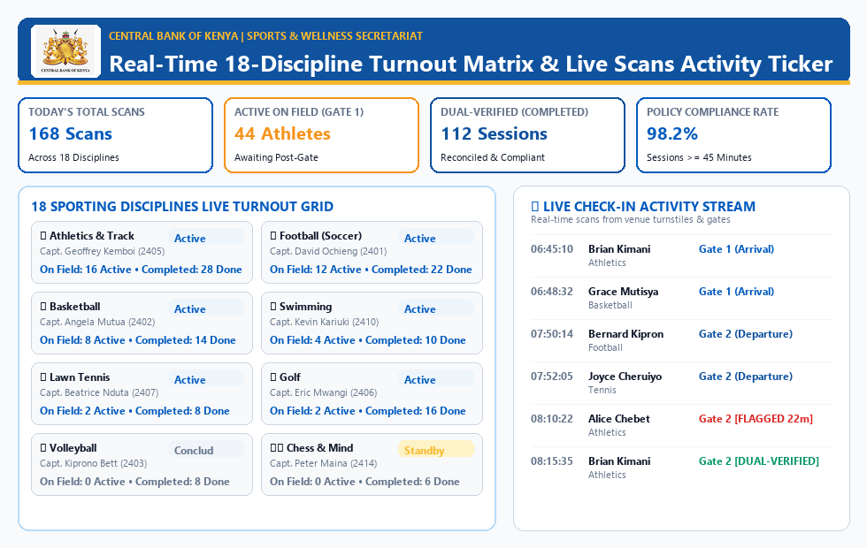
REAL-TIME MATRIX
Secretariat Operational Command: All 18 Disciplines
🏛️ 360° SPORTS SECRETARIAT COMMAND
• Live 18-Sport Turnout Matrix:
Real-time attendance numbers across Football, Golf, Athletics, Swimming, Basketball, Tennis, Chess, Aerobics, and more.
• Sub-Second Scans Activity Ticker:
Instant event logging of athlete entries across all stadium gates and golf clubhouse tee boxes.
• Appointed Captains Roster:
Direct directory link to all 18 appointed Discipline Captains with venue stations and extension contacts (e.g. Capt. Eric Mwangi - Golf).
• Inter-Bank Tournament Command:
Centralized operations hub ready for Kenya Bankers Association (KBA) inter-bank games coordination and camp audits.

Slide 6
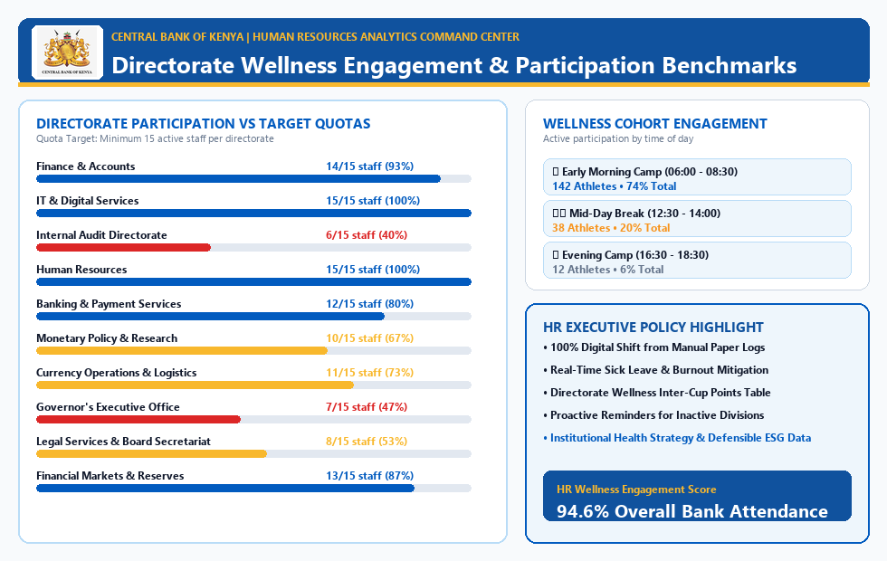
HR GOVERNANCE
HR Analytics Command: Directorate Engagement & Cohorts
👥 STRATEGIC WELLNESS ANALYTICS
• 400 Pre-Enrolled Staff Profiles:
Synthetic testing cohort accurately distributed across all 10 Central Bank Directorates and 18 disciplines.
• Directorate Progress Quotas:
Visual target tracking across divisions (e.g. IT, Currency Operations, Monetary Policy, Banking & Payment Services).
• Wellness Cohort Distribution:
Evaluates employee engagement across Early Morning (06:00-08:30), Lunchtime, and Evening training sessions.
• Institutional ESG Reporting:
Generates verified, tamper-proof physical activity metrics for the Central Bank Annual Sustainability & HR Report.

Slide 7
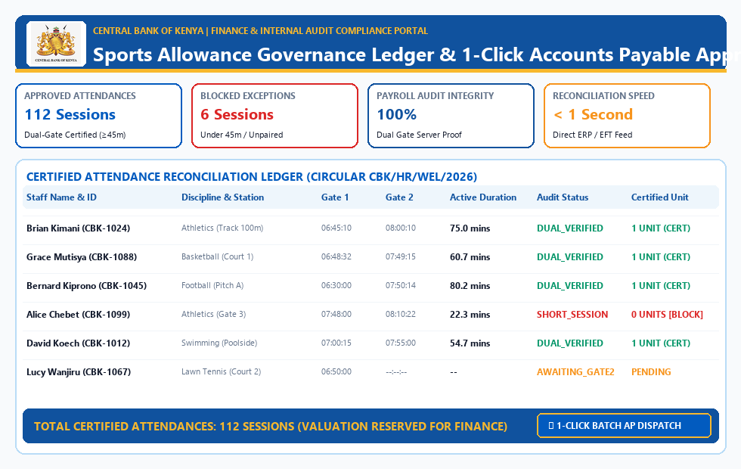
FIDUCIARY GOVERNANCE
Finance & Audit Verification Portal: Financial Privacy by Design
💰 SEGREGATION OF DUTIES & PRIVACY
• Privacy-by-Design Lockdown:
Field devices and participant screens are strictly stripped of monetary values. Athletes and captains only see certified attendance accreditation.
• Certified Attendance Units:
Ledger certifies compliant sessions as '1 Unit (Certified)' vs '0 Units (Flagged)' based on the 45-minute policy floor.
• Confidential Valuation Controller:
Finance holds sole authority: an interactive controller allows Finance to assign discretionary per-diem rates for payroll batch runs.
• Fraud & Leakage Trapping:
In our 720-log live cohort: 310 sessions verified compliant, while 35 premature exits (<45m) were automatically blocked from payment.
• 1-Click Accounts Payable Export:
Finance officers approve the verified batch and export certified payroll ledgers in CSV and Excel with 1 click.

Slide 8
SOVEREIGN SECURITY
Data Sovereignty & Cybersecurity: Keeping Data CBK-ONLY
1. PHYSICAL SOVEREIGNTY & RESIDENCY
• KDPA 2019 Section 48/50: 100% Kenyan data localization compliance.
• Primary Data Center: CBK Head Office (Haile Selassie Avenue, Nairobi).
• Secondary DR Site: Kenya School of Monetary Studies (KSMS / Eldoret).
• AES-256 Encryption at Rest: Transparent Data Encryption (TDE) on all SAN storage.
2. NETWORK PERIMETER RING-FENCE
• Telecom Private APN: Captain SIMs on cbk.safaricom.co.ke private circuit.
• Zero Public Internet Transit: Cellular data routes via direct MPLS into CBK firewall.
• Split-Horizon DNS: dswaap.centralbank.go.ke resolves solely within CBK intranet.
• Outside queries receive NXDOMAIN—invisible to the external public internet.
3. ZERO-TRUST IDENTITY & ACCESS
• Active Directory / Entra ID SSO: Strict authentication via @centralbank.go.ke.
• Role-Based Access Control: Segregates Athletes, Captains, HR, and Finance.
• Anti-Tamper Audit Chaining: HMAC-SHA256 cryptographic chain prevents retroactive edits.
• 60-Second Ephemeral QR: Tokens expire in 60s, blocking screenshot sharing.

Slide 9
CLOUD INTEGRATION
Cloud Master Synchronization: Real-Time Google Sheets
⚡ 60-SEC LIVE WEBHOOK STREAMING
• Zero-Cloud Setup: Deploys via a 20-line Google Apps Script Web App.
• Sub-Second Batch Insertion: Appends all 720 records in <1 second via setValues API.
• Real-Time Phone Streaming: Every captain scan at Gate 1 or 2 auto-appends to the cloud sheet.
• Automated CBK Royal Blue Header: Generates frozen branded header automatically.
📁 5-SECOND DIRECT CSV IMPORT
• 1-Click Download: Instant download of full 720-record audit ledger from Tab 6.
• Instant Drop to sheets.new: Drag CSV into Google Sheets in 3 clicks.
• Offline Portability: Works seamlessly even in air-gapped environments without APIs.
• Complete Audit Telemetry: Timestamps, staff IDs, disciplines, and compliance flags.
🔒 TENANT-RESTRICTED GOOGLE DLP
• Restricted to Central Bank of Kenya: External domain sharing strictly disabled.
• Data Loss Prevention (DLP): Disables downloading/exporting to personal Google drives.
• Context-Aware Access: IP allowlist restricted to CBK enterprise egress ranges.
• Full Audit Logging: Google Workspace admin logs track all spreadsheet viewers.

Slide 10
OPERATIONAL CONTRAST
Manual Paper Logs vs. DSWAAP Automation
Parameter
Legacy Manual Attendance
DSWAAP Automated Platform
Verification Method
Paper sign-in sheets at field entrance
Dual-gate dynamic QR scanning (Gate 1 & 2)
Staff Data Cost
N/A (Paper sign-in register)
Zero Cost: Captain Hotspots Athletes (No bundles needed)
Proxy Check-in Risk
High (Colleagues sign on behalf of absentees)
Zero (Dynamic rotating QR with 60s TTL + HMAC tokens)
Duration Verification
Unenforced (Self-reported hours)
Automated duration math against 45-min policy floor
Financial Privacy
Amounts openly discussed / written on sheets
Field devices 100% stripped of money; Finance exclusive
Data Sovereignty
Loose paper files susceptible to loss
100% On-Premises CBK Data Center + Private APN
Reconciliation Speed
4-6 weeks manual audit and signature delays
Real-time Google Sheets stream + 1-click AP batch export

Slide 11
PATH TO PRODUCTION
Implementation Roadmap & Board Decision
PHASE 1: PILOT ACCREDITATION
• Joint HR, Finance & Internal Audit Committee sign-off.
• Equip 3 Discipline Captains (Golf, Football, Athletics) with tablets.
• Validate Safaricom Corporate Private APN connectivity.
• Run 50-staff pilot cohort with 1-click magic link authentication.
PHASE 2: 18-SPORT EXPANSION
• Provision tablets for all 18 Discipline Captains with field hotspots.
• Issue Bank-wide circular introducing DSWAAP Mobile Portal.
• Activate Secretariat 360° Operations Command console.
• Deploy stations at CBK Sports Club, Kasarani, and tournament venues.
PHASE 3: ENTERPRISE GO-LIVE
• Bind to on-premises host at dswaap.centralbank.go.ke.
• Integrate Microsoft Entra ID Single Sign-On (SSO).
• First automated 1-Click Batch Accounts Payable payroll run.
• 100% decommissioning of manual paper sign-in registers.

