Slide 1
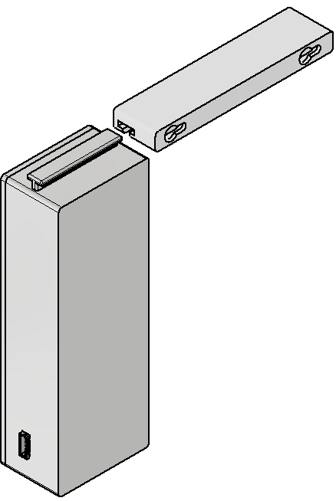
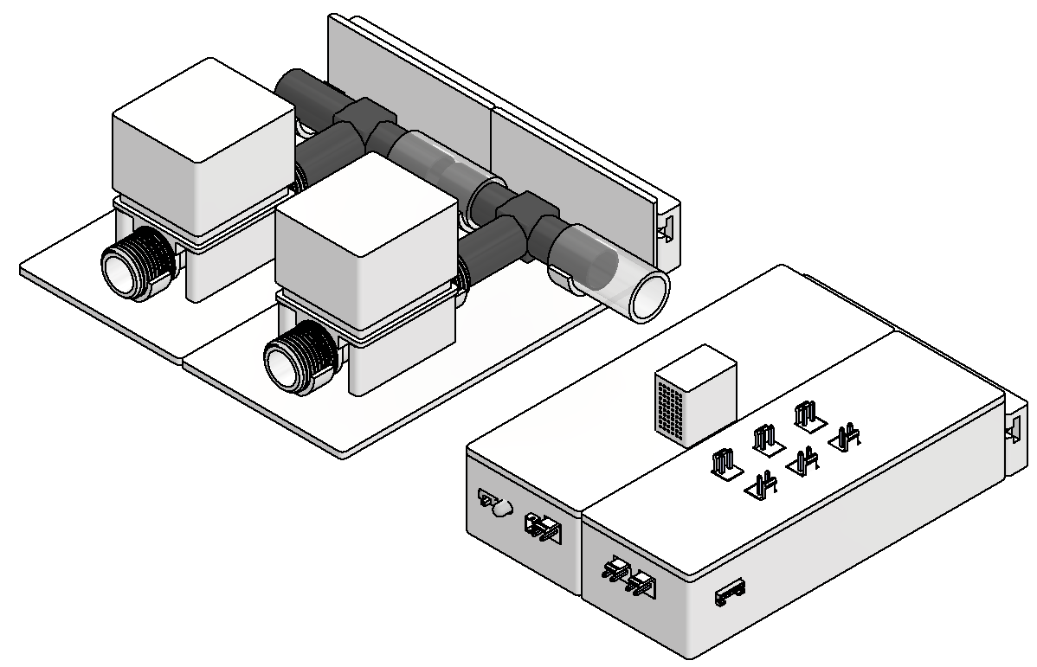
Regulated Irrigation System (RIS)
by Sam Dixon
What is it?
Key Points
Wall Mount
This is an irrigation system all about watering plants in any scenario possible like in a small greenhouse or industrial greenhouse due to giving you full control over its operation while being reliable, able to continue working across a whole year through all the seasons.
For instance, using the website interface on your phone you can set routines to water certain sets of plants at certain times for a duration based of the current temperature.
This allows all different types of plants to get the correct amount of water with no wasted.
Water Plants (Water Conservation).
Any Environment and Scale (Greenhouse / Farm).
Reliable (Works for Months / Years).
Sustainable (Self Sufficient: Solar / Rain).
Relatively Affordable (< ~£100).
Power
It all operates off 1 battery that is charged continuously with a solar panel to ensure it can run for years in remote locations like an allotment or field.
You can choose to power the pumps and valves by another source like mains or an external battery pack if they require more power in industrial environments.
Valve 1
Valve 2
Modules
Valve Module
Command
Module
This design is made up of multiple modules which allow it to scale to any scenario with them able to sit flat on a table or be easily mounted onto a wall with keyholes.
The command module is central, controlling all other modules based on the routines you have set.
Each valve is chained together on a module to allow water to be pumped to specific sets of plants for different durations giving you control.
You can add as many switch modules as needed where they interface with command to turn on certain ones of its 6 ports to power the water pumps or valves when needed.
Valve Module
Switch
Module
Ports

Slide 2
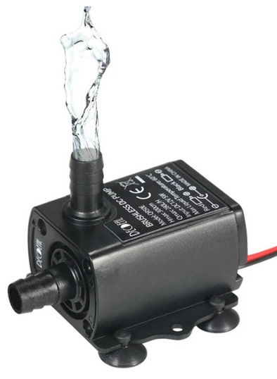

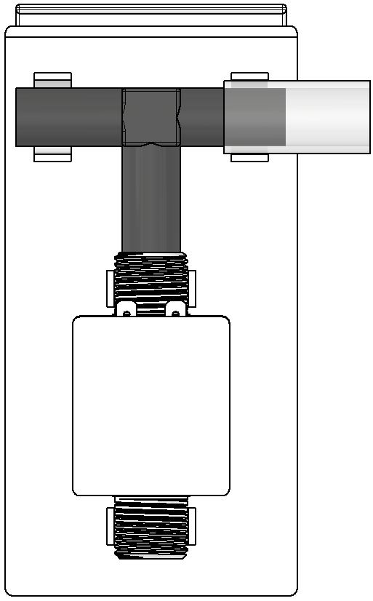
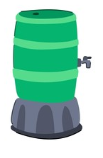
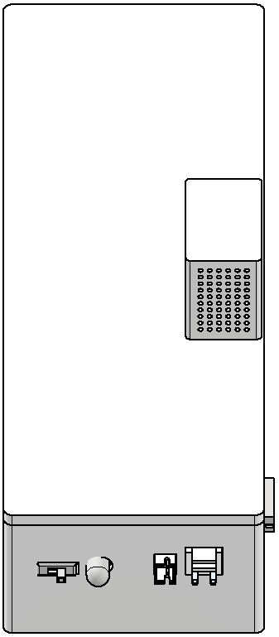
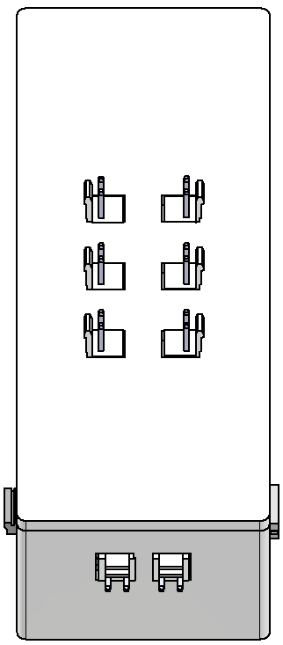


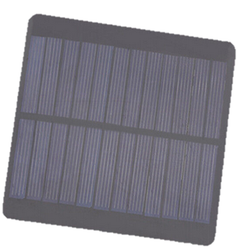
Regulated Irrigation System (RIS)
by Sam Dixon
Water Tank
… Valve Modules
Pump - 1
Valve
Module
1
Valve
Module
2
Pump 2
Command
Module
Switch
Module - 1
Switch
Module - 2
Pump - 2
Water Butt
Small Greenhouse Scenario
To take advantage of it in this scenario you can have both sides of the greenhouse on different valves because they may get a different amount of sunlight or have different varieties of plant so one side needs more water than the other.
Then you can have a pump that is operated with each valve at a time taking water out of a water tank and distributing it but also have another that fills the tank every couple weeks with more water from a water butt.
Due to only giving the plants the water they need they will have increased yields, and it will conserve water which is important when using a water butt as when there is little rainfall it will still have leftover water.
As well as this due to water duration being done based of temperature, across the year plants will get more water in the summer when they need it more and little to none in the winter when they don’t need it.
… Switch Modules
Solar Charging
Power Chaining …
Solar Panel

