Slide 1
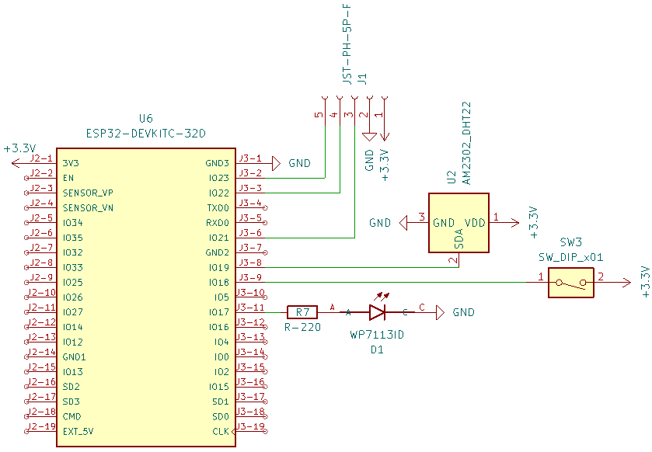
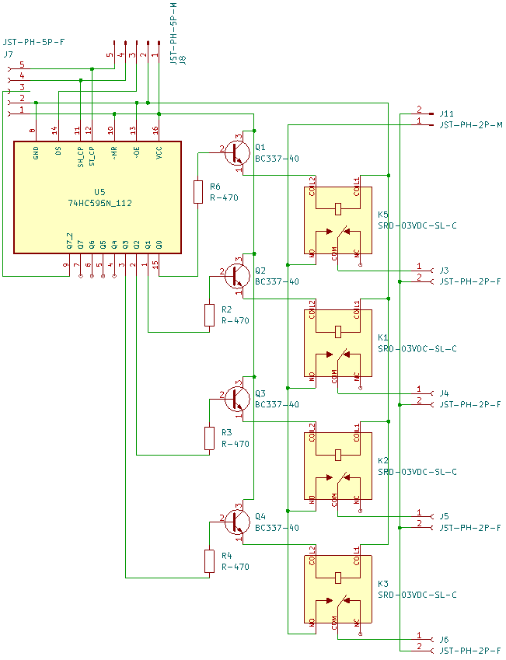
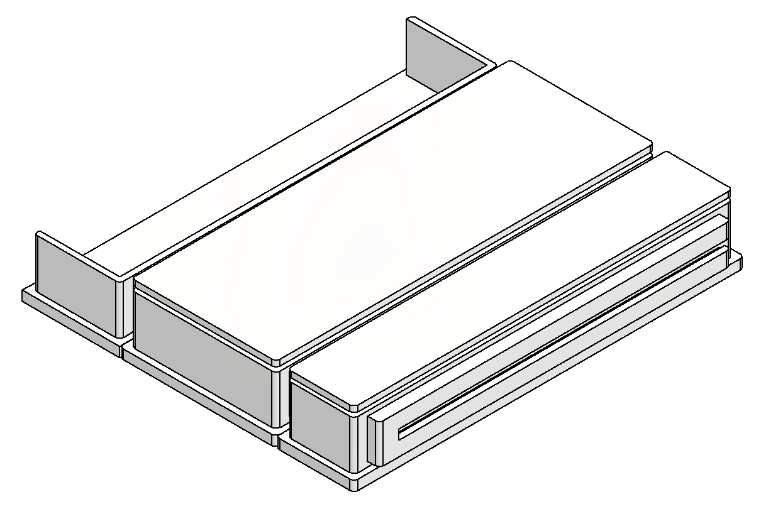
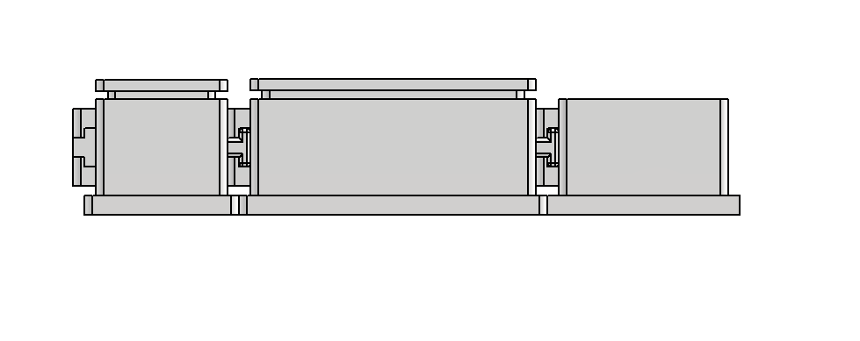
Regulated Irrigation System (RIS)
by Sam Dixon
What is it?
Circuit - Electronic Engineering
This project is all about watering plants in any scenario possible like in a small greenhouse or across an entire farm while being reliable, able to continue working across a whole year through all the seasons.
The idea for this project came from my Dad’s greenhouse which when we went on holiday was a struggle as no one could water the plants inside it.
There are many existing products for this issue already, but they are either too expensive for no reason due to being sold to businesses or are too simple and not reliable enough, so I thought I’ll make my own.
This all led me to my Design Brief I created:
Water Plants (Water Conservation).
Any Environment and Scale (Greenhouse / Farm).
Reliable (Works for Months / Years).
Sustainable (Self Sufficient: Solar / Rain).
Relatively Affordable (< ~£100).
A significant portion of this project has been research based as I have been ensuring it can fit my strict design brief with the main consideration being “Any Environment and Scale” because it increases the possible use cases to fit as many users needs as possible.
I am still currently developing this project and iterating over each area of the design outlined here (titles) over time getting closer to the final design that I will then produce and test as a prototype finally then producing it again as a final product (one-off for now).
There will be a circuit in the command and switch modules which I will organise onto 2 custom PCBs that I will get produced by JLCPCB as it is very cheap and scalable for batch production which I may consider if made into a product.
Command Module which controls the entire system regulating all the valves and pumps at certain times contains: the microcontroller (ESP32), a temperature sensor, Wi-Fi switch, status LED and power management (battery, solar).
Switch Module has multiple ports to turn on the valves and pumps bridging the gap between them and the command module containing: a shift register (74HC595) that will control relays (SRD-03VDC-SL-C) for each port.
Each module will communicate using connectors (JST-PH) for power or data.
Command Module
Circuit
(Ignore Diagram Text - Unreadable)
Temp Sensor
ESP32 (MC)
Shift Register
Wi-Fi Switch
Relay
Valve
Switch Module
Circuit
(Ignore Diagram Text - Unreadable)
Status LED
Relay
Pump
Shift Register
…
…
Command Module
…
Switch Module
External
Model - Mechanical Engineering
Regulation - Software Engineering
This design is built up of multiple modules to allow it to be scaled up from just a couple plants to hundreds with each being a 3D printed (due to it being more cost effective) case that slide into each other on the sides.
The Command Module will be the same across all implementations of the product containing the microcontroller (ESP32) for the regulation and a battery with a solar panel on top.
The Valve Modules contain many slots for electromechanical valves (Solenoid) that can send off water to different areas or types of plants that may want different amount of water.
The Pumps are external parts of the design that may have module enclosers in the future to protect them while they pump the water to the valves and then plants when needed.
The Switch Modules control relays for ports to the valves or pumps when needed and can be chained together due to the shift registers inside to allow as many valves and pumps as possible to be added for the required scale.
An example of an application of this project would be in a greenhouse where the plants on one side need to get more water (due to sunlight) that the other so could be on a different valve port meaning one side has it open for longer than the other allowing full control for the user over their plants or crops (same principle could be applied to a farm).
The microcontroller (ESP32) will control the entire system, regulating all the valves and pumps to ensure they turn on at the required times, with the program (C++ Code) running on it.
It creates a Wi-Fi Access Point Network with a Web Server as well that users can connect to even in the most remote locations to configure everything using the website interface (on a phone / laptop).
Routines can then be created that will turn on certain switch ports (Pumps / Valves) at certain times (12:00 every day or month) for a certain duration (60s) to give full control allowing it to be used in any environment.
This duration can change depending on the temperature sensor, for instance, if its hot (summer) then give plants more water (120s) or if its cold (winter) then give plants little to no water (0s) to allow it to function reliably all year-round while also being sustainable as it is only using the water it needs.
This ability to use only the water it needs to will allow it to conserve water used in times of shortage and still be able to function through hosepipe bans for instance that have happened recently in the UK.
All this customisation is given through the simple website that anyone can use to alter the functionality for their personal needs.
I believe this control for the user is very important as it really sets it apart from the alternatives which really lack any of this leading to the user being unsatisfied with their product which this solves.
Valve Module
Command Module
Switch Module

