Slide 1
Team Project
Sam Gonzalez & Luke Rouquette

Slide 2
Overview
Weekly Data
Aiming to predict Basket Total via a Regression Model
Mostly Categorical variables
Transaction – Shop Week, Date, Hour
Customer – Life Stage, Price Sensitivity, Basket Type, Basket Dominant Mission
Departments – Sub Departments, Class
Store – Format, Region, Retailer(Franchise)

Slide 3
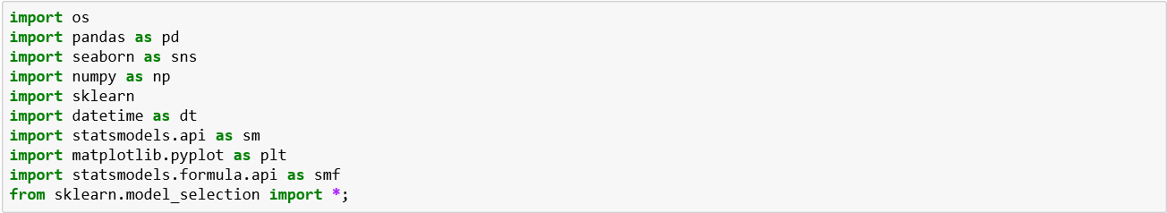
Tools Used

Slide 4
Basic Code Flow
main()
importData()
manipData()
plotData()
splitData()
prepForModel()
buildModel()
outputPredictionFile()

Slide 5

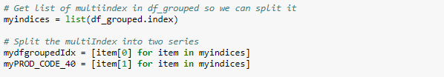
Pandas Tips
Convert string column to datetime
Group By Multiple Levels
Split Multi Index

Slide 6
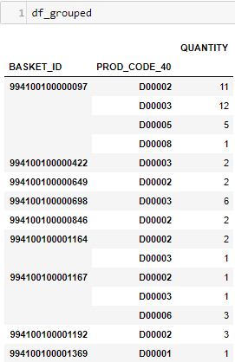
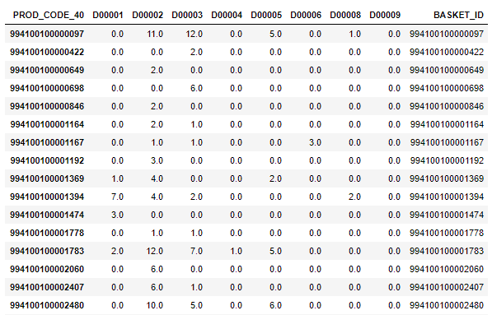
PANDAS DATAFRAME RESULTING FROM GROUPBY

Slide 7

PANDAS TIPS
Pivot table, Fill NaNs, Create Data Frame column from Index for Join
Join (aka Merge)

Slide 8



STATSMODELS
Had to go with STATSMODELS
Model constructor using ‘R’ style (don’t tell)

Slide 9
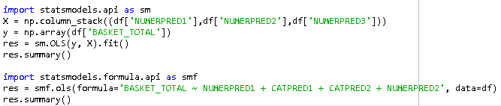
Statsmodels optional

Slide 10
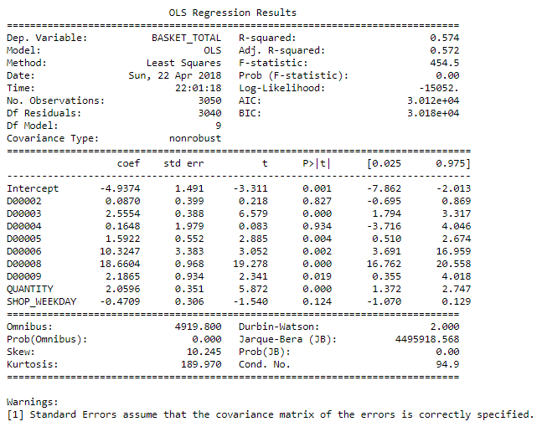
Regression Output

Slide 11
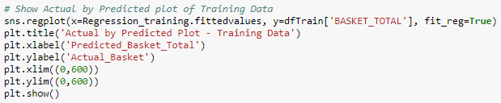

SEABORN & Matplotlib
Boxplots
Scatter Plot with Formatting Settings
Matplotlib (Straight from dataframe)

Slide 12
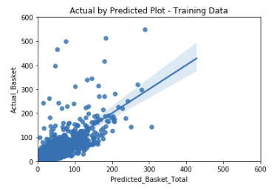
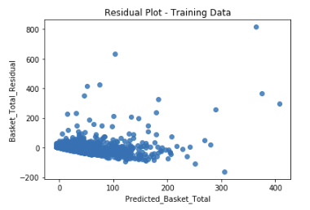
Seaborn Plots

Slide 13
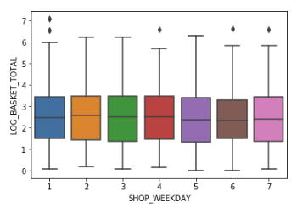
Seaborn Boxplot

