Slide 1
Predicting Homelessness from Evictions in Los Angeles
Samantha Gordon Danner
The Data Incubator

Slide 2
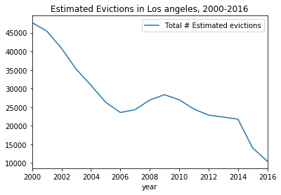
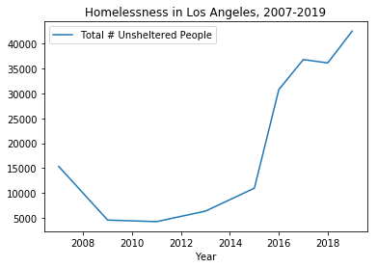
Summary: Evictions & Homelessness in LA
Over 500,000 formal evictions have been filed in Los Angeles since 2010; housing insecurity is increasing
Homelessness in LA has increased 52% from 2010 to 2019
Data from the Princeton Eviction Lab
Data from LAHSA Homeless Count
Notes:
*Homeless count in years prior to 2015 only included a sampling of census tracts
*Evictions data don’t include informal evictions like cash for keys or landlord intimidation

Slide 3
Protecting Housing-Insecure People
Tenants are at risk of homelessness due to:
Stagnant wages
High rent burden ( > 30% of income spent on rent)
Few tenant protections
Analyzing evictions data can mitigate homelessness by:
Predicting where people are most at risk
Targeting resources and development in the neediest areas

Slide 4
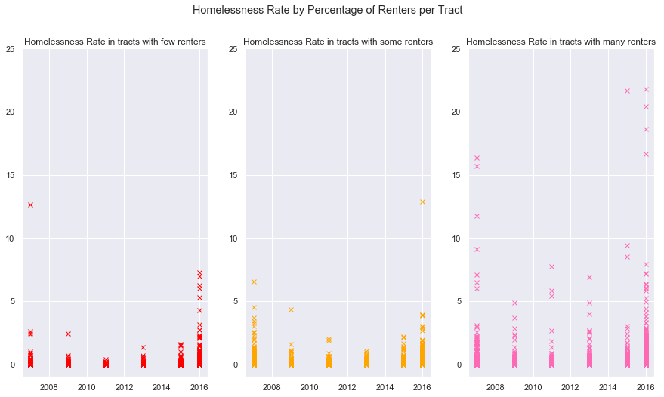
Modeling the Relationship between Evictions and Homelessness
Census tracts vary widely in demographic makeup
Models are fit using demographics to group similar census tracts for better prediction

Slide 5
Modeling the Relationship between Evictions and Homelessness
Modeling temporal delay between eviction and homelessness
Evictees may not become homeless immediately
Homeless people may cycle in and out of temporary shelters

Slide 6
Predicting Homelessness rate

Slide 7
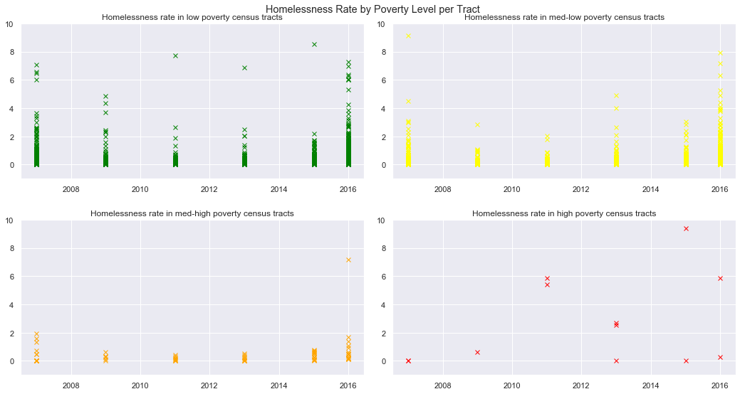
Predicting Homelessness rate

Slide 8
Website: Coming Soon
Additional demographic information!
Updated evictions data!
Interactive models!

