Slide 1
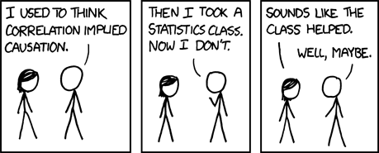
Intro to Data Science tools

Slide 2
Intro to Git/GitHub
Version control
Allows people to collaboratively work on something.
Keep track of who is working on what.
Can create different “branches” if multiple people are working on different parts of the project.
Allows you to go back in case of mis-fires.
Download Git
Find more info on these slides or on the Git website (more in depth)
GitHub
Where git repositories are stored.
Repos are just the collection of files for a project and the history for those files.

Slide 3
Essential Git Commands
Access Git through your command line (Git Bash)
Setting up a repo--- git clone.
Example.:Git clone github.com/samgottuso/star_wars.git
The general process is Pull -> Make Changes -> Add -> Commit -> Push (and then pull again)
Git add --- getting your file ready to be put into the main repo.
Example: git add deathstar_function.R
Git Commit– explaining why your file is being pushed on to GitHub.
Example: Git Commit –m “This file fixes the hole in the the deathstar function”
Git push– put it on GitHub
Git push origin master(branch)

Slide 4
Intro to R
What is R?
Language used for all different kinds of programming, mainly statistics.
Can also do things like generate reports, create web apps, fit machine learning models and much more!
What can I do with it?
Can help with a number of project tasks and personal interest projects.
Automate data cleaning process. Explore data, create graphs and tables.
We will start with visualization move into data transformation, work with text, fit basic predictive models and then turn everything into a web app.

Slide 5
Why R?
R and Python are the largest languages for data science.
R has a more standardized environment (everyone uses R studio and .R files)
In Python there are a ton of different IDEs and file types that you can use (Jupyter Notebook, Spyder, Atom Sublme, Git Bash)
R has much better documentation and easier to find.
If you are working with a function or a package, simply use ?function to find examples, documentation etc.
Python advantages
A more complete programming language (R is best for statistics).
Often there is only 1 way to do thing– in R there are many packages that accomplish the same thing
Python is faster for larger datasets (you won’t get there for a while).
Machine learning is more prominent on python (scikit learn, Keras, TensorFlow)

Slide 6
Intro to the Tidyverse
Certain way to think about the data science process.
Import -> Tidy -> Transform -> Visualize -> Model -> Communicate
Has a collection of packages that work together to help you accomplish all of these things.
Most important ones are dplyr, ggplot2 and stringr
Much of the course will be based on the book Data Science for R

Slide 7
First Steps
Download R and R Studio
Install.packages(‘tidyverse’)
Open the R file from the DS+bR github page.

