Slide 1
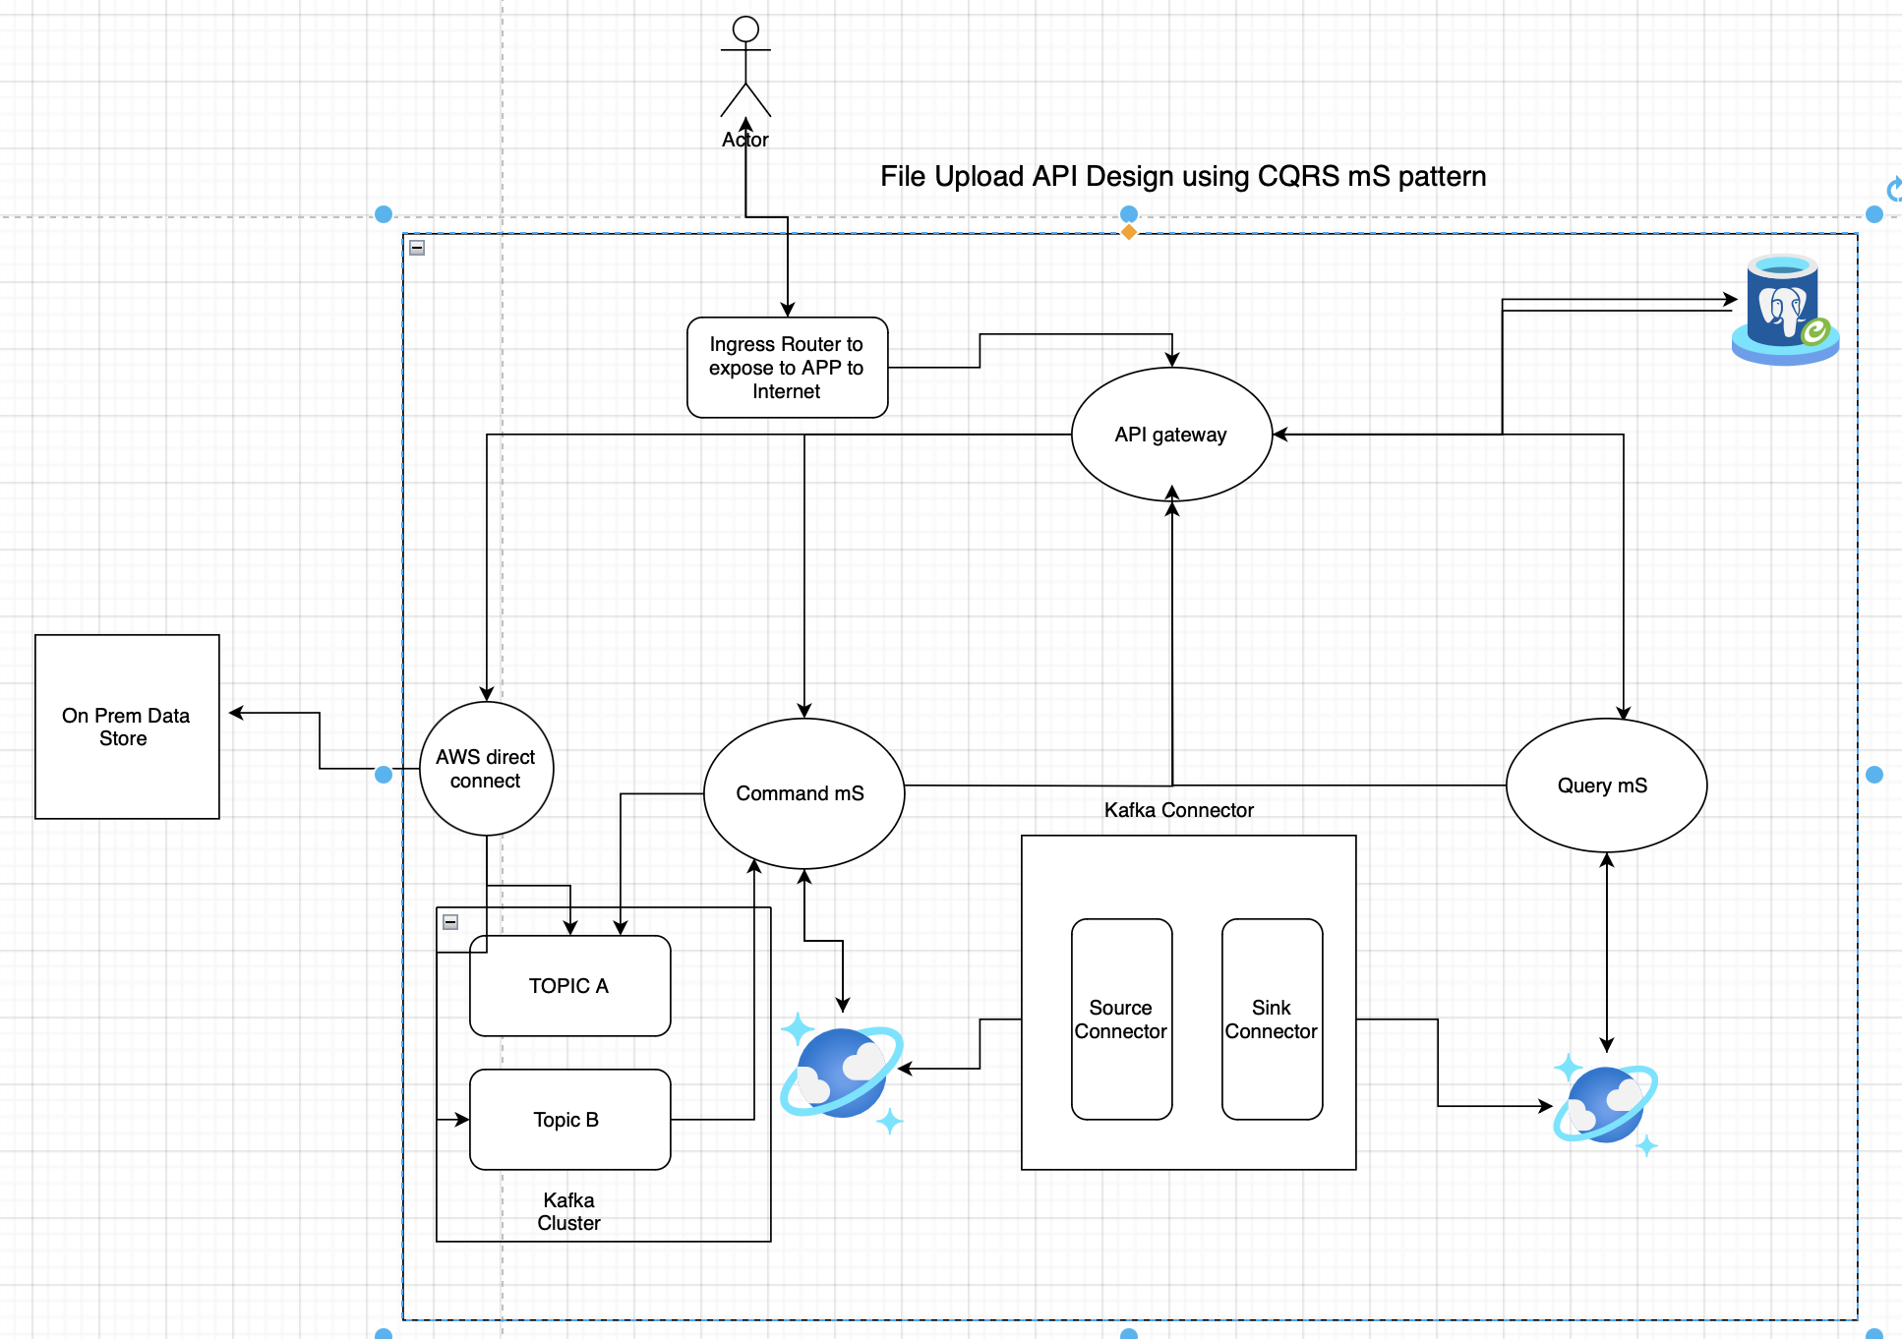
API Design for File Upload
Tech Stack and functionality
Tech Stack : Java , Spring boot , Cosmos, Microservice Architecture & AWS as cloud platform( Lambda, PostgreSQL )
Brief functionality of API: Using the developed Rest API, user should be able to upload and download the file with out impacting the application performance & security.
Requirement Overview
Functional Requirements:
Upload documents (PDF, JPG).
Preview files before upload.
View and delete uploaded documents.
Store all documents in a “Document Store”.
Support multiple users and bulk uploads/downloads.
Non-Functional Requirements:
Performance, reliability, and maintainability.
Security controls to prevent unauthorized access.
Data integrity and cost optimization.

Slide 2
High-Level Architecture
API Gateway: Handles incoming requests and routes them to the appropriate micro service and handle the authorization and authentication at first place.
Command Service: Will accommodate the file upload and crud operation( Delete)
Query Service: Will accommodate the file listing service.
Database: Stores URL mappings and statistics.
Cache: Caches frequently accessed documents to reduce database load.
Front end mS: Will be designed in Angular or React to interact with the application and perform the necessary task.
Kafka Connector : Used to sink the command and query microservices database
Kafka Producer and consumer API will be used to publish the file event to On Prem environment to store files.
AWS IAM : will be used for user authorization and authentication along with JWT token to secure the API’s exposed by each microservice . On top of this we are Ingress router to connect to internet.
API End Points
1.Upload Document
Method type is POST
Header Authorization: Bearer <token>
End Point : /api/documents/upload
Request Body : consumes = {MediaType.APPLICATION_PDF_VALUE, MediaType.IMAGE_JPEG_VALUE})
@RequestParam("file") MultipartFile multiPartfile1
Response: { "documentId": "12345 or null ", ”message": "Uploaded or Failed or Exception" }
2. Bulk Upload
Method Type : POST & it should be @Async
End Point : /api/documents/bulk-upload
Header Authorization: Bearer <token>
Request Body : consumes = {MediaType.APPLICATION_PDF_VALUE, MediaType.IMAGE_JPEG_VALUE})
@RequestParam("file") List<MultipartFile> multiPartfile1
Response: {“message” : “Request is submitted for process and email notification will be send or error message incase initial validation fails”}
Note: Use Completable Future to handle the asynchronous processing of file uploads or Spring Reactive program to active the better performance.
--As part of the Upload functionality from UI , Option will be given to preview the file from local storage this will not have impact on backend API.

Slide 3
API End Points
3. List Uploaded Documents
Method Type : GET
End Point : /api/documents/users/{userId}
Header Authorization: Bearer <token>
Response: [ { "id": "12345", "name": "example.jpg", "url": "https://example.com/documents/12345" }, { "id": "12346", "name":"report.pdf", "url": "https://example.com/documents/12346" } ]
Note:
1)After listing documents in UI , After selecting the documents and click on download will trigger the request S3 bucket and will be downloaded to local device . There will be no transaction will be triggered to back end after list the documents..
2) View document content will also be handled via UI API interacting with S3 bucket directly after listing the document.
4. Delete Uploaded Document
Method Type : DELETE
End Point : /api/documents/document/{documentId}
Header Authorization: Bearer <token>
Response: {“documentId” : ”123456”, ”message”: “Document is deleted successfully or proper error message” }
4. Delete Uploaded Documents
Method Type : DELETE
End Point : /api/documents/document/{documentIds}
Header Authorization: Bearer <token>
Response: [{“documentId” : ”123456”, ”message”: “Document is deleted successfully or proper error message” } , {“documentId” : ”123457”, ”message”: “Document is deleted successfully or proper error message” }]

Slide 4
User Management (Assumed functionality)
User Registration
POST /api/users
Request Body: JSON with user details.
Response: 201 Created with user ID.
User Login
POST /api/login
Request Body: JSON with username and password.
Response: 200 OK with authentication token.
API Security
Authentication: Use JWT (JSON Web Tokens) for user sessions. Secure endpoints with an Authorization header.
Access Control: Ensure that users can only access their documents. Implement role-based access if necessary.
AWS IAM will be used for user authorization and authentication On top of this we are Ingress router to connect to internet.
OnPrem
OnPrem services will consume the message from Kafka Topic for the uploaded files and produced messages will be consumed by command mS in case of upload failure.
Return appropriate HTTP status code in all API’s
200 OK: Successful request.
201 Created: Resource created.
204 No Content: Successful request with no content.
400 Bad Request: Invalid request.
401 Unauthorized: Authentication required.
403 Forbidden: Authorization required.
404 Not Found: Resource not found.
500 Internal Server Error: Unexpected server error.

Slide 5
NFR Considerations
Performance: Use pagination for listing documents, cache frequently accessed documents, and optimize file storage and retrieval.
The DB tables will be indexed partitioned basis on Range, so that it will support better scalability
Note: Further scalability we can think of database sharding to store the data basis on region in case the application will be enhanced to support multiregion.
Reliability: Implement retries for uploads and consider using a CDN for document storage to improve availability.
Data Integrity: Validate file types on upload, check for duplicates, and implement checksums to ensure file integrity.
Cost Optimization: Use a cloud storage service (like AWS S3) for storing documents, which can scale according to usage.
containerized the application and deploy on Lamda under cloud plat form.
Read access Geo-redundant storage as replication factor in case any failure in primary location data can be accessed from secondary region.
Concurrency Control: Pessimistic Locking will be implemented, lock the document during edits to prevent others from making changes until the lock is release.
Liveness and Readiness Probes: Continuously monitor the health of your microservices. Kubernetes automatically restarts pods that fail liveness checks and routes traffic away from pods failing readiness checks
Scalability :Design for horizontal scaling.
Create the Kubernetes yml file and keep 10 replicas and configure the CPU utilization crosses 90 % then it will automatically the brings the other pods active
Deploying under Lambda services will take care on scalability.

