Slide 1
South Florida Common Venue Analysis
Xin Guan

Slide 2

Selling your idea
Use Machine Learning technology to analysis the venue information for South Florida.

Slide 3


1. Intro
Python to perform the detail big data analysis.
BeautifulSoup Package www.unitedstateszipcode.org to retrieve the raw data.
Foursquare API To get the venue info for specific zip code.
Sklearn Package K-Mean cluster analysis of the venue data.
Folium Package Draw the local map with venues.

Slide 4
Initial Install
!conda install -c conda-forge folium=0.5.0 --yes
!conda install -c conda-forge BeautifulSoup4 --yes
!conda install -c conda-forge lxml --yes
!conda install -c conda-forge geocoder --yes
!conda install -c conda-forge geopy --yes
Tip
Use “PIP install xxxx” instead if needed.

Slide 5
Initial Import
import numpy as np
import requests
from bs4 import BeautifulSoup
import os
from sklearn.cluster import KMeans
import folium
from geopy.geocoders import Nominatim
import matplotlib.cm as cm
import matplotlib.colors as colors
import pandas as pd

Slide 6

LET’S GET STARTED!!

Slide 7
2. Zip Code Data
Load from US Zip Code Database
Extract FL data
Focus on South Florida tri-counties
Remove PO Box data
Drop unnecessary columns

Slide 8
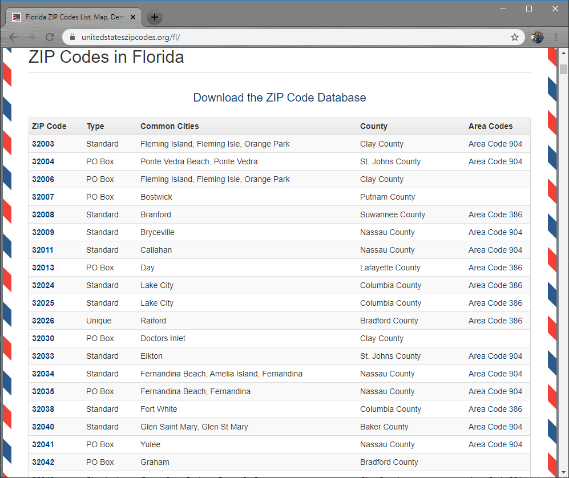
United States Zip Code Database

Slide 9
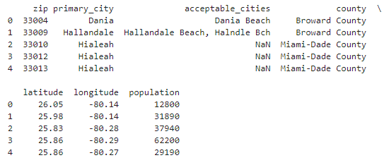
Store in DataFrame df
Story for illustration purposes only

Slide 10
3. Venue Info
Get data from Foursquare API
Processing Data
Store in sfl_venues

Slide 11
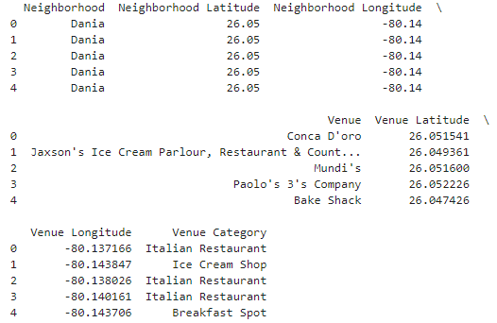

Slide 12
4. Data Process
Group Same City
Choose Top Ten venues
Sort most common ones

Slide 13
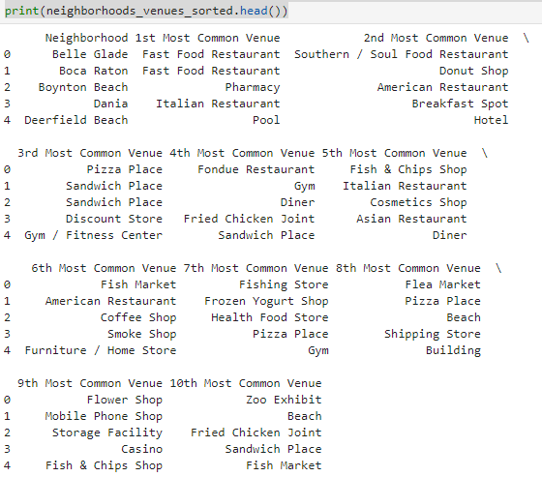

Slide 14
5. K-Mean Cluster
K = 10
Cluster based on Neighborhood
Sort most common ones
Apply “Cluster Label” to data
Merge with city dataframe

Slide 15
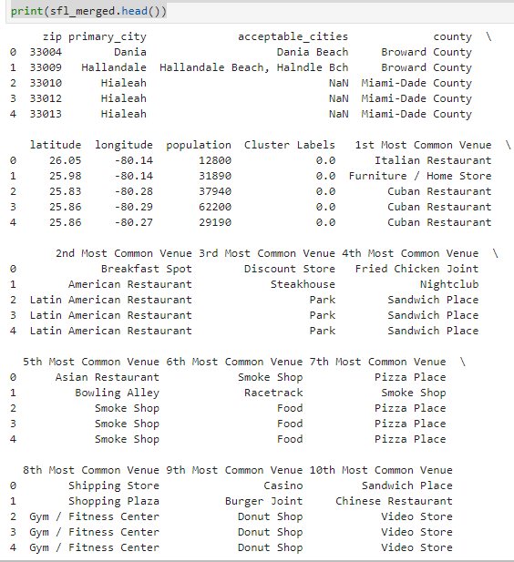

Slide 16
6. Visual Presentation
Center Location: Fort Lauderdale
Zoom Level: 10

Slide 17
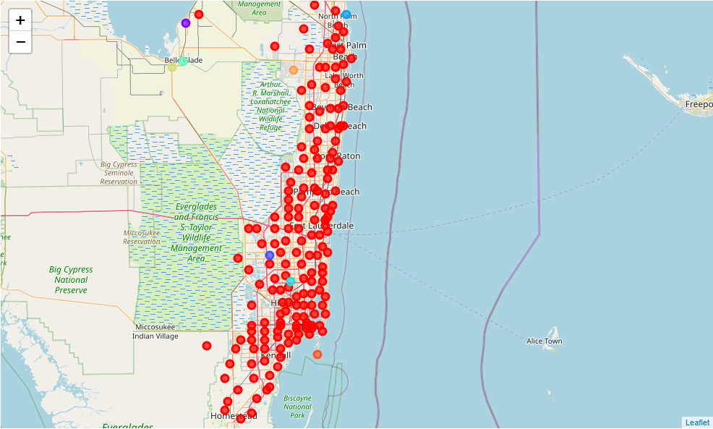

Slide 18
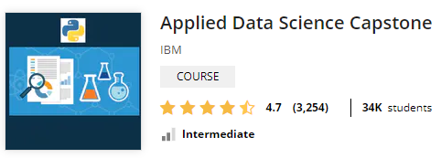
Thank You!

