Slide 1

Movie Recommender System
Team Members
106360101 謝尚泓 電子四甲
106360130 陳良葳 電子四甲
1

Slide 2
Problem: Information Overload
Sol: Personalization in the Big Data Era
2

Slide 3
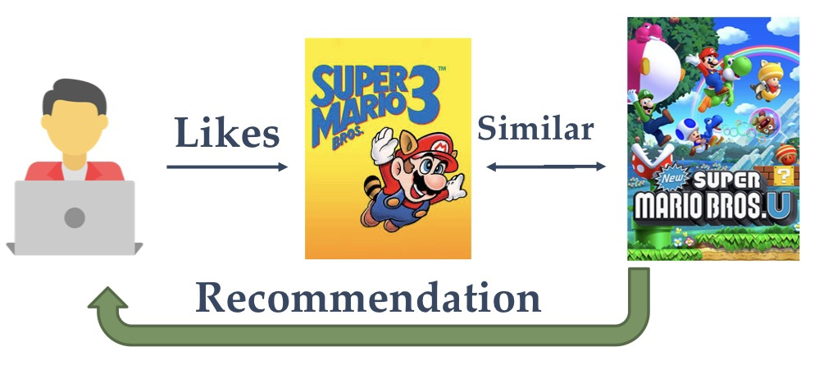
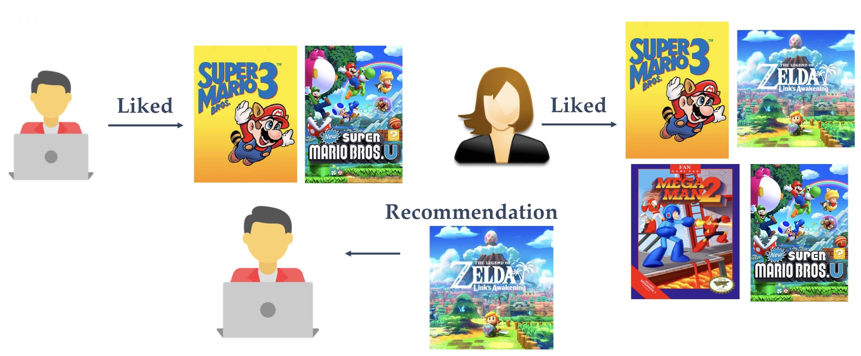
Recommender System (RS)
Recommender System
Content Based Filtering
Collaborative Filtering
Hybrid
3

Slide 4
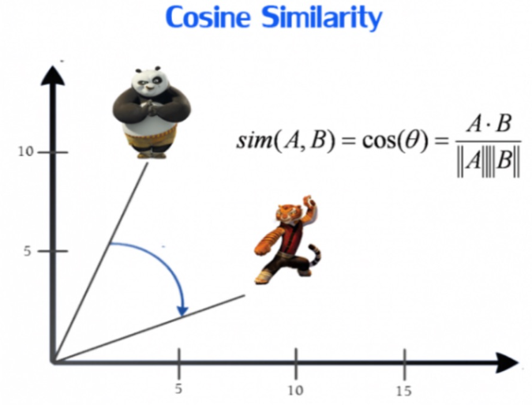
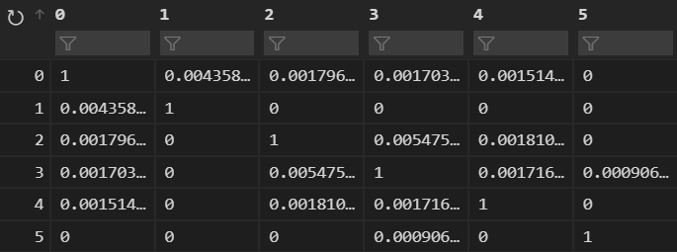
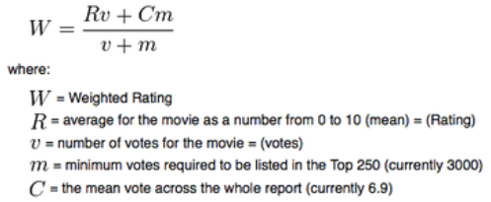
Content Based Filtering
文本數據預處理 - 詞頻、資訊檢索與文本挖掘
Sklearn – CountVectorizer、TfidfTransformer
Cosine Similarity
Sorted Cosine Similarity
Sorted Weighted Rating
IMDB formula of weighted rating (WR)( from 1 to 10)
4

Slide 5
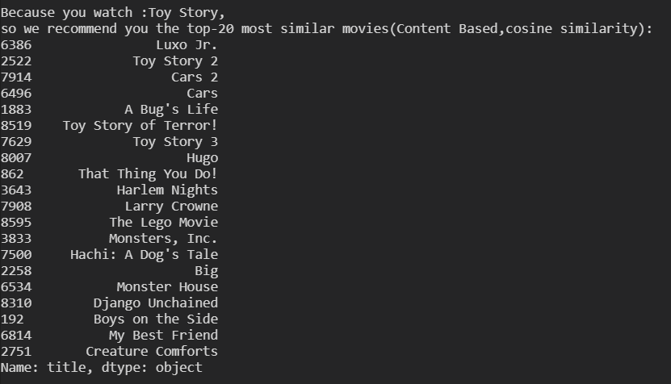
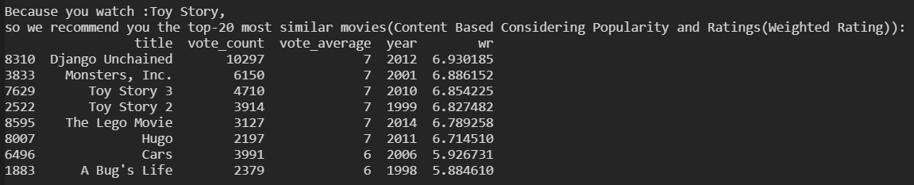
Sorted Cosine Similarity
Sorted Weighted Rating
IMDB formula of weighted rating (WR)( from 1 to 10)
5

Slide 6
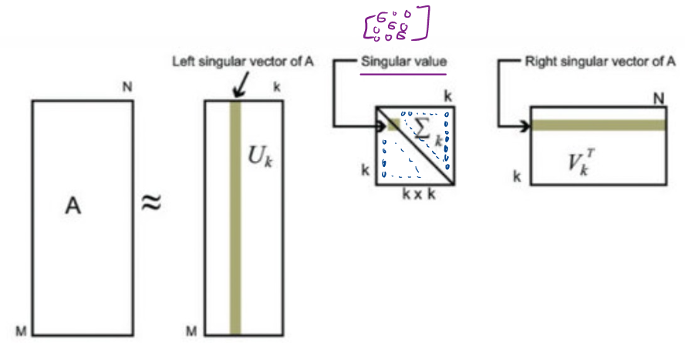
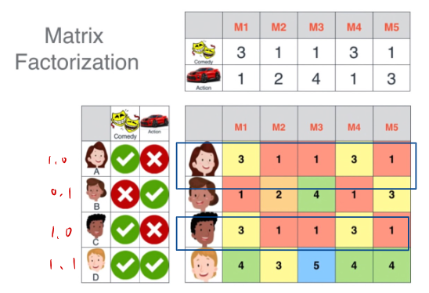
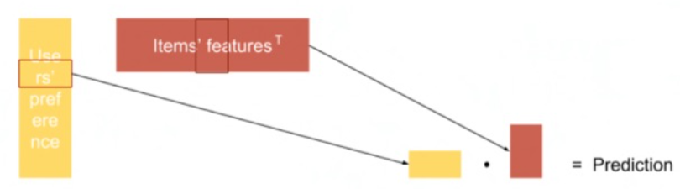
Collaborative Filtering
SVD對矩陣進行拆分
6

Slide 7






Hybrid Approach (Cascade)
A preliminary
output list of recommendations
Content Based
Sorted Cosine Similarity
Further Sorting
Based on Predictions
(SVD - Estimate Scores)
Model Based
Collaborative Filtering
Refined
Recommendations
7

Slide 8

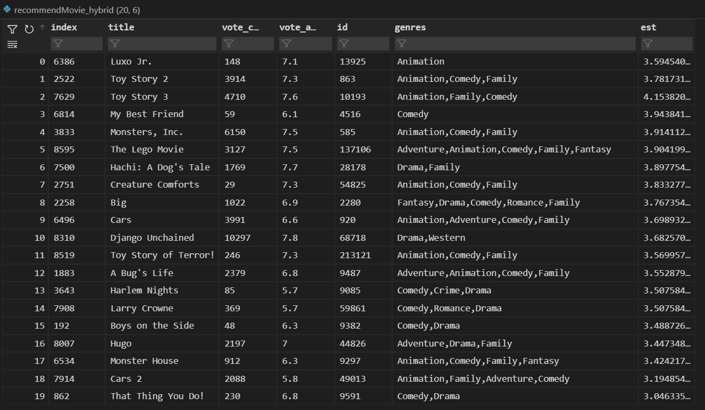
Hybrid Approach (Cascade)
Keep top-2 preliminary
Output list of recommendations
Based on content based filtering
Further sort the
preliminary output
Based on Predictions
(collaborative filtering)
The outcome varies by user ID
8

Slide 9
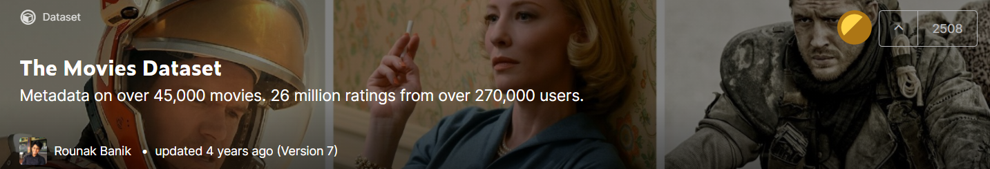
The Movie Dataset
Data from:
https://www.kaggle.com/rounakbanik/the-movies-dataset
The dataset consists of movies released on or before July 2017
9

Slide 10
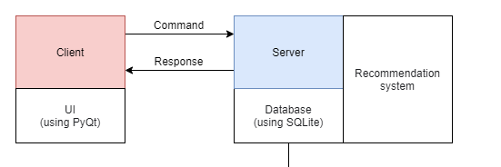
System Architecture
10

Slide 11
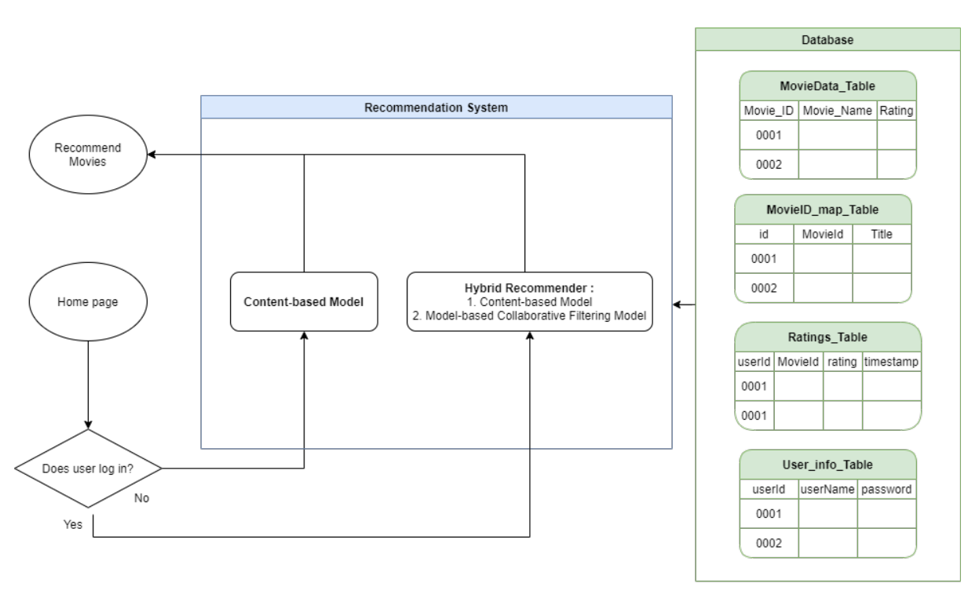
RS
11

Slide 12
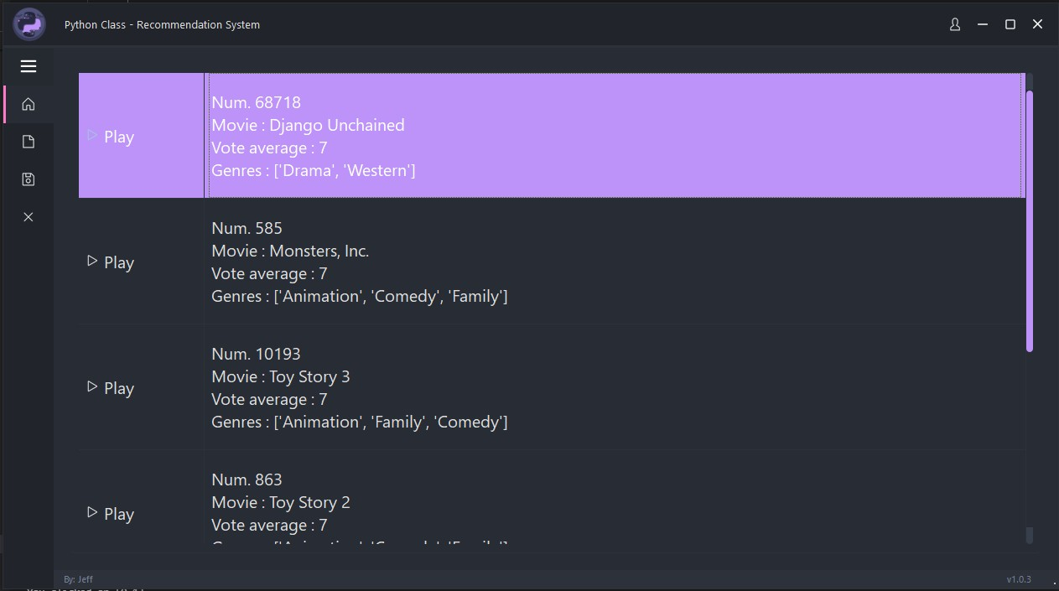
PyQt6 – Home Page
12

Slide 13
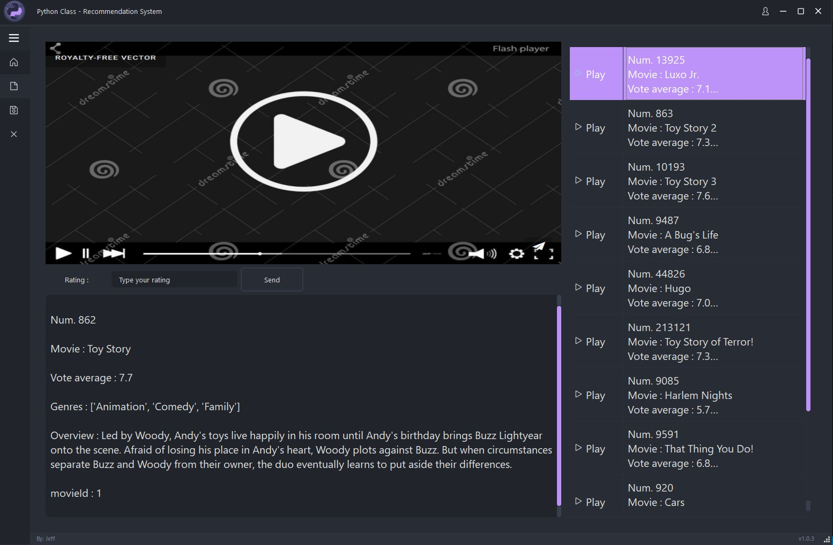
PyQt6 – Video Page
13

Slide 14
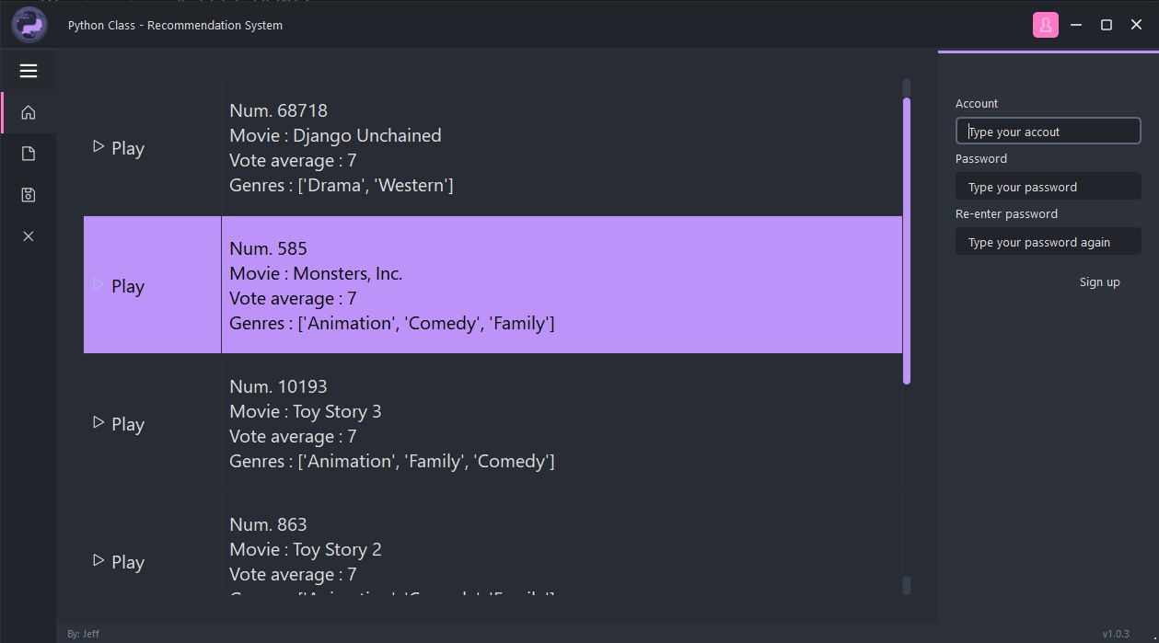
PyQt6 – Account
14

Slide 15
DEMO
DEMO
15

Slide 16
Contributions
◆106360101 謝尚泓 電子四甲
後端、Socket、Database、前後端整合
◆ 106360130 陳良葳 電子四甲
前端、PyQt6、GUI、前後端整合
16

Slide 17
Link
◆ [1] Github:
https://github.com/samh99474/Python_Final_Project_RecommenderSystem
◆ [2] Youtube Video Demo:
………………
17

