Slide 1

Movie Recommender System
Team Members
106360101 謝尚泓 電子四甲
106360130 陳良葳 電子四甲
1

Slide 2
Problem: Information Overload
Sol: Personalization in the Big Data Era
2
Notes:
資訊太多
使用者觀看
片商

Slide 3
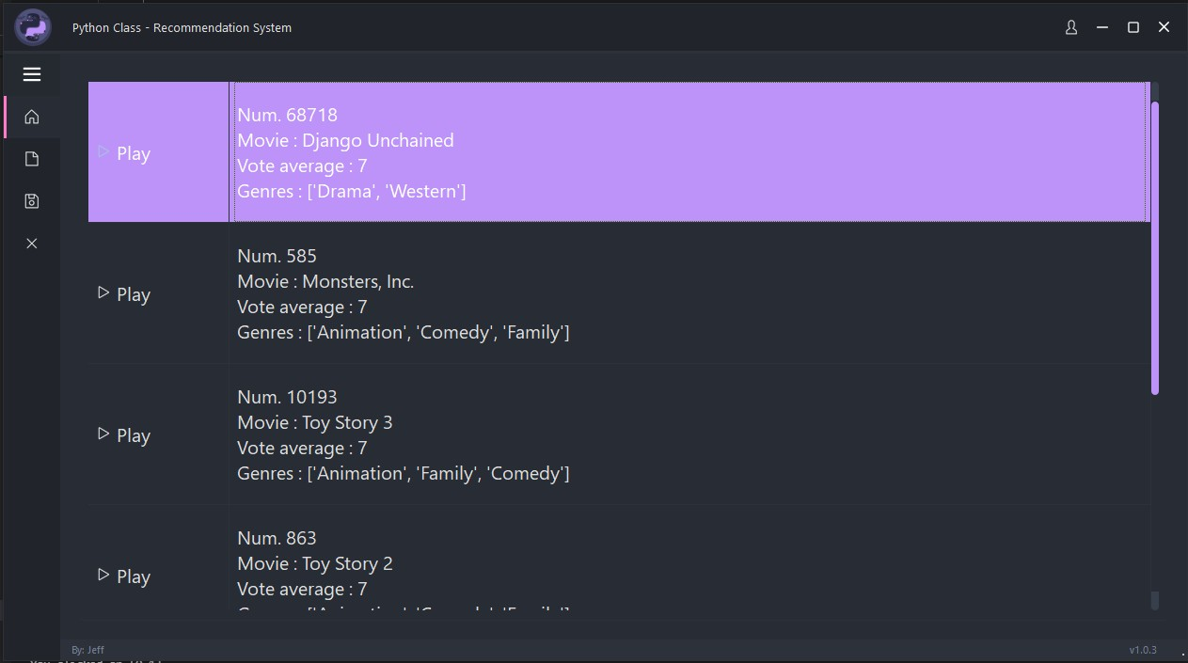
PyQt6 – Home Page
3

Slide 4
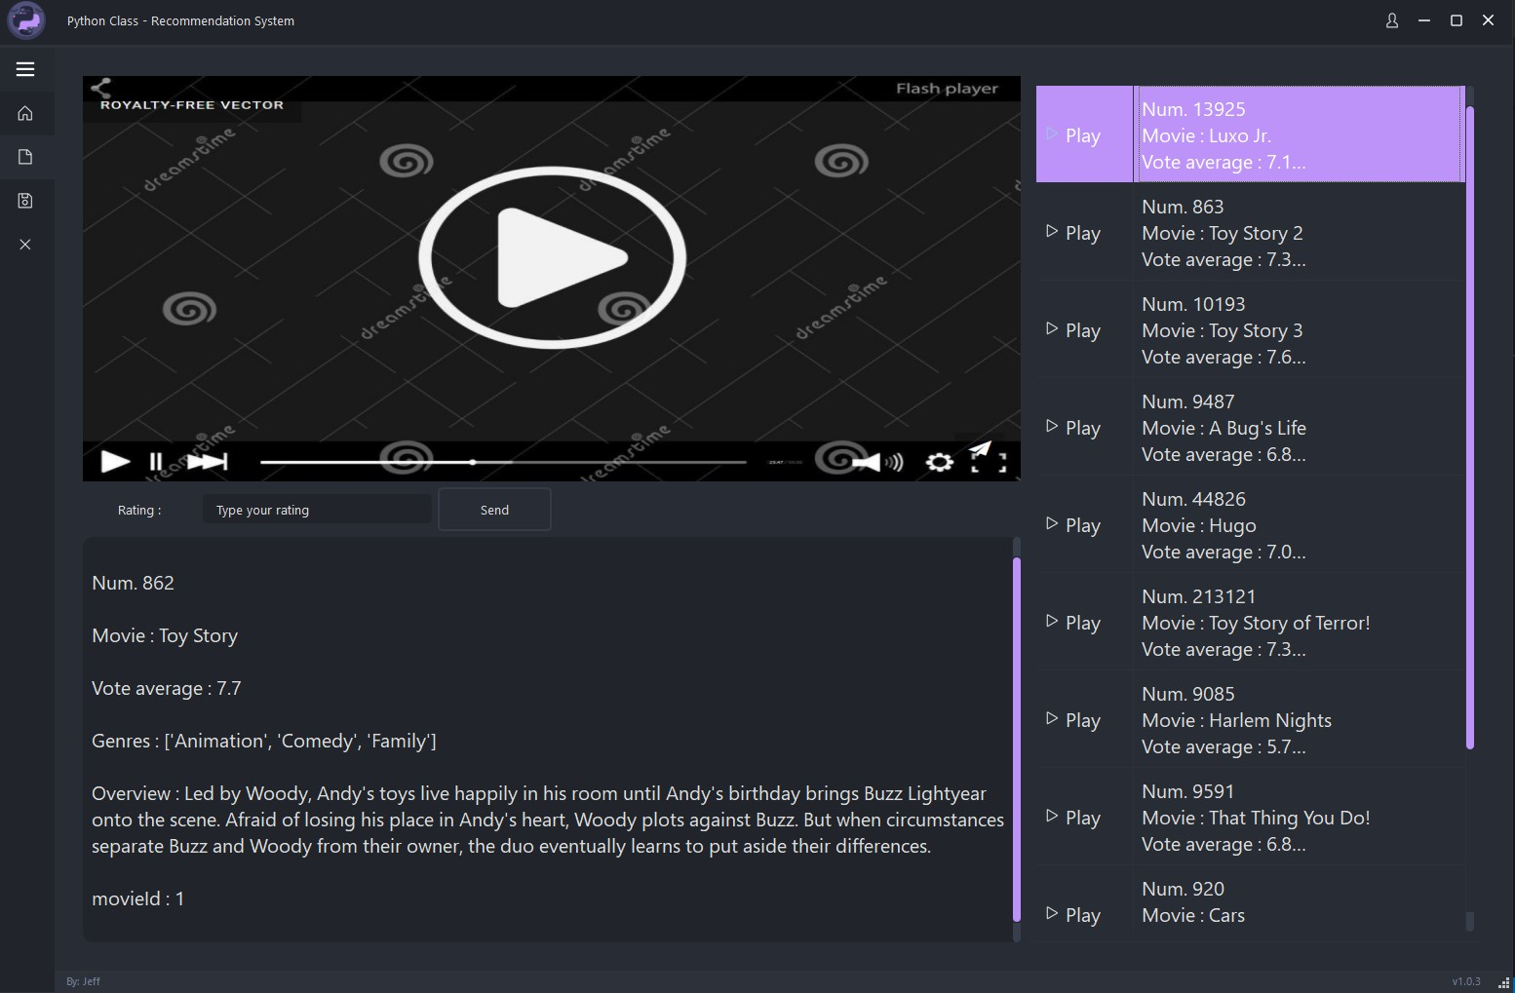
PyQt6 – Video Page
4

Slide 5
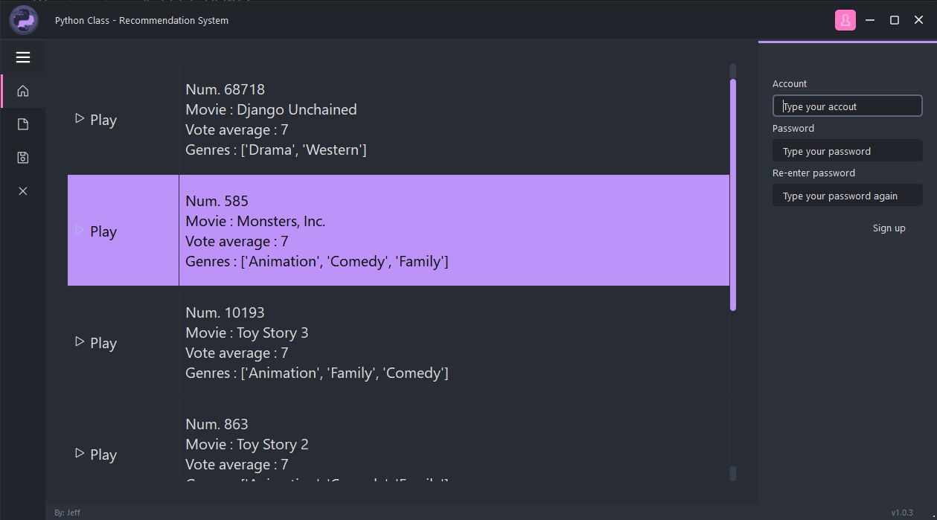
PyQt6 – Account
5

Slide 6
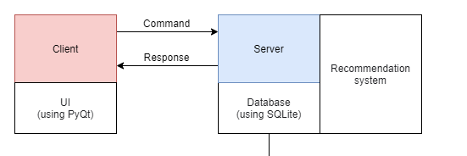
System Architecture
6

Slide 7
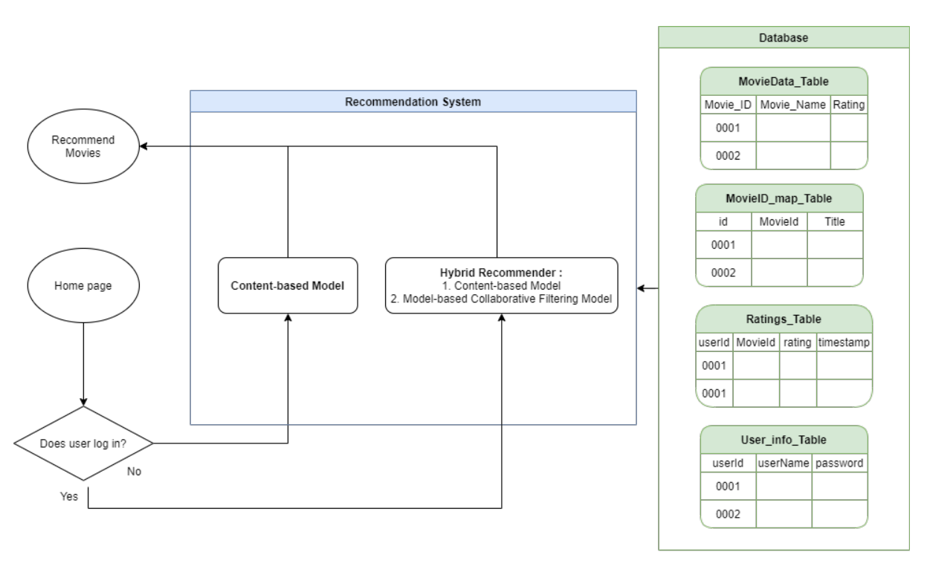
RS
7

Slide 8
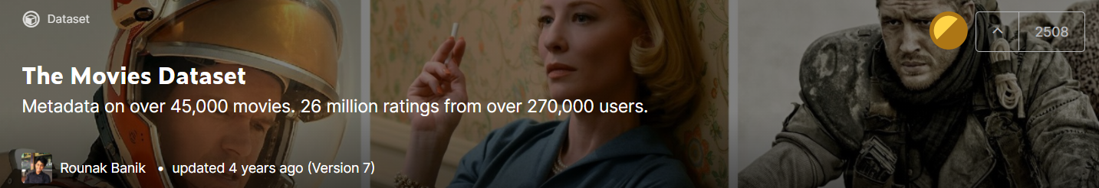
The Movie Dataset
Data from:
https://www.kaggle.com/rounakbanik/the-movies-dataset
The dataset consists of movies released on or before July 2017
8

Slide 9
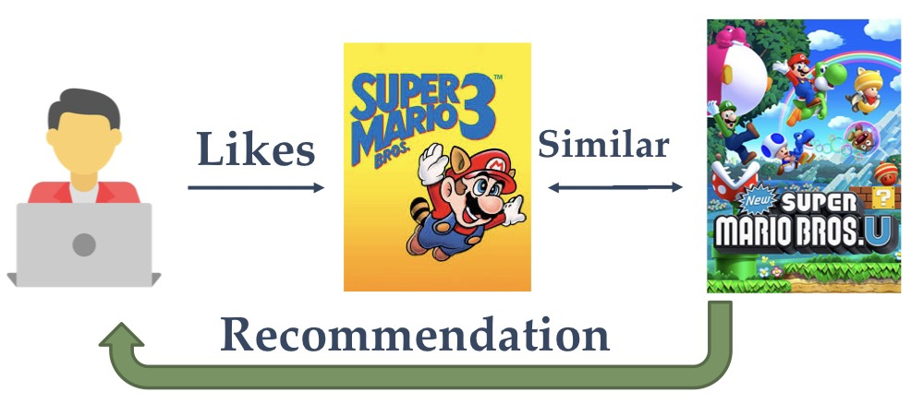
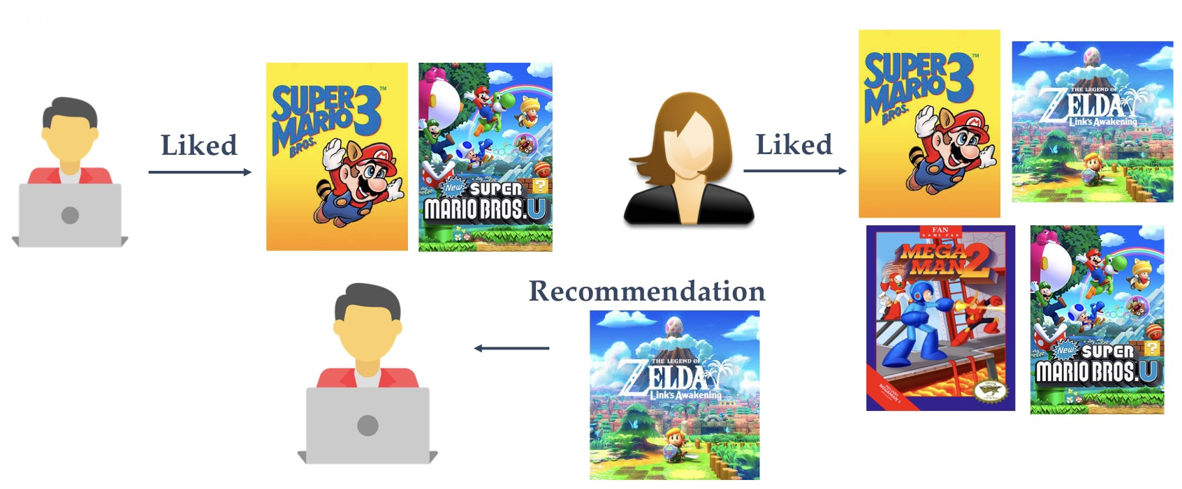
Recommender System (RS)
Recommender System
Content Based Filtering
Collaborative Filtering
Hybrid
9

Slide 10
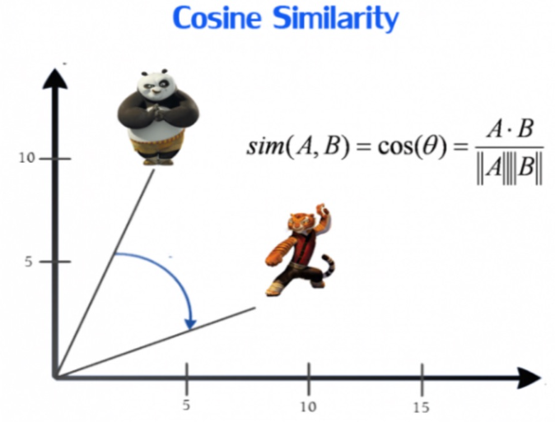
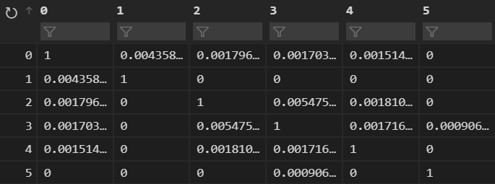
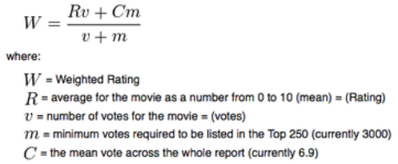
Content Based Filtering
文本數據預處理 - 詞頻、資訊檢索與文本挖掘
Sklearn – CountVectorizer、TfidfTransformer
Cosine Similarity
Sorted Cosine Similarity
Sorted Weighted Rating
IMDB formula of weighted rating (WR)( from 1 to 10)
10

Slide 11
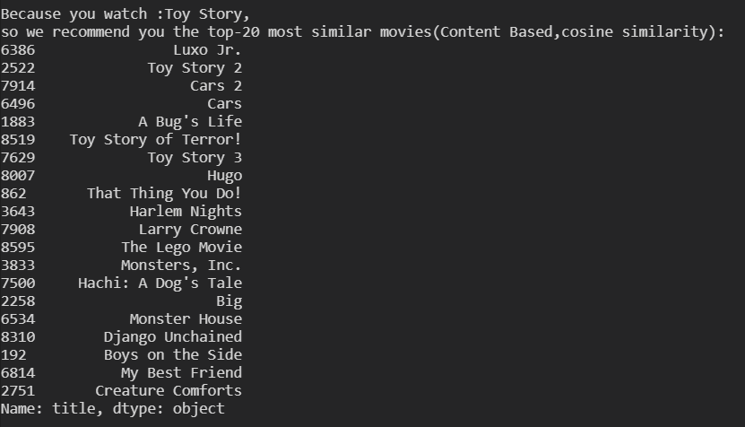
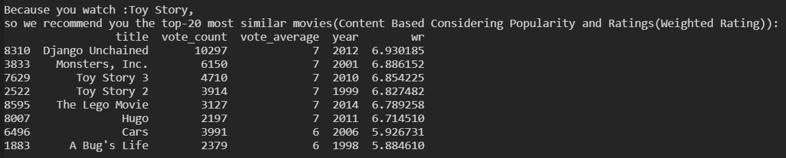
Sorted Cosine Similarity
Sorted Weighted Rating
IMDB formula of weighted rating (WR)( from 1 to 10)
11

Slide 12
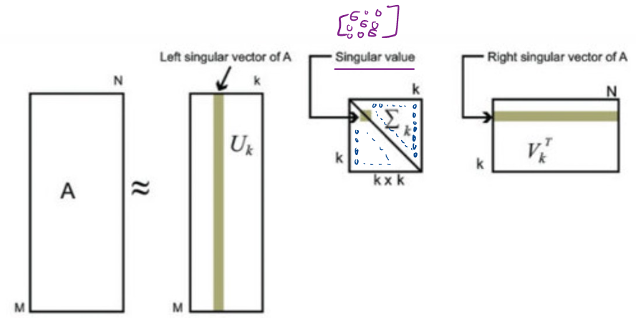
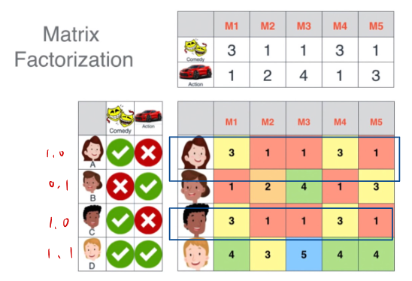
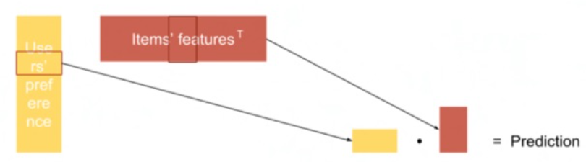
Collaborative Filtering
SVD對矩陣進行拆分
12

Slide 13






Hybrid Approach (Cascade)
A preliminary
output list of recommendations
Content Based
Sorted Cosine Similarity
Further Sorting
Based on Predictions
(SVD - Estimate Scores)
Model Based
Collaborative Filtering
Refined
Recommendations
13

Slide 14

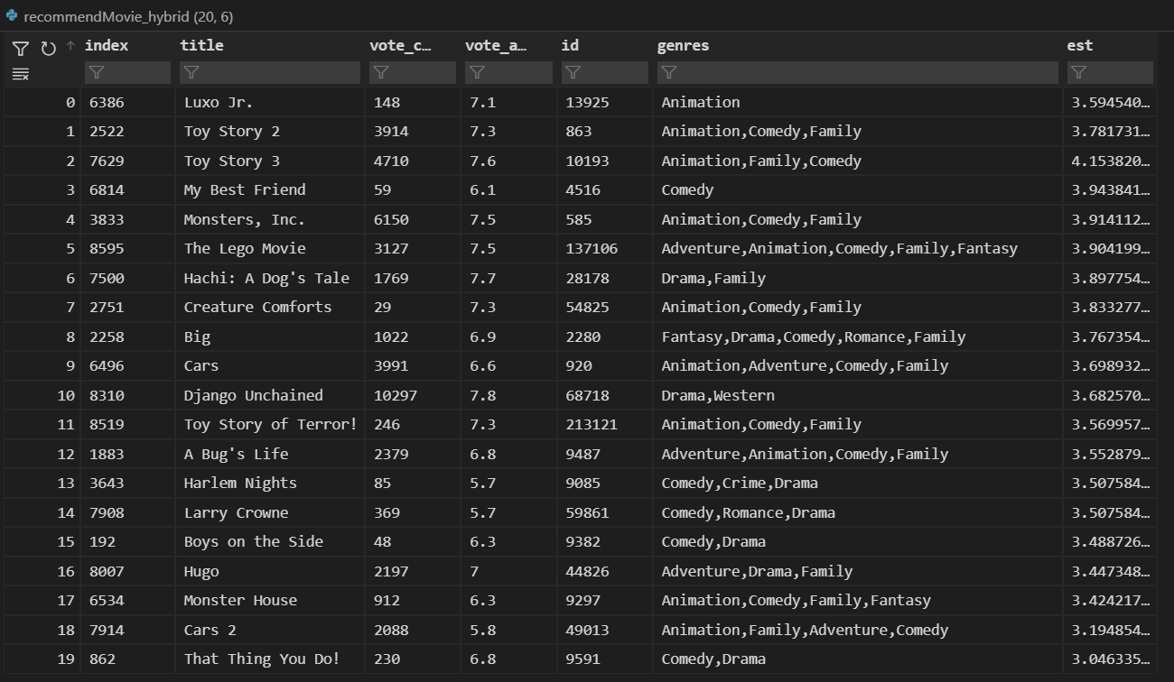
Hybrid Approach (Cascade)
Keep top-2 preliminary
Output list of recommendations
Based on content based filtering
Further sort the
preliminary output
Based on Predictions
(collaborative filtering)
The outcome varies by user ID
14

Slide 15
DEMO
DEMO
15

Slide 16
Contributions
◆106360101 謝尚泓 電子四甲
後端、Socket、Database、推薦系統、前後端整合
◆ 106360130 陳良葳 電子四甲
前端、PyQt6、GUI、前後端整合
16

Slide 17
Link
◆ [1] Github:
https://github.com/samh99474/Python_Final_Project_RecommenderSystem
◆ [2] Youtube Video Demo:
https://www.youtube.com/watch?v=aSEBuPXpsd4
17

Slide 18
Movie Recommender System
AI
Machine Learning
Python
兩個月完成
Netfilix電影推薦系統!?

