Slide 1


<<Team Name>>

Slide 2


Call for Code 2019 Challenge
Saravjeet Lamba
Sameer Kumar Choudhary
Krishna Priya Tadepalli

Slide 3

CHALLENGE
Solution can be used in any disaster
situation, be it:
1 Building collapse
2 War zone
3 Flood
4 Cyclones
5 Fire
6 Train accidents
7 Road accidents
8 Accidents in remote areas like
mountaineering expeditions
9 Earthquake
Natural Disasters, which had affected the humankind in past and been affecting drastically and leaving them in trauma for months to come. A number of families are shattered into despair and it takes immense effort and courage to bring the life back to normal.
Leverage Artificial Intelligence to reinforce rescue team and volunteers in tackling disaster like situation. Use of AI to identify survivals along with info like Age, Gender, Blood Group, Medical History, medical conditions. Sending the response team with only requisite medical care to provide immediate medical care and rescue people.
Notes:
A description of the problem statement you are trying to resolve.

Slide 4


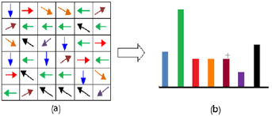






TECHNOLOGY SUGGESTIONS
live video feed Capturing
Drone webcam
Programming
Python – Open source Programming Language
Detection
HOG – Best suited for Human Detection in Computer Vision
Computer vision Libraries
OpenCV – Real Time computer vision, Dlib - cross-platform software library
Framework
Python-based free and open-source web framework, which follows the model-template-view architectural pattern
Services
IBM's one-stop cloud computing shop provides all the cloud solutions
IBM Cloud Object Storage
Store practically limitless amounts of data
Catalog - IBM Cloud
Develop, deploy, and scale Python web apps with ease on IBM cloud foundry.
Notes:
A raw list of technology that can be used to implement the solution, as well as alternatives. Mention any base code pattern, IBM Cloud service offerings, open source technologies, infrastructure etc.

Slide 5
SOLUTION APPROACH
Using live video streams form deployed drones that would use computer vision to identify needy humans and their locations. UAVs or Drones will mark the exact GPS location of the victims
Identification of people based on face recognition through live video feed provided and get their related info (like Age, Gender, Blood group and medical history) using available public data
Gathered Information will help to make proper medical care to reach people who require immediate attention with the help of medical experts
DRT teams can take an immediate action and perform an efficient search and rescue operation in less time and no need to carry extra medicines/equipment
System will detect if a victim has blood group which is rare or unavailable and mark the nearest blood bank which has it or help identify a donor
The emergency response team has important victim related information before arriving at the disaster site
Notes:
Describe the approach of resolving the challenge identified & the outcomes

Slide 6
HIGH LEVEL ARCHITECTURE
Face acquisition using live video feed
Face Identified
IBM Storage
Mapping the Information related to identified person
Gathered Information of identified person like Age, Gender, Blood group and medical history
No information available
Proceed with traditional approach.
DRT teams can take an immediate action based on the info provided
IBM Cloud Services
Notes:
Add architecture diagrams as applicable, e.g. – overall architecture, sequence, deployment etc.

Slide 7
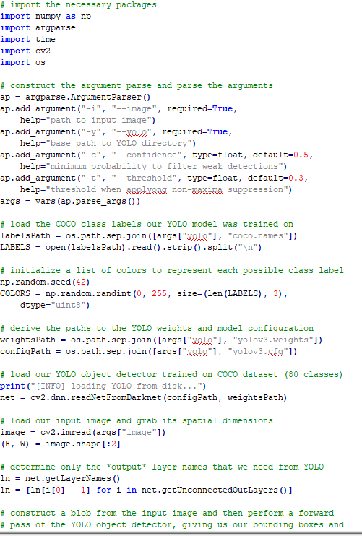
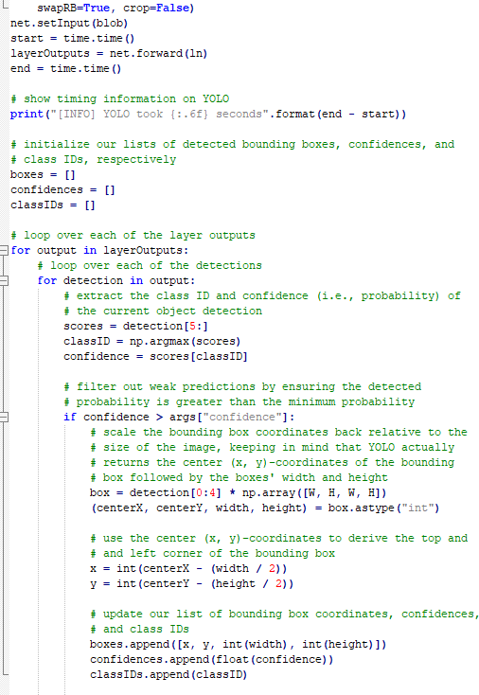
SOURCE CODE
Notes:
Add GIT link

Slide 8
RECOMMENDED RESOURCES
Documents
https://pdfs.semanticscholar.org/28e1/fa9bc622f035a59bf309837d75c08f630a57.pdf
https://app.mural.co/t/capgeminicallforcode5591/m/capgeminicallforcode5591/1563795727035/aaf6970f566d944dd6a9147efa6b24f82857775d
Opinion pieces
https://www.pyimagesearch.com/2018/11/12/yolo-object-detection-with-opencv/
https://arxiv.org/abs/1506.02640
Notes:
Add GIT link

