Slide 1
Vexing VBA
Day 5
The Data Boot Camp |
2/1/2018

Slide 2

Today,
This is you…

Slide 3
Refresher

Slide 4
Fundamentals of Coding
What is meant by the phrase:
“Coding requires thinking procedurally?”

Slide 5
How a Computer Thinks (Procedurally)
Complex Real-World Problem
Every problem in software development begins with a complex and abstract real-world need.

Slide 6
How a Computer Thinks (Procedurally)
Complex Real-World Problem
Step
Step
Step
Step
1
2
3
4
In order for a computer to handle things, this “real-world” problem needs to be broken into a set of procedural steps.

Slide 7
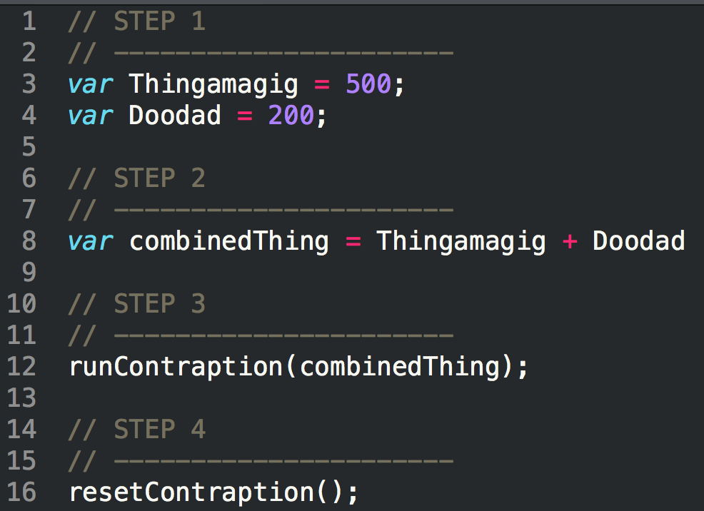
How Code is Written (Procedurally)
Code (JavaScript)
Steps
1
2
3
4

Slide 8
Fundamentals of Coding
What are the four building blocks in programming?

Slide 9
Fundamental Building Blocks
Common structures in nearly all languages:
Variables / Arrays
Conditionals
Iterations
Functions

Slide 10
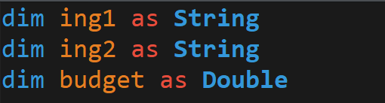
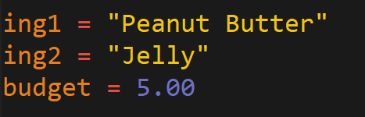
Variables: The Nouns of Code
Variables are effectively the items in a procedure.
They can be physical things (like an ingredient) or abstractions (like a counter).
In VBA, items can be declared as variables by using the dim followed by the type. They can then be assigned a value.
Variable Declaration
Variable Assignment

Slide 11
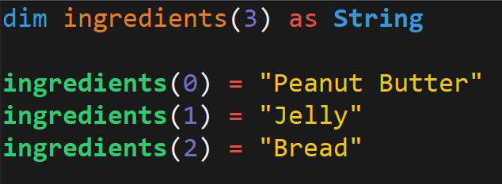
Arrays: A Collection of Items
Arrays are effectively groups of related items. It presents another way to store and reference like pieces of information.
[
Item: 0
Item: 1
Item: 2
[
Peanut Butter
,
Jelly
,
Bread

Slide 12
Conditionals: If This… Then That.
Conditionals present a way to control the flow of logic based on certain conditions being met.
In most languages, we’ll be using if / else code for this purpose.
Step
Step
If Condition a…
2a
1
If Condition b…
2b

Slide 13
Iteration: Round and Round We Go!
Iteration is the concept of using loops to perform a group of tasks repeatedly for a number of times.
In almost all languages, we’ll be using for-loops and while loops.
Step
1
2
Repeat X times…

Slide 14
Functions: For When One Block Can’t Do it All
Functions are, in essence, a sort of “sub-processes”. They allow us to create pre-made, re-usable blocks of code which can be called on demand.
Main Process
1
2
3
4
1
2
3
1
2
3
3
Sub-Processes

Slide 15
Let’s Start Coding

Slide 16
Questions / Discussion
Notes:
It’s important to keep in mind why you joined this class. Let’s talk about your goals.

