Slide 1
Bringing Knowledge Through Machine Learning and SMS
A dissertation presentation by
Sam Heather

Slide 2
In this presentation
Introduction
Implementation and Challenges
Experimental Evaluation
Results
Conclusions and Future Work
Demonstration

Slide 3
Introduction
What has been developed?
Motivation
Ethical Issues
Goals of the Project
Notes:
SMS service which provides automated answers to questions about geographical entities.
The system should learn from user feedback whether an answer was useful, and improve.
The system should take queries in Natural Language Form
Ethics:
Privacy
Providing correct information
Experimental Evaluation: informed consent
Goals:
To develop a system that is both useful and usable.
The systems use of machine learning results in effective learning and improvement over time.

Slide 4
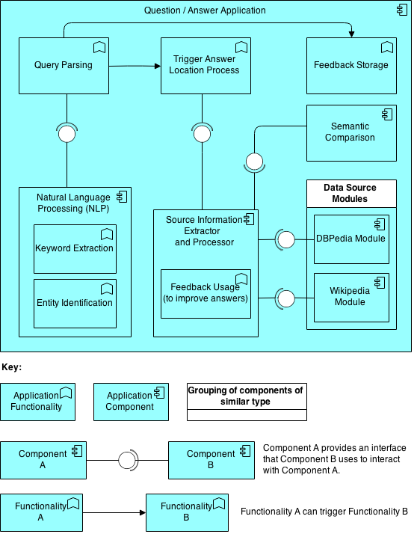
Implementation and Challenges
Notes:
Application constructed in a modular manner to make it maintainable and extendable.
One example: data sources
To add a data source, module must simply be created that conforms to a specified interface, then simply added to an array inside the Source Processor.

Slide 5
Implementation and Challenges
How tall is the Eiffel Tower?
“Eiffel Tower”
Entity Extraction Tool: https://dandelion.eu/products/datatxt/sim/
Notes:
Going to talk through the process of locating an answer in the implementation, and then some of the challenges and issues associated with it.
Units
NLP is delicate

Slide 6
Implementation and Challenges
How tall is the Eiffel Tower?
“Eiffel Tower”
How tall is the Eiffel Tower?
Entity Extraction Tool: https://dandelion.eu/products/datatxt/sim/
Notes:
Going to talk through the process of locating an answer in the implementation, and then some of the challenges and issues associated with it.
Units
NLP is delicate

Slide 7
Implementation and Challenges
How tall is the Eiffel Tower?
“Eiffel Tower”
How tall is the Eiffel Tower?
Entity Extraction Tool: https://dandelion.eu/products/datatxt/sim/
Notes:
Going to talk through the process of locating an answer in the implementation, and then some of the challenges and issues associated with it.
Units
NLP is delicate

Slide 8
Implementation and Challenges
How tall is the Eiffel Tower?
“Eiffel Tower”
How tall is the Eiffel Tower?
Entity Extraction Tool: https://dandelion.eu/products/datatxt/sim/
Notes:
Going to talk through the process of locating an answer in the implementation, and then some of the challenges and issues associated with it.
Units
NLP is delicate

Slide 9
Implementation and Challenges
How tall is the Eiffel Tower?
“Eiffel Tower”
How tall is the Eiffel Tower?
{‘property’:’tall’
‘place’:’Eiffel_Tower’}
Entity Extraction Tool: https://dandelion.eu/products/datatxt/sim/
Notes:
Going to talk through the process of locating an answer in the implementation, and then some of the challenges and issues associated with it.
Units
NLP is delicate

Slide 10
Implementation and Challenges
{‘property’:’tall’
‘place’:’Eiffel_Tower’}
Key | Value | Similarity to ‘tall’
height_m | 301 | 0.5
width_m | 40 | 0.3
date_constructed | 1887 | 0.2
Semantic Similarity Tool: http://api.cortical.io/Compare.htm
Notes:
Going to talk through the process of locating an answer in the implementation, and then some of the challenges and issues associated with it.
Units
NLP is delicate

Slide 11
Implementation and Challenges
{‘property’:’tall’
‘place’:’Eiffel_Tower’}
Key | Value | Similarity to ‘tall’ | Adjusted Similarity
height_m | 301 | 0.5 | 0.55
width_m | 40 | 0.3 | 0.3
date_constructed | 1887 | 0.2 | 0.2
Rating for tall-height relationship: [5,5]
Semantic Similarity Tool: http://api.cortical.io/Compare.htm
Notes:
Going to talk through the process of locating an answer in the implementation, and then some of the challenges and issues associated with it.
Units
NLP is delicate

Slide 12
Implementation and Challenges
{‘property’:’tall’
‘place’:’Eiffel_Tower’}
Key | Value | Similarity to ‘tall’ | Adjusted Similarity
height | 301m | 0.5 | 0.55
width | 40m | 0.3 | 0.3
date_constructed | 1887 | 0.2 | 0.2
Rating for tall-height relationship: [5,5]
Semantic Similarity Tool: http://api.cortical.io/Compare.htm
Notes:
Going to talk through the process of locating an answer in the implementation, and then some of the challenges and issues associated with it.
Units
NLP is delicate

Slide 13
Experimental Evaluation

Slide 14
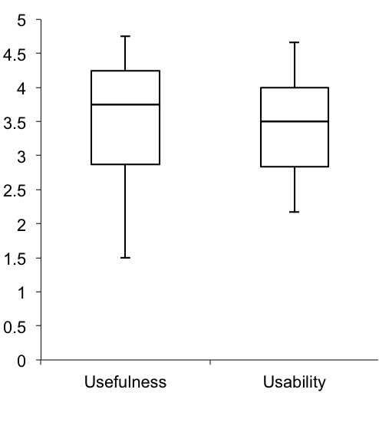
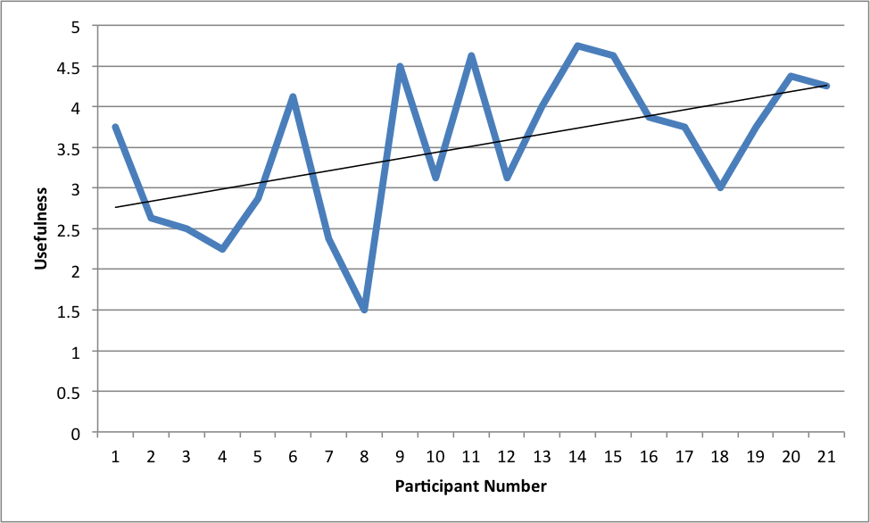
Experimental Evaluation

Slide 15
Conclusions and Future Work
Notes:
Overall system was a success
When compared to requirements, met all but 2
The usefulness and usability ratings were positive
The application was shown to be learning and improving

Slide 16
Demonstration

