Slide 1

Introduction to version control for academics using GitHub
Samuel Forbes
Twitter: @samhforbes

Slide 2
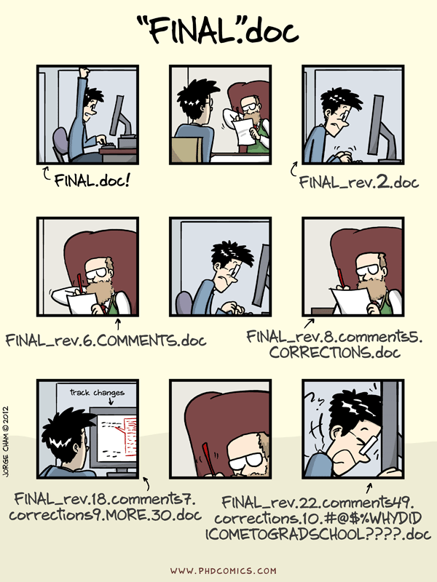
Version Control
First and foremost, back up your work!
Back it up in a way that means you can find it and you know which version is most recent!
Is Final2 more recent than Final_NEW?
This gets worse when you are collaborating

Slide 3
Version Control
Version control means we can see what’s changed and who changed it
We can also undo these changes if we need to
In some ways, this is a bit like google docs, but for other file types

Slide 4
If you are a student
Please please please back up your work…….. Please
Having version control in the cloud is good for this
Not good for all data / file types (speak to your PI)
You can keep up with which files are latest
Increase visibility / open science cred

Slide 5
If you are a PI / Researcher
Avoid conflicting files with your collaborators
Track issues as they arise
Keep a lab/personal version of resources so knowledge isn’t lost
Keep an eye on analysis / data / etc
Share code / data etc

Slide 6
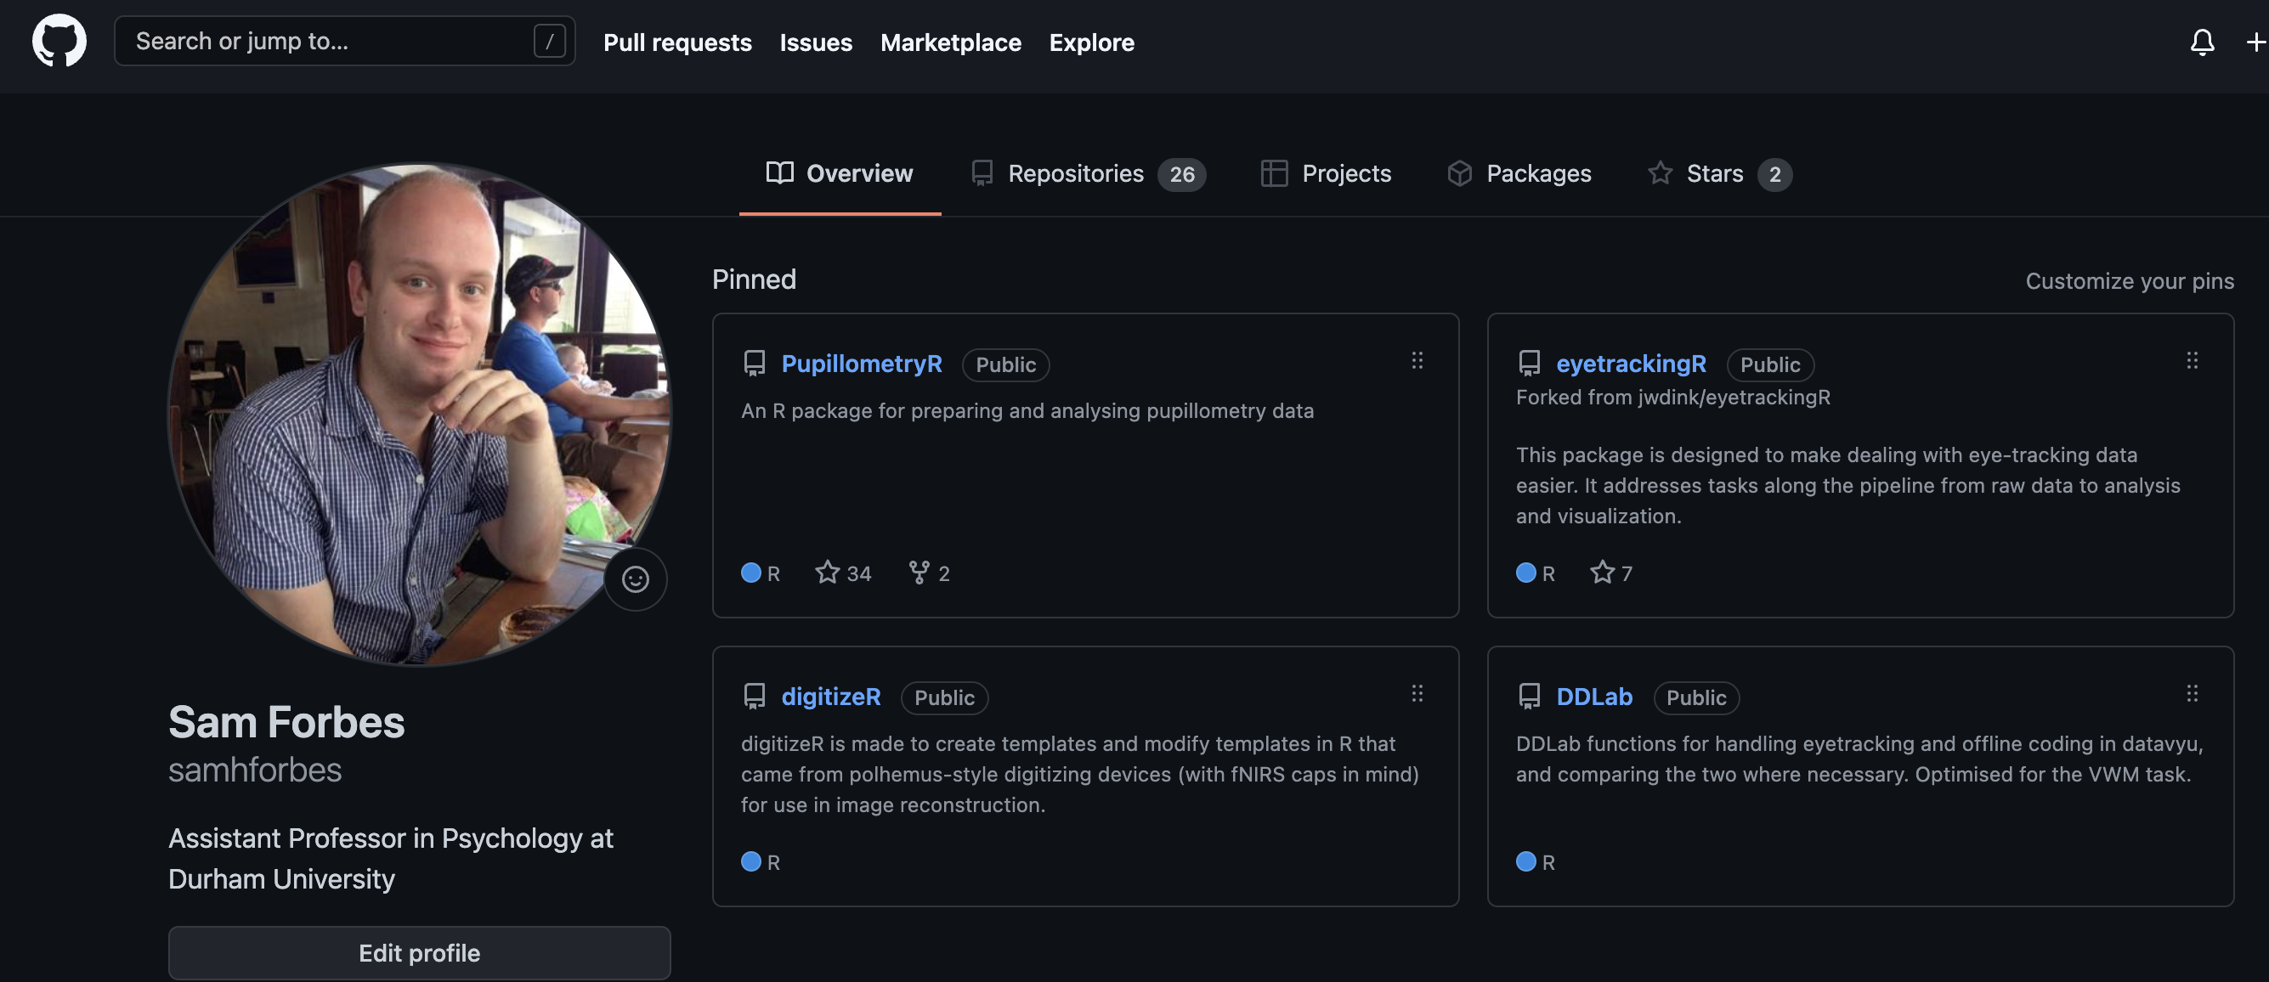
Introducing GitHub

Slide 7

New to GitHub
Sign up at github.com to get a username
Sign up for an education pack (this is changing) at education.github.com

Slide 8
Education pack
Comes with benefits for students and educators
Free GitHub Pro (unlimited private repositories)
1 year free namecheap hosting
3 month free datacamp experience

Slide 9
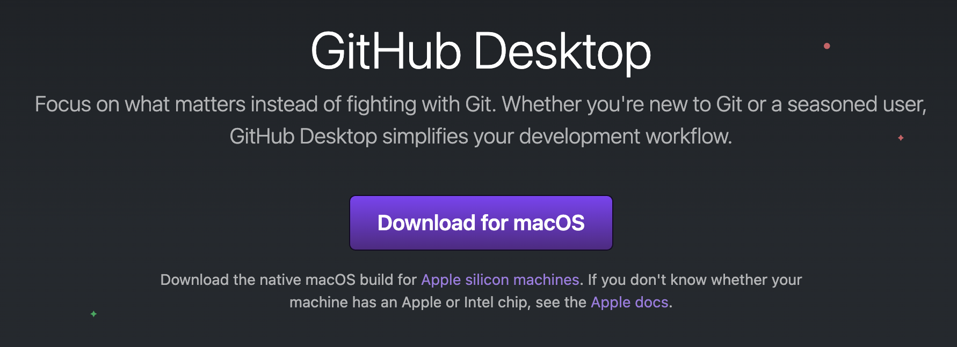
GitHub Desktop
Download from desktop.github.com
Not the only way to use GitHub!

Slide 10
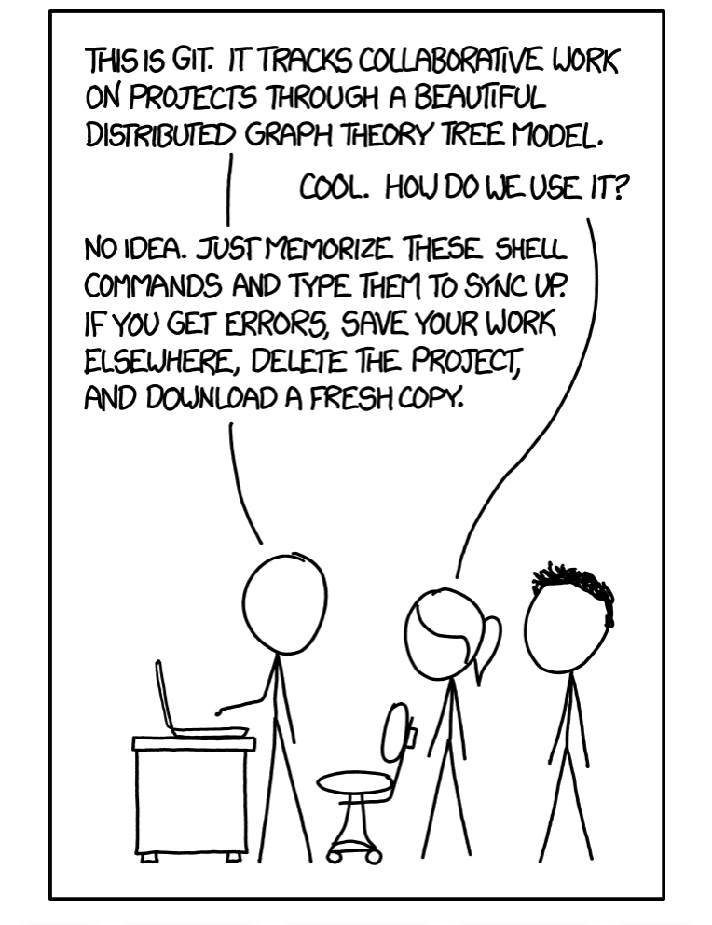
The basics of GitHub
Fetch
Pull
Commit
Push
Merge (we will come back to this)
https://xkcd.com/1597/

Slide 11

Fetch
Looks to see what’s on the cloud
Checking if you are up to date
Always remember to fetch!

Slide 12
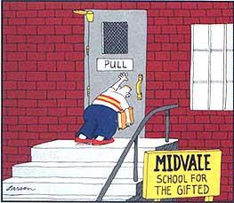
Pull
Updates your version with the cloud version
This ensures you are update
Pull (if able) before changing
(Larsen, the far side Gallery)

Slide 13

Commit
Commit records changes to your local branch
This records your change with timestamp
It can also record why you changed it
You can tag issues or people here
(Relationshipwellbeingspecialist.nz)

Slide 14
Push
Updates the cloud version with your commit(s)
This is normally the final step
Commits and accompanying notes are then saved on the cloud and ready for the next user / machine to pull

Slide 15

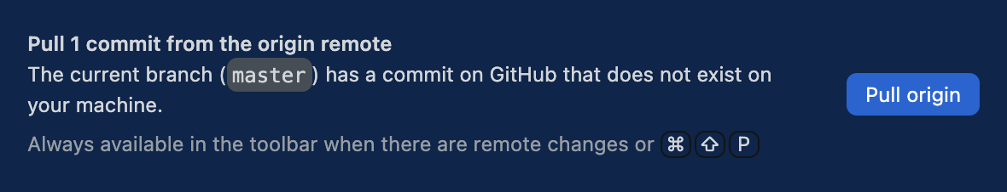
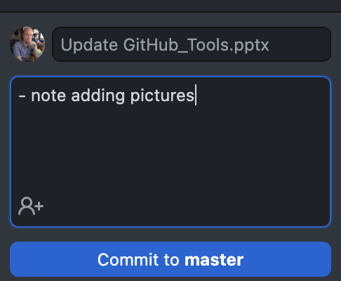
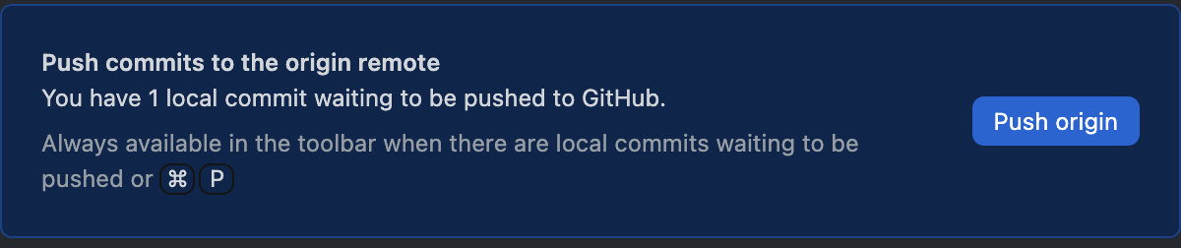
Basic workflow

Slide 16
File types
GitHub is less useful with binary file types

