Slide 1

Introduction to version control for academics using GitHub
Samuel Forbes
Twitter: @samhforbes

Slide 2
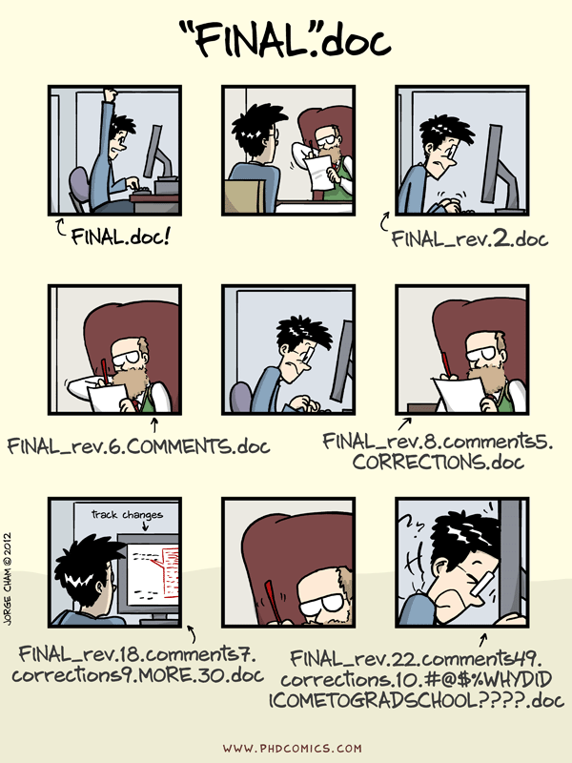
Version Control
First and foremost, back up your work!
Back it up in a way that means you can find it and you know which version is most recent!
Is Final2 more recent than Final_NEW?
This gets worse when you are collaborating

Slide 3
Version Control
Version control means we can see what’s changed and who changed it
We can also undo these changes if we need to
In some ways, this is a bit like google docs, but for other file types

Slide 4
If you are a student
Please please please back up your work…….. Please
Having version control in the cloud is good for this
Not good for all data / file types (speak to your PI)
You can keep up with which files are latest
Increase visibility / open science cred

Slide 5
If you are a PI / Researcher
Avoid conflicting files with your collaborators
Track issues as they arise
Keep a lab/personal version of resources so knowledge isn’t lost
Keep an eye on analysis / data / etc
Share code / data etc

Slide 6
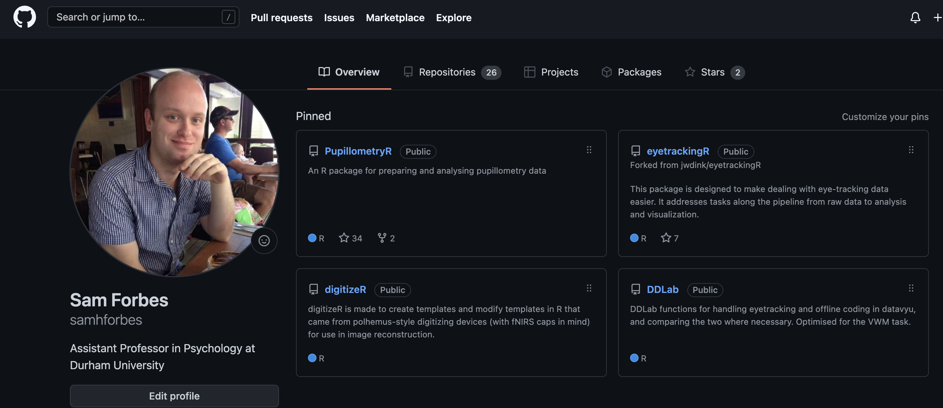
Introducing GitHub

Slide 7

New to GitHub
Sign up at github.com to get a username
Sign up for an education pack (this is changing) at education.github.com

Slide 8
Education pack
Comes with benefits for students and educators
Free GitHub Pro (unlimited private repositories)
1 year free namecheap hosting
3 month free datacamp experience

Slide 9
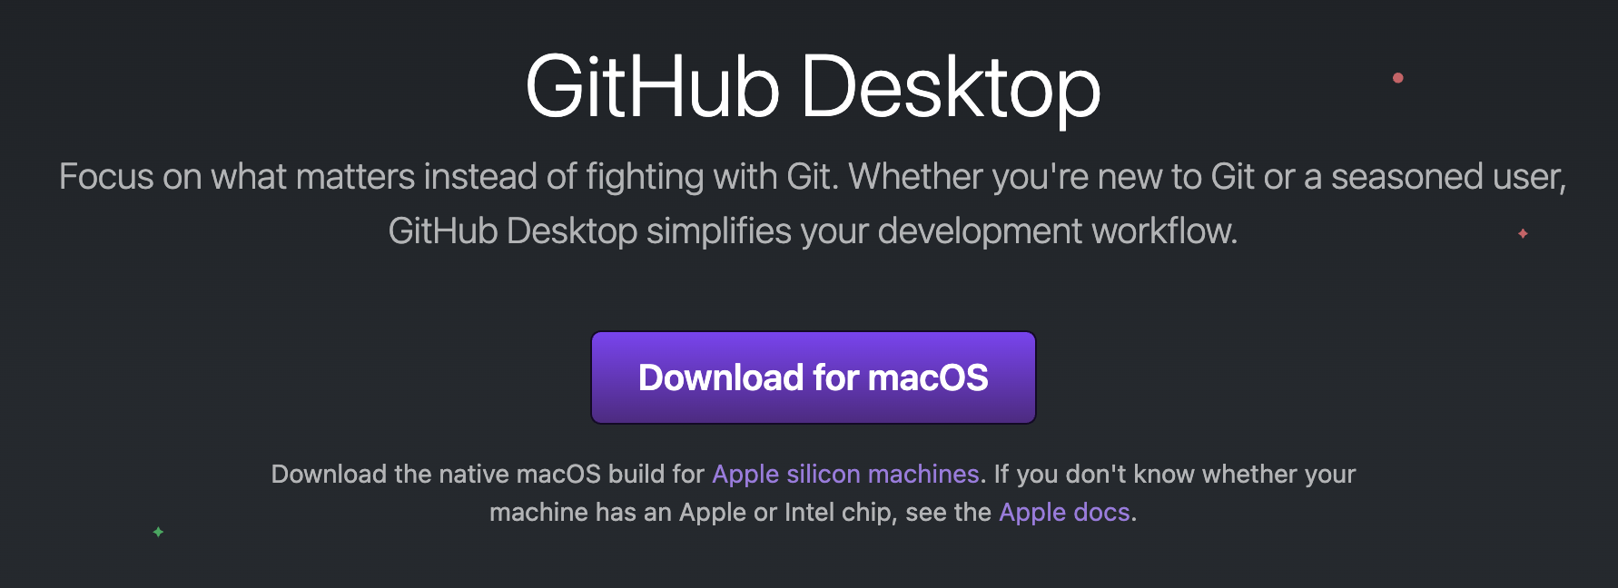
GitHub Desktop
Download from desktop.github.com
Not the only way to use GitHub!

Slide 10
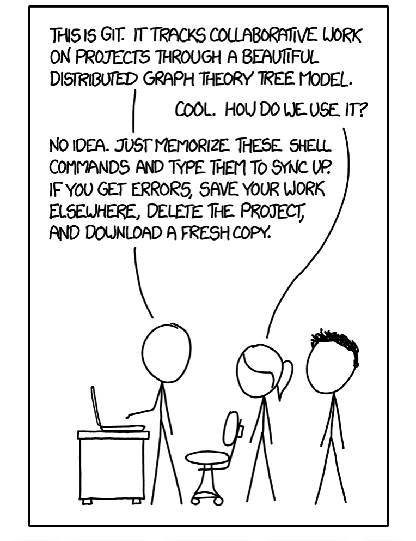
The basics of GitHub
Fetch
Pull
Commit
Push
Merge (we will come back to this)
https://xkcd.com/1597/

Slide 11
Repositories
Repositories (or repos) are what gets edited on GitHub
These are just folders locally or in the cloud
Repos can be private or public
You can use a git ignore file to keep things from being pushed

Slide 12

Fetch
Looks to see what’s on the cloud
Checking if you are up to date
Always remember to fetch!

Slide 13
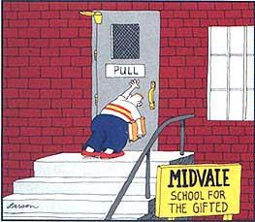
Pull
Updates your version with the cloud version
This ensures you are update
Pull (if able) before changing
(Larsen, the far side Gallery)

Slide 14

Commit
Commit records changes to your local branch
This records your change with timestamp
It can also record why you changed it
You can tag issues or people here
(Relationshipwellbeingspecialist.nz)

Slide 15
Push
Updates the cloud version with your commit(s)
This is normally the final step
Commits and accompanying notes are then saved on the cloud and ready for the next user / machine to pull

Slide 16
Branches and Merging
A branch allows you to make changes in isolation
You can then merge that branch with the main one
This is good when working on a side project and you want to work first, and then discus keeping it with someone down the line

Slide 17

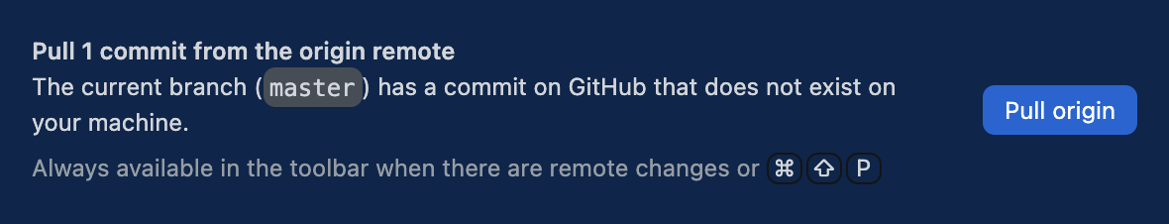
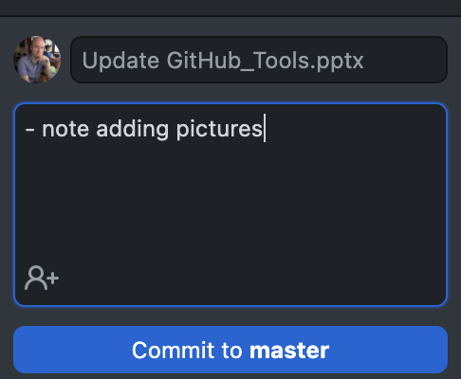
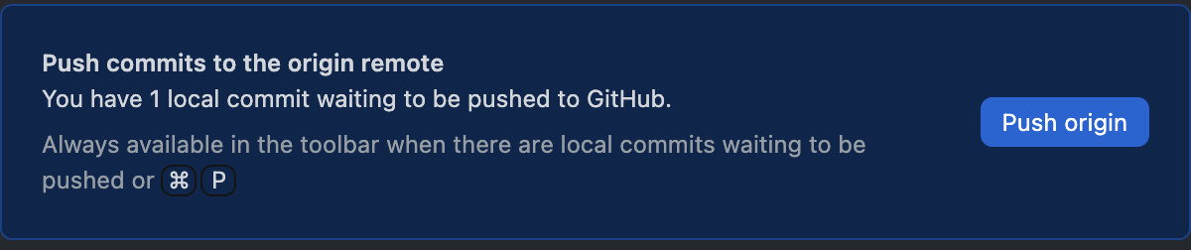
Basic workflow

Slide 18
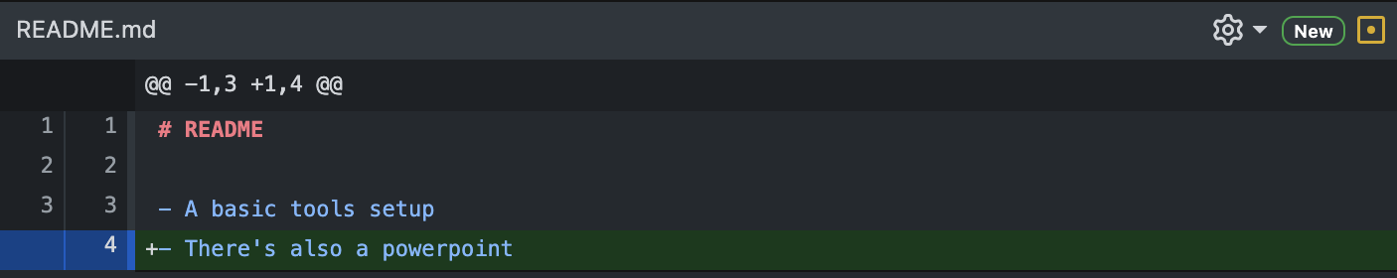

File types
GitHub is less informative with binary file types

Slide 19
File types
This means binary files struggle when dealing with conflicts
So csv, txt, etc will be easier than ppt, xlsx etc
Likewise tex, md, Rmd will work better than docx
But you *can* still use whatever files you are used to

Slide 20
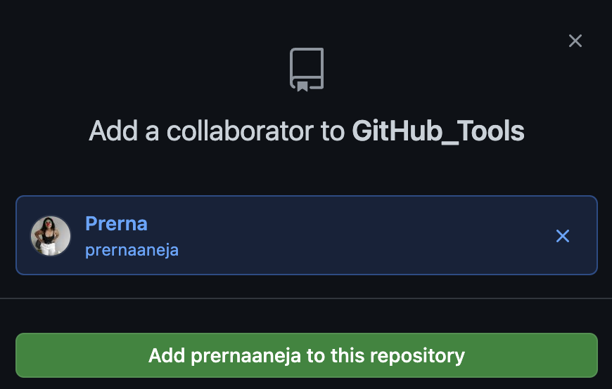
Collaborating
You can add collaborators
This means they can access files
They can also make changes

Slide 21

Forking
Another way of collaborating is to fork a repository
You then have your own local copy, but not rights to edit the original
But you can submit changes with a pull request
This is good if you notice a bug or similar
The good place wiki

Slide 22

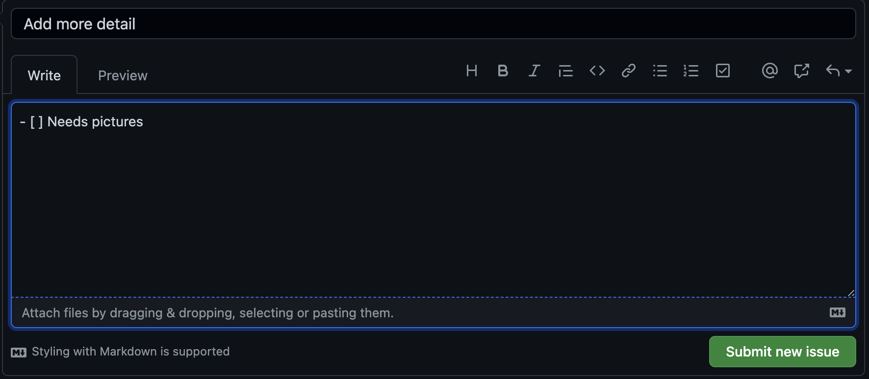
Issues
The GitHub website has an issue tracker
You can create an issue
You can add tickboxes etc to track progress

Slide 23
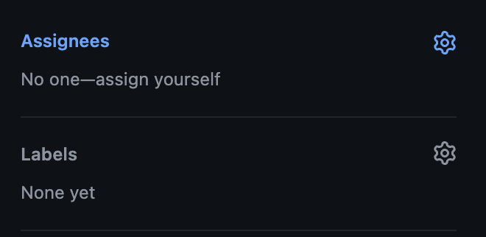
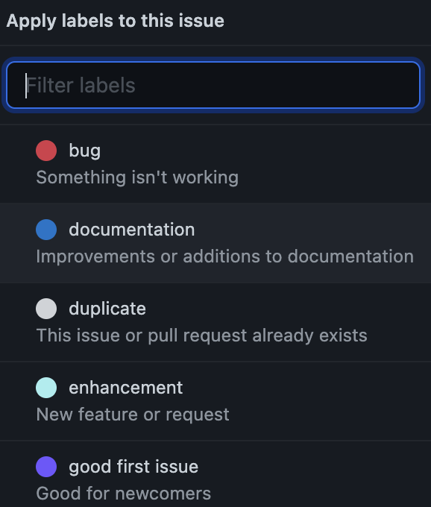
Advanced issues
You can customize the issue
Assigning someone means they can track
Labels allow you to see what type of issue it is

Slide 24
Working as a team
You can create a GitHub Organization
This works the same way, but repositories are in the organization instead of your private accounts
The owner can create teams, giving access to different repositories
You can also add external collaborators

Slide 25
Things I find useful…
Private repos: Non-lab things, external collaborations, messing with data or ideas
Public repos: Data or code to share, collaborations, R packages
Lab private: Student projects, works in progress, internal documentation
Lab public: Open data and code, lab studies

Slide 26
Things I find useful…
Think about a file structure in advance. I often have something like:
Data/
Scripts/
Documentation/
Misc/
On lab private repos sometimes a personal scripts folder is useful so you can play around in a safe environment

Slide 27
Things I find useful…
Think about what goes in a repository
One repo for a large project can sometimes be too big
Large files can’t go in there, so sometimes they need to be ignored
It can be nice to have a repo for each paper, so it is easy for other people to find

Slide 28
Other fun stuff
GitHub integrates nicely with OSF for sharing data
It can link with things like overleaf pro
You can host and maintain a website from there (for free)

Slide 29
Let’s try it!!

