Slide 1

Holmusk Technical Test
Sam Hillman
March 2024
https://github.com/samhillman/holmusk_technical_test

Slide 2
Background
Routine EHR data collected from inpatient stays at a hospital
Dataset of 3,700 patients with related demographic and clinical information
Interested in using RWD to assess patterns of MDD treatment

Slide 3
Research Questions
MDD is typically treated with antidepressants and psychological therapy. Individuals who do not respond to an antidepressant therapy may be co-prescribed an adjunctive medication (e.g., antipsychotic, anticonvulsant, or lithium) alongside their antidepressant to help improve their symptoms
What could we look at?
Co-prescription changes over time
Efficacy of different co-prescription options (changes in symptoms compared to baseline)
Cost comparisons of different treatment
Does co-prescription reduce inpatient costs
Toxicity/symptoms of different co-prescription options
Length of inpatient stay by co-prescription

Slide 4
Research questions continued
Focusing on how co-prescribing patterns / adjunctive therapies affect length of in-patient hospital stay for MDD
Adjunctive therapies are used in patients who do not respond to SSRIs alone; however, some clinical trial evidence suggests that some adjunct therapies (edivoxetine, in the example below) do not improve MADRS (Montgomery-Asberg Depression Rating Scale).
If they do not improve MADRS, do we see an improvement in length of time admitted to hospital for MDD?
Ball, S. G., Ferguson, M. B., Martinez, J. M., Pangallo, B. A., Monkul Nery, E. S., Dellva, M. A., Sparks, J., Zhang, Q., Liu, P., Bangs, M., & Goldberger, C. (2016). Efficacy outcomes from 3 clinical trials of edivoxetine as adjunctive treatment for patients with major depressive disorder who are partial responders to selective serotonin reuptake inhibitor treatment. Journal of Clinical Psychiatry. Published May 25, 2016.

Slide 5
Methods
Using the clinical and demographic data to assess the effect of treatment combinations on length of inpatient stay.
First assess data quality and convert data where needed (full details in the R script provided) and convert data to our treatment categories
Focusing here on SSRIs only vs SSRI + other treatment categories

Slide 6
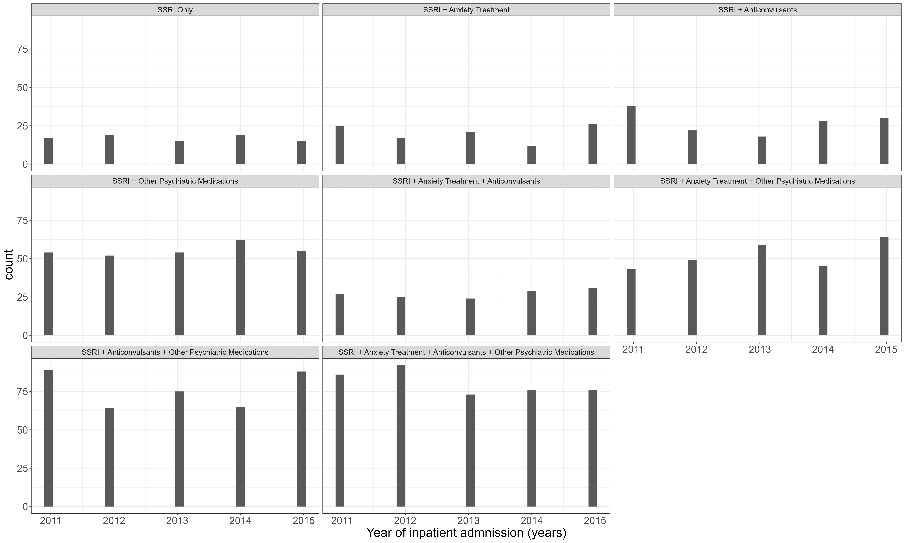
Data
Always a good idea to look at the patterns in our data!
We can first look at the distribution of combination therapies over time

Slide 7
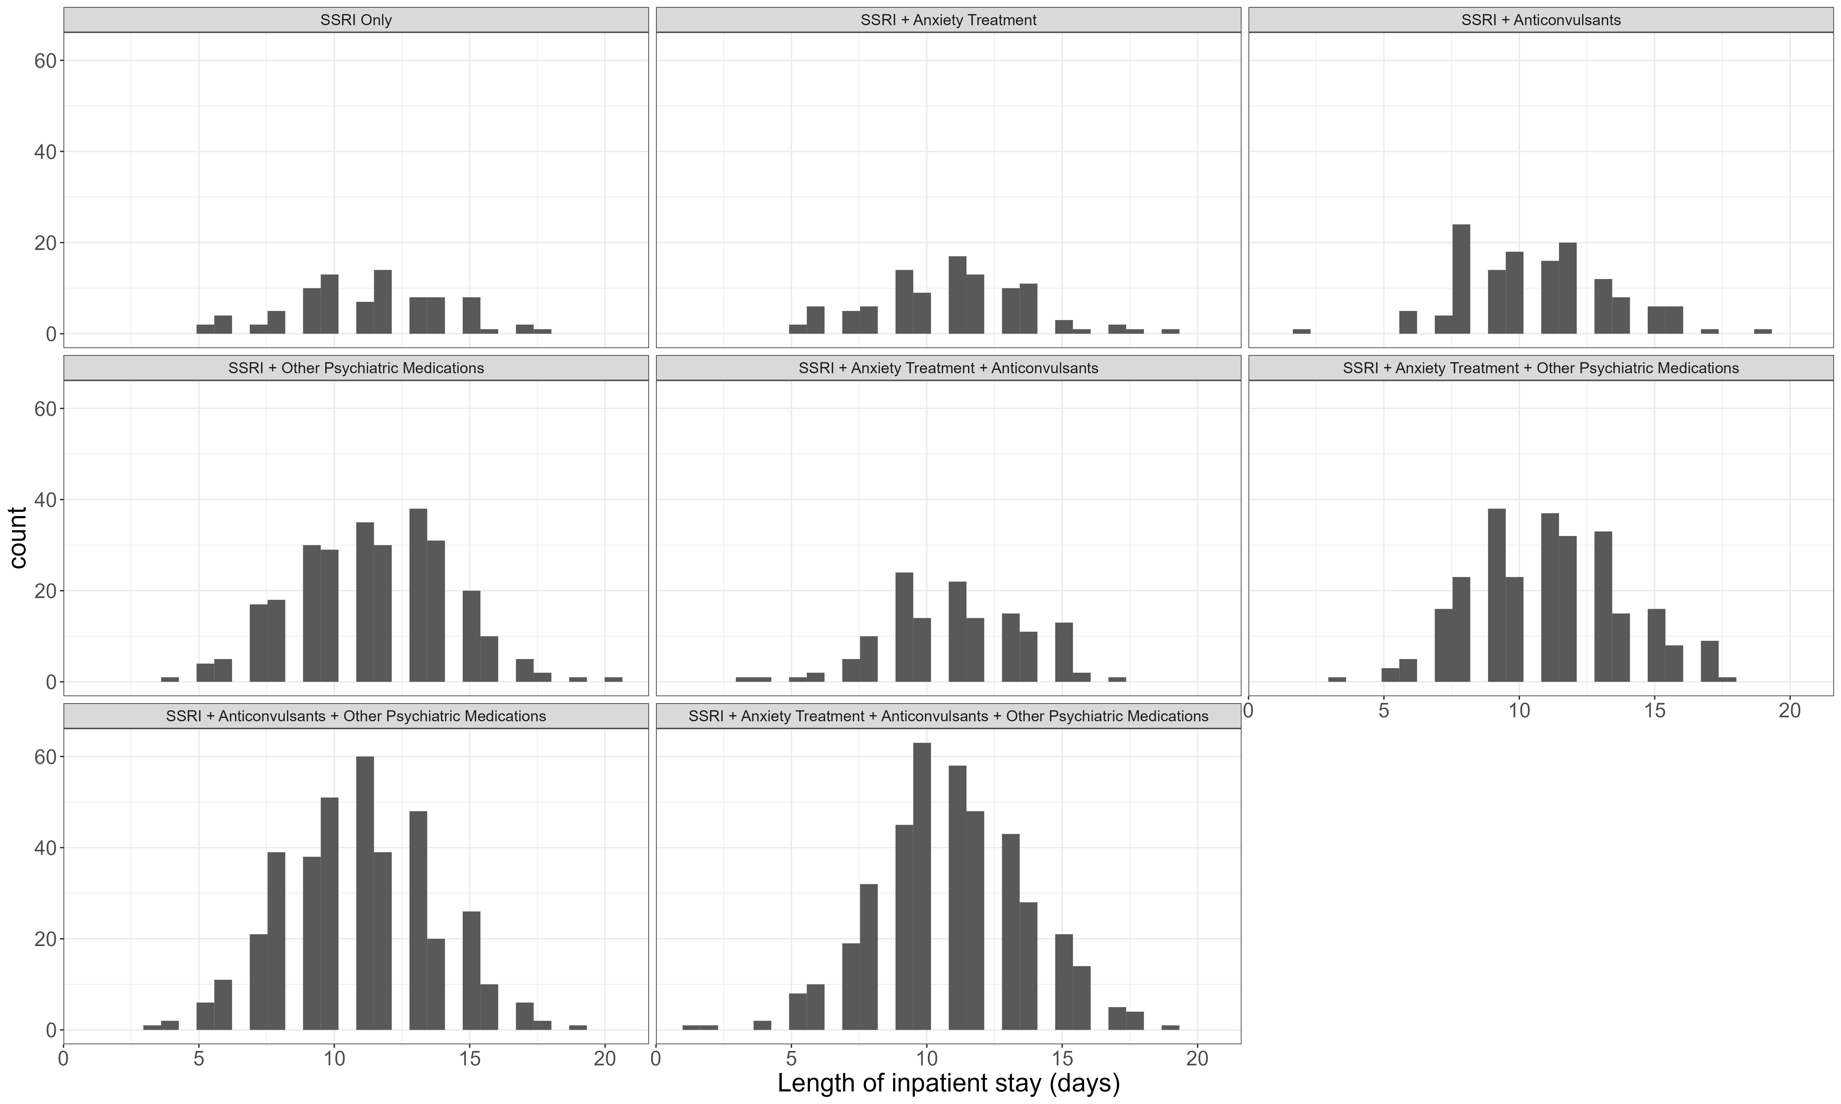
Data
Always a good idea to look at the patterns in our data!
And the length of inpatient stay by treatment type

Slide 8
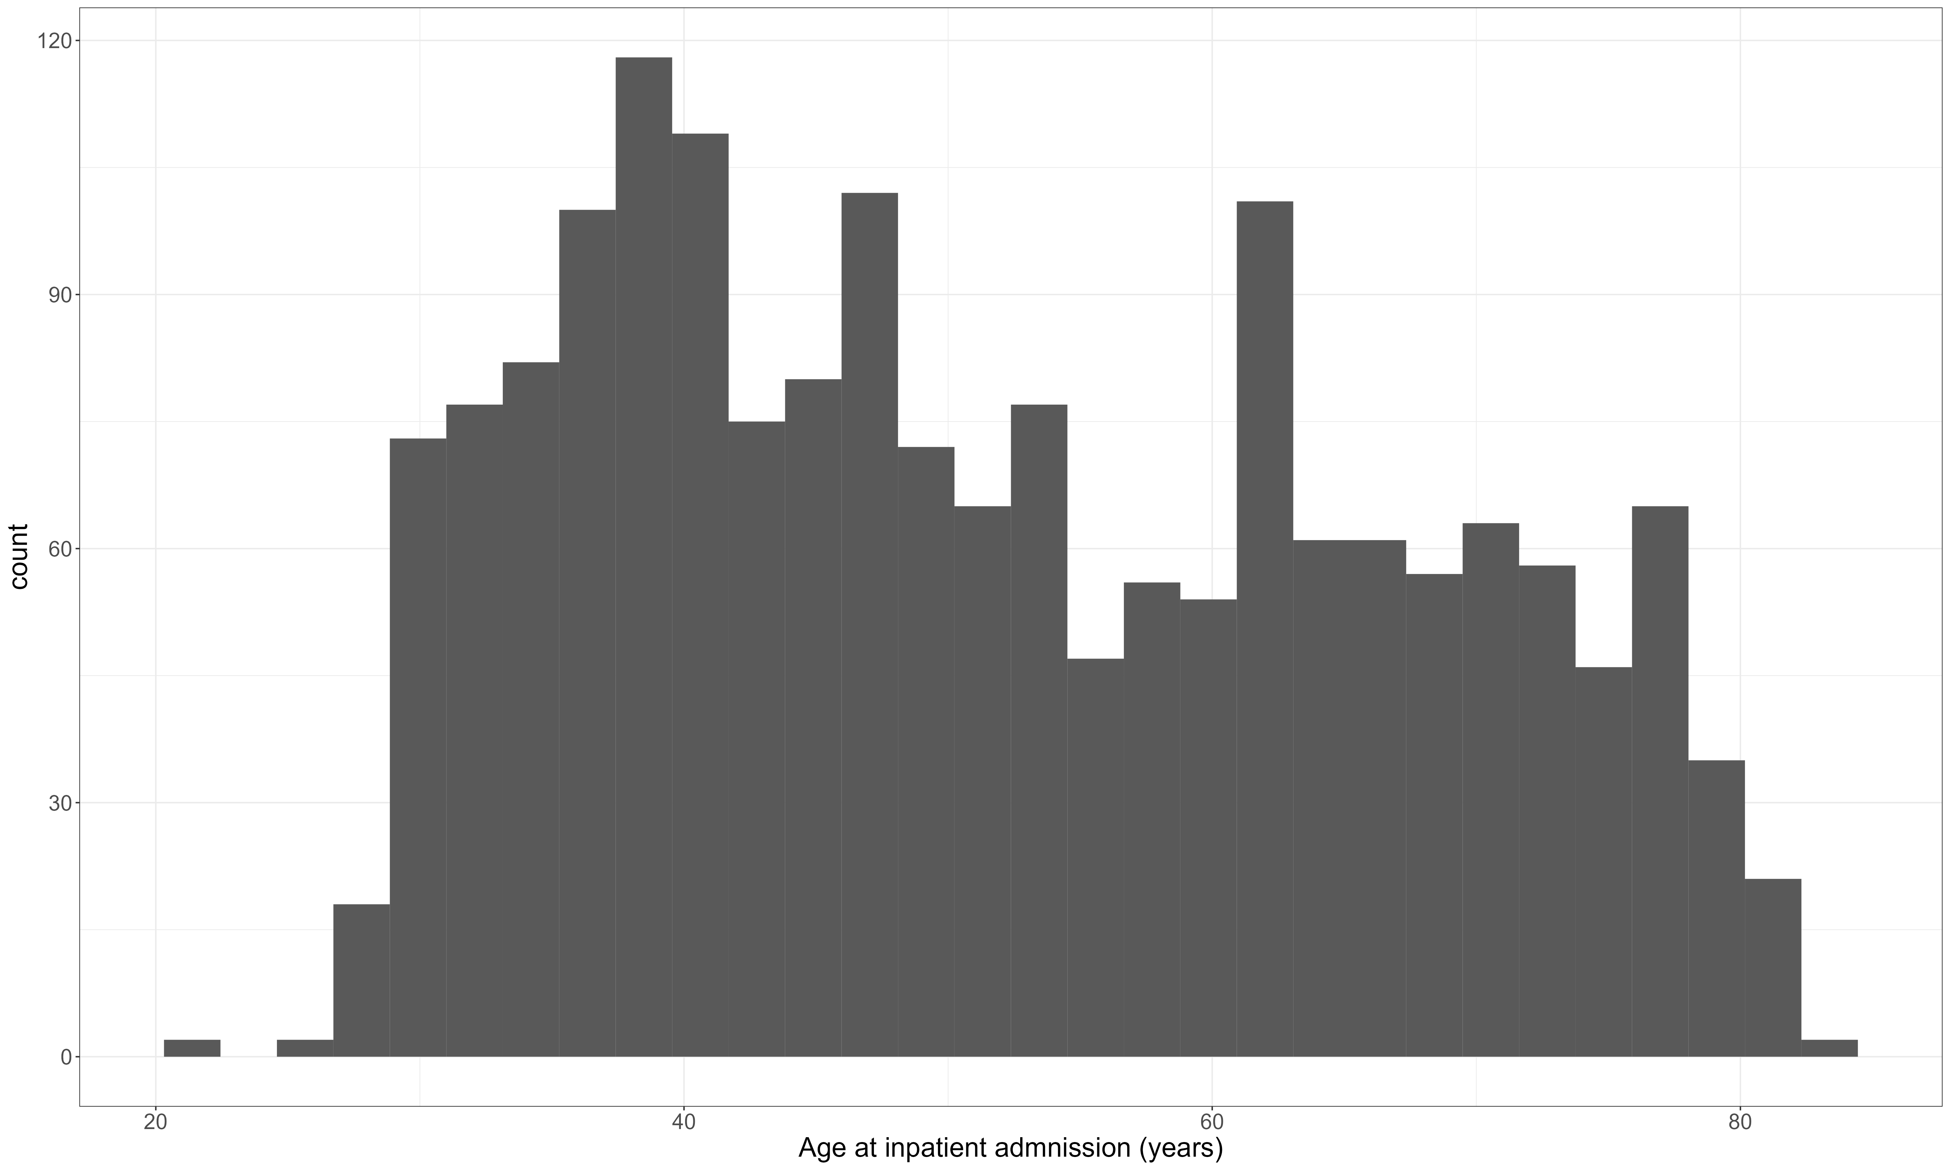
Data
Always a good idea to look at the patterns in our data!
And age at admission

Slide 9

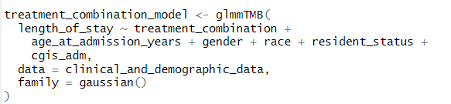
Methods
We can then model the length of inpatient stay by treatment with some relevant covariates:
Notes:
CGIS is severity of depression score, on a scale of 1:7

Slide 10
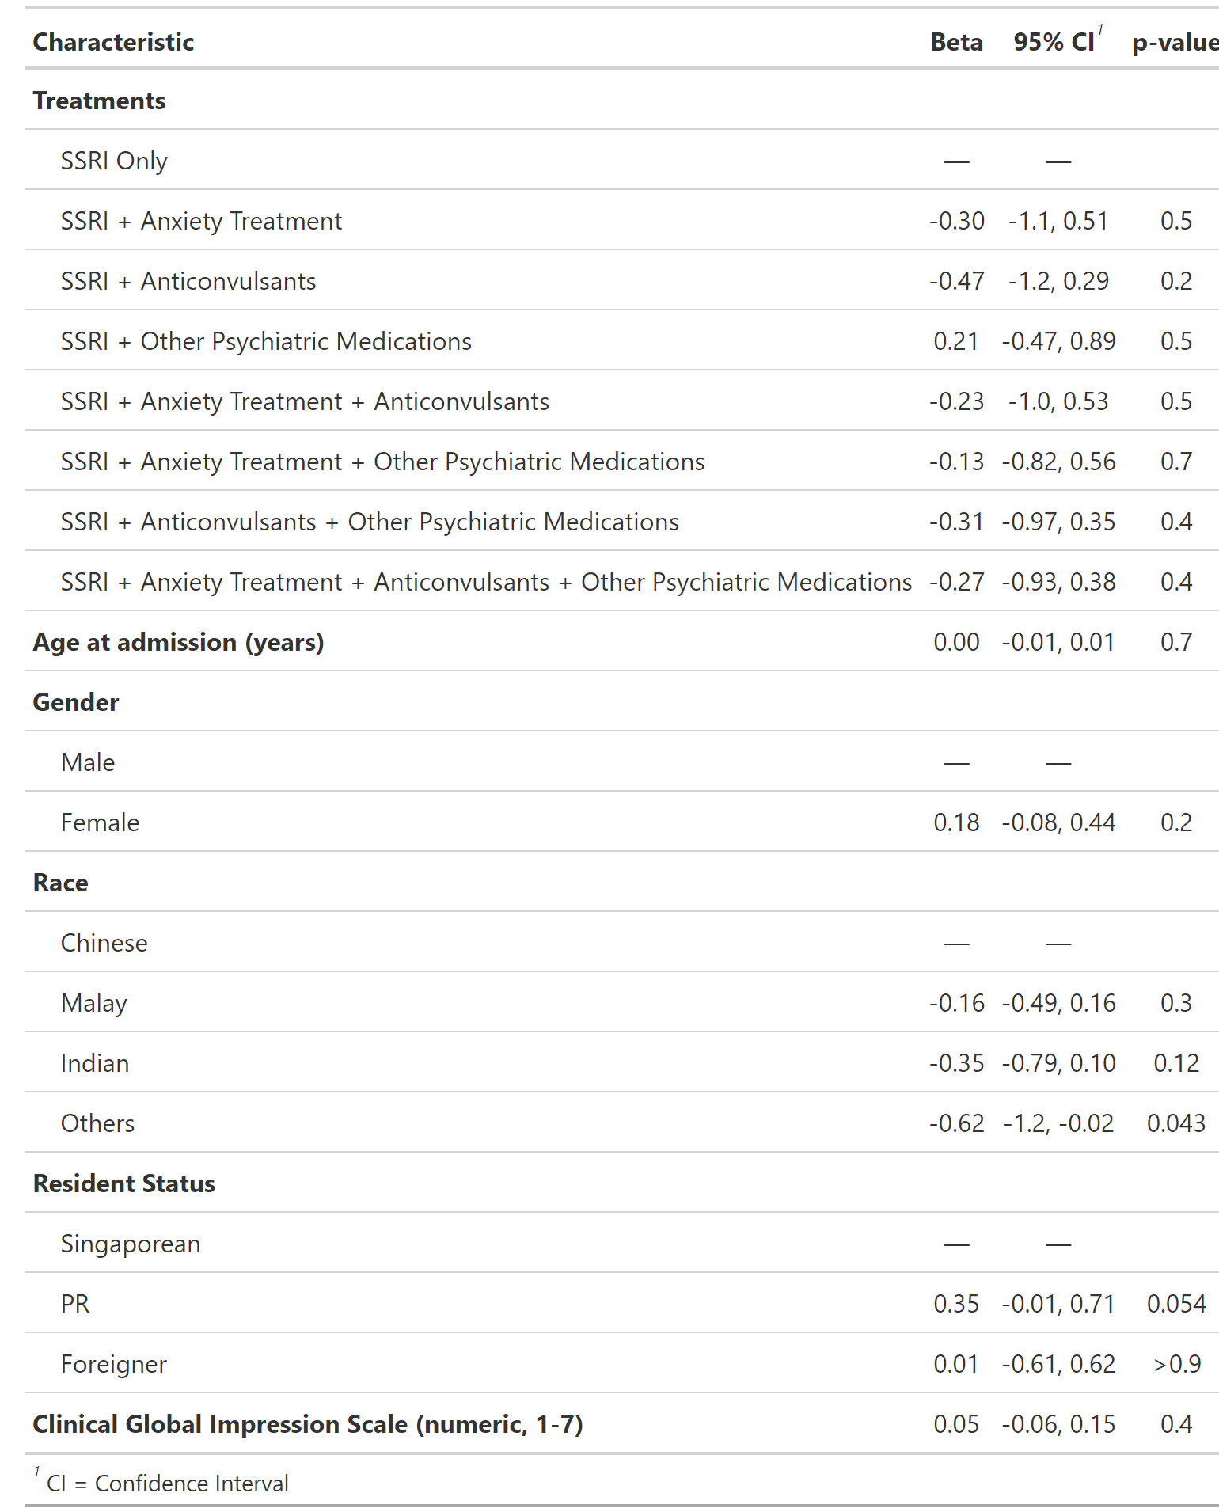
Results
Initial model results suggest there is no relationship between treatment combinations and length of inpatient stay

Slide 11
Takeaways and next steps
Most importantly, this is a very brief analysis!
Results so far suggest no effect on inpatient stay length – but is this the main consideration for treatment?
No information here about health treatment costs – just on length of stay
Need to make sure we have all relevant confounders too

