Slide 1
eCommerce-capstone Database Project
By
Himabindu Samayam
Naga Sharada Chamarty

Slide 2
Agenda
INTRODUCTION
PRIMARY GOALS
REQUIREMENTS
DESIGN
IMPLEMENTATION
CHALLENGES & LEARNING

Slide 3
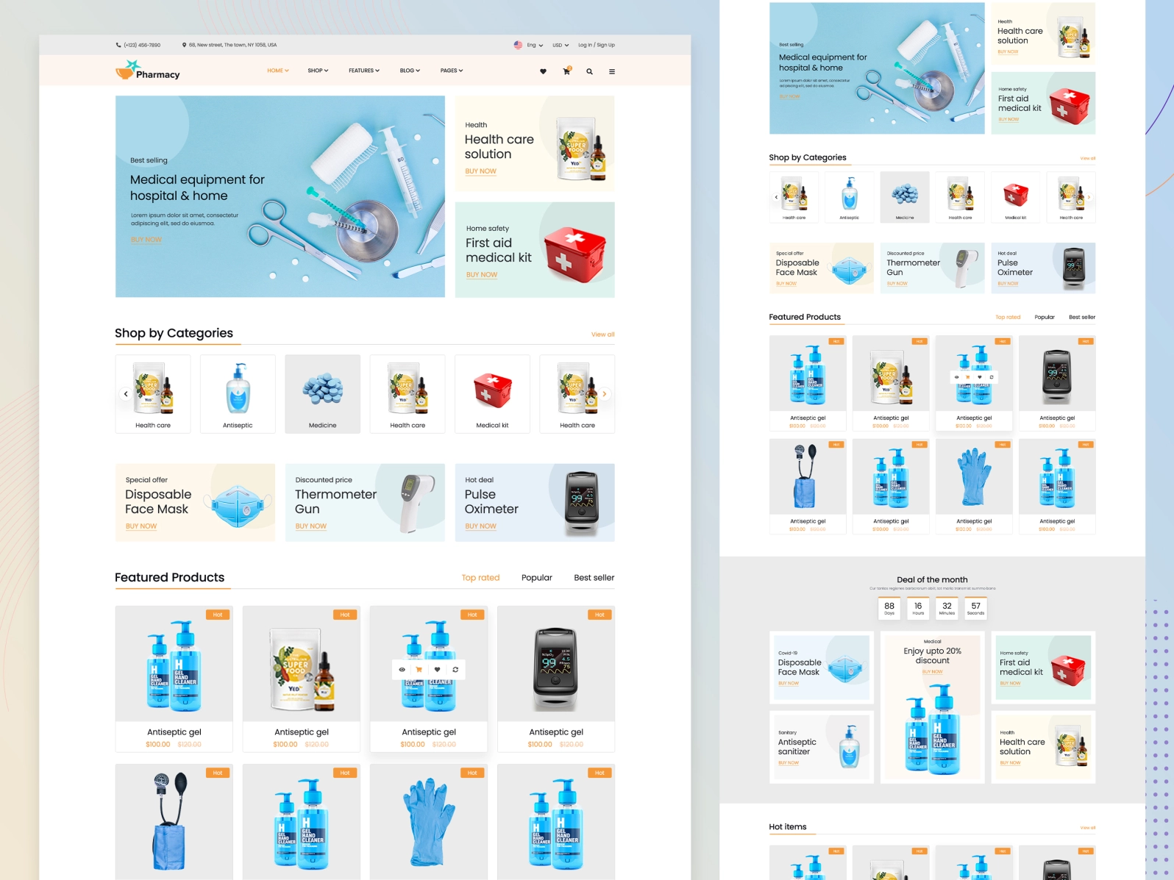
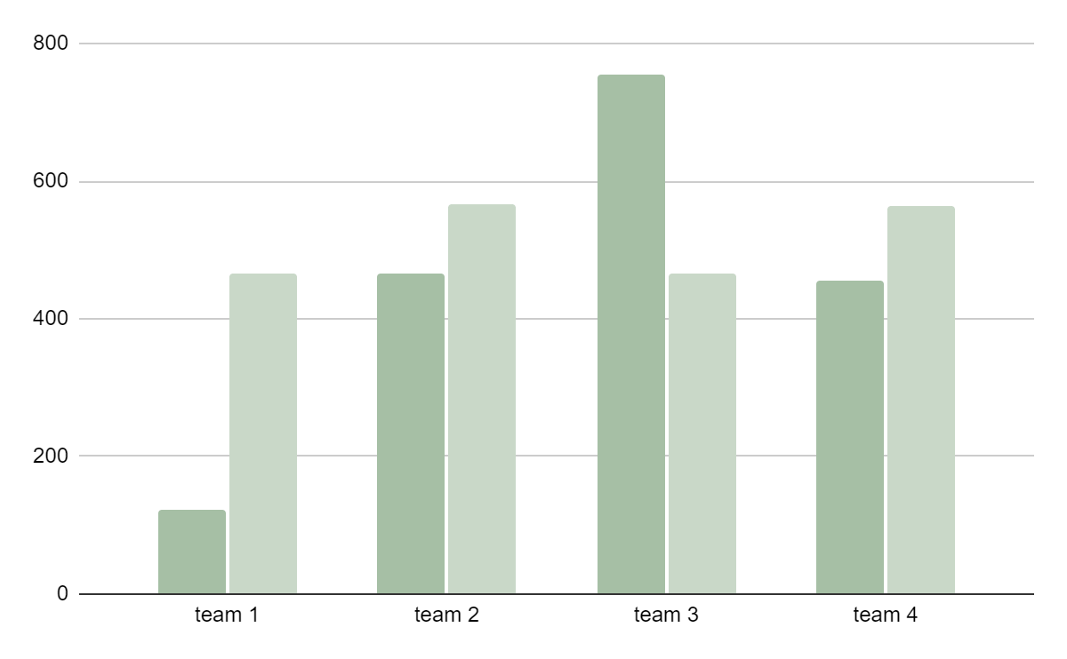
Introduction
Designed ecommerce database for online store. This allows customers to:
Mercury
Browse Products
Place the order
Track the shipment.
Venus

Slide 4
Primary Goals & Objectives
Basic concept of Designing database
High scalability
Faster Processing
Variety of Data
Secured

Slide 5
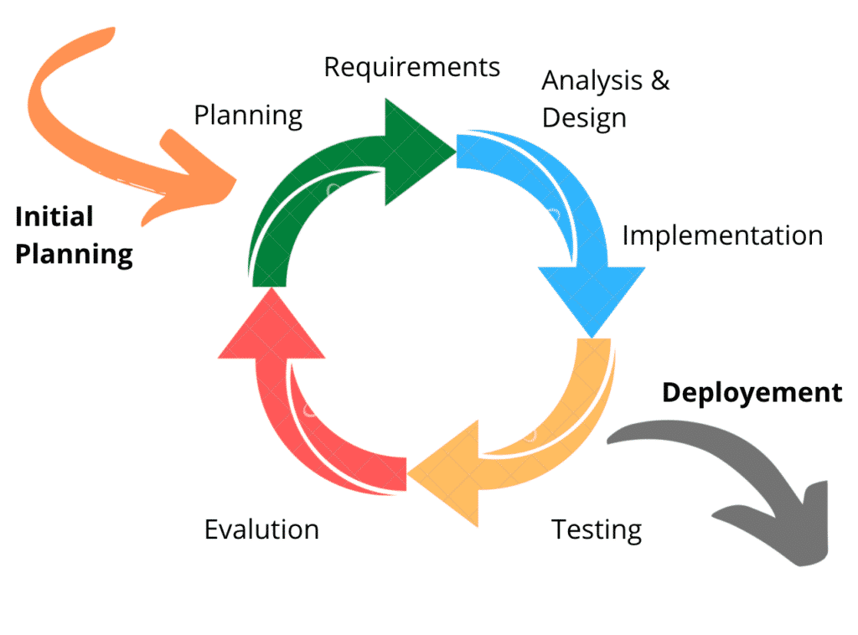
AGILE METHODOLOGY DBLC
Mercury
Mercury is quite a small planet
Jupiter
Jupiter is a very big planet
Venus
Venus has a beautiful name

Slide 6
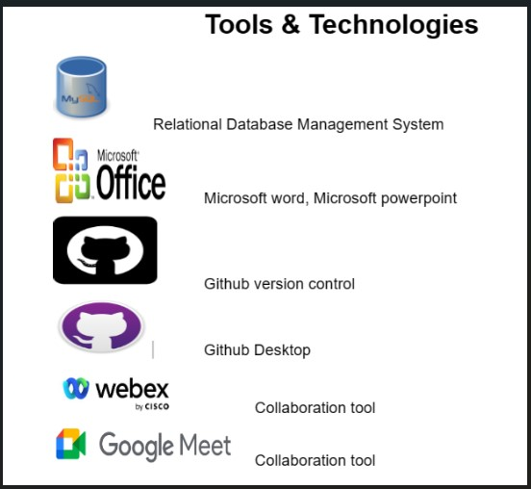
Minimalist green slides infographics
June
Mon | Tue | Wed | Thu | Fri | Sat | Sun
 |  | 1 | 2 | 3 | 4 | 5
6 | 7 | 8 | 9 | 10 | 11 | 12
13 | 14 | 15 | 16 | 17 | 18 | 19
20 | 21 | 22 | 23 | 24 | 25 | 26
27 | 28 | 29 | 30

Slide 7
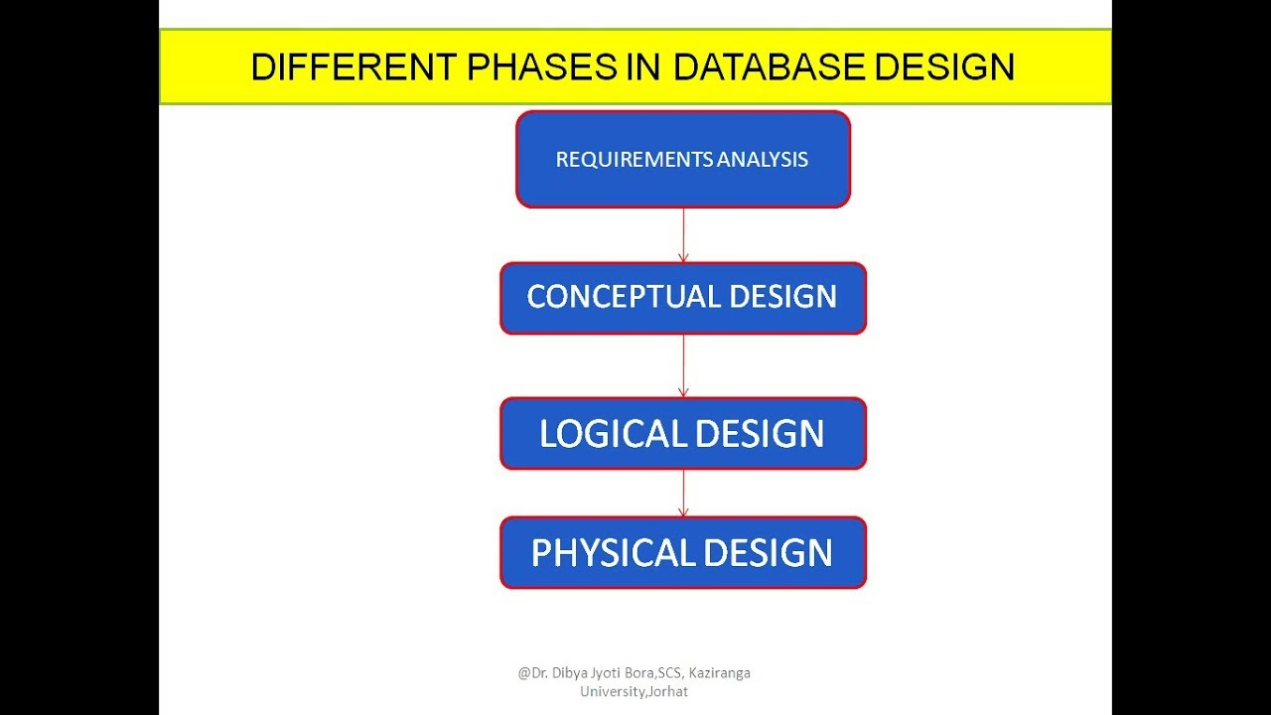

Slide 8
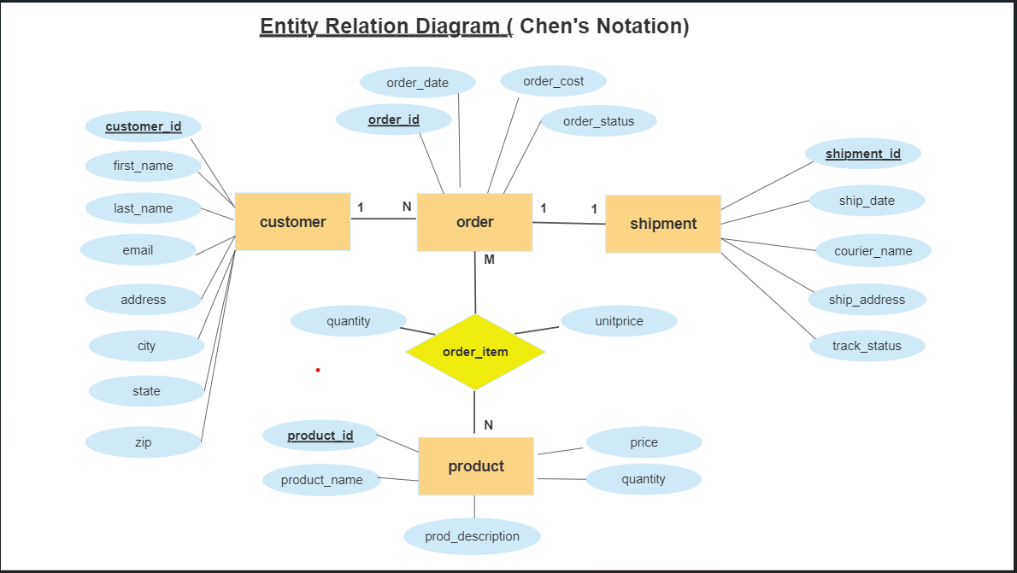
Conceptual Design
Mercury
Venus
Mars
Mercury is the closest planet to the Sun
Venus is the second planet from the Sun
Despite being red, Mars is a cold place

Slide 9
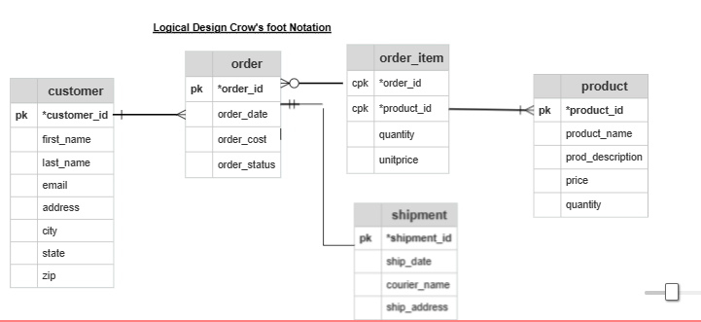
LOGICAL DESIGN
01
Mercury
Mercury is the closest planet to the Sun and the smallest
02
Venus
Venus has a beautiful name and is the second planet from the Sun
03
Mars
Despite being red, Mars is a cold place. It's full of iron oxide dust

Slide 10
NORMALIZATION
Eliminate Redundancy-
Same data saved more than once.
Reduce update anamolies - insert,update and delete
Same Data updated in more than one place
Reduce Storage space
Reduce redundancy -
We add more tables optimal way.
1NF –Prohibits repeating group of column.
2NF –1NF+Every column dependent on primary key
3NF –2NF+Non primary key columns are dependent on primary key.

Slide 11
PHYSICAL DESIGN
Implement the database –
Install DBMS
Create database, schemas using SQL commands.
Use different Data types to load and convert Data.
Indexes are created to access Data.
Established the relation between schemas with referential integrity.

Slide 12
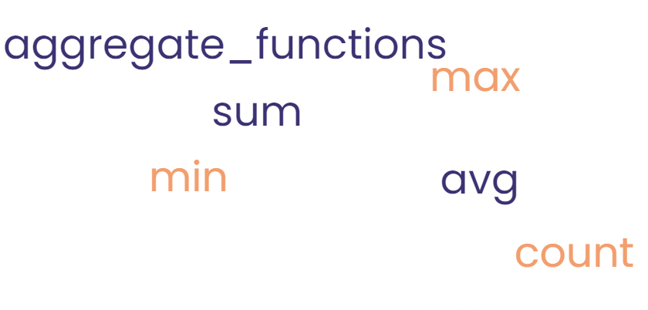
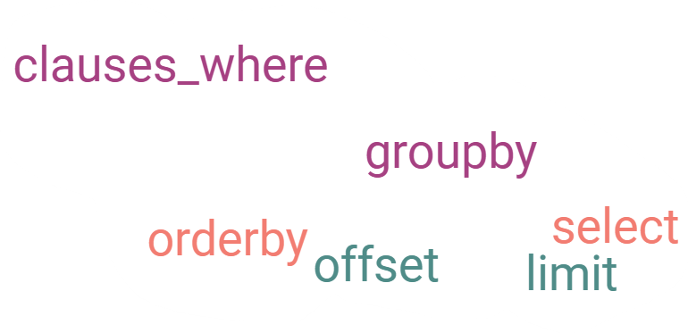
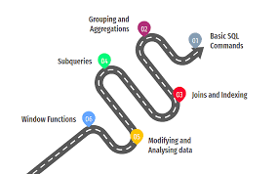
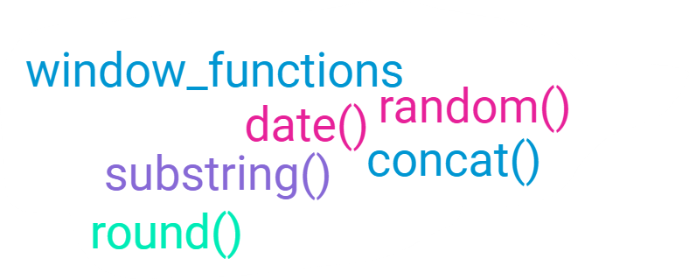
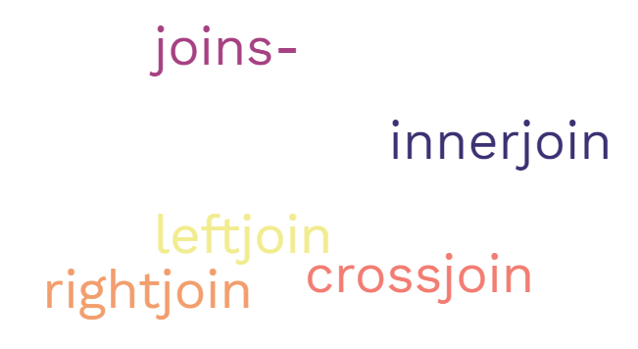
SQL ROAD MAP
Mercury
Mars
Saturn
Mercury is the closest planet t Sun
Despite being red, Mars is a cold place
Saturn is a gas giant and has rings
Venus
Jupiter
Neptune
Venus is the second planet from the Sun
Jupiter is the biggest planet of them all
It's the farthest planet from the Sun

Slide 13
Challenges
Understanding the Requirements document
Getting familiar with Mysql workbench
Inserting datasets into tables
Interpreting the queries to get desired output
Optimising queries as efficiently as possible
Search for appropriate resource to solve complex queries
Learnings
Learned to work as a team
Effective peer review has enhanced our knowledge
Time management and delivering within the timeline.
New functions and best ways to fashion our queries
Improved on troubleshooting
Followed Agile methodology to accomplish our goal

Slide 14
Thank you

