Slide 1
A Graph Analysis of Investment Patterns
Samhita Karnati
Advisor: Prof. Andrea LaPaugh

Slide 2
Motivation
“Raising capital when nobody knows who you are is one of the most discouraging parts of starting a company.”
- Garrett Lord, CEO/Co-Founder of Handshake
Entrepreneurship supposedly democratic
Funding often based on who a founder knows
Very difficult for first-time founders to efficiently seek out funding
Discover patterns in investment to determine which investors are likely to fund a given venture

Slide 3
Goal
Investigate investment patterns in startups
Fine patterns
Can we predict specific company-investor relationships based on past investments?
Coarse patterns
Do investment patterns relate to company category?

Slide 4
Related Work
Financial analysis for later-stage events¹ – general trends
Mergers & Acquisition prediction
IPO prediction
Dataset limited to firm’s portfolio/dealflow
Categorical and non-financial features for startup similarity and prediction
What features are common among successful startups
Do startups in similar categories (i.e. transportation, healthtech, edtech, etc.) have similar features?
Event prediction using categorical features² – specific events
¹ Surr, Pierre-Alain. “2016 Technology Industry Trends.” Strategy&. Strategy& and PwC, n.d. Web. 3 Oct. 2016.
² Xiang, Guang, et al. “A Supervised Approach to Predict Company Acquisition with Factual and Topic Features Using
Profiles and News Articles on TechCrunch.” ICWSM. 2012.

Slide 5
Approach
Use objective, numerical information to
Predict specific events – funding
Investigate correlation with general patterns – company category
Use more representative dataset – crunchbase
Do not constrain to particular firm or market

Slide 6
Implementation
Data and Organization
Supervised Learning
Unsupervised Learning
Supervised Clustering
Evaluation

Slide 7
Implementation: Data and Organization
Data from crunchbase
74,339 companies with complete funding and categorical data
Use funding rounds csv, storing
Company name
Funding rounds
Investors
Geographic location
Category tags
Create a digraph
Nodes: companies and investors
Attributes: Category and location
Edges: investments
Weights: Dollar amount transacted

Slide 8
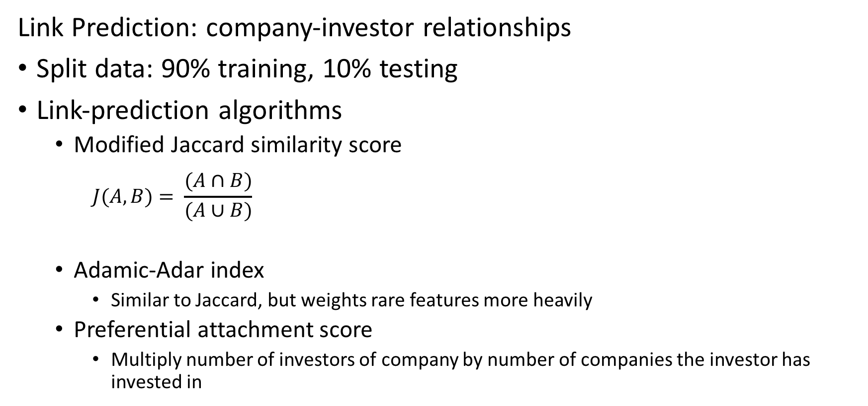
Implementation: Supervised Learning
Link Prediction: company-investor relationships
Split data: 90% training, 10% testing
Link-prediction algorithms
Modified Jaccard similarity score
$$J(A, B)= \frac{(A∩B)}{(A∪B)}$$
Adamic-Adar index
Similar to Jaccard, but weights rare features more heavily
Preferential attachment score
Multiply number of investors of company by number of companies the investor has invested in
where A = company’s neighbors’ neighbors
B = investor’s neighbors

Slide 9
Results & Evaluation: Supervised Learning
Full evaluation not done, but initial, cursory look over results makes sense
Jaccard seems to work better than Preferential Attachment
Jaccard seems to work better than Adamic-Adar
Plan going forward
ROC curves: receiver operating characteristic curves
Illustrates the performance of a binary classifier system
True positive rate against false positive rate at various threshold settings
Goal: maximize area under the curve

Slide 10
Implementation: Unsupervised Learning
Clustering and investigating category within clusters
K-means clustering
Limit to SF-region companies
Hypothesis: companies in the same category have similar investing patterns and would therefore be in the same cluster
550 unique first-order categories – use this for cluster number
Cross validation
Fine-tuning cluster size parameter using k-fold cross validation

Slide 11
Results & Evaluation: Unsupervised Learning
100 random companies with their investors
Blue nodes: companies
Green nodes: investors

Slide 12
Results & Evaluation: Unsupervised Learning
500 random companies with their investors
Blue nodes: companies
Green nodes: investors

Slide 13
Results & Evaluation: Unsupervised Learning
Plan going forward
Evaluate k means with 550 clustering
Metric 1: are all the companies in the cluster of the same category?
Metric 2: are all the companies of a given category captured within a cluster?
Take out VCs from clusters
K-fold cross-validation
Do VCs form their own clusters?
Is there an optimal number of clusters to capture industry-specific VC clusters?

Slide 14
Supervised Clustering
Based on work by Finley and Joachims from Cornell
Structural support vector machine (SSVM) algorithm for supervised k-means learning problem
Directly optimizes a similarity measure to maximize cluster accuracy
Training set: form of sets of items with desired partitioning
Two options
Spectral relaxation
Traditional k-means algorithm
Do similar evaluation as with unsupervised learning

Slide 15
Future Work
Get more than just binary information
Predict how much money will flow, not just if it will
Add other attributes other than just geographical location and category
Investors typically fund the same founder in multiple ventures
Series information – size of company

Slide 16
Acknowledgements
Prof. Andrea LaPaugh
Peers in my IW seminar
Crunchbase

