Slide 1



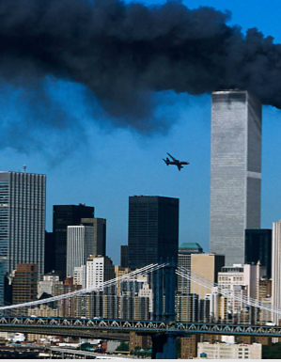
Global Terrorism Data Visualization
Samhitha (015276092)
Image Source: Robert Clark Institute

Slide 2

Introduction
“Terrorism is, in the broadest sense, the use of intentionally discriminative violence as a means to create terror, or fear ,to achieve generally against civilians, for political ,religious or ideological purposes”.
The Global Terrorism Database (GTD) which is an open-source database including information on Terrorist event around the world is used as the data source.
According to Institute for Economics & Peace for the inclusion of event in GTD the following criteria to be satisfied:
The incident must be intentional.
The incident must entail some level of violence or threat of violence.
The perpetrators of the incidents must be sub-national actors.

Slide 3





Data Source: START, the National Consortium for the Study of Terrorism and Responses to Terrorism,
University of Maryland, College Park
Global Terrorism Index Report, Institute for Economics & Peace: Public Release Data
HDR Report, United Nations Development Program(UNDP)
Records: 180k+ incidents
Time Period: 1970 to 2019 (except 1993)
Variables: >100
S1: GTD ID & Date, Incident Information, Incident Location, Attack Information, weapon Information, Target & Perpetrators
S2 & S3: Country, GTI Rank, GTI Score, HDI Rank, HDI Score
Source: Publicly available Unclassified materials which includes media articles, electronic news archives, legal documents
Tools: Tableau Desktop(Version 2021.3.3), D3

Slide 4
Objective
To explore the data and draw inferences from the data set, also develop a comprehensive and visual storyline for the project.
How does the world look like?
Are some countries more affected from Terrorist attacks?
How big is the problem of Terrorism?
What are the Weapons, Attacks & Target Types?
Who are responsible for the attacks?
How are terrorism activities spread across region?
How does the global Trend look like?
Do terrorism affect in development of countries?

Slide 5

Visualizations Demo

Slide 6
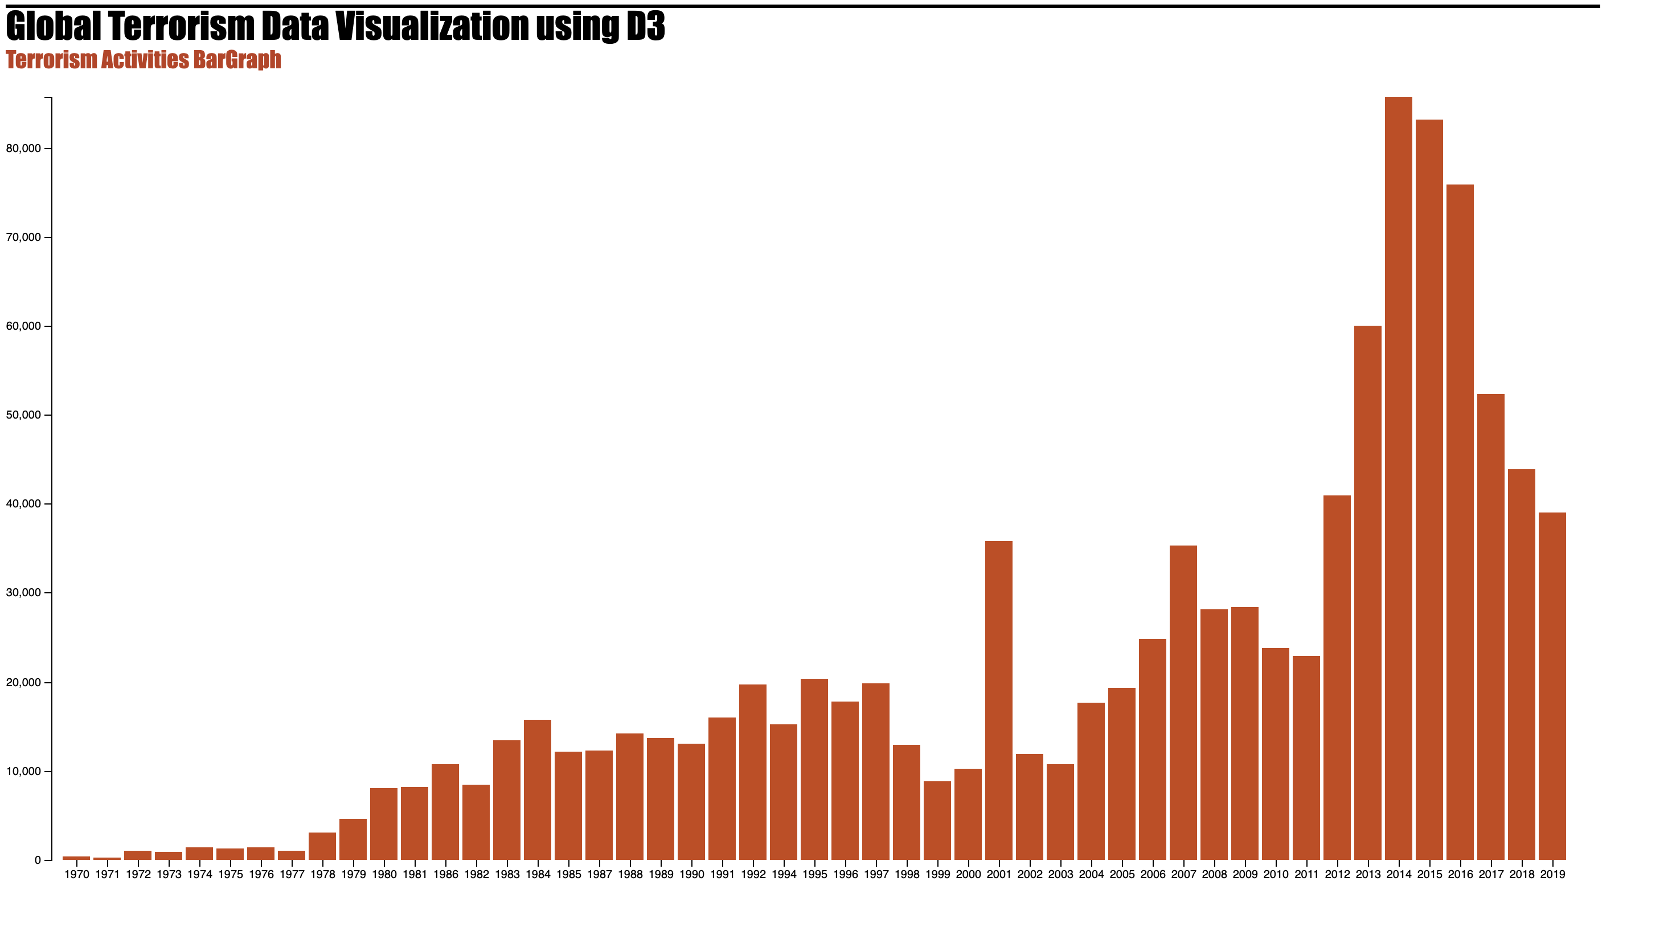

Slide 7
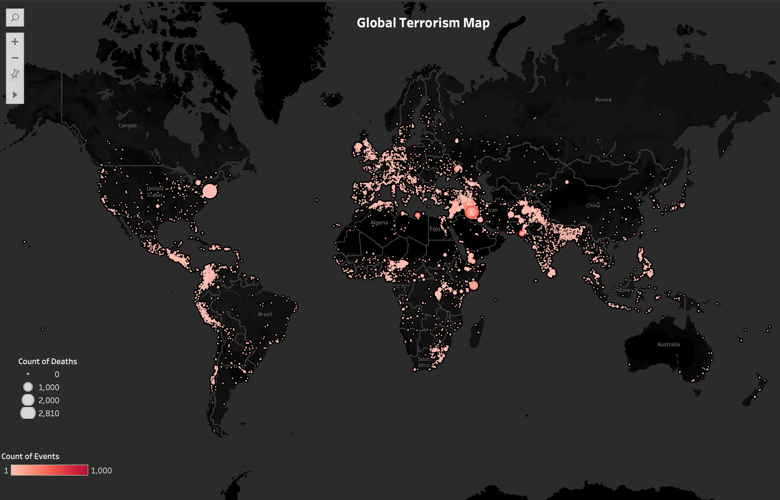

Slide 8
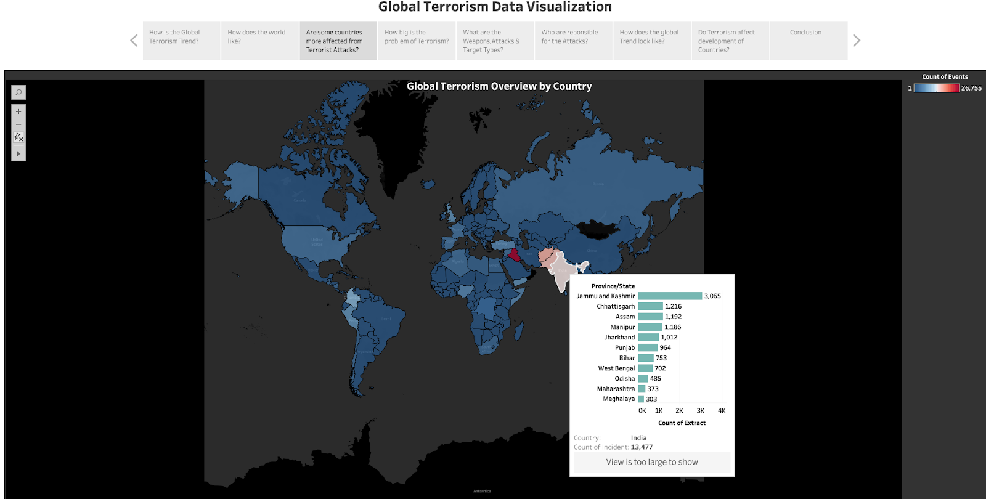

Slide 9
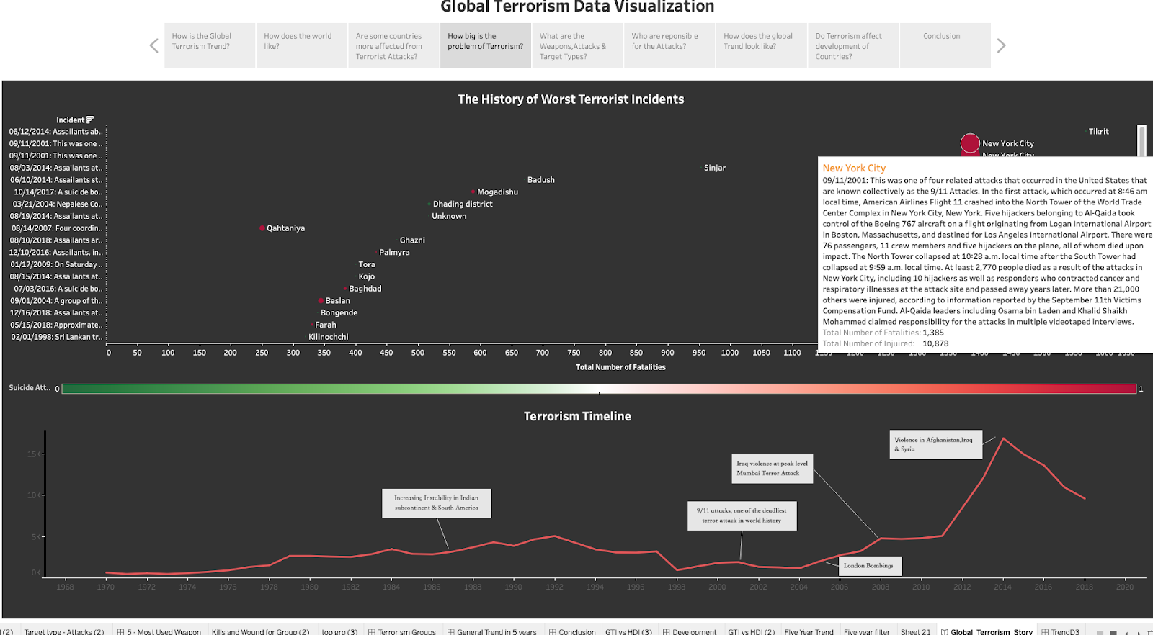

Slide 10
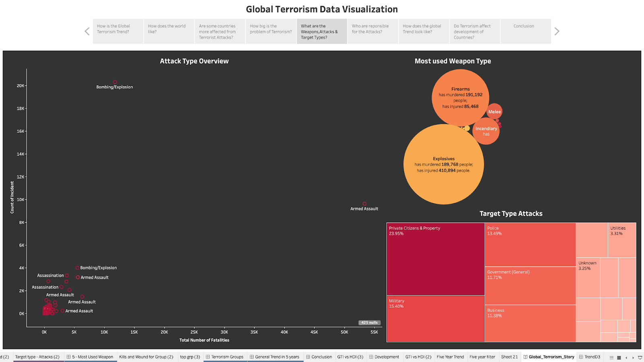

Slide 11
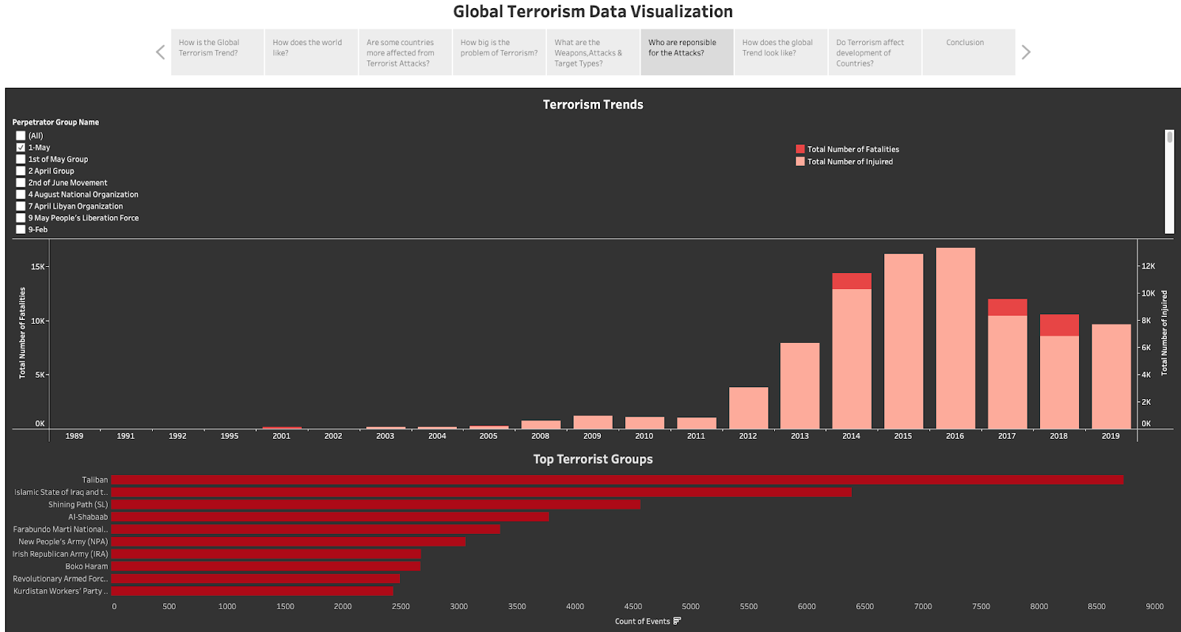

Slide 12
